Slide 1



Earth Observation for
Water Management
International trends & developments
How to promote earth observation applications?
How to get funding?
Capacity building

Slide 2

0. Introduction
Mark Noort, consultant, project manager
HCP international:
consulting, marketing of earth observation
Coordinator GEONetCab:
project for promotion & capacity building of
earth observation applications

Slide 3
Earth observation applications
On the verge of reaching new user communities
These new user communities need to be involved
Weakest link / last mile aspects are important
Marketing needed: promotion & capacity building

Slide 4
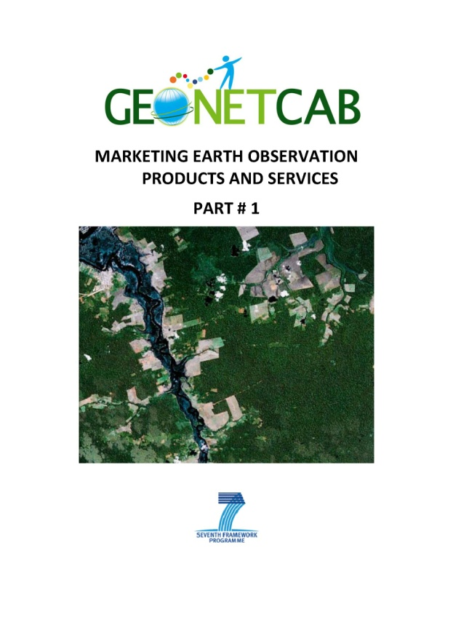
Life cycle of products & services
Initialization
System analysis & design
Rapid prototyping
System development
Implementation
Post-implementation

Slide 5
Assessment of business & funding opportunities
Categories of water management products & services
Life cycle phase of product or service
Regional context, level of technological & economic development
Optimum marketing mix

Slide 6
1. International trends & developments in water management

Slide 7
Decision making
“We can only manage what we measure”
Water cycle: water resources availability and quality for
  Economic development
  Green economy
  Poverty reduction
  Community empowerment
  Risk management

Slide 8
“Advances in Earth observation for water cycle science”
(Fernandez-Prieto, van Oevelen, Su, Wagner)
Complex process mainly driven by solar radiation
Evaporation of water from open water and wet soil surfaces controlled by energy, water availability and near-surface atmospheric conditions (air temperature, humidity, wind speed) + transpiration controlled by vegetation
Results in water vapor in the atmosphere -> cloud formation
Cloud condensation nuclei + atmospheric state allows for condensation, clouds formed and globally distributed by winds
Precipitation clouds, water to the Earth’s surface, accumulates in rivers, lakes, oceans
Surface water infiltrates in soil, moistening soil layers and accumulating as groundwater, replenishing aquifers
Aquifers store water, provide water for human activities or discharge it naturally to the surface or to oceans

Slide 10
“Advances in Earth observation for water cycle science”
(Fernandez-Prieto, van Oevelen, Su, Wagner)
What is needed from a science perspective?
Accurate and continuous observation of the long-term dynamics of the different key variables governing the energy and water cycle processes from global to local scale -> increase understanding of components of the water cycle (spatial, temporal) and characterize the processes and interactions between the terrestrial and atmospheric aspects of the energy and water cycle (to assess influence on climate variability and predictability)
For decision making: global synoptic information on water resources availability and quality for water governance, management and planning (+ adaptation to climate change)
Earth observation complemented with in-situ observations for vailidation, calibration and development of EO-derived products.

Slide 11






Africa Water Atlas
Modeling of Africa’s surface water systems
(water balance data), identifying:
  “hotspots”: tenuous food security situation
  “hopespots”: potential for rainwater harvesting
  “water towers”: areas with upstream water surplus

Slide 12
Africa Water Atlas
Key Facts:
  Millions of people in Africa suffer water shortages throughout the year
  Water scarcity is not simply due to geography: population growth, poor planning and poverty are significant factors
  Most urban population growth has taken place in peri-urban slum neighbourhoods, overwhelming municipal water services
  64% of people in Africa use improved drinking water sources (2010)
  Only 38% of Africa’s population has access to improved sanitation facilities (2010)
  Increases in access to improved drinking water sources and sanitation facilities are not keeping pace with population growth

Slide 13
Africa Water Atlas
Linkages between poverty water and the environment

Slide 14
Africa Water Atlas
Action:
  Provide safe drinking water + ensure access to adequate sanitation
  Foster cooperation in transboundary water basins
  Provide water for food security
  Develop hydropower to enhance energy security
  Meet growing water demand
  Prevent land degradation and water pollution
  Manage water under global climate change
  Enhance capacity to address water challenges

Slide 15

Earth observation contribution to action
  Increase insight in and visibility of available resources
  Analysis of historical and future use for planning and decision making
  Mapping of informal settlements, infrastructure and resources
  Analysis for more efficient use of water resources
  Hydropower: assessment of resources, planning & monitoring
  Instrument for community empowerment ->
  example – Human sensor webs: challenges for monitoring

Slide 16

Water resources across Europe — confronting water scarcity and drought
EEA Report No 2/2009
  DPSIR: framework used for water resources management
  Water exploitation index (ration of annual total water abstraction to available long-term freshwater resources)
  Action: water pricing, drought management plans, water efficiency and conservation, raising awareness, tackling illegal water use, alternative supplies, desalination
  Information requirements: river basin scale water balances based on the UN system of environmental economic accounting for water (SEEAW, 2007) & WISE (water information system for Europe)

Slide 17
DPSIR framework: driving force, pressure, state, impact, response

Slide 18
Back to decision making
“Make Information Relevant to Managers”
Main messages given to managers:
It is definitely getting warmer
Though we expect that the hydrological cycle will be enhanced due to more energy in the atmosphere, we really don’t know how precipitation patterns will be affected.
Managers are liable to respond with:
“I need more information before I will invest in adaptive activities – I don’t know how to respond to this much uncertainty”
Reference: Managing Drought: A Roadmap for Change in the United States

Slide 19
Back to decision making (2)
“Make Information Relevant to Managers”
Reframe the information in terms of combining the effect of temperature and demand:
Increased human demands for water for human, agricultural and the environment, among other sectors
Impacts on supply (increased evaporation from reservoirs, increased consumption by plants, decreased snowpack, etc.)
If it does rain more in a warmer climate, it is likely to rain harder than more often
Reference: Managing Drought: A Roadmap for Change in the United States

Slide 20
Back to decision making (3)
“Make Information Relevant to Managers”
Then the message to managers becomes: “though we don’t know much about whether total precipitation will increase or decrease, the implication of global warming for water management are likely a reduction in average supply availability and an increase in extreme events, including both droughts and floods”
Framed in terms of risk to managers’ systems
Reference: Managing Drought: A Roadmap for Change in the United States

Slide 21
Back to decision making (4)
“Make Information Relevant to Managers”
Need for “integrated and adaptive decision support systems able to explicitly account for system uncertainty”
Incorporate institutional, political, and economic considerations into translating physical science findings into relevant information for specific types of decisions within specific sectors
Communication should be perceived by the users as:
Salient (answering the right questions)
Credible (coming from a trusted source)
Legitimate (accurate)

Slide 22


Other references related to extreme events:
References on flooding can be found in the GEONetCab disaster management toolkit
More references on drought:
Drought monitoring and early warning:
concepts, progress and future challenges
The national drought information system implementation plan a pathway for national resilience
Agriculture and Agri-Food Canada’s Drought Monitoring and Information System

Slide 23


Methodologies for:
“we can only manage what we measure”
Measuring Water use
in a Green Economy
Water registers (as key to fair distribution of access to water)
Water and ecosystem capital (water as natural capital, linked to economy and well-being (UN SEEAW 2007, NAMEA))
Water scarcity and vulnerability indices (per capita, renewal vs withdrawal, etc.)
Water footprint assessment (amount of water consumed per unit of product)
Life cycle assessment (benchmarking for industries)
Water stewardship (quantify corporate water monitoring)

Slide 24
Key observations for:
“we can only manage what we measure”
Measuring Water use
in a Green Economy
Over the past 50 years global freshwater withdrawals have tripled
A quarter of freshwater use exceeds accessible supplies
By 2030 nearly 3.9 billion people will live under conditions of severe water stress (OECD)
By 2030 global demand for water will be 40% higher than it is today
Open data access and optimal data availability are of cardinal importance

Slide 25
Different levels for:
“we can only manage what we measure”
Measuring Water use
in a Green Economy
User level: price and technology play a key role (creating awareness, charging prices based on full marginal costs, stimulating water saving technology
Catchment or river basin level: choice on how to allocate the available water resources to the different sectors of the economy (depends on the value of water in its alternative uses)
International trade: water as a global resource (overall efficiency)

Slide 26
Economic calculations of:
“we can only manage what we measure”
Measuring Water use
in a Green Economy
Calculating the monetary value of externalities and ecosystem resources and services that are currently unpriced
Decoupling concepts:
Resource decoupling:
reducing resource use per unit of economic activity
Relative decoupling:
resource use still increases but at a lower rate of economic growth
Impact decoupling: scale and character of resource use causes no negative environmental impact
Absolute decoupling:
resource use declines irrespective of the growth rate of the economic driver

Slide 27
2. Steps to promote earth observation for water management

Slide 28
State-of-the-art
Earth observation is new technology.
Learn technical skills, but when back in professional practice, it has to be put to good use.
That involves ‘selling’ it.
How to do that?
To whom? Could be your own boss, local authorities, communities, etc.

Slide 29
Categories of products and services
Hydrologic information systems
Soil moisture modelling
Drought monitoring / early warning
Monsoon monitoring / forecasting

Slide 30
Different levels of intervention for earth observation products & services
Formalization axis (technical products, such as DEM, terrain analysis, land use / land cover & change detection)
Axis of use (processed information, for example for management of dams, water or hydro-erosion and flood risk zones)
Axis of facilitation (products and services that directly facilitate decision making)
From: Application of satellite remote sensing to support water resources
management in Africa: results from the TIGER initiative

Slide 31
Steps for Earth observation supported water resource management
  Land use and land cover mapping + change monitoring
  Water abstraction estimate in respect of crop water demand estimates for irrigated areas
  Refined land use / land cover mapping
  Surface water bodies or water pools (location, extent, dynamics)
  Digital elevation models and derived products
  Estimates of basin-wide evapotranspiration and precipitation
  Water and vegetation monitoring (entire aquifer)
  Ground subsidence monitoring and its correlation with groundwater abstraction
From: Application of satellite remote sensing to support water resources management in Africa: results from the TIGER initiative

Slide 32
Where to get the data from?
  Global energy and water experiment (GEWEX) -> now:
  Global and regional energy and water exchanges – some considerations from “GEWEX Plans for 2013 and Beyond”
  Prototype data management scheme for GEOSS
  Development of land data assimilation systems
  Decadal-long data records of land states for soil moisture
  Systems require inputs from some combination of in-situ meteorological networks, satellite observations and forecast model outputs
  Transfer research developments and demonstration applications to operational agencies and users

Slide 34

More references:
GEO Task US-09-01a: Critical Earth Observations Priorities - Water Societal Benefit Area Overview of available and needed observations, overview of application areas and user types
EUGENE Water Status Quo report (and final report)
Overview of state-of-the-art EO for water in Europe
WMO statement of guidance for hydrology
Overview of (international) organizations dealing with water
Overview of observation gaps: water use, evapotranspiration and soil moisture
WMO guide to hydrological practices
Part 1: from measurement to information
Part 2: management of water resources and application of hydrological practices

Slide 35


More references (2):
Remote sensing applications, National Remote Sensing Centre, India Chapter 6: water resources management & Chapter 8: groundwater
Overview of remote sensing applications and case studies in India
Water management by satellites; the unavoidable way forward
Visionary presentation from a Dutch SME: assessing spatial water productivity & water footprint
Spatial dimensions of land administration and users rights over groundwater: case study of Kerala, India vs. Coca Cola
Case study on how geo-information visualizes groundwater rights, water use and associated problems
Impacts of agricultural intensification through upscaling of suitable rainwater harvesting technologies in the upper Ewaso Ngiro North basin, Kenya Article describing remote sensing applications for rainwater harvesting

Slide 36
More references (3):
Evaluating nitrogen removal by vegetation uptake using satellite image time series in riparian catchments
Article on a pilot study in China on improving water quality by making use of natural vegetation
Summary of the 2nd GEOSS Africa water cycle symposium
Overview of available data and models in Africa
Update on the Integrated Global Water Cycle Observation (IGWCO) community of practice Overview of activities of the GEO water community
HARIMAU Radar-Profiler Network over the Indonesian Maritime Continent: A GEOSS Early Achievement for Hydrological Cycle and Disaster Prevention Article describing the establishment of a network for monsoon forecasting and monitoring

Slide 37


More references (4):
Global Runoff Data Centre report series
hydrologic information – metadata
UML model of available catalogues
The current status of global river discharge monitoring and potential new technologies complementing traditional discharge measurements Article on options for discharge monitoring by remote sensing, especially in remote areas
Essential climate variable studies on: glacier, snow cover, groundwater, water level, river discharge Description of available and needed information, including role of earth observation
References on drought: see slide above (on extreme events)

Slide 38

More references (5):
SHARE: soil moisture for hydrological applications Article on earth observation for soil moisture products
Emerging technology analysis Overview of application and possibilities of emerging technologies for earth observation related to water, weather and oceans
Space research – a European journey Overview of space-related research projects, including projects dedicated to GMES downstream services
GLOWASIS user requirement study Report on user requirements for the GMES global water scarcity information system

Slide 39
Marketing of earth observation
Marketing of earth observation is difficult.
New technology, few big companies, lots of small ones.
Lots of reports describing the bottlenecks, like reliability,
data access, data continuity, etc.
Means that relatively a lot of effort is needed to promote
EO.

Slide 40
Points to keep in mind:
Look for opportunities, where can you have most success in a short time: quick-wins.
Target the right audience to start with: who would be interested and listen to you?
Identify the problem that they are trying to solve: is it the same as yours?
Learn to speak the same language. Example ‘evapotranspiration’: this is a term most managers do not understand and do not care about. Use terms related to water use, supply and demand instead.
Look for examples from elsewhere (success stories): solutions that work and are affordable.

Slide 41
Be patient: introduction of new technology and / or applications takes time

Slide 42
3. How to get funding for your activities

Slide 43
Approach
Share information on your subject (a thing you are doing) and think that is interesting for your contact, then look for the link. Could this solve a problem for your partner? Are adjustments necessary? Need other parties be involved? Take it from there.
LEADS, LEADS, LEADS

Slide 44
How?
Establish your network.
Look for opportunities.
Write a good proposal.
Promise much, but not too much.

Slide 45
Proposal outline
(more detailed version in separate document, see also www.geonetcab.eu )
1. Introduction / relevance
2. Objective(s)
3. Activities
4. Output
5. Management & evaluation
6. Risk assessment
7. Time schedule
8. Budget
Annexes

Slide 46


Other references
Civicus: writing a funding proposal
Michigan State University: guide for writing a funding proposal
ESRI: writing a competitive GRANT application
REC: project proposal writing

Slide 47
Again:
SHARED PROBLEM
SHARED LANGUAGE
SHARED SOLUTION
If all else fails, try to link with a more popular (and easy to
understand) topic.

Slide 48
4. Capacity Building

Slide 49
General
Marketing is promotion + capacity building.
Especially for the introduction of new technologies capacity
building is important at all levels.
Capacity building is the instrument to increase
self-sufficiency and make solutions work.

Slide 50
Think of:
Different instruments for different levels: workshops for decision makers and awareness raising, detailed technical training for professionals.
Provide follow-up. Getting funding for good capacity building is difficult: everybody agrees that it is important, but nobody has time.
Training is usually part of funding of big projects that are managed by big companies or ministries, as a consequence capacity building is forgotten (in the end).
Aim at small budgets that are available without having to tender.

Slide 51
Examples & references
White paper on GEO capacity building and water resources in Africa
Dedicated programs, such as TIGER and DRAGON
Tiger capacity building facility: growing from projects to professional community (article by Vekerdy, et al.)
GEONetCab capacity building web www.geonetcab.eu
compilation of tutorials, references, open-source software, etc.
GEO Portal: www.earthobservations.org
Focal points: general appraisal of water resources, specialist information (such as improving on curve number method), historical analysis (making use of free and open data): integration with other services

Slide 52

More references
A Rough Google Earth Guide
MEASURE Evaluation Global Positioning System Toolkit
(USAID)
Handbook of Research on Developments and Trends in
Wireless Sensor Networks: From Principle to Practice

Slide 53
Further details:
Contact: Mark Noort
m.noort@hcpinternational.com
www.geonetcab.eu

