Slide 1



Earth Observation for
Urban Management, Land Administration
& Spatial Data Infrastructures
International trends & developments
How to promote earth observation applications?
How to get funding?
Capacity building

Slide 2

0. Introduction
Mark Noort, consultant, project manager
HCP international:
consulting, marketing of earth observation
Coordinator GEONetCab:
project for promotion & capacity building of
earth observation applications

Slide 3
Earth observation applications
On the verge of reaching new user communities
These new user communities need to be involved
Weakest link / last mile aspects are important
Marketing needed: promotion & capacity building

Slide 4
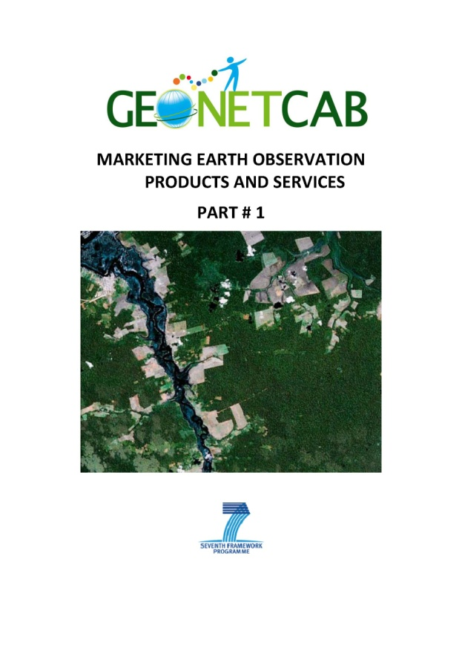
Life cycle of products & services
Initialization
System analysis & design
Rapid prototyping
System development
Implementation
Post-implementation

Slide 5
Assessment of business & funding opportunities
Categories of environmental products & services
Life cycle phase of product or service
Regional context, level of technological & economic development
Optimum marketing mix

Slide 6
1. International trends & developments in urban management, land administration & spatial data infrastructures

Slide 7
Main trends:
Rapid urban growth: need for management and planning
Improve the urban living environment: infrastructure, services, health, environment
Improve urban safety: risk management (natural and man-made disasters), crime, anticipating and mitigating climate change
Increase community participation: e-governance, web-based consultation

Slide 8
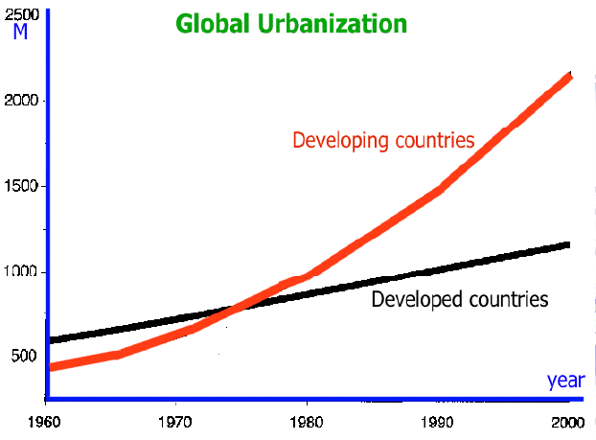
Absolute urban growth
Source: http://iwrmnotes.blogspot.com

Slide 9
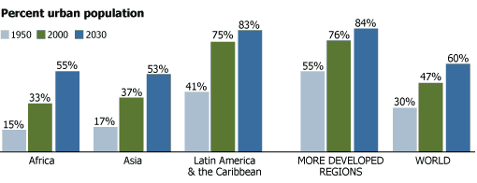
And relative urban growth
Source: www.prb.org

Slide 10

Example urban Africa:
Diversity of urban sizes
Large cities are growing at a faster rate than smaller cities
Great heterogeneity between countries in size distribution of their cities
Faster urban growth means faster slum growth
More and better infrastructure and service are needed
Source: Africa’s urbanization for development: understanding Africa’s urban challenges and opportunities (World Bank)

Slide 11


Pro-poor land administration
The ten design elements of the pro-poor land recordation system (re-worked from Williamson et al., 2010: land administration for sustainable development)

Slide 12
Benefits of modern
land administration systems:
Improvement security of tenure
Improved land resources management
Land disputes reduction
Increased revenue generation
Credit security
Source: Crowd sourcing support of land administration systems (RICS)

Slide 13
Desirable characteristics of
property rights to land:
Long enough horizon to provide investment incentives
Defined in a way that makes them easy to observe, enforce and exchange
Administered and enforced by institutions that have both legal backing and social legitimacy and are accessible by and accountable to the holders of property rights
Rights and duties of individuals, within a group that holds communal rights, have to be clear
Institutions administering property rights need to be flexible enough to evolve over time in response to changing requirements
Source: Land policies for growth and poverty reduction – executive summary (World Bank)

Slide 14

References land administration:
Pro-poor land administration: principles for recording the land rights of the underrepresented
Description of a pro-poor approach to land administration, as developed by the global land tool network (GLTN)
Crowd sourcing support of land administration (RICS)
Description of opportunities provided by crowd sourcing for land administration, including examples of crowd sourcing with mobile phones for other applications
Land policies for growth and poverty reduction - executive summary (World Bank)
Description of the basics for good land policies, showing empirical evidence of the link between tenure security and economic development and poverty reduction + an analysis of land markets and description of the situation in different regions of the world

Slide 15


References land administration (2):
Social tenure domain model (STDM) – a pro-poor land tool (FIG)
Description of a land administration model, accommodating community land rights and using earth observation as an instrument for community participation
A domain model for land administration (ITC)
PhD thesis on the social tenure domain model, including a description of other land administration models
www.cadastre.org – exploring potential avenues and concerns
Article on volunteered geographic information for land administration applications (the article provides interesting perspectives, but the website doesn’t exist)

Slide 16

Benefits of spatial data infrastructures:
Positive cultural change in the stakeholder organizations with greater willingness to cooperate and share resources;
More coordinated initiatives at the local level in data collection, and reduction of duplication and costs;
Agreement on the common usage and maintenance of reference datasets;
More evidence-based applications, particularly in land use planning and infrastructure planning and maintenance;
Time and cost reduction in finding and accessing data held by other organizations;
Improved shared understanding among public agencies of the problems and issues affecting the region.
Source: Advanced regional spatial data infrastructures in Europe (JRC)

Slide 17
Important elements
spatial data infrastructures (SDIs):
“Regional” dimension of SDIs is crucial (often neglected by professional and academic debates that tend to focus more on the national dimension, subsuming the regional in a hierarchical view of SDIs);
SDIs facilitate building and supporting applications for citizens and local businesses related to land and property, planning, traffic, local services, as well as allowing new services from the private sector to be developed around addresses and locations
Source: Advanced regional spatial data infrastructures in Europe (JRC)

Slide 18

Do’s and don’ts of SDIs
• All stakeholders must feel ownership
– public sector
– private sector
– third sector
• Top‐down leadership
– government mandate extremely valuable
• Bottom‐up implementation
– individual organizations will determine whether it is successful
– the more that participate the more useful the infrastructure becomes
Source: Spatial data infrastructures: some lessons learned from UK and Europe (ConsultingWhere)

Slide 19

SDI goals
Source: Spatial data infrastructures: some lessons learned from UK and Europe (ConsultingWhere)

Slide 20


Other references SDI:
Open geospatial consortium (OGC) www.opengeospatial.org Information on standards and open geospatial data
United Nations geo-information working group (UNGIWG) www.ungiwg.org
Info on standards and international cooperation efforts in cartography and geospatial information
United Nations Spatial Data Infrastructure compendium
Overview of international SDIs and description of UNSDI
Strategy for developing and implementing a United Nations Spatial Data Infrastructure in support of Humanitarian Response, Economic Development, Environmental Protection, Peace and Safety
Roadmap towards achieving the UNSDI, focusing on different application fields

Slide 21

Other references SDI (2):
Geospatial Science & Technology and Development (UNCTAD)
Report on the state-of-the-art of geospatial science and applications, including urban management, land administration and SDIs
External ties that bind: shaping geospatial information
Overview of SDIs and their effectiveness, viewed from a research standpoint, with lots of regional examples
The socio-economic impact of the spatial data infrastructure of Catalonia (JRC) Study into cost-benefit of SDI in Catalonia: mainly derived from internal efficiency (time saved by government staff) and external effectiveness (time saved by the general public) + potential democracy impact
GeoSUR: setting the foundation for a regional SDI in Latin America and the Caribbean www.geosur.info
Description of framework and first steps for setting up an SDI in the LAC-region

Slide 22

Other references SDI (3):
D 6.1.2 Report on user requirements, costs, derived direct benefits, and current obstacles for a European and Global Spatial Data Infrastructure (EuroGEOSS) Report describing the user requirements, costs, derived direct benefits, and current obstacles for a European and Global Spatial Data Infrastructure, with special emphasis on GEOSS and INSPIRE, based on a survey of (potential) users
Mapping for results (World Bank) http://maps.worldbank.org
Geospatial data on World Bank projects
World Bank on spatial data infrastructure
References to World Bank and country SDI reports
Using spatial data infrastructures for monitoring development outcomes: a manual for developing countries (World Bank SDI report) Report on SDI for measuring progress in development (in wiki format)

Slide 23

Other references SDI (4):
INSPIRE: a real step forward in building an interoperable and unified spatial information infrastructure for Europe? (ESPI) Description of, and views on, a European initiative for uniform rules for an SDI
INSPIRE: infrastructure for spatial information in the European Community http://inspire.jrc.ec.europa.eu/
eGovernment Economics Project (eGEP) - measurement framework final version www.epractice.eu
Towards a national 3D spatial data infrastructure: case of the Netherlands Research article on a possible 3D SDI

Slide 24
2. Steps to promote earth observation for urban management, land administration & spatial data infrastructures

Slide 25
State-of-the-art
Earth observation is new technology.
Learn technical skills, but when back in professional practice, it has to be put to good use.
That involves ‘selling’ it.
How to do that?
To whom? Could be your own boss, local authorities, communities, etc.

Slide 26
Categories of products and services
Earth observations provides an important base layer for urban management, land administration and spatial data infrastructure products and services. No special categories are therefore distinguished; a number of examples are given.
Mapping scales (resolution) are related to various forms of planning.

Slide 27
Scale dependent urban analysis
Source: Remote sensing of urban and suburban areas (from Banzhaf and Höfer 2008; modified after Wickop et al. 1998)

Slide 28
Benefits of urban remote sensing:
The growth of ‘Spatial Data Infrastructures’, Geo-portals and private sector initiatives (e.g. Google Earth, Microsoft Virtual Earth, etc.) produced an increase of geographical data availability at any scale and worldwide;
Remote sensing can provide a useful and direct indication of the physical form and morphology of urban land cover in cities;
Remote sensing represents a complementary data source to traditional socioeconomic surveys;
Remote sensing supports “smart growth” (a range of urban strategies that focuses on sustainability of development under different economic scenarios).
Source: Remote sensing of urban and suburban areas

Slide 29
Urban remote sensing scale example
Comparison of urban objects and land uses in Enschede, The Netherlands, by sensor and spatial resolution (each window represents a
400 × 400 m area
on the ground)
Source: Remote sensing of urban and suburban areas

Slide 30
Urban remote sensing scale example (2)
Examples of informal urban development with different sensors and spatial resolution
Source: Remote sensing of urban and suburban areas

Slide 31
Urban remote sensing applications:
Urban population studies
Health
Environment
Interpreting urban land uses from urban land cover
Desertification
Urban heat islands (thermal mapping)
Urban ecosystems
Crime mapping (combination RS & GIS)
Characterizing urban population (nighttime satellite data)
Source: Remote sensing of urban and suburban areas

Slide 32
Object-based urban remote sensing
Principle workflow of object-based image analysis
(Source: Remote sensing of urban and suburban areas)

Slide 33
Urban example: impervious surfaces
Source: Urban remote sensing: how can earth observation support the sustainable development of urban environments?

Slide 34
Urban example: cost - benefit
Description project activity | RS & GIS methods |  | Traditional ground methods (~ estimated values)
 | ~ costs per square km (Indian rupees) | ~ time required | ~ costs per square km (Indian rupees) | ~ time required
Thematic/urban land use / land cover mapping and GIS database creation for Delhi NRC region (34,000 km²⁾ on 1: 50,000 scale | 1,000 | 1 year | 10,000 | more than 2 years
Cartographic quality large scale mapping on 1: 10,000 scale using high resolution satellite data; 5,000 km² covering 40 towns | 10,000 | 2 years | 25,000 | more than 3 years
Thematic quality urban land use / land cover mapping and GIS database created for Hyderabad, HUDA region on 1: 5,000 scale, using high resolution satellite data | 5,000 | 6 months for 2,000 km² | 20,000 | more than 2 years
Cost and time requirements for preparation of urban thematic maps in various scales
Source: Remote sensing applications, chapter 5 – urban & regional planning (NRSC)

Slide 35
Urban remote sensing references:
Urban remote sensing: how can earth observation support the sustainable development of urban environments?
Description of opportunities for remote sensing with examples on monitoring of urban sprawl, mapping of the percent impervious surface, mapping of urban heat islands (local heating potential), micro-climate model development and flood vulnerability and risk mapping
Remote sensing applications: chapter 5 urban and regional planning (NRSC)
Overview of the use and prospects of remote sensing for urban and regional planning applications in India
Remote sensing of urban and suburban areas
Collection of state-of-the-art chapters on urban remote sensing, aimed at capacity building (with references); a strong focus on science and techniques

Slide 36

Urban remote sensing references (2):
Expanding cities – a growing concern (GMES brochure) Description of remote sensing activities for Europe, including the development of an urban atlas and a pan-European comparable land use and land cover information database at high resolution
Workshop report on sustainable urban development (NASA)
Urban heat islands, urban vulnerability to climate change, sustainability (including transportation and renewable energy), community participation, sustainable buildings, air quality and urban health, urban risk management
Planetary skin www.planetaryskin.org
Instrument for decision making

Slide 37


Example: decision making
The planetary skin platform

Slide 38
Example slum mapping: features
Access network
Irregular road layout with variable road types and widths; mostly approach roads or in some cases perhaps only footpaths that may be easily distinguishable from road networks in planned areas.
Density
Very dense, with generally very high roof coverage and very little open spaces and vegetation.
Shape
Irregular shape easily distinguishable from planned areas; tend to follow the shape of features like roads, railways due to easy availability of land.
Connectivity
Very poor connectivity with infrastructure in neighbouring areas.
Location
Tend to locate near to places that offer substantial economic opportunities and/or in hazard-prone areas.
Source: An ontology of slums for image-based classification

Slide 39
Example slum mapping: indicators
The six general indicators categorized to form a hierarchy to represent concepts at three spatial levels
(Source: An ontology of slums for image-based classification)

Slide 40
Example slum mapping: building attributes
Diagram of building attributes with the corresponding values derived from the expert survey
(Source: An ontology of slums for image-based classification)

Slide 41
Example slum mapping: delineation
An example of slum delineation in different contexts by an Indian expert. City names:
(a) Ahmedabad (India),
(b) Nairobi (Kenya),
(c) Cape Town (South Africa) and (d) Kisumu (Kenya).
Source: Google Earth.
(From: An ontology of slums for image-based classification)

Slide 42
Example slum mapping: recognition
A snapshot of Kisumu, Kenya. The Nyalenda slum area is clearly visible below the major road running diagonally from bottom left to top right.
(From: An ontology of slums for image-based classification)

Slide 43
Completely different example: LIDAR
Lidar map from Manhattan, New York

Slide 44
Land administration & earth observation
Rural areas
Surveying from images HRSI (high resolution satellite imagery) and even lower resolution satellite imagery, can also provide for high-speed cadastral surveying. The use has already been trialed in Ethiopia by the World Bank. This approach is particularly worthy for rural areas: these contexts possess the wide-open spaces necessary for boundary identification.
Urban areas
In urban areas, where highly precise boundaries are used (known to surveyors as fixed boundaries) current HRSI resolutions are not yet considered adequate. The situation will most likely change as image resolutions increase and prices inevitably decrease.
Benefits for cadastral applications
The benefits of using HRSI for cadastral applications, even in urban areas, should become increasingly apparent for some contexts. However, the need for in field checks, surveys, and more importantly, agreement on where boundaries lie, will remain.
Source: Land administration: a key to sustainable economic development

Slide 45
Land administration: workflow (1)
Process flow of integrated approach
(Source: An integrated approach for updating cadastral maps in Pakistan using satellite remote sensing data)

Slide 46
Land administration: workflow (2)
Workflow for capturing cadastral boundaries using PGIS technique
(Source: An integrated approach for updating cadastral maps in Pakistan using satellite remote sensing data)

Slide 47
Land administration: example
Digitised parcel boundaries on QuickBird HRSI in Zormandi area
(Source: First experiences using high-resolution imagery-based adjudication approach in Ethiopia (WB))

Slide 48
Marketing of earth observation
Marketing of earth observation is difficult.
New technology, few big companies, lots of small ones.
Lots of reports describing the bottlenecks, like reliability,
data access, data continuity, etc.
Means that relatively a lot of effort is needed to promote
EO.

Slide 49
Points to keep in mind:
Look for opportunities, where can you have most success in a short time: quick-wins.
Target the right audience to start with: who would be interested and listen to you?
Identify the problem that they are trying to solve: is it the same as yours?
Learn to speak the same language. Avoid abbreviations, such as PGIS or VGI, that politicians and managers do not understand and do not care about. Use terms related to profits and losses.
Look for examples from elsewhere (success stories): solutions that work and are affordable.

Slide 50
Be patient: introduction of new technology and / or applications takes time

Slide 51
3. How to get funding for your activities

Slide 52
Approach
Share information on your subject (a thing you are doing) and think that is interesting for your contact, then look for the link. Could this solve a problem for your partner? Are adjustments necessary? Need other parties be involved? Take it from there.
LEADS, LEADS, LEADS

Slide 53
How?
Establish your network.
Look for opportunities.
Write a good proposal.
Promise much, but not too much.

Slide 54
Proposal outline
(more detailed version in separate document, see also www.geonetcab.eu )
1. Introduction / relevance
2. Objective(s)
3. Activities
4. Output
5. Management & evaluation
6. Risk assessment
7. Time schedule
8. Budget
Annexes

Slide 55


Other references
Civicus: writing a funding proposal
Michigan State University: guide for writing a funding proposal
ESRI: writing a competitive GRANT application
REC: project proposal writing

Slide 56
Again:
SHARED PROBLEM
SHARED LANGUAGE
SHARED SOLUTION
If all else fails, try to link with a more popular (and easy to
understand) topic.

Slide 57
4. Capacity Building

Slide 58
General
Marketing is promotion + capacity building.
Especially for the introduction of new technologies capacity
building is important at all levels.
Capacity building is the instrument to increase
self-sufficiency and make solutions work.

Slide 59
Think of:
Different instruments for different levels: workshops for decision makers and awareness raising, detailed technical training for professionals.
Provide follow-up. Getting funding for good capacity building is difficult: everybody agrees that it is important, but nobody has time.
Training is usually part of funding of big projects that are managed by big companies or ministries, as a consequence capacity building is forgotten (in the end).
Aim at small budgets that are available without having to tender.

Slide 60

Examples & references
Remote sensing of urban and suburban areas
Collection of state-of-the-art chapters on urban remote sensing, aimed at capacity building (with references); a strong focus on science and techniques
An ontology of slums for image-based classification
Description of approaches for slum identification and mapping and how remote sensing can help
First experiences using high-resolution imagery-based adjudication approach in Ethiopia (WB)
Description of a pilot for using Quickbird images by communities for land adjudication

Slide 61

More references
A Rough Google Earth Guide
MEASURE Evaluation Global Positioning System Toolkit
(USAID)
Handbook of Research on Developments and Trends in
Wireless Sensor Networks: From Principle to Practice

Slide 62
Further details:
Contact: Mark Noort
m.noort@hcpinternational.com
www.geonetcab.eu

