Slide 1



Earth Observation for
Marine Environment
International trends & developments
How to promote earth observation applications?
How to get funding?
Capacity building

Slide 2

0. Introduction
Mark Noort, consultant, project manager
HCP international:
consulting, marketing of earth observation
Coordinator GEONetCab:
project for promotion & capacity building of
earth observation applications

Slide 3
Earth observation applications
On the verge of reaching new user communities
These new user communities need to be involved
Weakest link / last mile aspects are important
Marketing needed: promotion & capacity building

Slide 4
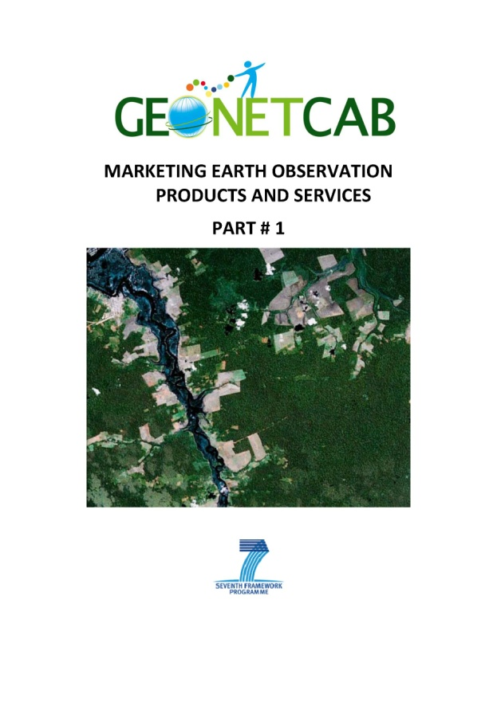
Life cycle of products & services
Initialization
System analysis & design
Rapid prototyping
System development
Implementation
Post-implementation

Slide 5
Assessment of business & funding opportunities
Categories of environmental products & services
Life cycle phase of product or service
Regional context, level of technological & economic development
Optimum marketing mix

Slide 6
1. International trends & developments in marine environment

Slide 7
Trends
More attention for:
(sustainable) fisheries management
management of extreme events (flooding, safety, pollution)
management of marine ecosystems
effects of climate change
more effective and efficient exploitation of resources (oil, wind, tidal, etc.)
community participation and public awareness

Slide 8

Ecosystems Approach
Reduce resource use and emission of greenhouse gases;
Minimizing waste;
Improving governance.
State of fisheries and aquaculture (FAO)

Slide 9
Goals
Ensure that:
• More food is produced sustainably;
• Demand for the most resource-intense types of food is contained;
• Waste in all areas of the food system is minimized;
• The political and economic governance of the food system is improved.
State of fisheries and aquaculture (FAO)

Slide 10
Climate change
Implications:
• Availability of aquatic foods will vary;
• Stability of supply will be impacted;
• Access to aquatic food will be affected;
• Utilization of aquatic products will be impacted.
Climate change fisheries and aquaculture (FAO)

Slide 11
Climate change
Options for enabling change:
• Developing the knowledge base;
• Policy, legal and implementation frameworks;
• Capacity building: technical and organizational structures;
• Enabling financial mechanisms: embodying food security concerns in existing and new financial mechanisms.
Climate change fisheries and aquaculture (FAO)

Slide 12

Marine protected area classification scheme
Marine protected areas (FAO)

Slide 13
Results of protection measures inside reserves
Marine protected
areas (FAO)

Slide 14
Marine protected areas
Goals:
• Biological/ecological (protection fishery resources, biological diversity, individual species, habitat, restoration degraded areas)
• Social and economic (fostering food security, improving livelihoods, non-monetary benefits, compatibility management & local cultures, enhancement awareness & knowledge)
• Governance (effective management & legal structures, stakeholder participation & representation, management plan compliance by resource users, management and reduction of resource–use conflicts)
Based on Pomeroy, Parks and Watson (2004) Marine protected areas (FAO)

Slide 15

Census of Marine Life (highlights & summary)
Overview of global inventory of marine life in the past decade
www.coml.org

Slide 16
Census of Marine Life – project areas

Slide 17

Large marine ecosystem concept (NOAA)
Combination of satellite and in-situ information
Below surface:
ARGO programme www.argo.uscd.edu

Slide 18

More references:
Green economy in a blue world (UNEP) Overview of options to combine economic development with sustainable management of the marine environment
Technical guidelines on fisheries and aquaculture (FAO)
Marine protected areas (FAO) Overall guidelines for management of marine protected areas in the context of fisheries, including a short description of GIS and remote sensing as support tools
Fisheries management (FAO)
Case studies from Brazil, India, Palau and Senegal

Slide 19



More references (2):
Marine and coastal dimension of climate change in Europe (EC) Description of actual situation and expected effects of climate change for ‘European’ seas and coastal areas, including sections on GIS, remote sensing and SDI
SAHFOS ecological status reports 2011, 2010, 2009, 2008 Overview of monitoring marine biodiversity by means of the continuous plankton recorder survey: trends for each of the world’s oceans with respect to ecosystems and climate change
IGBP marine ecosystems and climate change
Overview of changes due to human intervention and/or climate change

Slide 20
2. Steps to promote earth observation for marine environment

Slide 21
State-of-the-art
Earth observation is new technology.
Learn technical skills, but when back in professional practice, it has to be put to good use.
That involves ‘selling’ it.
How to do that?
To whom? Could be your own boss, local authorities, communities, etc.

Slide 22
Categories of products and services
Ocean topography, temperature and currents
Ocean colour
Satellite-based fishing
Marine and coastal ecosystems
(see also environmental management toolkit)
Climate monitoring and modelling, mitigation of the effects of climate change (see also climate change toolkit)
Marine and coastal safety and disaster management
(see also disaster management toolkit)

Slide 23
Discovering the Ocean from space (Robinson):
General overview

Slide 24
Discovering the Ocean from space (Robinson):
Data processing tasks

Slide 25
Discovering the Ocean from space (Robinson):
Electromagnetic spectrum

Slide 26
Discovering the Ocean from space (Robinson):
Classes of sensors

Slide 27
What can be measured and assessed?
Sea surface height
Sea surface temperature
Ocean colour
Wind vector
Sea state (significant wave height)
Sea state (directional wave spectra)
Sea ice parameters
From: Discovering the Ocean from space (Robinson)

Slide 28
Observations
Altimeter: sea level change, ocean circulation, ocean tides, ocean surface wind wave studies, El Niño studies, cyclone/hurricane studies, rainfall studies.
Scatterometer (wind velocity and direction): weather forecasting, storm detection, ship routing, oil production.
Radiometers: sea surface temperature, salinity, soil moisture, sea ice, precipitation, integrated water vapour, liquid water content of the atmosphere
From: Remote sensing applications – Oceans (NRSC)

Slide 29
Application areas
Weather prediction, including extreme events and climate change studies modelling
Ship route planning
Maritime safety
Satellite based fishery & sustainable fisheries management
Ecosystem management
Coastal zone management and solutions
Energy
Pollution tracking and mitigation

Slide 30
Characteristics and perspectives of Earth Observation
Multiple inter-related phenomena
Expert knowledge required (in addition to automated data processing)
Application of complicated models
Specialization needed
Clients in off-shore energy and shipping capable of defining specifications and appreciating technicalities
Ecosystem services more directed at government clients and general public
Fisheries is intermediate case, depending on development level
Leads to: market dominated by government organizations and specialized companies, both as suppliers and clients

Slide 31

Example (1)
MyOcean www.myocean.eu
Marine safety
Marine resources
Coastal & marine environment
Weather & seasonal forecasting
GMES Marine Core Service
Information and data for specialists and general public
Catalogue with products and databases available

Slide 32

Example (2)
BMT ARGOSS www.bmtargoss.com
High resolution weather forecasting
Global wind & weather forecast services
Near-shore modelling
Persistence analysis: determining the operational risks & workability
Ambient climate design criteria
Oil spill information services
Search and rescue information system
Shipping applications (maneuvering, performance)

Slide 33

Example (3)
ASTRIUM maritime surveillance www.astrium.eads.net
(SpotImage)
Space-based technologies for traffic control, smuggling, illegal fishing, oil dumping & pollution monitoring, illegal immigration, piracy, safety
Three service levels: statistical, tactical & urgent
Features:
- situation awareness of the overall maritime domain
- effectiveness from early warning to interception
- optimised operation plan at sea

Slide 34


Example (4)
Sustainable Fisheries Management:
INCOIS marine fishery advisory services www.incois.gov.in/Incois/marine_fisheries_main.jsp
Indian Ocean advisory service on fishery
SAFARI & ChloroGIN projects: now FARO
www.faro-project.org
Research on sustainable fisheries management

Slide 35

More references:
African marine atlas http://omap.africanmarineatlas.org/index.htm
Online atlas product on African marine resources, training courses and work programmes
Global ocean data assimilation experiment (GODAE) Improved standardisation, modelling, forecasting and a cost-effective and sustainable ocean observing system
FUGRO ocean science & metocean Company brochures with description of meteorological and oceanographic services
Why ocean colour? The societal benefits of ocean colour technology With chapter on ocean colour for fisheries,
including management of endangered species

Slide 36
Marketing of earth observation
Marketing of earth observation is difficult.
New technology, few big companies, lots of small ones.
Lots of reports describing the bottlenecks, like reliability,
data access, data continuity, etc.
Means that relatively a lot of effort is needed to promote
EO.

Slide 37
Points to keep in mind:
Look for opportunities, where can you have most success in a short time: quick-wins.
Target the right audience to start with: who would be interested and listen to you?
Identify the problem that they are trying to solve: is it the same as yours?
Learn to speak the same language. Example ‘pelagic species’: this is a term most politicians do not understand and do not care about. Use terms related to profits and losses.
Look for examples from elsewhere (success stories): solutions that work and are affordable.

Slide 38
Be patient: introduction of new technology and / or applications takes time

Slide 39
3. How to get funding for your activities

Slide 40
Approach
Share information on your subject (a thing you are doing) and think that is interesting for your contact, then look for the link. Could this solve a problem for your partner? Are adjustments necessary? Need other parties be involved? Take it from there.
LEADS, LEADS, LEADS

Slide 41
How?
Establish your network.
Look for opportunities.
Write a good proposal.
Promise much, but not too much.

Slide 42
Proposal outline
(more detailed version in separate document, see also www.geonetcab.eu )
1. Introduction / relevance
2. Objective(s)
3. Activities
4. Output
5. Management & evaluation
6. Risk assessment
7. Time schedule
8. Budget
Annexes

Slide 43


Other references
Civicus: writing a funding proposal
Michigan State University: guide for writing a funding proposal
ESRI: writing a competitive GRANT application
REC: project proposal writing

Slide 44
Again:
SHARED PROBLEM
SHARED LANGUAGE
SHARED SOLUTION
If all else fails, try to link with a more popular (and easy to
understand) topic.

Slide 45
4. Capacity Building

Slide 46
General
Marketing is promotion + capacity building.
Especially for the introduction of new technologies capacity
building is important at all levels.
Capacity building is the instrument to increase
self-sufficiency and make solutions work.

Slide 47
Think of:
Different instruments for different levels: workshops for decision makers and awareness raising, detailed technical training for professionals.
Provide follow-up. Getting funding for good capacity building is difficult: everybody agrees that it is important, but nobody has time.
Training is usually part of funding of big projects that are managed by big companies or ministries, as a consequence capacity building is forgotten (in the end).
Aim at small budgets that are available without having to tender.

Slide 48
Examples & references
Handbook of satellite remote sensing image interpretation www.iocg.org/handbook.html Case studies on air/water quality, phytoplankton and macro algae, fisheries and aquaculture, marine ecosystem characterization + exercises
www.pi-goos.org Support to marine observing programmes, communication and capacity building in the Pacific
IOC principles and strategy for capacity building
General framework for capacity building
GEONetCab capacity building web www.geonetcab.eu
Compilation of tutorials, references, open-source software, etc.
GEO Portal: www.earthobservations.org

Slide 49

More references
A Rough Google Earth Guide
MEASURE Evaluation Global Positioning System Toolkit
(USAID)
Handbook of Research on Developments and Trends in
Wireless Sensor Networks: From Principle to Practice

Slide 50
Further details:
Contact: Mark Noort
m.noort@hcpinternational.com
www.geonetcab.eu

