Slide 1



Earth Observation for
Health
International trends & developments
How to promote earth observation applications?
How to get funding?
Capacity building

Slide 2

0. Introduction
Mark Noort, consultant, project manager
HCP international:
consulting, marketing of earth observation
Coordinator GEONetCab:
project for promotion & capacity building of
earth observation applications

Slide 3
Earth observation applications
On the verge of reaching new user communities
These new user communities need to be involved
Weakest link / last mile aspects are important
Marketing needed: promotion & capacity building

Slide 4
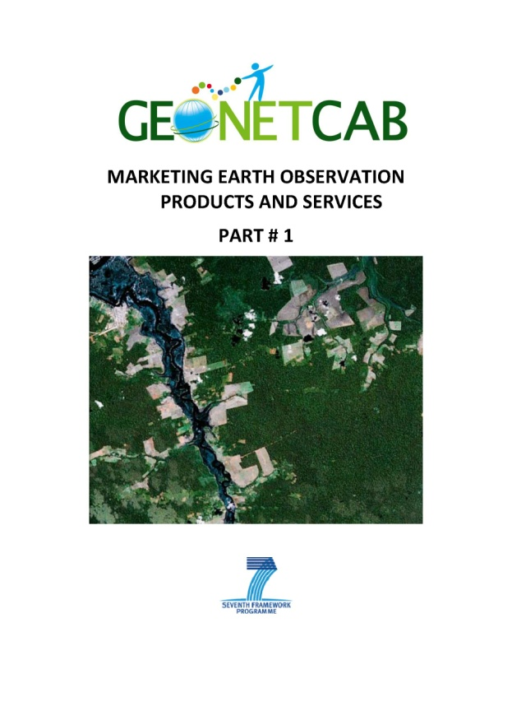
Life cycle of products & services
Initialization
System analysis & design
Rapid prototyping
System development
Implementation
Post-implementation

Slide 5
Assessment of business & funding opportunities
Categories of environmental products & services
Life cycle phase of product or service
Regional context, level of technological & economic development
Optimum marketing mix

Slide 6
1. International trends & developments in marine environment

Slide 7
Trends
Increasing population
Economic growth
Increasing urbanization
Increasing (energy) consumption
Increasing mobilization -> motor vehicles
Leads to increased pollution of water, air and soil

Slide 8
Trends (2)
Positive trends:
New, cleaner technologies available
Increased attention for environmental issues
Increased attention for sustainable economic development
Improved living standards and increased life expectancy
Improved monitoring, forecasting and early warning -> focus of Earth observation
Improved understanding of processes affecting human health -> focus of Earth observation

Slide 9
Focal points:
Air quality (pollution, aeroallergens, dust storms)
Fighting disease (malaria, meningitis, dengue, rift fever, west nile virus, cholera, etc.)
Climate change and health

Slide 10

Type and sources of air pollutants
Optical remote sensing for measurement and monitoring of emission flux (EPA Handbook)

Slide 11

Air quality
Main observations for Europe:
• Particulate matter (PM) and ozone (O₃) are most harmful for human health;
• Emissions of air pollutant declined in last decade: improved air quality across the region for some pollutants;
• Emission reduction does not always cause a drop in atmospheric concentrations, especially for PM and O₃;
• Pollutants of interest: PM, ground-level O₃, nitrogen oxides, sulfur dioxide, carbon monoxide, heavy metals, benzene and benzo(a)pyrene.
• AirBase database:
http://www.eea.europa.eu/themes/air/air-quality/map/airbase
Air quality in Europe - 2012 report (EEA)

Slide 12
Particulate matter, relative size
EPA (2010)

Slide 13
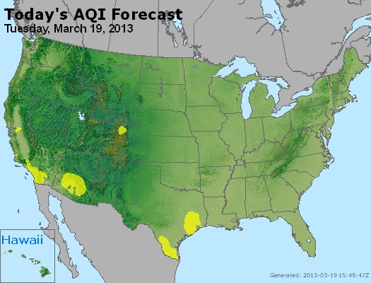

Air Quality Index map of the US
AIRnow website: http://airnow.gov/

Slide 14


References:
Air quality in Europe – 2012 report (EEA)
Air Quality Index – a guide to air quality and your health (EPA)
Brochure that explains air quality index, causes of air quality variation (ozone, particle pollution, sulfur dioxide, carbon monoxide), health effects and possible action (avoidance)
The EveryAware sensor box: a tool for community-based air quality monitoring
Description of sensor box that users can apply to measure / monitor air traffic pollution

Slide 15
Air quality: sand and dust
Sand and dust storm over Japan (MODIS image, 2002)

Slide 16

Dust storm life cycle
Dust storm early warning (UNEP)

Slide 17

Information flow SDS-WAS
Sand and dust storm warning, advisory and assessment system (WMO)

Slide 18

References:
Forecasting and early warning of dust storms (UNEP global environmental alert service)
Presents general process and role of forecasting and early warning
Dust and sand storms (Ministry of the Environment Japan)
Description of how the sand and dust storm mechanism works and the usefulness of improved forecasts and early warning
WMO sand and dust storm warning, advisory and assessment system (SDS-WAS) – science and implementation plan 2011 - 2015
Research to improve forecasts, modelling and information to user communities, including meningitis risk in the Sahel region

Slide 19

Fighting disease
Example:
Roll back malaria - malaria early warning systems (WHO):
Initiative for the prevention and control of malaria epidemics in Africa
Comprehensive approach, including an suitability analysis of transmission and vulnerability risk indicators
Uses WHO/UNICEF HealthMapper: http://healthmapper.software.informer.com/
For more examples see section 2.

Slide 20
Climate change and health
Areas of concern:
• Infections: malaria, diarrhea, meningitis, dengue fever are the most important ones
• Emergencies: floods and cyclones, drought, airborne dispersion of hazardous materials
• Emerging environmental challenges: heat stress, UV radiation, pollen, air pollution
Atlas of health and climate (WHO/WMO)

Slide 21


More references:
Human health climate change brochure (US global change research program)
Predicts: increase in risk of illness and death related to extreme heat and heat waves, reduced extreme cold, challenge to meet air quality standards, more extreme weather events (storms, floods, wild fires), increase of some diseases transmitted by food, water or insects (west nile, lyme, salmonella, etc.), increased pollen health risk
Human health, climate change 2007: impacts, adaptation and vulnerability (IPCC)
Covers: heat and cold effects on health, wind, storms and floods, drought, nutrition and food security, food safety, water and disease, air quality and disease, aeroallergens and disease, vector-borne, rodent-borne and other infectious diseases, occupational health and UV radiation

Slide 22
2. Steps to promote earth observation for health

Slide 23
State-of-the-art
Earth observation is new technology.
Learn technical skills, but when back in professional practice, it has to be put to good use.
That involves ‘selling’ it.
How to do that?
To whom? Could be your own boss, local authorities, communities, etc.

Slide 24
Categories of products and services
Air quality forecasting / early warning / monitoring
Epidemics forecasting
Relationships between diseases and environmental factors
All these categories, particularly the 2nd & 3rd, are of course linked, the time/response factor providing the main distinction.

Slide 25
Introduction example: United States
Air quality: emissions from industrial processes and motor vehicles, particulate matter in the air (sand, dust, volcanic and noxious gases, smoke and soot from fires)
- measure air masses (monitor extent and source of emissions)
- track health impact from fires
- track dust (meningitis, other diseases)
- monitor trace species in the air (carbon monoxide, ozone)
Temperature: extremes (heat waves lead to weather-related deaths, aggravation of chronic diseases)
From: Using Earth observation data to improve health in the United States (CSIS)

Slide 26
Introduction example: United States (2)
Water: health risks caused by
- droughts (affects supply of fresh water, famine, fires)
- floods (spread of diseases, fuel, pollutants)
- contamination (chemicals, toxins, sewage)
Special attention to ‘health’ of the ocean.
Infectious disease and disease vectors: environmental factors (land and water surface temperatures, rainfall, water depth, marine organisms) contribute to disease outbreaks, changes in weather and climatic conditions (example: cholera).
From: Using Earth observation data to improve health in the United States (CSIS)

Slide 27
Introduction example: United States (3)
Remote sensing data requested by public health
community:
Climate change parameters and health
Heat island effects on urban areas
Precipitation (water, drought)
Data on at-risk population
Detection of algae blooms that are harmful to health
Pesticides and crop prediction
From: Using Earth observation data to improve health in the United States (CSIS)

Slide 28
Introduction example: United States (4)
Public health community users are interested in:
Areas of intrinsic variability or high trend (rapid change)
Integrated Earth observation climate models for health impact (novel ways of using high spatial resolution)
Indicators to monitor climate-change-related health outcomes within surveillance systems
Development of early warning systems
Improved decision support for vulnerability and adaptation assessment, operational predictions and understanding of the decision making process
From: Using Earth observation data to improve health in the United States (CSIS)

Slide 29

Air quality example: Europe
Healthcare costs associated with poor air quality:
€ 189 billion/year
Satellite-based air quality assessments support the European Commission’s goal of improving reduced life expectancy due to airborne particulate matter by
- compliance monitoring support to environmental agencies,
- early warning of pollution exceeding allowed levels
The WHO estimates that by reducing illness caused by airborne PM the EU could save up to € 29 billion/year
Regional and municipal governments already provide citizens with detailed air pollution alerts
From: Monitoring the air we breathe from space (GMES)

Slide 30
Air quality example: Europe (2)
Mean density of nitrogen oxide (January 2003 – June 2004)

Slide 31

EO priorities: air quality for health
Framework for categorizing earth observations for air quality and health

Slide 32

Example: comprehensive
air quality approach (1)
Monitoring Atmospheric Composition and Climate project structure

Slide 33

Example: comprehensive
air quality approach (2)
Integrated forecasting system

Slide 34
Air quality references:
Critical earth observations priorities, health societal benefit area: aeroallergens
Priority observations needed: ground-based samplers, temperature, humidity and precipitation, thunderstorms, wind direction, speed and persistence, air pollution, land cover data
Critical earth observations priorities, health societal benefit area: air quality for health
Focus on air pollutants (PM_{2.5} , PM₁₀ , O₃ , NO₂ , SO₂), observation coverage and utility; proper allocation of multi-pollutant observations, assuring spatio-temporal coverage & including the chemical precursors of secondary pollutants, such as PM_{2.5} and O₃

Slide 35


Air quality references (2):
Particulate matter in the atmosphere of Dakar, Senegal (Planet Action)
Pilot on monitoring of particulate matter, measurement of aerosol optical depth, specifically aimed at Sahara desert dust; combination of in-situ and EO; satellite observations can detect gradient & therefore hotspots of emission
Air pollution using remote sensing and GIS, Cyprus
Case study on the use of satellite observations for air pollution monitoring and modelling
SERVIR air quality monitoring Central America
Description of the use of EO for an air quality monitoring system and public information, including ‘SmogBlog’, agricultural fires, vulcanic eruptions, Saharan dust + capacity building
http://www.servir.net/

Slide 36
Epidemics forecasting
& environmental factors
User cycle framework (EO priorities)

Slide 37
Epidemics forecasting
& environmental factors
Epidemiological system showing the four main categories of EO
(EO priorities)

Slide 38

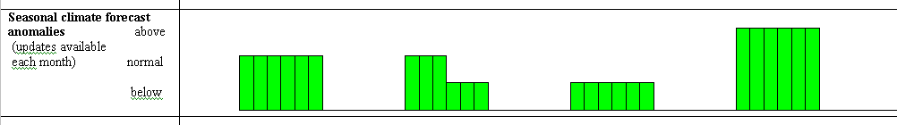
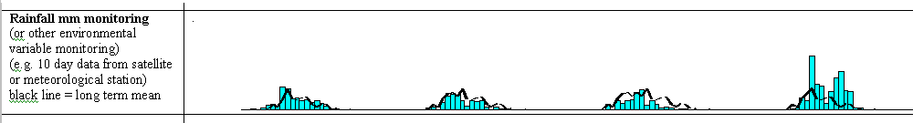
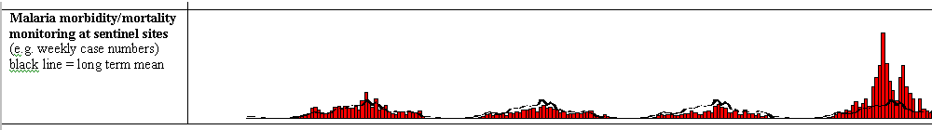
Malaria early warning systems
Case surveillance alone = late warning
Integrated MEWS gathering cumulative evidence for early and focused epidemic preparedness and response (WHO 2004)
)

Slide 39
EO for malaria early warning systems
Vulnerability assessment (pre-season, rainy season, malaria season)
Seasonal climate forecast anomalies
Rainfall monitoring
Correlation rainfall – incidence and vegetation (NDVI) - incidence
Malaria morbidity/mortality monitoring at sentinel sites
Short-term forecasting and long-term forecasting
From: IRI presentation

Slide 40
Useful sites for early warning
IRI, Columbia University http://iridl.ldeo.columbia.edu/maproom/.Health/ (malaria, meningitis)
CNES RedGems http://www.redgems.org/ (malaria, rift valley fever, dengue, vibrio diseases and cholera)
NASA SERVIR http://www.nasa.gov/mission_pages/servir/index.html (general)
ISID Pro-MED http://www.promedmail.org/pls/otn/f?p=2400:1000 (diseases general)
USAID FEWSNET http://earlywarning.usgs.gov/adds/ (famine)

Slide 41

Tele-epidemiology
From: CNES Strategy, Satellite data and modeling for Public Health

Slide 42
Use of Google Earth
Distribution of city blocks with dengue cases, Chetumal, Quintana Roo, Mexico (2006)

Slide 43

Epidemics and environmental factors references:
Use of Google Earth to strengthen public health capacity and facilitate management of vector-borne diseases in resource-poor environments
Case study from Mexico; Google Earth images used to extract urban infrastructure patterns
Positive: easy to use and easy to learn
Negative: spatial analysis and modelling capacity is limited
Connecting ecosystems, biodiversity, and human health: using earth observations to reduce and prevent infectious diseases
Presentation on establishing links between human health and environmental factors with a call for integrated tools and approaches that link ecology to human health

Slide 44

Epidemics and environmental factors references (2):
State of the art for environmental and health monitoring in air and water (EO2HEAVEN)
Overview of regulations, feasibility of measuring and monitoring practices (including EO) and future developments
Satellite remote sensing variables as environmental risk factors and their association with child nutritional status and survival in a context of climate change
Relation between NDVI and child nutrition: rainfall data is less reliable than NDVI in monsoon systems with high intensity rainfall
Telesanté (CNES) see also GEONetCab success stories
HappySun Something different: UV-radiation information for tourists and the tourist sector (Italy)

Slide 45
GEO Health task: scope
Develop tools and information systems for the environment and human health
Advance the integration of Earth observations and forecasts into health decision-making processes
Engage with health users and decision-makers to identify needs
Increase capacity building on use of Earth information by the health user-community
Establish linkages with other Societal Benefit Areas, such as ecosystems, biodiversity, climate and disasters

Slide 46
Possible business opportunities
Scientists, public health organizations, NGOs, general public
Mainly G2G or B2G market, government or international organizations are in virtually in all cases the paying client
Opportunities for businesses in developing countries: refinement of existing models for local circumstances and processing of data flows
Air quality particularly relevant in the large, densely populated cities

Slide 47
Marketing of earth observation
Marketing of earth observation is difficult.
New technology, few big companies, lots of small ones.
Lots of reports describing the bottlenecks, like reliability,
data access, data continuity, etc.
Means that relatively a lot of effort is needed to promote
EO.

Slide 48
Points to keep in mind:
Look for opportunities, where can you have most success in a short time: quick-wins.
Target the right audience to start with: who would be interested and listen to you?
Identify the problem that they are trying to solve: is it the same as yours?
Learn to speak the same language. Example ‘ZPOM’: this is a term most politicians do not understand and do not care about (although ‘zone potentially occupied by mosquitoes may be sufficient explanation). Use terms related to profits and losses.
Look for examples from elsewhere (success stories): solutions that work and are affordable.

Slide 49
Be patient: introduction of new technology and / or applications takes time

Slide 50
3. How to get funding for your activities

Slide 51
Approach
Share information on your subject (a thing you are doing) and think that is interesting for your contact, then look for the link. Could this solve a problem for your partner? Are adjustments necessary? Need other parties be involved? Take it from there.
LEADS, LEADS, LEADS

Slide 52
How?
Establish your network.
Look for opportunities.
Write a good proposal.
Promise much, but not too much.

Slide 53
Proposal outline
(more detailed version in separate document, see also www.geonetcab.eu )
1. Introduction / relevance
2. Objective(s)
3. Activities
4. Output
5. Management & evaluation
6. Risk assessment
7. Time schedule
8. Budget
Annexes

Slide 54


Other references
Civicus: writing a funding proposal
Michigan State University: guide for writing a funding proposal
ESRI: writing a competitive GRANT application
REC: project proposal writing

Slide 55
Again:
SHARED PROBLEM
SHARED LANGUAGE
SHARED SOLUTION
If all else fails, try to link with a more popular (and easy to
understand) topic.

Slide 56
4. Capacity Building

Slide 57
General
Marketing is promotion + capacity building.
Especially for the introduction of new technologies capacity
building is important at all levels.
Capacity building is the instrument to increase
self-sufficiency and make solutions work.

Slide 58
Think of:
Different instruments for different levels: workshops for decision makers and awareness raising, detailed technical training for professionals.
Provide follow-up. Getting funding for good capacity building is difficult: everybody agrees that it is important, but nobody has time.
Training is usually part of funding of big projects that are managed by big companies or ministries, as a consequence capacity building is forgotten (in the end).
Aim at small budgets that are available without having to tender.

Slide 59


Examples & references
Approaches to GIS programs in health education
Short examples from different universities (no EO as such, but it is a small step)
EPA handbook: optical remote sensing for measurement and monitoring of emission flux
Also not strictly EO, but explains remote sensing techniques with similar underlying processes, including optical, LIDAR and thermal infrared
SERVIR and public health
Examples of projects and capacity building to support public health initiatives in the developing world, making use of EO
GEONetCab capacity building web www.geonetcab.eu
Compilation of tutorials, references, open-source software, etc.
GEO Portal: www.earthobservations.org

Slide 60

More references
A Rough Google Earth Guide
MEASURE Evaluation Global Positioning System Toolkit
(USAID)
Handbook of Research on Developments and Trends in
Wireless Sensor Networks: From Principle to Practice

Slide 61
Further details:
Contact: Mark Noort
m.noort@hcpinternational.com
www.geonetcab.eu

