Slide 1



Earth Observation for
Forest Management
International trends & developments
How to promote earth observation applications?
How to get funding?
Capacity building

Slide 2

0. Introduction
Mark Noort, consultant, project manager
HCP international:
consulting, marketing of earth observation
Coordinator GEONetCab:
project for promotion & capacity building of
earth observation applications

Slide 3
Earth observation applications
On the verge of reaching new user communities
These new user communities need to be involved
Weakest link / last mile aspects are important
Marketing needed: promotion & capacity building

Slide 4
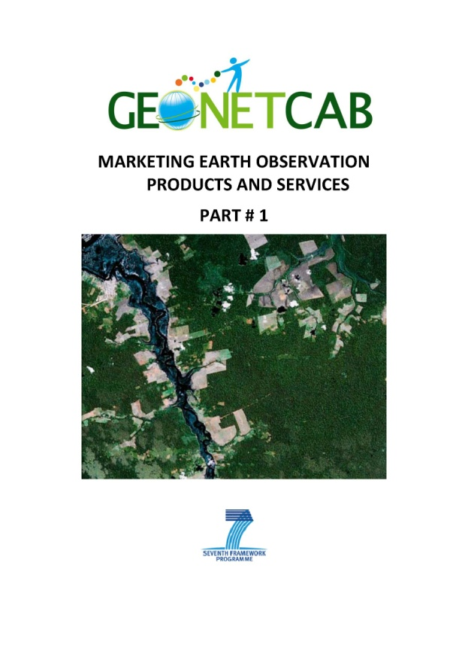
Life cycle of products & services
Initialization
System analysis & design
Rapid prototyping
System development
Implementation
Post-implementation

Slide 5
Assessment of business & funding opportunities
Categories of environmental management products & services
Life cycle phase of product or service
Regional context, level of technological & economic development
Optimum marketing mix

Slide 6
1. International trends & developments in forest management

Slide 7


Forest Governance
Based on three pillars:
Policy, legal, institutional and
regulatory frameworks
Planning and decision-making processes
Implementation enforcement and compliance
And a number of cross-cutting aspects:
accountability, effectiveness, efficiency, fairness/equity, participation, transparency + description of subcomponents and indicators
Framework for assessing and monitoring forest governance (PROFOR, FAO)

Slide 8
Global Monitoring
FAO Forest Resource Assessment 2010 outcomes:
• improved knowledge on land cover and land use changes related to forests, especially deforestation, afforestation and natural expansion of forests;
• information on the rate of change between 1990 and 2005 at global, biome and regional levels;
• a global framework and method for monitoring forest change;
• easy access to satellite imagery through an internet-based data portal;
• enhanced capacity in many countries for monitoring, assessing and reporting on forest area and forest area

Slide 9
Example FRA sampling grid
Steps:
1. Satellite data
2. Classify and label
3. Validate

Slide 10


Ecosystem Management
Find your country:
Non-Legally Binding Instrument on all types of forests (NLBI): http://www.un.org/en/members/
Convention on Biological Diversity (CBD): http://www.cbd.int/convention/parties/list/
United Nations Framework Convention on Climate Change (UNFCCC):http://unfccc.int/parties_and_observers/parties/items/2352.php
Kyoto Protocol: http://unfccc.int/kyoto_protocol/status_of_ratification/items/2613.php
United Nations Convention on Combating Desertification (UNCCD): http://www.unccd.int/convention/ratif/doeif.php

Slide 11

Ecosystem Management
Find your country (continued):
Convention on International Trade in Endangered Species of wild fauna and flora (CITES): http://www.cites.org/eng/disc/parties/alphabet.shtml
Convention on wetlands of international importance (Ramsar): http://www.ramsar.org/cda/en/ramsar-about-parties-contracting-parties-to-23808/main/ramsar/1-36-123%5E23808_4000_0__
World Heritage Convention: http://whc.unesco.org/en/statesparties/
International Tropical Timber Agreement (ITTA): http://www.itto.int/itta/

Slide 12
Automatic change detection
Landsat 1992 Landsat 2001 Likely areas of
deforestation

Slide 13

Certification
The International Tropical Timber Organization (ITTO) and the Forest Stewardship Council (FSC) developed criteria and indicators for sustainable forest management and certification:
FSC label required by customers and therefore by producers

Slide 14

Interactivity
Increased use of social media and interactive instruments for forest cover monitoring and management.
Examples:
Interactive forest cover atlas of Cameroon (WRI) http://www.wri.org/publication/interactive-forestry-atlas-cameroon-version-2-0
Forestracker: www.cincs.com
Marketracker: www.carboncreditcapital.com

Slide 15


More references:
Forest sourcebook (World Bank) Comprehensive overview of forest management, including a discussion of remote sensing applications
+ cost comparison between RS and conventional monitoring
Impact of the global forest industry on atmospheric greenhouse gases (FAO) Calculations of the actual situation and future scenarios, suggestions for sustainable forest management
Sustaining forests - investing in our common future (UNEP)
Global ecological forest classification and forest protected area gap analysis (UNEP)

Slide 16
2. Steps to promote earth observation for forest management

Slide 17
State-of-the-art
Earth observation is new technology.
Learn technical skills, but when back in professional practice, it has to be put to good use.
That involves ‘selling’ it.
How to do that?
To whom? Could be your own boss, local authorities, communities, etc.

Slide 18
Categories of products and services
Fire monitoring and prevention
(see disaster toolkit)
Carbon accounting
(see climate toolkit)
Monitoring and management
Pest and disease control and management

Slide 19
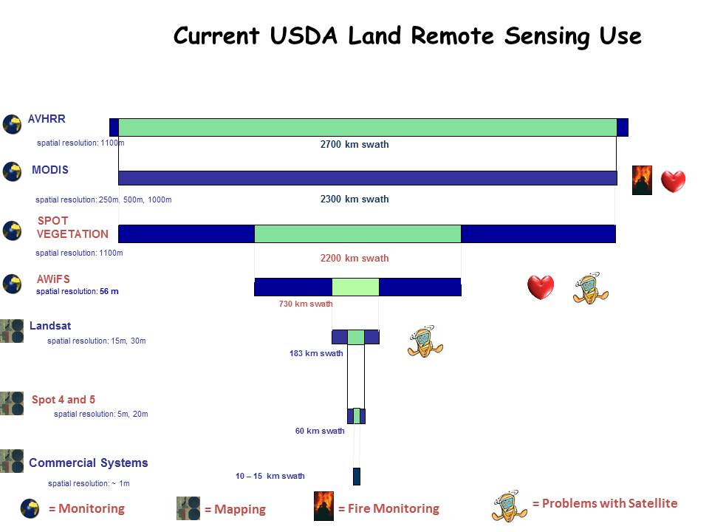

Example:
USDA use of satellite imagery for land cover (1)
USDA Remote Sensing Programs and Uses (Bethel)

Slide 20
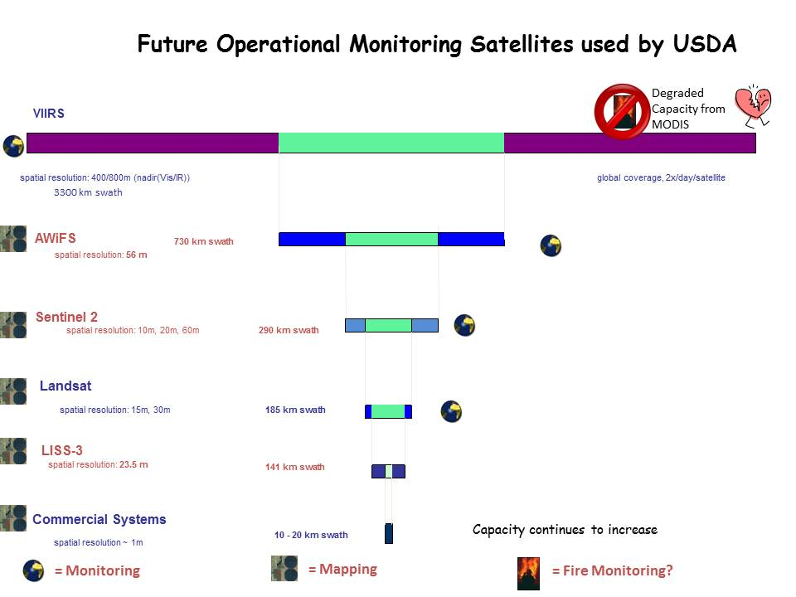
Example:
USDA use of satellite imagery for land cover (2)
USDA Remote Sensing Programs and Uses (Bethel)

Slide 21
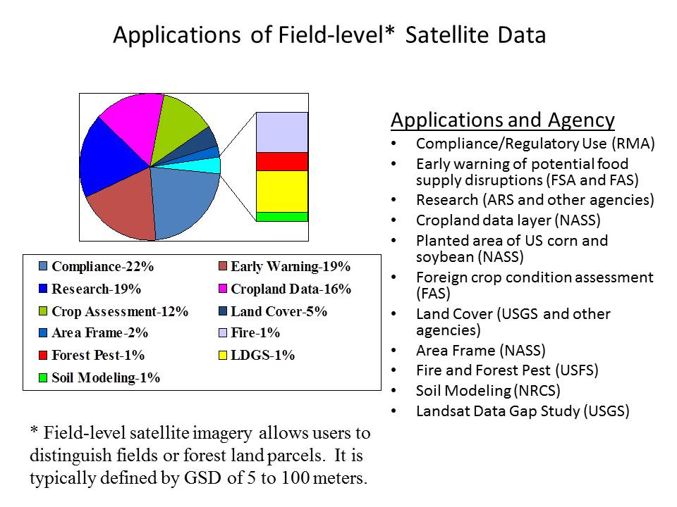
Example:
USDA use of satellite imagery for land cover (3)
USDA Remote Sensing Programs and Uses (Bethel)

Slide 22
What can be measured and assessed (1)?
Area coverage + stratification
Change detection forest land appraisal
Timber harvest planning, monitoring, logging and reforestation
Planning and assessing plant vigor and health in forest nurseries
Mapping fire potential, planning fire suppression activities
Assessing potential slope features and soil erosion
Planning forest roads
Inventorying forest recreation resources
From: Remote sensing applications – forests and vegetation (NRSC)

Slide 23
What can be measured and assessed (2)?
Wildlife and assessing wildlife habitat
Monitoring vegetation regrowth in fire lanes and power lines rights-of-way
Synoptic and periodic measurements
Forest parameters: greenness, crown closure, vegetation type, species assemblage / gregarious formations
From: Remote sensing applications – forests and vegetation (NRSC)

Slide 24

What is still needed?
Improved correlation between remote sensing observations and ground-based observations
Better algorithms to interpret and correct remote sensing data
Validation and standardization of land cover maps
Long time series of data and internally consistent products, and consistency of data availability
Finer temporal and spatial resolution
Model integration.
From: Critical earth observation priorities – agriculture societal benefit area – forests (GEO)

Slide 25
Pilots that work (1)
Overview of case studies for sustainable forest management (FSC), service delivery report and service operations reports – studies of forest clearance and management in Sweden, Russia and South Africa, total land cover analysis and cost estimates + accuracy analysis & validation
Land cover mapping, mapping of broadleaved trees, timber volume, mapping of retention trees, burnt area mapping, clearfell mapping
Products: digital surface model, forest area, forest type, burnt area, clear cut and re-growth, road mapping, settlements, monitoring of protected forest areas, biophysical parameters

Slide 26
Pilots that work (2)
Evaluation, it works, but:
Data calibration is the most complex and technical barrier
Not many companies have the required skill set and technological expertise in EO, GIS and mensuration to successfully implement and use the data provided
For optical data: processing chain is known and understood. For SAR, processing support would be required
It is easy to have misunderstandings on very technical issues. But provided the process is carefully managed data transferability is possible.

Slide 27
Example Canada: building a next generation forest management and monitoring system
This image (right) represents the differences between the 1990 and 1999 Landsat images (above). Green represents cut blocks prior 1990 and light blue indicates changes that occurred between 1990 and the 1999 image dates. The blue line at "E" is a road constructed between the image dates.

Slide 28

More references (1):
Forest and biomass management using satellite information and services (Eurisy) Remote sensing
for forestry applications in European regions + examples
SERVIR: forest cover and deforestation in Belize
1980-2010 Use of remote sensing for change detection and analysis
Earth observation responses to geo-information drivers (ESA) Market studies on forestry and earth observation: markets, demand, supply, opportunities, risks
The use of remote sensing techniques in operational forestry (UK) Description of remote sensing techniques, costs per km2 and examples of applications in the UK (tree counting, monitoring of forest stands, national inventory: automated classification of woodland acres (95% accuracy), tree heights)

Slide 29


More references (2):
Global forest land-use change 1990 – 2005 (FAO)
Remote sensing analysis of global forests, comparison with FAO FRA
GEONetCab examples from the Czech Republic and Poland www.geonetcab.eu
New European satellite imagery supports development of forest-related ecosystem services projects (ESA) Success stories
Application of GIS and remote sensing for conservation and management of forests in Myanmar
Overview of GIS and remote sensing for forest management in Myanmar
DMCii’s detailed satellite imagery helps Brazil stamp out deforestation as it happens Detection of forest clearing and illegal logging (complementary to MODIS)

Slide 30
Marketing of earth observation
Marketing of earth observation is difficult.
New technology, few big companies, lots of small ones.
Lots of reports describing the bottlenecks, like reliability,
data access, data continuity, etc.
Means that relatively a lot of effort is needed to promote
EO.

Slide 31
Points to keep in mind:
Look for opportunities, where can you have most success in a short time: quick-wins.
Target the right audience to start with: who would be interested and listen to you?
Identify the problem that they are trying to solve: is it the same as yours?
Learn to speak the same language. Example ‘canopy’: this is a term most managers do not understand and do not care about. Use terms related to profits and losses.
Look for examples from elsewhere (success stories): solutions that work and are affordable.

Slide 32
Be patient: introduction of new technology and / or applications takes time

Slide 33
3. How to get funding for your activities

Slide 34
Approach
Share information on your subject (a thing you are doing) and think that is interesting for your contact, then look for the link. Could this solve a problem for your partner? Are adjustments necessary? Need other parties be involved? Take it from there.
LEADS, LEADS, LEADS

Slide 35
How?
Establish your network.
Look for opportunities.
Write a good proposal.
Promise much, but not too much.

Slide 36
Proposal outline
(more detailed version in separate document, see also www.geonetcab.eu )
1. Introduction / relevance
2. Objective(s)
3. Activities
4. Output
5. Management & evaluation
6. Risk assessment
7. Time schedule
8. Budget
Annexes

Slide 37


Other references
Civicus: writing a funding proposal
Michigan State University: guide for writing a funding proposal
ESRI: writing a competitive GRANT application
REC: project proposal writing

Slide 38
Again:
SHARED PROBLEM
SHARED LANGUAGE
SHARED SOLUTION
If all else fails, try to link with a more popular (and easy to
understand) topic.

Slide 39
4. Capacity Building

Slide 40
Forest management toolkit
Tool for forestry analysts to assist in
calculating and verifying areas harvested,
protection of conservation areas and
buffer zones,
validating maps of infrastructure,
checking regeneration areas, forest types, forest inventory,
estimating volumes, allowable cuts and rotations
based on data from earth
Runs on QGIS platform: www.qgis.org
Get it from www.denisalder.net/fmt/

Slide 41
General
Marketing is promotion + capacity building.
Especially for the introduction of new technologies capacity
building is important at all levels.
Capacity building is the instrument to increase
self-sufficiency and make solutions work.

Slide 42
Think of:
Different instruments for different levels: workshops for decision makers and awareness raising, detailed technical training for professionals.
Provide follow-up. Getting funding for good capacity building is difficult: everybody agrees that it is important, but nobody has time.
Training is usually part of funding of big projects that are managed by big companies or ministries, as a consequence capacity building is forgotten (in the end).
Aim at small budgets that are available without having to tender.

Slide 43
Examples & references
GEONetCab capacity building web www.geonetcab.eu
compilation of tutorials, references, open-source software, etc.
GEO Portal: www.earthobservations.org

Slide 44

More references
A Rough Google Earth Guide
MEASURE Evaluation Global Positioning System Toolkit (USAID)
Handbook of Research on Developments and Trends in Wireless Sensor Networks: From Principle to Practice

Slide 45
Further details:
Contact: Mark Noort
m.noort@hcpinternational.com
www.geonetcab.eu

