Slide 1



Earth Observation for Environmental Management
International trends & developments
How to promote earth observation applications?
How to get funding?
Capacity building

Slide 2

0. Introduction
Mark Noort, consultant, project manager
HCP international:
consulting, marketing of earth observation
Coordinator GEONetCab:
project for promotion & capacity building of
earth observation applications

Slide 3
Earth observation applications
On the verge of reaching new user communities
These new user communities need to be involved
Weakest link / last mile aspects are important
Marketing needed: promotion & capacity building

Slide 4
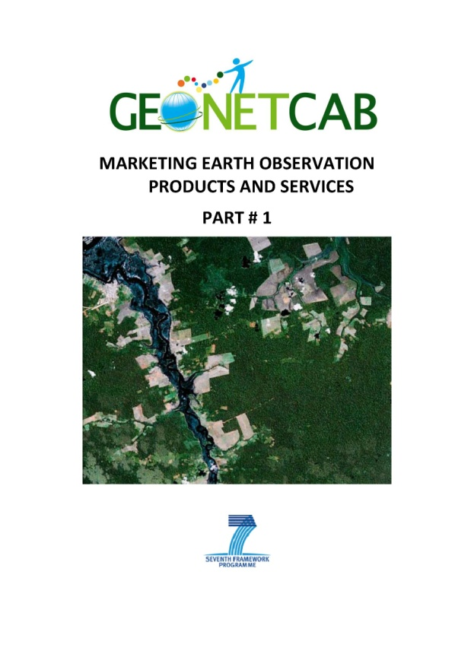
Life cycle of products & services
Initialization
System analysis & design
Rapid prototyping
System development
Implementation
Post-implementation

Slide 5
Assessment of business & funding opportunities
Categories of environmental management products & services
Life cycle phase of product or service
Regional context, level of technological & economic development
Optimum marketing mix

Slide 6
1. International trends & developments in environmental management

Slide 7
Payment for Ecosystem Services (PES)
The Economics of Ecosystems and Biodiversity (TEEB)
Studies on how to estimate economic benefits of management of the environment for:
  Business
  Policy makers
  Local and regional authorities

Slide 8
Potential losses

Slide 9
6 major challenges
Freshwater scarcity
Climate change
Habitat change
Invasive species
Overexploitation of oceans
Nutrient overloading
Examples of standards, frameworks & methodologies
International certification, such as FSC
Individual standards, such as Starbucks’ C.A.F.E.

Slide 10
Major drivers (Europe)

Slide 11
Cost-benefit analysis

Slide 12
DPSIR framework

Slide 13
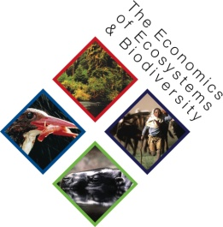
What can be done? What message? (next page)
Environmentally oriented policies and public investment as life insurance (rather than luxury)
Certification & labeling
Payments for ecosystem services - market profiles:
Carbon: compliant & voluntary carbon forestry
Water: compliant water quality trading, voluntary watershed management payments, government-mediated watershed PES
Biodiversity: compliant & voluntary biodiversity offsets, government-mediated biodiversity PES, individual fisheries quotas
Bundled: certified agricultural products

Slide 15
Key principles of valuation practices
The focus of valuation should be on marginal changes rather than the “total” value of an ecosystem.
Valuation of ecosystem services must be context specific, ecosystem-specific, and relevant to the initial state of the ecosystem.
Good practices in “benefits transfer” need to be adapted to biodiversity valuation, while more work is needed on how to aggregate the values of marginal changes.
Values should be guided by the perception of the beneficiaries.
Participatory approaches and ways of embedding the preferences of local communities may be used to help make valuation more accepted.
Issues of irreversibility and resilience must be kept in mind.
Substantiating bio-physical linkages helps the valuation exercise and contributes to its credibility.
There are inevitable uncertainties in the valuation of ecosystem services, so a sensitivity analysis should be provided for decision makers.
Valuation has the potential to shed light on conflicting goals and trade-offs but it should be presented in combination with other qualitative and quantitative information, and it might not be the last word.

Slide 16

Future policy priorities (EEA)
Better implementation and further strengthening of current environmental priorities
Dedicated management of natural capital and ecosystem services
Coherent integration of environmental considerations across the many sectoral policy domains
Transformation to a green economy

Slide 17
Considerations
– example of regional strategy (EEA)
Eco-innovation in products and services
Europe has first-mover advantage in air pollution reduction, water and waste management, eco-efficient technologies, resource-efficient architecture, eco-tourism, green infrastructure and green financial instruments.
Combining climate change mitigation and air pollution abatement legislation could deliver benefits in the order of EUR 10 billion per year through reductions in damage to public health and ecosystems.
Key elements: European research programmes, European space and EO policy (including GMES and Galileo), INSPIRE and SEIS
Implement information systems in support to EU 2020 strategy: cloud computing, smart grids and mobile GIS.

Slide 18
2. Steps to promote earth observation for environmental management

Slide 19
State-of-the-art
Earth observation is new technology.
Learn technical skills, but when back in professional practice, it has to be put to good use.
That involves ‘selling’ it.
How to do that?
To whom? Could be your own boss, local authorities, communities, etc.

Slide 20
Categories of products and services
marine and coastal ecosystems (global/regional)
terrestrial and freshwater ecosystems (global/regional)
biogeophysical variables (vegetation, soil, radiation, water cycle
local applications, such as protected areas
biodiversity modelling & monitoring
invasive species monitoring
ecological forecasting

Slide 21

Spatial aspects of ecosystems and biodiversity management
Presence and abundance of organisms, their interactions with the environment, and the other ecological processes form spatial patterns over time.
Patterns of disturbance are heterogeneous and spatially structured.
Ecological models that account for spatial processes are more realistic and powerful than those that do not.
Prepare, monitor and achieve assessments and goals, quality data and information must be registered and accurately to both place and time.
From: Geospatial tools address emerging issues in spatial ecology (Skidmore et al.)

Slide 22
Where has Earth observation added value?
  Population ecology
GPS, satellite-telemetry
Landscape categories may become barriers or corridors to in connection between population clusters.
Models of landscape dynamics, using geospatial data, generate maps of suitable habitat over time for input to metapopulation models.

Slide 23
Where has Earth observation added value?
  Landscape ecology
Interactions between species occur at spatial scales determined in part by the mobility of the organisms.
Basic element of land inventory for resource management.
Multi-temporal and hyper-temporal remote sensing and image analysis allow annual cycles, interannual variability, and state-changing anomalies caused by disturbance and succession in ecological communities to be tracked through biophysical measures of productivity, photosynthetic activity, foliar chlorophyll concentration, standing biomass, leaf area index, vegetation species type, and so on.
Change detection to map changes in land cover that result from natural or anthropogenic disturbances.

Slide 24
Where has Earth observation added value?
  Ecosystem ecology
Interactions between organisms and the environment with an emphasis on the exchange and flow of matter and energy between biota, water, soil and atmosphere.
Evaluating ecosystem services in support of sustainable ecosystem management requires the use of (spatial) models.
Inclusion of individual species or functional types in ecosystem modeling and models linked to carbon.

Slide 25
Where has Earth observation added value?
  Ecosystem goods and services
Assessing the status of ecosystem goods and services, provided by the regulation, habitat, production, and information functions of ecosystems.
Predicting the impact of habitat loss and fragmentation on biodiversity elements and ecosystems processes.

Slide 26
Example: Digital Observatory for Protected Areas (Africa)

Slide 27
Example: Shared Environmental Information System (Europe)

Slide 28
More references:
GEO Task US-09-01a: Critical Earth Observations Priorities
- Ecosystems Societal Benefit Area
GEO Task US-09-01a: Critical Earth Observations Priorities
- Biodiversity Societal Benefit Area
Overview of observations needs in terms of coverage / extent, spatial resolution, temporal resolution and other aspects + indication of priorities
Environmental performance index (Yale, CIESIN, WEF, JRC)
Assessing and comparing environmental performance by country
Mapping wetlands using earth observation techniques
Technical background + overview of applications

Slide 29
More references (2):
Sensor web technology for sharing environmental data across Europe Facilitate exchange of near real-time data exchange between EEA and EU member states, based on open standard web-based approach
Impact of oil palm plantations on peatland conversion in Sarawak 2005 – 2010 (SARVision)
Study using remote sensing showing developments
Monitoring of mangrove degradation East Kalimantan
Practical example
Remote sensing of forest transition and its ecosystem impacts in mountain environments Practical example
A new map of standardized terrestrial ecosystems of the conterminous United States (USGS)
Overview of integrated and comprehensive ecosystem mapping exercise

Slide 30
More references (3):
Adequacy of Biodiversity Observation Systems to support the CBD 2020 Targets Comprehensive overview of needed and existing observation systems for the Convention on Biological Diversity by the GEO Biodiversity Observation Network GEOBON)
Sourcebook on Remote Sensing and Biodiversity Indicators (CBD) Potential and examples on forests, dry and sub-humid lands, inland waters, marine and coastal waters, trends in species populations, coverage of protected areas, habitat fragmentation and connectivity, trends in invasive alien species
Biodiversity and Climate Change (Convention on Biological Diversity) Overview of impact of climate change and adaptation options for polar ecosystems, agricultural ecosystems, dry and sub-humid lands ecosystems, forest ecosystems, inland waters ecosystems, island ecosystems, marine and coastal ecosystems and mountain ecosystems
Design of a plan for an integrated biodiversity observing system in space and time (European Biodiversity Observation Network – EBONE) Plan for identification of biodiversity indicators, their observation and predictive capabilities

Slide 31
Marketing of earth observation
Marketing of earth observation is difficult.
New technology, few big companies, lots of small ones.
Lots of reports describing the bottlenecks, like reliability,
data access, data continuity, etc.
Means that relatively a lot of effort is needed to promote
EO.

Slide 32
Points to keep in mind:
Look for opportunities, where can you have most success in a short time: quick-wins.
Target the right audience to start with: who would be interested and listen to you?
Identify the problem that they are trying to solve: is it the same as yours?
Learn to speak the same language. Example ‘biota’: this is a term most managers do not understand and do not care about. Use terms related to ecosystem management and biodiversity conservation.
Look for examples from elsewhere (success stories): solutions that work and are affordable.

Slide 33
Be patient: introduction of new technology and / or applications takes time

Slide 34
3. How to get funding for your activities

Slide 35
Approach
Share information on your subject (a thing you are doing) and think that is interesting for your contact, then look for the link. Could this solve a problem for your partner? Are adjustments necessary? Need other parties be involved? Take it from there.
LEADS, LEADS, LEADS

Slide 36
How?
Establish your network.
Look for opportunities.
Write a good proposal.
Promise much, but not too much.

Slide 37
Proposal outline
(more detailed version in separate document, see also www.geonetcab.eu )
1. Introduction / relevance
2. Objective(s)
3. Activities
4. Output
5. Management & evaluation
6. Risk assessment
7. Time schedule
8. Budget
Annexes

Slide 38


Other references
Civicus: writing a funding proposal
Michigan State University: guide for writing a funding proposal
ESRI: writing a competitive GRANT application
REC: project proposal writing

Slide 39
Again:
SHARED PROBLEM
SHARED LANGUAGE
SHARED SOLUTION
If all else fails, try to link with a more popular (and easy to
understand) topic.

Slide 40
4. Capacity Building

Slide 41
General
Marketing is promotion + capacity building.
Especially for the introduction of new technologies capacity
building is important at all levels.
Capacity building is the instrument to increase
self-sufficiency and make solutions work.

Slide 42
Think of:
Different instruments for different levels: workshops for decision makers and awareness raising, detailed technical training for professionals.
Provide follow-up. Getting funding for good capacity building is difficult: everybody agrees that it is important, but nobody has time.
Training is usually part of funding of big projects that are managed by big companies or ministries, as a consequence capacity building is forgotten (in the end).
Aim at small budgets that are available without having to tender.

Slide 43

Examples & references
The GBIF data portal: a practical “hands-on” tutorial – user guide to Global Biodiversity Information Facility
Guidelines for Biodiversity Monitoring and for Protected Areas (UNEP) – practical guide on how to go about it: definitions, scope, approach, sampling, monitoring
GEONetCab capacity building web www.geonetcab.eu
compilation of tutorials, references, open-source software, etc.
GEO Portal: www.earthobservations.org
Focal points: general appraisal of water resources, specialist information (such as improving on curve number method), historical analysis (making use of free and open data): integration with other services

Slide 44

More references
A Rough Google Earth Guide
MEASURE Evaluation Global Positioning System Toolkit (USAID)
Handbook of Research on Developments and Trends in Wireless Sensor Networks: From Principle to Practice

Slide 45
Further details:
Contact: Mark Noort
m.noort@hcpinternational.com
www.geonetcab.eu

