Slide 1



Earth Observation for
Disaster Management
International trends & developments
How to promote earth observation applications?
How to get funding?
Capacity building

Slide 2

0. Introduction
Mark Noort, consultant, project manager
HCP international:
consulting, marketing of earth observation
Coordinator GEONetCab:
project for promotion & capacity building of
earth observation applications

Slide 3
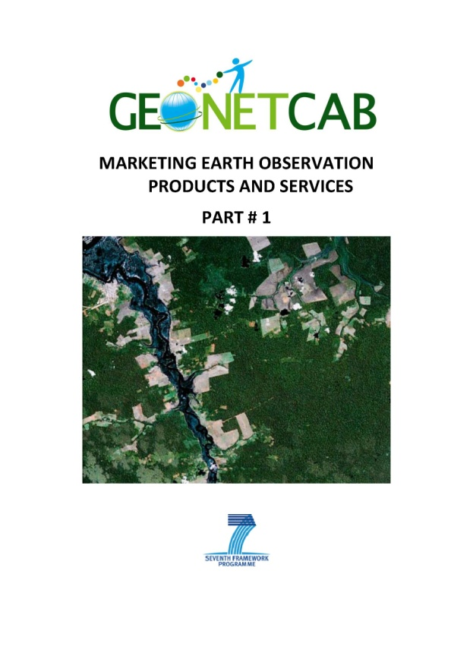
Disaster management - categories
Risk assessment / simulation models
Forecasting / early warning
Monitoring
Damage assessment
Prevention / planning
General

Slide 4
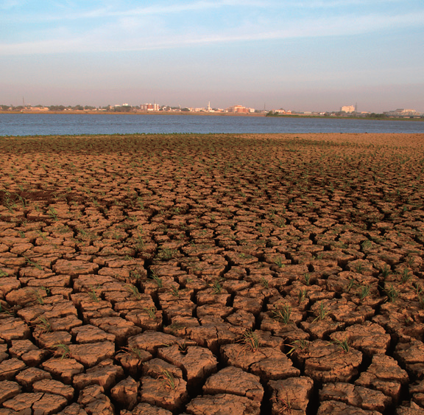
(Natural) disaster types
Volcanic eruptions
Earthquakes
Landslides
Floods
Tsunamis
Droughts
Fires, etc.

Slide 5
Earth observation applications
On the verge of reaching new user communities
These new user communities need to be involved
Weakest link / last mile aspects are important
Marketing needed: promotion & capacity building

Slide 6
Life cycle of products & services
Initialization
System analysis & design
Rapid prototyping
System development
Implementation
Post-implementation

Slide 7
Assessment of business & funding opportunities
Categories of environmental management products & services
Life cycle phase of product or service
Regional context, level of technological & economic development
Optimum marketing mix

Slide 8
1. International trends & developments in disaster management

Slide 9
Climate change
Climate change becomes more and more important,
local adaptation focuses on disaster management and food security
References:

Slide 10

The World Bank
Mainstreaming Adaptation to Climate Change in Agriculture and Natural Resources Management Projects (increased risk)
Climate Change Adaptation and Natural Disasters Preparedness in the Coastal Cities of North Africa
Phase 1 : Risk Assessment for the Present Situation and Horizon 2030 – Alexandria Area
Phase 2 : Adaptation and Resilience Action Plan – Alexandria Area
(practical example, cost – benefit analysis)

Slide 11

Other references:
http://reliefweb.int/briefingkit search or make your own portfolio / case study
global disaster alert and coordination system www.gdacs.org information network for alert & response
Provention consortium of important international organizations.
Example of information material:
Tools for Mainstreaming Disaster Risk Reduction:
Guidance Notes for Development Organisations
outline of integrated strategic approach to disaster management

Slide 12


Increased use of open-source software
Open-source software is not necessarily free
Look for: GEO, GEOSS, OGC, Terralook, Google Earth, etc. at
www.earthobservations.org (GEO website)
geonode.org
or become a member of The Earth Observation Network at LinkedIn

Slide 13
From post-disaster intervention to prevention
Examples:
SERVIR (USAID):
www.servir.net (Central America) www.servirglobal.net (global)
UN-SPIDER: www.un-spider.org earth observation for disaster reduction
CAPRA (World Bank, IDB): probabilistic risk assessment in Central America
Importance of capacity building, example RiskCity

Slide 14
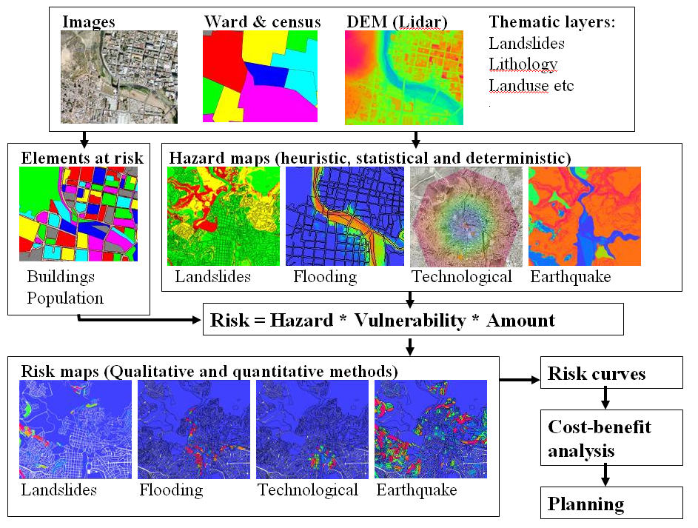
Risk City presentation:
GIS based training package for multi hazard risk assessment for risk reduction & management.
Article RiskCity:
a training package on the use of GIS for urban multi-hazard risk assessment.
www.itc.nl Cees van Westen

Slide 15
Articles
Adapting a quantative risk assessment based method to guide land use planning decisions in India &
Bridging risk management deficits in India using a geo-ICT based tool shows spatial approach towards all kinds of hazards, including industrial: Environmental Risk Reporting and Information System (ERRIS) & Risk Management Information System (RMIS)
ICT for disaster management Asia-Pacific Development Information Programme UNDP / ESCAP overview of options of ICT use

Slide 16
Empowerment of local communities
Community mapping initiatives: Google (H2O) and World Bank
Mapping & visualization in general:
importance of knowing what is where
Example: World Bank ‘mapping for results’ @ maps.worldbank.org & aiddata.org (tracking development finance)
Growing WB Global Facility for Disaster Risk Reduction lab www.gfdrr.org/gfdrr/labs
References:

Slide 17
New technologies & communities
Importance of improved early warning & communication
Last mile: reaching communities with sensor webs, web mapping, mobile phones, satellite communication (GEONETCast)
References:

Slide 18
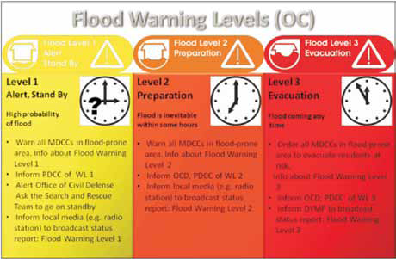
Participatory Approach for Integrated Basin Planning with Focus on Disaster Risk Reduction: The Case of the Limpopo River article on living with floods in Africa, shows community approach, includes a to-do list for participatory GIS (PGIS)
Coping strategies and risk manageability: using participatory geographical information systems to represent local knowledge article on coping with floods in the Philippines
Local Flood Early Warning Based on Low-Tech Geoinformatics Approaches and Community Involvement A Solution For Rural Areas in The Philippines idem

Slide 19
Sensor Web Infrastructures 52°North
Applying OGC Sensor Web Enablement to Risk Monitoring and
Disaster Management

Slide 20
Toolbox & manual - mapping the vulnerability of communities, example from Buzi, Mozambique
involvement of insurance company, example of capacity building

Slide 21
2. Steps to promote earth observation for disaster management

Slide 22
State-of-the-art
Earth observation is new technology.
Learn technical skills, but when back in professional practice, it has to be put to good use.
That involves ‘selling’ it.
How to do that?
To whom? Could be your own boss, local authorities, communities, etc.

Slide 23
References
Atlas de las dinamicas del territorio Andino: poblacion y buenes expuestos a amenazas naturales (Bolivia, Colombia, Ecuador, Peru) www.youtube.com/watch?v=HCSAIZPM4NE
EUGENE disasters status quo report analysis of state of the art of earth observation for disasters in Europe
Natural catastrophes and reinsurance (Swiss Re) shows interest and point of view of insurance companies

Slide 24
References (continued)
Promoting risk-wise behavior: an integrated strategy for reducing vulnerability and improving resilience (United States) inspiration for showing importance of disaster management
GEO capacity building showcase: www.youtube.com/watch?v=bhjfSeiKiGk
join www.understandrisk.org to stay informed about developments

Slide 25
Marketing of earth observation
Marketing of earth observation is difficult.
New technology, few big companies, lots of small ones.
Lots of reports describing the bottlenecks, like reliability,
data access, data continuity, etc.
Means that relatively a lot of effort is needed to promote
EO.

Slide 26
Points to keep in mind:
Look for opportunities, where can you have most success in a short time: quick-wins.
Target the right audience to start with: who would be interested and listen to you? For disaster management: paradigm shift from civil protection to NGO’s, local structures.
Identify the problem that they are trying to solve: is it the same as yours?
Learn to speak the same language. Example ‘food security’. Translate to something the client (or your partner) understands.
Look for examples from elsewhere (success stories): solutions that work and are affordable.

Slide 27
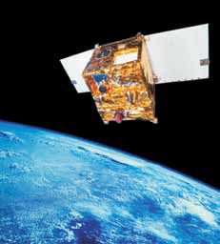
Examples & references
GEO Task US-09-01a: Critical Earth Observations Priorities Disasters Societal Benefit Area (part 1 & 2) global overview of available observations and what is needed
Geoinformation for Disaster and Risk Management
Examples and Best Practices (United Nations Office for Outer Space Affairs) different articles on what works in practice and promising developments
GEONetCab success stories on disasters: www.geonetcab.eu
floods (Poland, Czech Republic), wild fires (South Africa)

Slide 28

GEONETCast:
Worldwide information dissemination system by which satellite and in situ data, products and services are transmitted to users through communications satellites.
Receiving stations use low-cost, off the shelf technology.
Information includes climate, weather, agriculture, air quality, disasters, and more.
No internet connection required.
DevCoCast:
Share products & data freely via GEONetCast with communities in developing countries.
Promote use of earth observation products through training & networking.
Agricultural & environmental monitoring: biomass, land degradation, water cycle (floods), pest control, etc.

Slide 29
www.devcocast.eu

Slide 30
Be patient: introduction of new technology and / or applications takes time

Slide 31
3. How to get funding for your activities

Slide 32
Approach
Share information on your subject (a thing you are doing) and think that is interesting for your contact, then look for the link. Could this solve a problem for your partner? Are adjustments necessary? Need other parties be involved? Take it from there.
LEADS, LEADS, LEADS

Slide 33
How?
Establish your network.
Look for opportunities.
Write a good proposal.
Promise much, but not too much.

Slide 34
Proposal outline
(more detailed version in separate document, see also www.geonetcab.eu )
1. Introduction / relevance
2. Objective(s)
3. Activities
4. Output
5. Management & evaluation
6. Risk assessment
7. Time schedule
8. Budget
Annexes

Slide 35


Other references
Civicus: writing a funding proposal
Michigan State University: guide for writing a funding proposal
ESRI: writing a competitive GRANT application
REC: project proposal writing

Slide 36
Again:
SHARED PROBLEM
SHARED LANGUAGE
SHARED SOLUTION
If all else fails, try to link with a more popular (and easy to
understand) topic.

Slide 37
4. Capacity Building

Slide 38
General
Marketing is promotion + capacity building.
Especially for the introduction of new technologies capacity
building is important at all levels.
Capacity building is the instrument to increase
self-sufficiency and make solutions work.

Slide 39
Think of:
Different instruments for different levels: workshops for decision makers and awareness raising, detailed technical training for professionals.
Provide follow-up. Getting funding for good capacity building is difficult: everybody agrees that it is important, but nobody has time.
Training is usually part of funding of big projects that are managed by big companies or ministries, as a consequence capacity building is forgotten (in the end).
Aim at small budgets that are available without having to tender.

Slide 40

Examples & references
CAPRA Training Needs and Recommendation Report (Central America) example of approach to assessing training needs for disaster management
GEONetCab capacity building web www.geonetcab.eu
compilation of tutorials, references, open-source software, etc.
GEO Portal: www.earthobservations.org
Handbook of Research on Developments and Trends in Wireless Sensor Networks: From Principle to Practice

Slide 41


More references
A Rough Google Earth Guide
MEASURE Evaluation Global Positioning System Toolkit (USAID)
Field Guide to Humanitarian Mapping (MapAction)

Slide 42
Further details:
Contact: Mark Noort
m.noort@hcpinternational.com
www.geonetcab.eu

