Slide 1



Earth Observation for
Crop Modelling
International trends & developments
How to promote earth observation applications?
How to get funding?
Capacity building

Slide 2

0. Introduction
Mark Noort, consultant, project manager
HCP international:
consulting, marketing of earth observation
Coordinator GEONetCab:
project for promotion & capacity building of
earth observation applications

Slide 3
Earth observation applications
On the verge of reaching new user communities
These new user communities need to be involved
Weakest link / last mile aspects are important
Marketing needed: promotion & capacity building

Slide 4
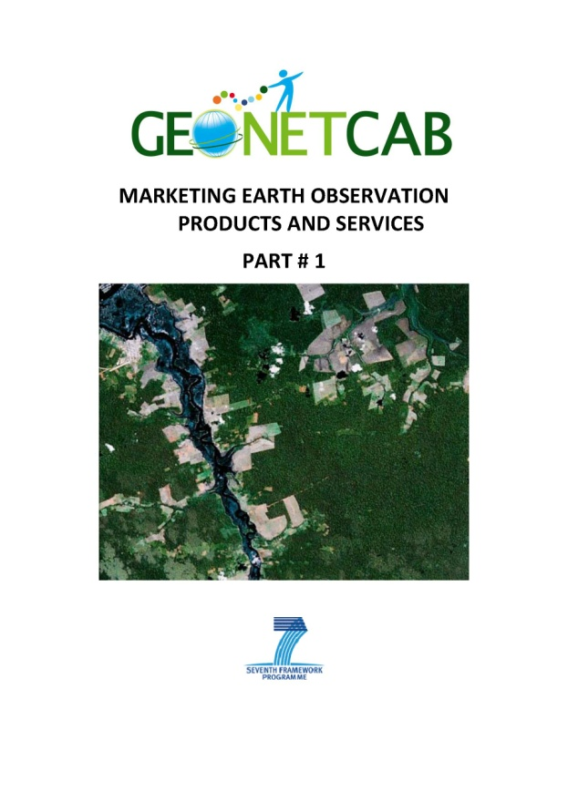
Life cycle of products & services
Initialization
System analysis & design
Rapid prototyping
System development
Implementation
Post-implementation

Slide 5
Assessment of business & funding opportunities
Categories of environmental management products & services
Life cycle phase of product or service
Regional context, level of technological & economic development
Optimum marketing mix

Slide 6
1. International trends & developments in crop modelling

Slide 7
Climate change
Climate change becomes more and more important,
local adaptation focuses on disaster management and food security
References:

Slide 8
Western Australia:
WA Agriculture Climate Science
Example of ‘how to be prepared’:
Aims at better prediction of: yields (yield prophet), changing land use on unproductive soils, preparedness for drought (off-farm employment & new farming systems).
This is done by: soil characterization, biomass estimation & crop yield from space, cropping decisions based on Yield Prophet, economic resilience index, carbon sequestration on native vegetation (poor soils).
Real-time & local weather information + seasonal forecasting + historical analysis: farmers like the short-term forecasts (also of extreme events), but critical of seasonal forecasts. Early part of season is critical for decision on sowing, fertilizer rate, weed & pest control.
Climate change perception: what is influencing attitudes (credibility of science versus local knowledge, how does information translate into action)?

Slide 9

Climate Change and Food Security:
A framework document
Description of processes and possible adaptive measures

Slide 10
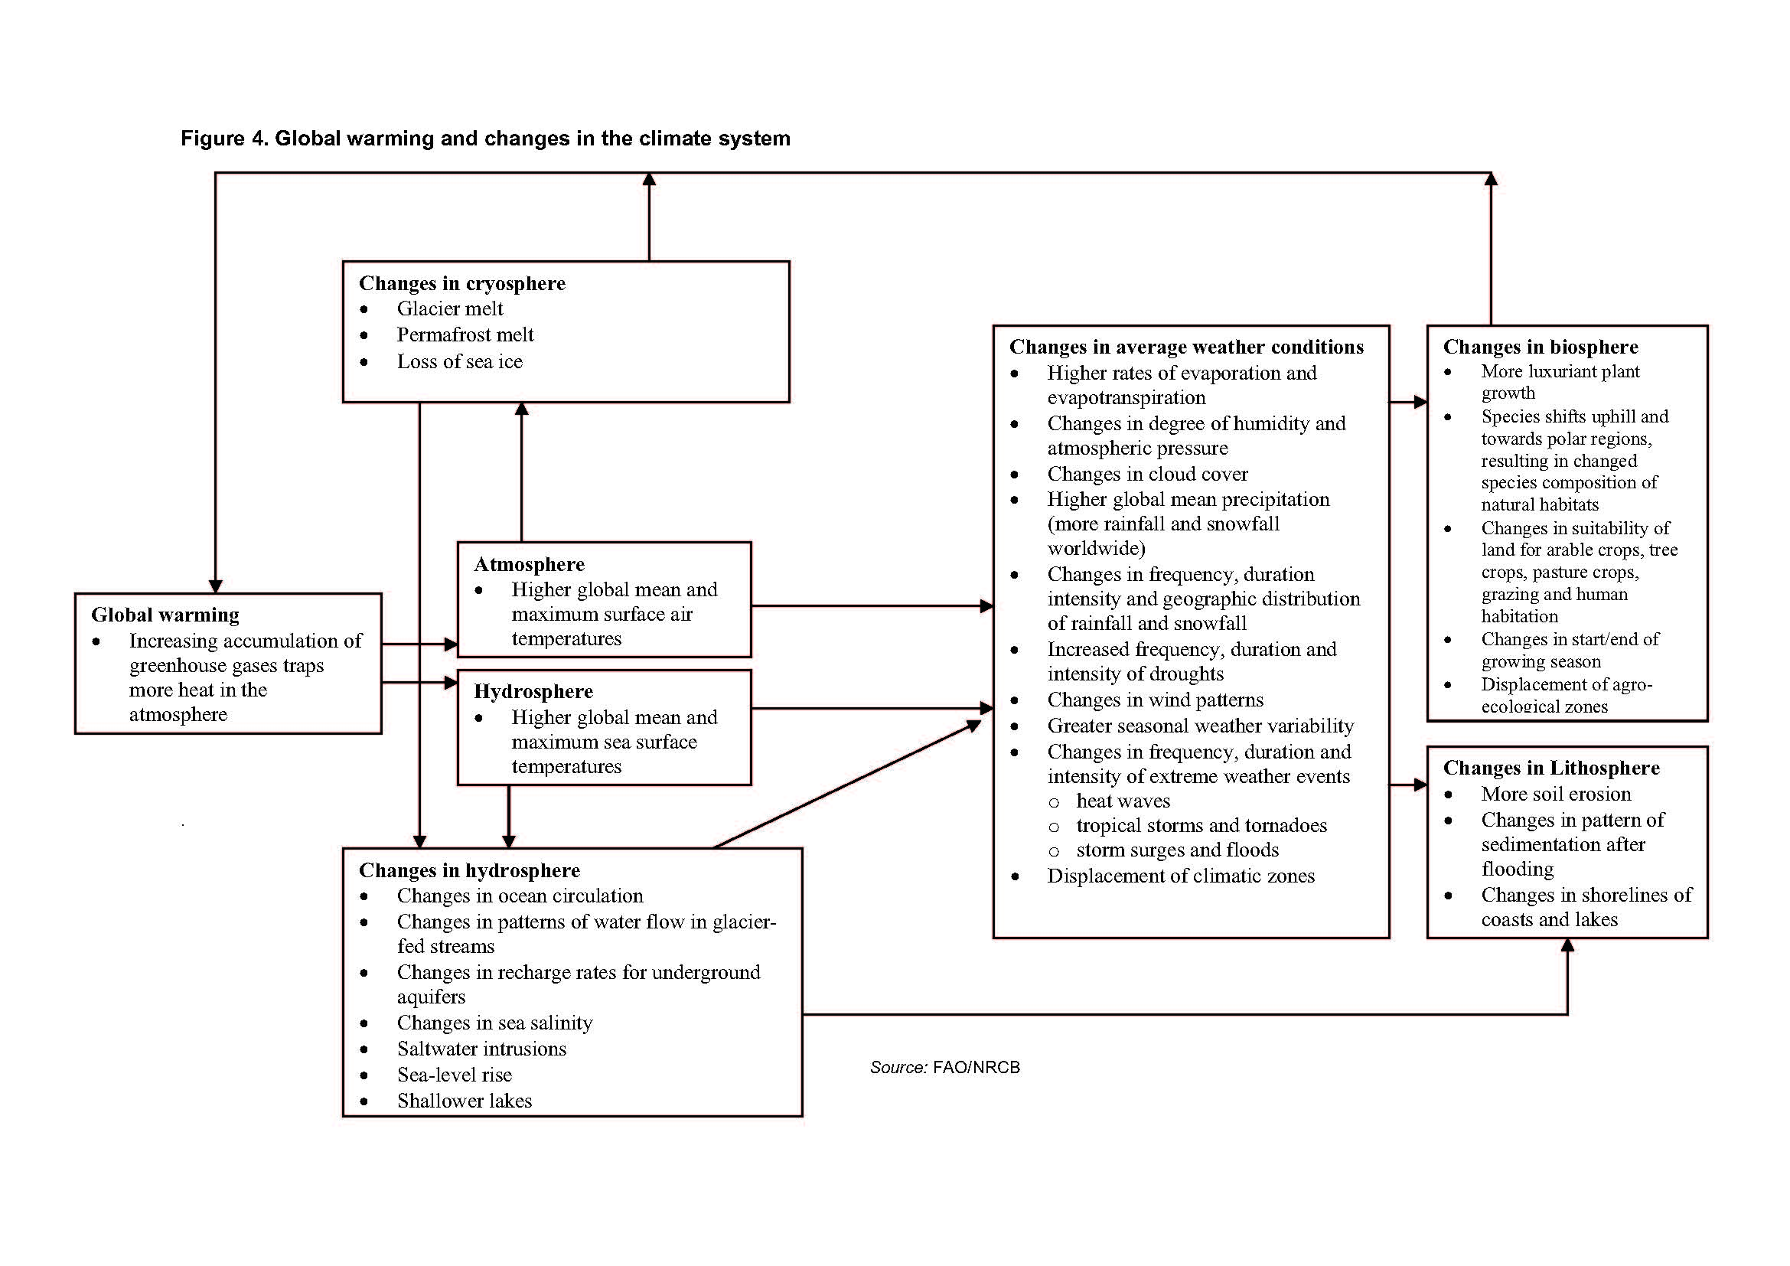

Slide 11
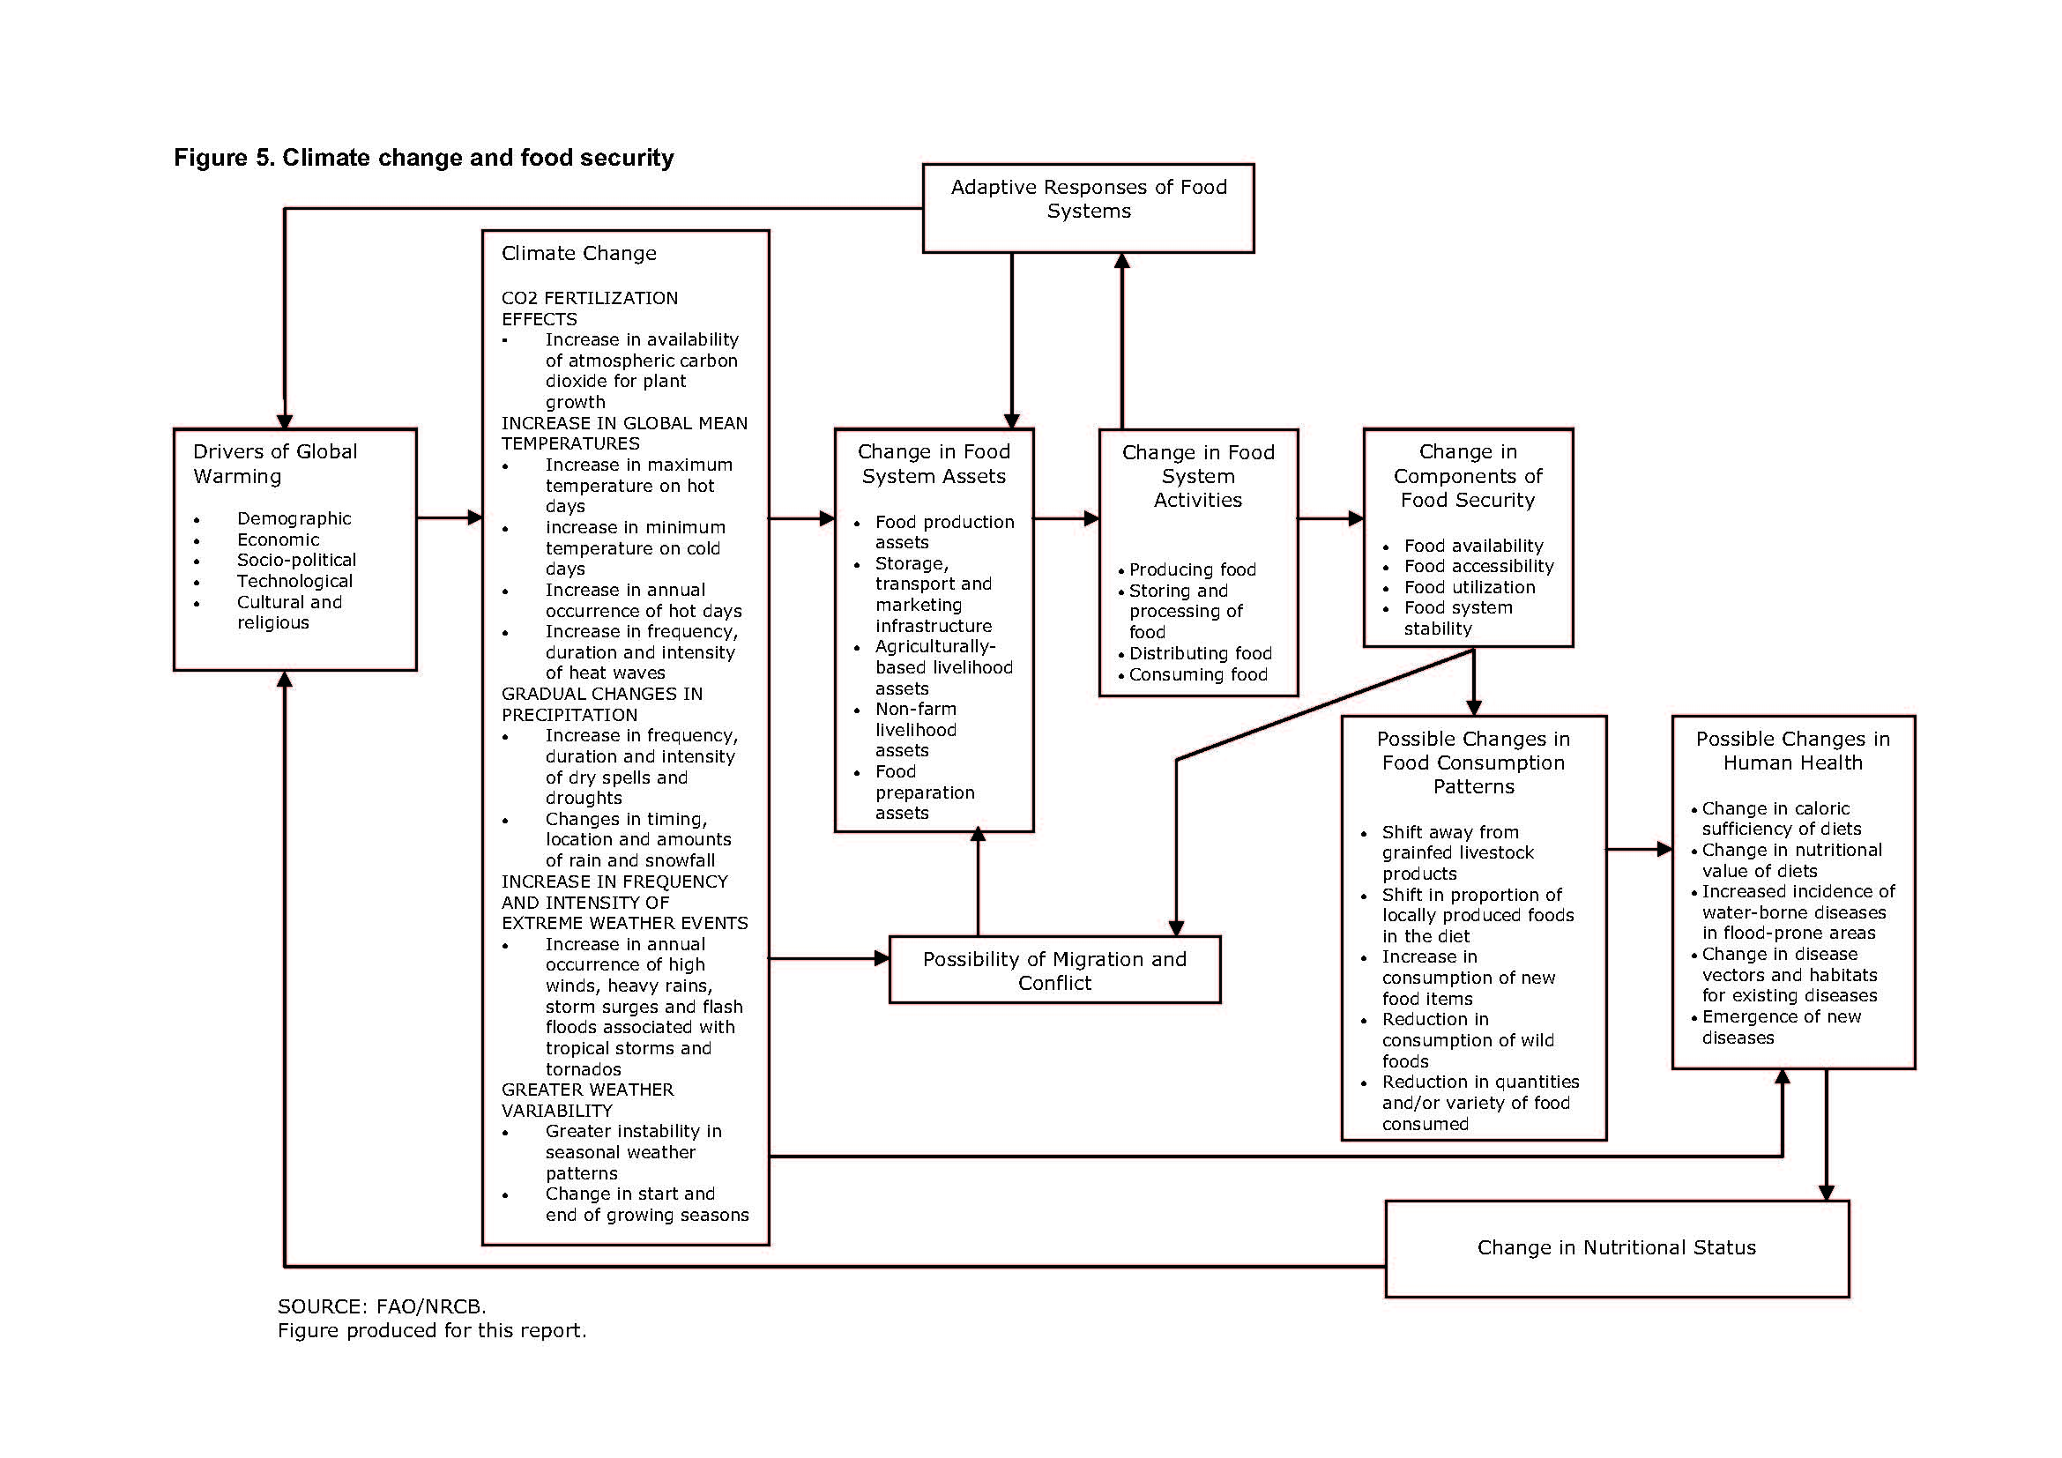

Slide 12
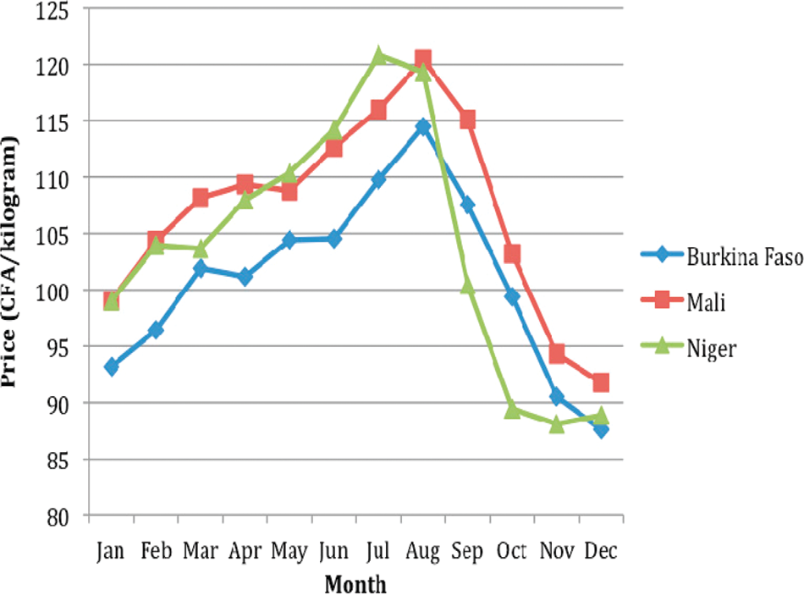
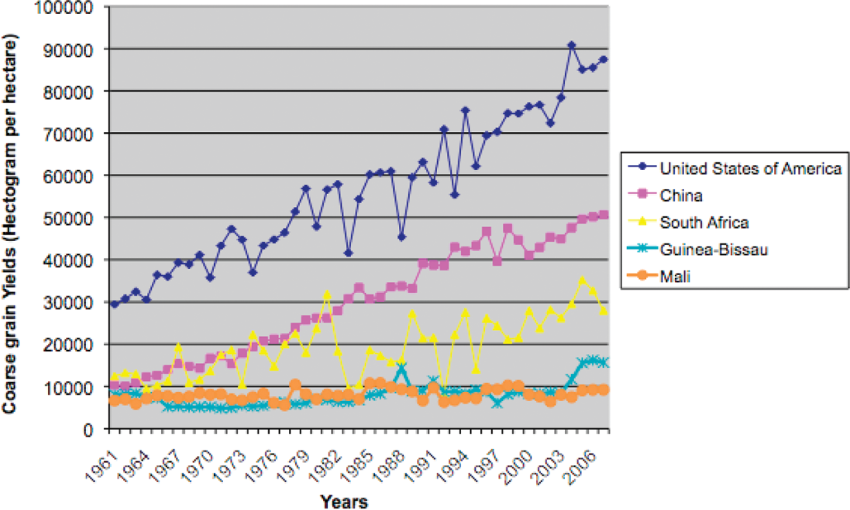
Markets, Climate Change, and Food Security
in West Africa (Brown, Hintermann, Higgins)
Effects of climate change difficult to predict, but possible reduction of agricultural production up to 50% by 2020: increase resilience!
Increase agricultural production: affordable technology, financial assistance, high-yielding agricultural seeds and fertilizer, small-scale storage facilities, mobile phone fund transfers, microloans + crop insurance, community-based natural resource programs.

Slide 13
Empowerment of local communities
Community mapping initiatives: Google (H2O) and World Bank
Mapping & visualization in general:
importance of knowing what is where
Example: World Bank ‘mapping for results’ @ maps.worldbank.org & aiddata.org (tracking development finance)
Crop modelling: better information provision to improve quantity and quality of production.
References:

Slide 14

Bridging the rural digital divide
“e-Agriculture” A Definition and Profile of its Application (FAO, 2005) description of global trends and FAO policy
GIEWS workstation (Global Information and Early Warning System) – FAO description of services offered to 20 countries in Africa, CIS, SE Asia and Central America
Space Technology Enabled Village Resource Centre (VRC)
description of societal benefit support to villages:
tele-education, tele-healthcare, land and water resources management,
tele-fishery, e-governance services and weather services by the Indian Space Research Organization (ISRO)

Slide 15



Food Prices and Markets
FAO: handle protracted crises – long-term assistance, social protection mechanisms (school meals, vouchers), stimulating markets (food-aid through local markets, cash-based schemes)
The State of Food Security in the World (2010)
World Bank / IMF : better manage risks and reduce future vulnerabilities (insurance, the use of weather derivatives, accurate weather forecasting, warehouse receipts and commodity exchanges, and public stock management)
Responding to Global Food Price Volatility and its Impact on Food Security (2011)
IFC: Global Agriculture Price Risk Management Facility
WFP: earth observation as support tool for food-aid logistics
G20: improve weather forecasting and monitoring, Agricultural Market Information System (AMIS), Global Agricultural Monitoring (GLAM), agriculture and food security risk management toolbox
Action Plan on Food Price Volatility and Agriculture, Ministerial Declaration (2011)

Slide 16



Studies on food prices and markets:
NASA / University of Maryland:
The effect of vegetation productivity on millet prices in the informal markets of Mali, Burkina Faso and Niger (Brown, Pinzon, Prince; 2006) describes the relation between NDVI and millet prices in West-Africa
Several Michican State University International Development Working Papers – example:
Spatial Patterns of Food Staple Production and Marketing in South East Africa: Implications for Trade Policy and Emergency Response (Haggblade, Longabaugh, Tschirley; 2009)
analyzes total market and production system,
not only crop modeling

Slide 17


Historical Analysis
Time dimension very important as input for decision-making:
Crop Modelling
Climate change monitoring and adaptation
Change detection (depletion of natural resources)
Analyzing the effects of different policies, practices, customs, across administrative borders
Example:
SPOT VGT difference products offered by VITO (every 10 days):
Scaled Difference Vegetation Index, Vegetation Condition Index, absolute difference, etc.

Slide 18



Improved Prediction
Examples of global systems for prediction of food shortages and timely planning of aid operations:
FEWSNET
GIEWS (FAO)
GMFS
FOOD-SEC (MARS)

Slide 19

Improved Prediction
Other examples:
GLAM (global agricultural monitoring project) timely data delivery, continuity of EO missions, enhanced value added products, yield models, crop area estimates and seasonal weather forecasts, interoperability and better integration of datasets
Harvest Choice data harmonization (assembling heterogeneous datasets) + data distribution (new ways of collecting and distributing spatial data)
CanaSat project sugarcane area mapping and harvest monitoring (environmental protection) in Brazil

Slide 20

Insurance
Very much in focus as part of agricultural risk management strategy (World Bank reports: Managing Agricultural Production Risk & Agricultural Insurance)
Example of use of earth observation: ADASCIS, Belgium
The use of remote sensing and agrometeorological modelling for crop damage & risk assessment in support of the Belgian Calamity Fund
Business model developed countries: more about income transfers then about risk management – indemnities paid about equal to total premiums collected, but administrative and operation costs not taken into account.

Slide 21
Insurance
Index-based, weather-related agricultural insurance
Based on: rainfall or NDVI – Spain, Canada, Mongolia, Kenya, Mexico (all pasture / rangeland -> for crops apparent low correlation NDVI and yields) or evapotranspiration – Food Early Solutions for Africa (FESA) in experimental stage
Should be:
observable and easily measured, objective, transparent, independently verifyable, reportable in a timely manner & stable and sustainable over time
Products best suited for:
homogeneous areas, systemic risk at the aggregated level (reinsurance)
Historical analysis (weather, crops) is important

Slide 22


Insurance
References and case studies:
The Potential for Scale and Sustainability in Weather Index Insurance for Agriculture and Rural Livelihoods (IFAD, WFP)
Insurance as an Adaptation Measure to Climate Variability in Agriculture (CEIGRAM, Spain)
Comprehensive Risk Cover through Remote Sensing Techniques in Agriculture Insurance for Developing Countries: a pilot project (India)
Providing index-based agricultural insurance to smallholders: recent progress and future promise (Univ. of California, Berkeley)
Agricultural Insurance Schemes (JRC, European Union)

Slide 23

Insurance
References and case studies (continued):
Index Based Livestock Insurance for Northern Kenya’s Arid and Semi-Arid Lands: the Marsabit Pilot (ILRI & partners) +
Designing Index Based Livestock Insurance for Managing Asset Risk in Northern Kenya
Index Based Agricultural Insurance in Developing Countries: Feasibility, Scalability and Sustainability (Montana State University)
Science-based insurance (Brown, Osgood, Carriquiry)
Contributions of Agricultural Systems Modeling to Weather Index Insurance (Baethgen et al)
State of Knowledge Report – Data Requirements for the Design of Weather Index Insurance: Innovation in Catastrophic Weather Insurance to Improve the Livelyhood of Rural Households (GlobalAgRisk)

Slide 24
Insurance
Farmers perception:
Difficulty in understanding index-based concepts, what satellite images can do and concerns about visualizing satellite-based indices + calculating mean vegetation when sowing dates are different
Local companies experience:
Calculating NDVI is expensive (one-off for GIS company)

Slide 25
Other Risk Management
Comprehensive Food Security and Vulnerability Analysis (CFSVA)
Baseline mapping
Agricultural monitoring: background information, estimation of area cultivated, yield estimation (all include historical analysis)
Disaster assessment
Operational planning
Other example:
Locust Habitat Monitoring for GIEWS (see also disaster management toolkit)

Slide 26
2. Steps to promote earth observation for crop modelling

Slide 27
State-of-the-art
Earth observation is new technology.
Learn technical skills, but when back in professional practice, it has to be put to good use.
That involves ‘selling’ it.
How to do that?
To whom? Could be your own boss, local authorities, communities, etc.

Slide 28
References
Western Australia: WA Agriculture Climate Science
FAO: Climate Change and Food Security: a framework document
Added value earth observation:
Crop modelling is one of the contributors to food security (as part of value chain management),
Facilitates implementation of insurance schemes,
Helps manage water more efficiently,
Supports sustainable land management,
Helps maintaining biodiversity,
Improves livestock management,
Improves fishery management.

Slide 29

References (continued)
CanaSat (Brazil) see above
e-Leaf (eleaf.com) offers integrated agricultural services to farmers in the Netherlands and Europe – pilot phase
GEO Task US-09-01a: Critical Earth Observations Priorities Agriculture Societal Benefit Area global overview of available observations and what is needed
for more examples: have a look at www.geonetcab.eu

Slide 30
GLobal Agricultural Monitoring community – GLAM: what is needed?

Slide 31
Marketing of earth observation
Marketing of earth observation is difficult.
New technology, few big companies, lots of small ones.
Lots of reports describing the bottlenecks, like reliability,
data access, data continuity, etc.
Means that relatively a lot of effort is needed to promote
EO.

Slide 32
Points to keep in mind:
Look for opportunities, where can you have most success in a short time: quick-wins.
Target the right audience to start with: who would be interested and listen to you? For crop modelling: see next slides.
Identify the problem that they are trying to solve: is it the same as yours?
Learn to speak the same language. Example: when EO specialists talk about ‘food security’, experts in other fields consider EO activities as crop modelling. Translate to something the client (or your partner) understands.
Look for examples from elsewhere (success stories): solutions that work and are affordable.

Slide 33
What users need to serve clients:
Accurate and reliable crop production information on specific reporting levels (national, district)
Spatial distribution of cultivated area
Crop growth models
Timely and unbiased production information on main crops
(Timely) availability of satellite data
Good quality meteorological data
Capacity building to enable correct use and integration of products and services

Slide 34
Figure 2: Advanced multi scale crop information services
(GMFS services, CA = Cultivated Area; CEP = Crop Emergence Period; EoC = Extent of Cultivation;
DMP = Dry Matter Productivity; VPI= Vegetation Productivity Indicator).

Slide 35
Maturity of EO Services
Early warning: fully operational
Cultivated area: further development needed (timely delivery of data, technical complexity)
Extent of cultivation: accuracy needs to be improved for good local results (district, farm)
Crop yield forecasting: fully operational
Index-based insurance: better results for rangeland than for crops, especially for smallholders (NDVI-based, cloud cover a problem)
Precision agriculture: still in pilot phase (cloud cover in critical months of the growing season is a problem)

Slide 36
Costs of EO Services for crop modelling / food security support
Service Definition of Unit Service Cost (k€)
Early Warning Annual coverage of Africa with suite 230
Service of early warning indicators, at 10-day
update frequency
Agricultural Validated map of cultivated area 175
Mapping (10 – 20 m resolution) per 100 000 km²
Crop Yield Yield forecast for 2-3 main crops, 85
Assessment for 100 000 km²
Support to Support to one CFSVA mission 35
CFSVA
very global estimate, includes development for specific user needs and training

Slide 37
Be patient: introduction of new technology and / or applications takes time

Slide 38
3. How to get funding for your activities

Slide 39
Approach
Share information on your subject (a thing you are doing) and think that is interesting for your contact, then look for the link. Could this solve a problem for your partner? Are adjustments necessary? Need other parties be involved? Take it from there.
LEADS, LEADS, LEADS

Slide 40
How?
Establish your network.
Look for opportunities.
Write a good proposal.
Promise much, but not too much.

Slide 41
Proposal outline
(more detailed version in separate document, see also www.geonetcab.eu )
1. Introduction / relevance
2. Objective(s)
3. Activities
4. Output
5. Management & evaluation
6. Risk assessment
7. Time schedule
8. Budget
Annexes

Slide 42


Other references
Civicus: writing a funding proposal
Michigan State University: guide for writing a funding proposal
ESRI: writing a competitive GRANT application
REC: project proposal writing

Slide 43
Again:
SHARED PROBLEM
SHARED LANGUAGE
SHARED SOLUTION
If all else fails, try to link with a more popular (and easy to
understand) topic.

Slide 44
4. Capacity Building

Slide 45
General
Marketing is promotion + capacity building.
Especially for the introduction of new technologies capacity
building is important at all levels.
Capacity building is the instrument to increase
self-sufficiency and make solutions work.

Slide 46
Think of:
Different instruments for different levels: workshops for decision makers and awareness raising, detailed technical training for professionals.
Provide follow-up. Getting funding for good capacity building is difficult: everybody agrees that it is important, but nobody has time.
Training is usually part of funding of big projects that are managed by big companies or ministries, as a consequence capacity building is forgotten (in the end).
Aim at small budgets that are available without having to tender.

Slide 47

Examples & references
AGRICAB project (follow-up of DevCoCast and GMFS)
optical remote sensing, radar remote sensing, agro-meteorological modelling, food security information systems, product validation
GEONetCab capacity building web www.geonetcab.eu
compilation of tutorials, references, open-source software, etc.
GEO Portal: www.earthobservations.org
Focal points: cheaper processing of NDVI calculations, ground truthing, historical analysis (making use of free and open data): integration with other services

Slide 48

More references
A Rough Google Earth Guide
MEASURE Evaluation Global Positioning System Toolkit
(USAID)
Handbook of Research on Developments and Trends in
Wireless Sensor Networks: From Principle to Practice

Slide 49
Further details:
Contact: Mark Noort
m.noort@hcpinternational.com
www.geonetcab.eu

