Slide 1



Earth Observation for
Climate Change
International trends & developments
How to promote earth observation applications?
How to get funding?
Capacity building

Slide 2

0. Introduction
Mark Noort, consultant, project manager
HCP international:
consulting, marketing of earth observation
Coordinator GEONetCab:
project for promotion & capacity building of
earth observation applications

Slide 3
Earth observation applications
On the verge of reaching new user communities
These new user communities need to be involved
Weakest link / last mile aspects are important
Marketing needed: promotion & capacity building

Slide 4
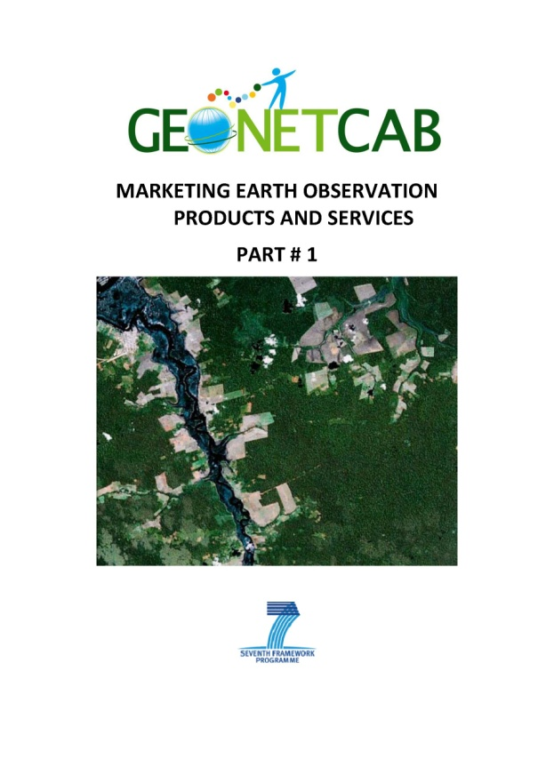
Life cycle of products & services
Initialization
System analysis & design
Rapid prototyping
System development
Implementation
Post-implementation

Slide 5
Assessment of business & funding opportunities
Categories of environmental management products & services
Life cycle phase of product or service
Regional context, level of technological & economic development
Optimum marketing mix

Slide 6
1. International trends & developments in climate change

Slide 7

Goals
Increased resilience of communities with respect to climate variability
Increased adaptive capacity of natural and managed systems under current and predicted climate variability
Mainstreaming adaptation to climate change in agriculture and natural resources projects (World Bank)

Slide 8
Data needed for monitoring (from “Climate knowledge for action”)
Atmospheric (over land, sea and ice) | Surface | Air temperature, Precipitation*, Air pressure, Surface radiation budget, Wind speed and direction*, Water vapour.
 | Upper-air | Earth radiation budget (including solar irradiance)*, Upper-air temperature*, Wind speed and direction*, Water vapour*, Cloud properties*.
 | Composition | Carbon dioxide*, Methane*, Other long-lived greenhouse gases*; Ozone* and Aerosol properties*, supported by their precursors.
Oceanic | Surface | Sea-surface temperature*, Sea-surface salinity*, Sea level*, Sea state*, Sea ice*, Surface current, Ocean colour*, Carbon dioxide partial pressure, Ocean acidity.
 | Sub-surface | Temperature, Salinity, Current, Nutrients, Carbon dioxide partial pressure, Ocean acidity, Oxygen, Tracers, Phytoplankton.
Terrestrial |  | River discharge, Water use, Ground water, Lakes*, Snow cover*, Glaciers and ice caps*, Ice sheets*, Permafrost, Albedo*, Land cover (including vegetation type)*, Fraction of absorbed photosyntheti­cally active radiation*, Leaf area index*, Above-ground Biomass*, Fire disturbance*, Soil moisture*, Soil carbon.
* Those to which satellites make an important monitoring contribution

Slide 9



Data Portals
Climate change knowledge portal
http://sdwebx.worldbank.org/climateportal/index.cfm
Climate change explorer http://weadapt.org/knowledge-base/using-climate-information/the-climate-change-explorer-tool
Climate wizard http://www.climatewizard.org/
UNDP adaptation learning net http://www.adaptationlearning.net/
IPCC data distribution center http://www.ipcc-data.org/
Earth System Grid http://www.earthsystemgrid.org/home.htm;
jsessionid=92341D76DB0CDDB7EE13A2D59C9B80D5

Slide 10
Approach
Choose entry points such as food security or risk management
Identify champions = most appropriate counterpart
Show vulnerability patterns & socio-economic impact
Adaptation: different levels of possible regret (no, low, high) -> aim at no regret, high impact
Mainstreaming adaptation to climate change in agriculture and natural resources projects (World Bank)

Slide 11

The Role of Science
Improved projections, predictions and monitoring of multidecadal global to regional climate changes
Stronger scientific foundation for adaptation and mitigation
Improved predictions of high-impact weather and climate
Science-based support to responses and planning
Developing national and international climate services
Education and capacity building
An Earth-system prediction initiative for the twenty-first century (AMS)

Slide 12

Important aspects related to carbon
accounting programmes, such as REDD
MRV: measurement, reporting, verification
Control of emissions leakage (displaced emissions): reduction
in one place leads to higher emission in another area
Closely related to tenure questions
Payment for ecosystem services (PES)
Communication with and involvement of villagers
Approved methodologies for verified carbon standard (VCS)
Land use / land cover baseline, using GIS and remote sensing
Phases, approaches, tiers and steps for measuring / assessing
REDD
Analysing REDD+, challenges and choices

Slide 13

Response strategies
Reactive adaptation
Anticipatory adaptation
Climate change: impacts, vulnerabilities and adaptation in developing countries (UNFCCC)
Africa: temperature ↑, rainfall ↓, droughts ↑, floods ↑
Asia: temperature ↑, rainfall ↓ (except Central Asia), droughts ↑,
cyclones ↑, heat waves ↑
Latin America: temperature ↑, rainfall ?, glaciers ↓, landslides ↑,
floods ↑, hurricanes (Caribbean) ↑, heat waves ↑
Small island developing states: temperature ↑, rainfall ↑ or ↓ (depending on region), cyclones ↑

Slide 14
Lessons from experience
Climate change needs to be treated as a major social and economic risk to national economies (not just environmental)
Addressing short-term vulnerabilities is the best strategy for preparing for long-term impacts
Important role for communities and private sector in climate risk management (involve in planning and implementation of adaptation
Full buy in from regulatory agencies is needed
No-regrets strategies and “soft” solutions embedded in more sustainable natural resources management should be pursued where they are available
Managing climate risk (World Bank)

Slide 15
Adaptation at the farm level
Crop calender shifts and crop changes
Soil and water management changes
Fertilizer use / land use decisions
Water, labour, capital use (intensive or not, efficiency)
Needed:
Climate information, seasonal climate forecasts, early warning, infrastructure, insurance, technology development (crop varieties, irrigation technology)
Mainstreaming adaptation to climate change in agriculture and natural resources projects (World Bank)

Slide 16
It can be simple
Trees planted in Niger for soil conservation (left 1975, right 2003)

Slide 17

More references on monitoring:
Climate knowledge for action, a global framework for action – empowering the most vulnerable Advocating a Global Framework for Action, consisting of a User Interface Platform, Climate Services Information System and three components: observations and planning, research modelling and prediction, capacity building
Climate and land degradation (WMO) Overview of trends, causes and measures (including remote sensing for agroclimatic mapping)
Guidelines on analysis of extremes in a changing climate in support of informed decisions for adaptation (WMO) Guide on datasets, observations, analysis and toolkit(s)
WCRP (GEWEX, CliC, CLIVAR, SPARC) documents Reports on clouds, implementation plan and achievements, fact sheets on sea level rise and monsoons
State of the climate in 2011 Very detailed overview of the state-of-the-art in climate research, related to the year 2011
River basins and climate change report 2012 Overview of climate change in river basins + case studies

Slide 18


More references on adaptation:
Mainstreaming climate change adaptation into development planning:
a guide for practitioners (UNDP/UNEP)
Guide for policy formulation, including adaptation indicators
Forest service roadmap for responding to climate change (USA) Approach towards adaptation, mitigation and sustainable consumption)
Planning for climate change: leading practice principles and models for sea change communities in coastal Australia Study on possible adaptation measures for coastal climate change
Integrating agriculture, forestry and other land use in future climate regimes Overview of possible adaptation measures, including the use of remote sensing
World Bank studies on coastal cities in Northern Africa Reports on risks and possible actions, see also GEONetCab disaster management toolkit

Slide 19


More references on carbon accounting:
Forest carbon accounting, overview and principles
General guidelines, stresses importance of remote sensing
Analysing REDD+, challenges and choices
Detailed overview of approach, methodology, guidelines and
performance indicators

Slide 20


More general references:
Kick the habit (UN)
General introduction on climate change and what you can do as an individual
Acting on climate change: the UN system delivering as one
Overall description of UN strategy
Climate change science compendium
Comprehensive popular overview of climate science
Managing the risks of extreme events and disasters to advance climate change adaptation – summary for policy makers (IPCC)
Short description of risks and adaptation options for decision making

Slide 21
2. Steps to promote earth observation for climate change

Slide 22
State-of-the-art
Earth observation is new technology.
Learn technical skills, but when back in professional practice, it has to be put to good use.
That involves ‘selling’ it.
How to do that?
To whom? Could be your own boss, local authorities, communities, etc.

Slide 23
Categories of products and services
monitoring and modelling (global/regional -> greenhouse gases, arctic environment, oceans, agriculture, weather)
carbon accounting
prediction and mitigation of effects

Slide 24

Main advantages of using satellite data for climate change
Year-round data collection,
also when field data collection is not possible
(remote locations, bad weather conditions)
Reduced costs when compared to traditional field data collection methods in remote environments (land cover classification for example).
Remote sensing systems can capture a synoptic view of the landscape and oceans, to more adequately characterise dynamics.
Remote sensing provides additional information that can supplement more intensive sampling efforts and help extrapolate findings
From: Space technologies and climate change, implications for water management, marine resources and maritime transport (OECD)

Slide 25

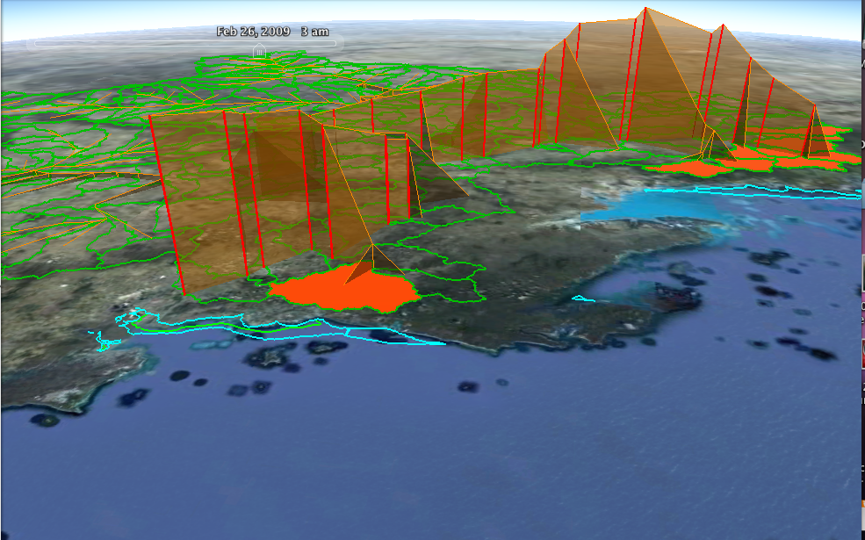
Visualization with Google Earth
Using digital globes to visualize climate change impact ->
testing Google Earth applications to visualize climate change in Australia +
community forest monitoring (Google Earth + handheld GPS)
                Climate impact water cycle presentation
                (Australia)
                4D water visualization potential in Google Earth

Slide 26
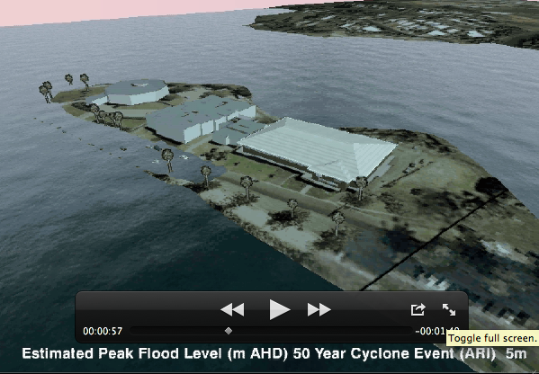

Slide 27


Monitoring references:
Capacity development and integration of local knowledge for climate change impacts and vulnerability assessment (Philippines) SimCLIM and impact models for climate change preparedness at the local level
Accelerated changes of environmental conditions on the Tibetan plateau caused by climate change Changes in temperature, NDVI, wind and heat flux over the last decades, derived from remote sensing
Changes in land cover, rainfall and stream flow in Upper Gilgel Abbay catchment, Blue Nile Basin (Ethiopia) Study on changes over the last decades based on several satellite images
Global biophysical datasets (NASA) presentation Overview of results/trends of different satellite measurements related to climate change

Slide 28



More monitoring references:
GEO Carbon showcase: http://www.youtube.com/watch?v=cmS3RergtP4
GMES climate change: http://www.youtube.com/watch?v=ujDU6hyn-vg
General climate change: http://preview.grid.unep.org
GEO Task US-09-01a: Critical Earth Observation priorities – climate societal benefit area Overview of observation needs for research, modelling, policy formulation and decision making
EUGENE climate change status quo and workshop report Overview of data and information requirements , actors, models, outputs and gaps

Slide 29
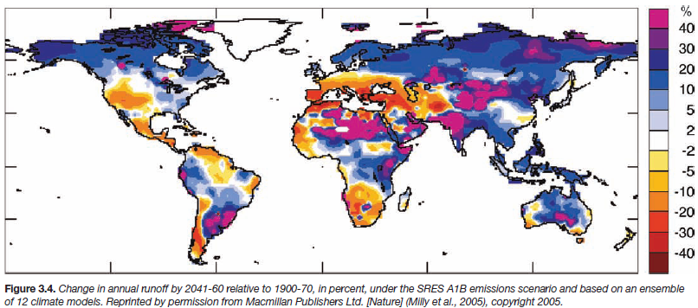
Example: change in annual runoff by
2041-2060, relative to 1900-1970 in %
From: Water resources climate change presentation (Japan)

Slide 30
GEO Carbon Strategy: modelling framework

Slide 31
GEO Carbon Strategy: decision support tools

Slide 32
Support change detection
Muir glacier, Alaska – August 1941
Muir glacier, Alaska – August 2004

Slide 33

Adaptation references:
NASA regional integrated sciences and assessments annual report 2011 Examples of successful earth observation applications for climate change preparedness, mainly in the areas of drought and water management
Tearfund CEDRA toolkit Step-by-step guide to define community
climate adaptation activities in developing countries
Important adaptation topics: disaster risk management & food security, see:
GEONetCab disaster management toolkit
GEONetCab crop modelling toolkit

Slide 34



Carbon accounting references:
GMES brochures on forest carbon tracking & arctic monitoring
Bolsa floresta progress report Use of remote sensing (INPE, Planet Action) for monitoring community REDD activities in Brazil
SARvision presentation REDD+ examples from Guyana and Surinam and oil palm example from Malaysia
Global and regional land cover and land change monitoring: progress and needs (Wageningen) Overview of land cover change and carbon stock monitoring
Field examples of community forest carbon mapping Chapters from book on community forest management
Community forestry as a prerequisite for REDD Overview of requirement, possibilities and difficulties of community forestry, including the use of remote sensing

Slide 35

More carbon accounting references:
Carbon accounting example Madagascar (Planet Action) Land use analysis, above-ground biomass assessment with LIDAR, soil organic carbon mapping with satellite imagery, scenario development, scaling up from project level to national level http://www.planet-action.org/automne_modules_files/polyProjects/public/r8299_93_reddpilot_project_goodplanet_madagascar_17dec10.pdf
Global Forest Observation Initiative (GFOI) implementation plan Overview of requirements, possibilities and difficulties of community forestry, including the use of remote sensing
GOFC-GOLD sourcebook Exhaustive overview of assessing carbon stocks and emissions, detailed description of methodology

Slide 36

Other references:
Land administration options for projects involving payments for carbon sequestration Article on remote sensing and participatory land tenure identification for payment for ecosystem services, examples from Brazil, Mozambique and Indonesia
GIS for climate change (ESRI)
Climate change is a geographic problem (ESRI)
Practical examples and approach

Slide 37
Marketing of earth observation
Marketing of earth observation is difficult.
New technology, few big companies, lots of small ones.
Lots of reports describing the bottlenecks, like reliability,
data access, data continuity, etc.
Means that relatively a lot of effort is needed to promote
EO.

Slide 38
Points to keep in mind:
Look for opportunities, where can you have most success in a short time: quick-wins.
Target the right audience to start with: who would be interested and listen to you?
Identify the problem that they are trying to solve: is it the same as yours?
Learn to speak the same language. Example ‘ECVs’: this is a term most managers do not understand and do not care about. Use terms related to mitigation and adaptation.
Look for examples from elsewhere (success stories): solutions that work and are affordable.

Slide 39
Be patient: introduction of new technology and / or applications takes time

Slide 40
3. How to get funding for your activities

Slide 41
Approach
Share information on your subject (a thing you are doing) and think that is interesting for your contact, then look for the link. Could this solve a problem for your partner? Are adjustments necessary? Need other parties be involved? Take it from there.
LEADS, LEADS, LEADS

Slide 42
How?
Establish your network.
Look for opportunities.
Write a good proposal.
Promise much, but not too much.

Slide 43
Proposal outline
(more detailed version in separate document, see also www.geonetcab.eu )
1. Introduction / relevance
2. Objective(s)
3. Activities
4. Output
5. Management & evaluation
6. Risk assessment
7. Time schedule
8. Budget
Annexes

Slide 44


Other references
Civicus: writing a funding proposal
Michigan State University: guide for writing a funding proposal
ESRI: writing a competitive GRANT application
REC: project proposal writing

Slide 45
Again:
SHARED PROBLEM
SHARED LANGUAGE
SHARED SOLUTION
If all else fails, try to link with a more popular (and easy to
understand) topic.

Slide 46
4. Capacity Building

Slide 47
General
Marketing is promotion + capacity building.
Especially for the introduction of new technologies capacity
building is important at all levels.
Capacity building is the instrument to increase
self-sufficiency and make solutions work.

Slide 48
Think of:
Different instruments for different levels: workshops for decision makers and awareness raising, detailed technical training for professionals.
Provide follow-up. Getting funding for good capacity building is difficult: everybody agrees that it is important, but nobody has time.
Training is usually part of funding of big projects that are managed by big companies or ministries, as a consequence capacity building is forgotten (in the end).
Aim at small budgets that are available without having to tender.

Slide 49

Examples & references
global change SysTem for Analysis, Research & Training: START
provides guidelines and training opportunities related to climate change issues
Tearfund CEDRA toolkit Step-by-step guide to define community climate adaptation activities in developing countries
GEONetCab capacity building web www.geonetcab.eu
compilation of tutorials, references, open-source software, etc.
GEO Portal: www.earthobservations.org

Slide 50
START: biodiversity and climate change training
www.start.org

Slide 51

More references
A Rough Google Earth Guide
MEASURE Evaluation Global Positioning System Toolkit
(USAID)
Handbook of Research on Developments and Trends in
Wireless Sensor Networks: From Principle to Practice

Slide 52
Further details:
Contact: Mark Noort
m.noort@hcpinternational.com
www.geonetcab.eu

