Slide 1



Earth Observation for
Weather
International trends & developments
Earth observation applications
Business development
Capacity building

Slide 2

0. Introduction
Mark Noort, consultant, project manager
HCP international:
consulting, marketing of earth observation
Project director EOPOWER:
project for promotion & capacity building of
earth observation applications

Slide 3
Sequence:
General assessment of the state-of-the-art of earth observation
Major trends and developments in the application field
Description of earth observation solutions
Assessment of market potential for earth observation solutions and marketing instruments
Capacity building for successful application of earth observation solutions

Slide 4
Earth Observation helps you: save money save lives save the environment

Slide 5
Earth observation
applications
On the verge of reaching new user communities
These new user communities need to be involved
Weakest link / last mile aspects are important
Marketing needed: promotion & capacity building

Slide 6
Life cycle of products & services
Initialization
System analysis & design
Rapid prototyping
System development
Implementation
Post-implementation

Slide 7
Scope and definitions
Weather: state of the atmosphere, to the degree that it is hot or cold, wet or dry, calm or stormy, clear or cloudy.
Atmosphere: a layer of gases surrounding a planet or other material body of sufficient mass that is held in place by the gravity of the body.
Weather forecast / prediction: the application of science and technology to predict the state of the atmosphere for a given location.
Weather aspects are also covered in the disaster management toolkit, climate toolkit, energy and mining toolkit, environmental management toolkit and agriculture toolkit.

Slide 8
Assessment of business & funding opportunities
Categories of weather products & services
Life cycle phase of product or service
Regional context, level of technological & economic development
Optimum marketing mix

Slide 9
1. International trends & developments in weather

Slide 10
Issues & trends in
weather
Improvements in weather forecasting accuracy and capability, including high-impact weather prediction;
Increased attention for communication with stakeholders and support to decision-making;
Increased attention for changes of weather patterns in different climate scenarios (see also climate toolkit).

Slide 11
Drivers
Importance of timely and accurate weather forecasts for all kinds of economic activity;
Increased vulnerability (in terms of economic losses and lives lost) in relation to high-impact weather events (concentration of people and physical assets, especially in urban areas);
Uncertainty about future weather with respect to climate change (trends, seasonal forecasts and deviations from “normal, expected” weather).

Slide 12
Weather forecasting
accuracy and capability
Improvements in forecasting related to: time range (nowcasting, short, medium, long), accuracy, probability, risk (possible damage / lives lost);
Numerical weather prediction (NWP): application of model(s) using mathematical equations for weather prediction (divide the atmosphere in grid boxes, record data on processes for each grid box and then calculate the future state for that box);
Nowcasting: technique for very short range forecasting (map the current weather, use the speed and direction of movement to forecast the weather a short period ahead);
Ensemble forecasting: estimate risk of particular weather events, using multiple forecasts (by making small alterations to either the starting conditions or the forecast model, or both).

Slide 13
World Weather Research Programme:
Improvement of weather forecasts in the form of the THORPEX and TIGGE programmes (as part of THORPEX)
THORPEX (THe Observing system Research and Predictability Experiment) is an international research programme to accelerate improvements in the accuracy and utility of high-impact weather forecasts up to two weeks ahead
TIGGE (THORPEX Interactive Grand Global Ensemble) provides a data base of ensemble predictions from the leading global NWP centres, for scientific research on predictability and development of probabilistic weather forecasting methods

Slide 14
THORPEX
Global observing system

Slide 15
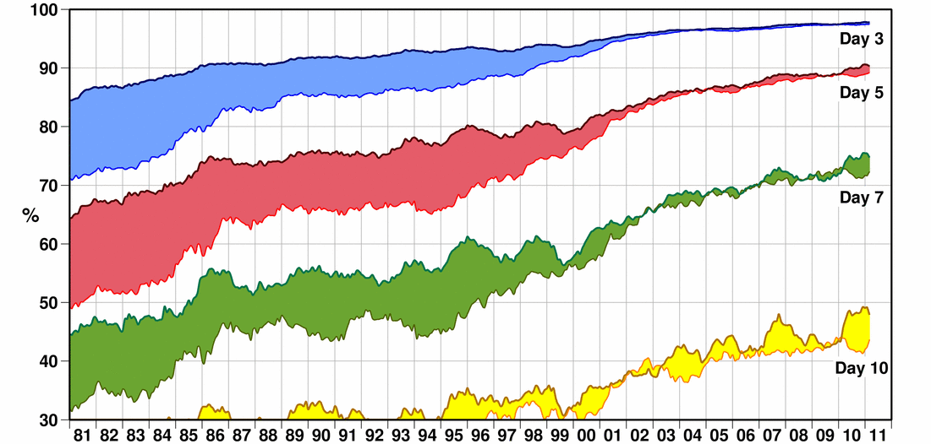
Weather: improved forecasts
Improvement in accuracy of weather forecasts over a period of 30 years:
upper line = northern hemisphere, bottom line = southern hemisphere
(Source: ECMWF; 2013)

Slide 16
More information:
Subseasonal to seasonal prediction – research implementation plan (WWRP/WCRP/THORPEX; 2012) research plan, with attention for climate change, disaster risk management and food security (food supply and markets)
TIGGE – The THORPEX Interactive Grand Global Ensemble (THORPEX; 2010) short description of the TIGGE programme
User requirements specification for TIGGE archive functions and applications;
Products based on TIGGE ensembles delivered to SWFDP users;
Enhanced TIGGE archive functions available & demonstrated; data registered in GCI (GEOWOW; 2012) enhancing TIGGE and making the results accessible to users
TIGGE website http://www.ecmwf.int , data archive available at http://apps.ecmwf.int/datasets/data/tigge/

Slide 17
Communication
with stakeholders (1)
High-impact weather: accuracy and timing of forecast should be balanced against size of avoidable loss;
Communication of uncertainty: decision makers are very sensitive to false alarms and, at the same time, have a strong need for a high detection rate;
Verification: verification results should be presented alongside the forecasts so that users can readily understand the quality of the forecast they are currently using.

Slide 18
Communication
with stakeholders (2)
Better dissemination of forecast information to reach end users;
Improved insight into how users do interpret and apply (or do not apply) forecast information;
Integrate all stakeholders through interaction to produce suitable information tailored to the user needs;
Facilitate quantification and evaluation of environmental, societal and economic benefits by the end user;
Find the most cost effective combination of observing system, data assimilation, forecast and application procedures (Early Warning System) to improve high impact weather forecasts from the user perspective.

Slide 19

Example: Monsoon prediction
and decision making
Important for arranging cropping strategy and taking preventive action in potential flooding zones;
Institutional mechanism for communicating climate information to various user departments and agencies is important;
Forecasts should be released that match the lead-time requirements that are relevant to the end-users;
Seasonal forecast products should reflect local climatic zones (rather than administrative regions);
Governments should rethink the value of climate prediction in societal and economic development.

Slide 20
Example: Requirements for an
effective community response to warnings
Getting free warning and hazard information;
Receiving warning with sufficient lead time;
Understanding the warning content;
Believing the warning;
Believing that the threat is real;
Knowing when and what appropriate action to take;
Being in a state of preparedness.

Slide 21
THORPEX decision support
A global interactive end- to-end forecasting system for the 21st century

Slide 22

More information:
Weather research in Europe – a THORPEX European plan (WMO; 2010) research plan for Europe and the Mediterranean, including section on decision making
WWRP/THORPEX African science plan (WMO; 2008)
science plan for Africa, involving end-users
Global monsoon system – Research and forecast (World Scientific; 2011) series of articles on monsoon system research, only some chapters are freely available: heaviest precipitation (ch2), intraseasonal variability (ch11), diurnal cycle (ch15), Taiwan monsoon (ch18), modelling monsoons (ch25), atmospheric and oceanic weather (ch29), oceanic processes (ch30)
The global monsoon systems (WCRP) introduction to monsoon systems and research efforts

Slide 23
Changing weather
patterns and climate
Concerns about the impact of global climate change, in terms of weather and climate variability and associated effects such as sea-level rise;
Science and technology of weather forecasting and climate prediction has been moving ahead rapidly;
Need for reduction of the uncertainty about the relationship between weather and climate change, to predict changing weather patterns under different scenarios with the aim to improve decision-making for adaptation and mitigation.

Slide 24



More information:
Climate impacts on energy systems - Key issues for energy sector adaptation (World Bank; 2011) how the changing climate impacts energy systems, including need for improved observation networks in developing countries + case studies from Albania and Mexico
Frequently asked questions (IPCC; 2007) answers on frequently asked questions on climate change, including the relation between weather and climate change
Reviewing weather and climate services in the Pacific (SPREP; 2010) review of National Meteorological Services in the Pacific region (mainly small island states that are especially vulnerable to sea-level rise)
Climate and ocean: Variability, predictability and change (CLIVAR; 2014) brochure on the CLIVAR research programme

Slide 25
2. Earth observation applications

Slide 26
Earth observation for
weather
Tropical cyclone Eline provoking flooding in Mozambique and Madagascar

Slide 27
Earth observation
contribution
High-impact weather prediction (see also disaster management toolkit)
Precipitation (and general weather) forecasting and monitoring
Earth observation for weather (-indexed) insurance (in agriculture toolkit)
Weather products and services are linked to all GEO Societal Benefit Areas and provide input to products and services related to these SBAs

Slide 28
Example high-impact
weather prediction
Forecasting strike probabilities for Hurricane Ike by combining two TIGGE ensembles

Slide 29
Example high-impact
weather prediction (2)
Predicting flood alerts for Romania using TIGGE

Slide 30
Example high-impact
weather prediction (3)
Massive sandstorm blows off the northwest African desert (February 26th, 2000)

Slide 31
High-impact weather
prediction
Earth observation supports high-impact weather prediction for disaster management, water management, agriculture, energy, health, fisheries, aviation / transportation, etc.;
Data series are available for historical and statistical analysis and analysis of whole regions;
Earth observation facilitates shortening of the warning time and the communication and decision-making process;
Cost estimate: on case-by-case basis, meteorological satellite imagery is usually free;
Main challenges: cost, complexity, business model, knowledge transfer.

Slide 32


Examples:
The European Centre for Medium-range Weather Forecasts – European co-operation at its best (ECMWF; 2012) describes improvements in medium-range forecasts, with some examples of high-impact weather prediction
Weather satellites: Critical technology in an uncertain environment (Space Solutions; 2013) overview of weather satellites and their benefits (US perspective)
NOAA knows… Earth observation satellites (NOAA; 2011) factsheet on the use of earth observation for a ‘weather-ready nation’
Heaviest precipitation events, 1998 – 2007: a near global survey (Mapes; 2011) chapter 2 of ‘The global monsoon system’: Analysis of and attempts to understand extreme rainfall events over a 10-year period
Predicting and managing extreme weather events (NOAA; 2012) description of state-of-the-art in understanding and prediction extreme weather events and requirements for managing these events in the US

Slide 33
Example precipitation
monitoring and forecasting
Approximate location of monsoons across the globe

Slide 34
Example precipitation
monitoring and forecasting
(2)
GEONETCast coverage

Slide 35
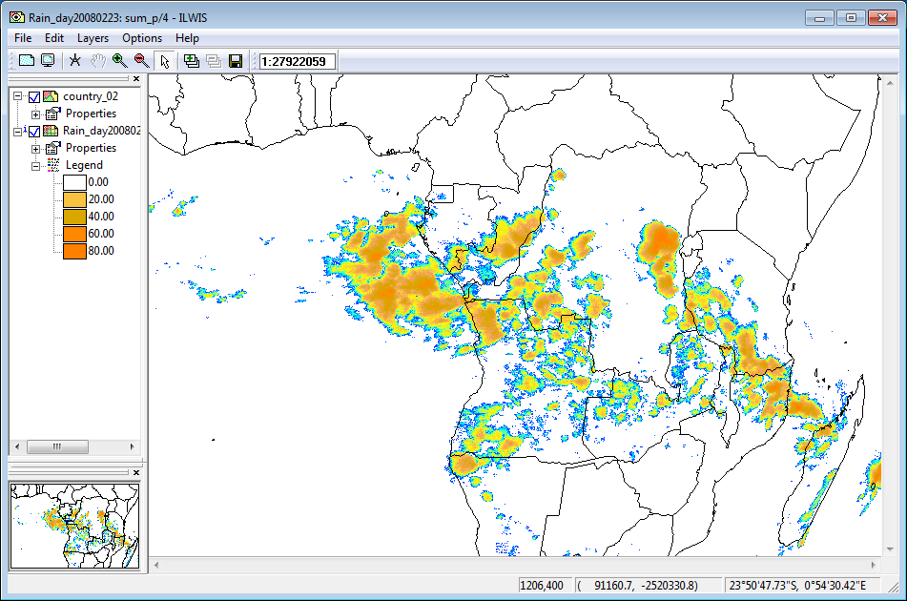
Example precipitation
monitoring and forecasting
(3)
Precipitation calculated over central Africa for 23/02/2008 (Source: DevCoCast

Slide 36
Precipitation monitoring
and forecasting
All aspects of the high-impact weather prediction apply;
Services, such as GEONETCast (service that delivers meteorological products and services to end-users, among other services) make weather information accessible and affordable to all kinds of users;
Cost estimate: on case-by-case basis, setting up a GEONETCast station costs about € 1,500, satellite imagery distributed through GEONETCast is free;
Main challenges: acceptance, knowledge transfer.

Slide 37

Examples:
Statements of guidance (WMO; 2012) on: global numerical weather prediction, high-resolution numerical weather prediction, nowcasting and very short range forecasting, seasonal to inter-annual forecasts, aeronautical meteorology, atmospheric chemistry, ocean applications, agricultural meteorology, hydrology, climate monitoring, climate applications and space weather
How Sentinels can support space-based weather predictions (Copernicus; 2013) description of support to weather forecasts through the Sentinel satellites programme

Slide 38
Examples (2):
GEONETCast – DevCoCast application manual (DevCoCast; 2012) description of how to use the system and software with application examples on meteorology, agriculture and water quality
GEONETCast toolbox – installation, configuration and user guide of the GEONETCast toolbox plug-in for ILWIS
http://52north.org/downloads/earth-observation/geonetcast/geonetcast-toolbox/52n-eo-gnc-toolbox-1-4
GEONETCast toolbox factsheet XML version 1.2 description of all the products and data that can be received and of the features of the GEONETCast toolbox
Demonstration of GEONETCast technology (Maathuis; 2015) presentation on the state-of-the-art of GEONETCast applications

Slide 39
Growth potential for
earth observation
Mainly a public good, provided by national meteorological organizations (NMOs) and international specialized organizations;
Research topics in meteorological phenomena require specialization and are best studied in an international context;
Gains can be obtained by improving management of the whole communication chain between specialized meteorological agencies and beneficiaries (think of timely warning for flooding or agricultural management);
The envisaged role for business (SMEs) consists primarily in the delivery of meteorological products and services of specialized agencies to end users and/or using these as input for other products or services (think of agriculture, water management, health, energy, etc.).

Slide 40
3. Business development

Slide 41
Why is marketing / promotion of earth observation needed?
Public sector information (PSI)
Externalities (environmental accounting & payment for ecosystem services)
Global datasets, open access, data sharing, compatibility (GEO)

Slide 42
If public sector information is made available free-of-charge, demand will increase and, in the end, government revenue also, as companies will derive income from value-added products and services, and consequently pay more taxes (see figures in following slides).

Slide 43
Supply & Demand Public Sector Information
http://vimeo.com/63079712
Source: About GMES and data: geese and golden eggs (Sawyer, de Vries 2012)

Slide 44
Cost-benefit Public Sector Information
Source: About GMES and data: geese and golden eggs (Sawyer, de Vries 2012)

Slide 45
Re-use of Public Sector Information
Source: About GMES and data: geese and golden eggs (Sawyer, de Vries 2012)

Slide 46
Most earth observation applications deal with so-called externalities, such as impact on the environment.
It is difficult to capture these in terms of conventional cost-benefit models.
To tackle this, the following framework for analysis of earth observation applications is developed:

Slide 47
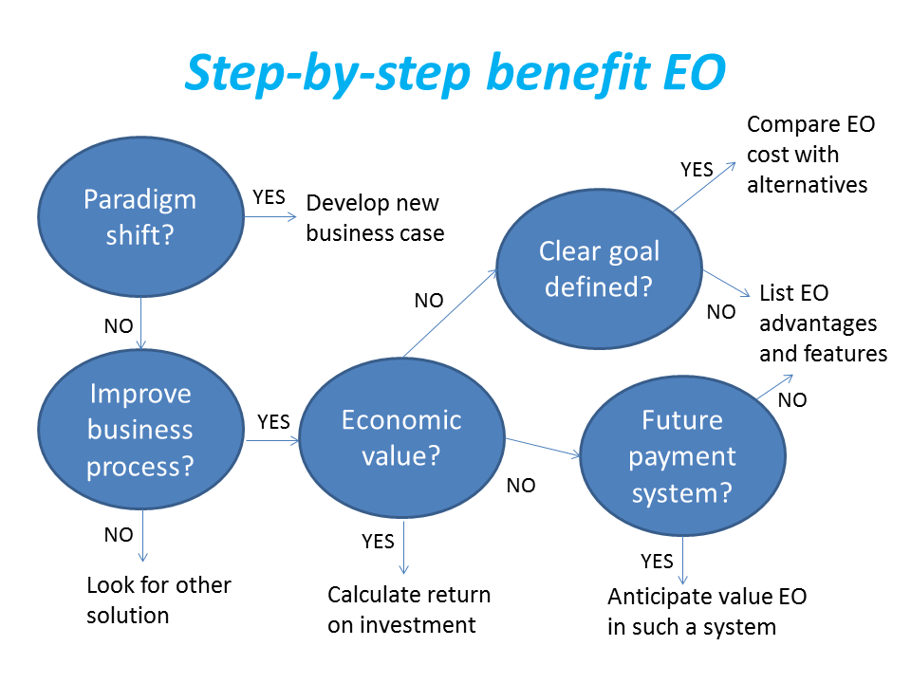
Framework for analysis
Step-by-step analysis of the benefits of earth observation (source: GEONetCab, 2013)

Slide 48
Key questions
Does the new application cause a paradigm shift?
Is the current business or organization process improved?
Does the application provide economic value that can be quantified?
Is a clear measurable goal defined to which the earth observation application contributes?
Is a future payment scheme or other economic mechanism foreseen in which the earth observation application fits?

Slide 49
Assessment of
geospatial solutions
Rating of characteristics of geospatial solutions:
fit-for-purpose
comparative advantage
complexity to user / ease- of-use
elegance
cost-benefit,
sustainability
resilience
reproduction capacity / flexibility
acceptance
level of knowledge transfer required
ethics, transparency, public accountability, objectivity & impartiality
Rating of business environment:
Willingness to pay (by clients)
Embedding (in organizational processes)
Openness (transparency and ease of doing business, access to markets)
Institutions (is the institutional environment conducive to doing business, acceptance of new solutions?)

Slide 50
Fit-for-purpose
An important, but often forgotten requirement:
Does the product or service do what it is supposed to do to solve a certain problem?
In other words: is it really a solution or just an attempt towards a solution?
Quantitative: not applicable
Qualitative (on scale of 1 to 5): based on description of what the EO solution actually does

Slide 51
Comparative advantage
What it does significantly better than other solutions to the same problem.
For earth observation usually the comparative advantages of greater accuracy, better resolution in time and space, comprehensive overview of large areas and near real-time information provision are mentioned as comparative advantages.
Quantitative: calculation of degree in which the EO solution is better than alternatives
Qualitative (on scale of 1 to 5): based on listing of comparative advantages

Slide 52
Complexity (to user) / ease-of-use
At all levels in the value chain the users (professionals and
end-users) are able to work with the product or service.
Quantitative: not applicable
Qualitative (on scale of 1 to 5): based on user testimonials and user surveys

Slide 53
Elegance
Once you get the idea behind this product or service, you want to be part of the community that uses it.
This sense of belonging facilitates the formation of user groups that provide valuable feedback.
Quantitative: none, or it should be the size of the user community
Qualitative (on scale of 1 to 5): based on user testimonials and user surveys

Slide 54
Cost-benefit
The cost-benefit of the product or service is quantified and sufficiently attractive, also in the long-term.
Quantitative: cost-benefit calculation
Qualitative (on scale of 1 to 5): based on quantitative assessment

Slide 55
Sustainability
The product or service can be delivered when it is needed.
There is a long-term perspective that guarantees delivery.
Sustainability concerns the following aspects:
Long-term data availability
Availability of finance/funds to provide the solution continuously for present and future use
Long-term institutional / governmental interest and support
Long-term user interest for a solution that addresses real needs
Quantitative: not applicable
Qualitative (on scale of 1 to 5): based on sensitivity analysis of the EO solution

Slide 56
Resilience
In case of extremes or breakdown in the value chain, the product or service can still be delivered at an acceptable level. Alternatives (plan B) are available (and developed).
Quantitative: cost-benefit calculation of plan B
Qualitative (on scale of 1 to 5): based on risk analysis of the EO solution

Slide 57
Reproduction
capacity / flexibility
The product or service can be easily applied or adapted for use in another region or another situation, while still providing the solution without (too much) extra cost.
Quantitative: calculation of reproduction costs for application in other regions or situations; measurement of spreading of actual use
Qualitative (on scale of 1 to 5): based on quantitative assessment and description of EO solution

Slide 58
Acceptance
The users intuitively get what the product or service is about and are interested. They accept it as a solution to their problem.
Quantitative: none, or survey results about acceptance. After introduction of the solution: number of clients and/or users
Qualitative (on scale of 1 to 5): based on user testimonials and user surveys

Slide 59
Level of knowledge
transfer required
The training requirements for professionals and other users along the value chain are clear and associated costs and efforts are acceptable.
Quantitative: cost and time required to get the users at the desired knowledge and skill level
Qualitative (on scale of 1 to 5): based on knowledge transfer plans and evaluation of training activities

Slide 60
Ethics, transparency,
public accountability,
objectivity & impartiality
Application of Earth observation increases the level of objectivity and impartiality in decision-making processes, including conflict resolution. The application improves transparency and public accountability. It raises no ethical issues or if it does, as in the case of privacy concerns, these are resolved in a satisfactory way for all parties concerned.
Quantitative: not applicable
Qualitative (on scale of 1 to 5): based on user testimonials and user surveys

Slide 61
Several attempts have been made to introduce environmental accounting and to enlarge the sphere of the conventional economy to include and quantify impact on ecosystems.
The following slides give some examples:

Slide 62







Environmental accounting & payment for ecosystem services
SEEA:
System of Environmental-Economic Accounts
(EC, FAO, IMF, OECD, UN, WB )
WAVES:
Wealth Accounting and the Valuation of Ecosystem Services (global partnership, led by World Bank)
TEEB:
The Economics of Ecosystems and Biodiversity
(group led by UNEP)

Slide 63
SEEA Conceptual Framework
Source: SEEA conceptual framework report (EC, FAO, IMF, OECD, UN, WB 2012)

Slide 64
For earth observation the work of the Group on Earth Observations (GEO) is essential to achieve the goal of a Global Earth Observations System of Systems (GEOSS), resulting in the shared GEO common infrastructure (GCI):

Slide 65
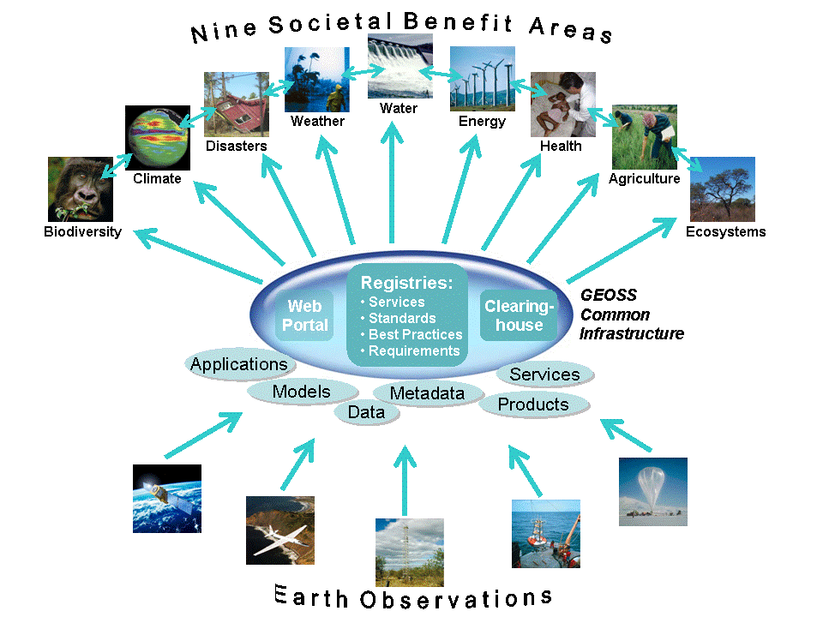

Group on Earth Observations

Slide 66
Marketing elements
Customer value propositions
Crossing the technology chasm
Creating shared value
Promotion tools

Slide 67
Customer value propositions capture the unique value of a product or services as perceived and appreciated by the customer.
Interestingly, they can differ completely from the features that the provider considers most important:

Slide 68
Customer Value Propositions
VALUE PROPOSITION | ALL BENEFITS | FAVOURABLE POINTS OF DIFFERENCE | RESONATING FOCUS
Consists of: | All benefits customers receive from a market offering | All favourable points of difference a market offering has relative to the next best alternative | The one or two points of difference whose improvement will deliver the greatest value to the customer
Answers the customer question: | “Why should our firm purchase your offering?” | “Why should our firm purchase your offering instead of your competitor’s?” | “What is most worthwhile for our firm to keep in mind about your offering?”
Requires: | Knowledge of own market offering | Knowledge of own market offering and next best alternative | Knowledge of how own marketing offering delivers value to customers, compared with next best alternative
Has the potential pitfall: | Benefit assertion | Value presumption | Requires customer value research
Source: Customer value propositions in business markets (HBR 2006)

Slide 69
Buyer behaviour & motivation
Type | Buyer behaviour | Motivation
Transactional sales | Intrinsic value buyers: “keep it cheap and easy to do business” | Understands the product Perceives it as substitutable Cost focus Resents time ‘wasted’ with sales people
Consultative sales | Extrinsic value buyers: “I don’t know the answer: help me analyse and solve the issue | Focus on how the product is used Interested in solutions and applications Values advice and help Needs the sales person
Source: Rethinking the sales force (Rackham, de Vincentis 1999)

Slide 70
Even when customer value propositions are well captured and formulated, introduction of solutions that involve new technology will have to overcome some hurdles.
This is called “crossing the technology chasm”:

Slide 71
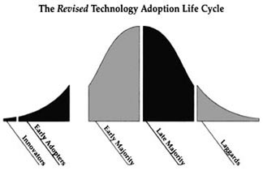
Crossing the technology chasm
Source: Crossing the chasm (Moore 1991)

Slide 72
Crossing the technology chasm
Most clients of EO products and services belong to the early and late majority,
They are pragmatists and are not prepared or willing to take substantial risk: the solution should work and be reliable.
Once convinced, the pragmatists will be long-term clients.
Source: Crossing the chasm (Moore 1991)

Slide 73
More information:
Creating & delivering your value proposition
– managing customer experience for profit
(Barnes, Blake, Pinder; 2009)
Customer value propositions in business markets
(Anderson, Narus, van Rossum [Harvard Business Review]; 2006)
Rethinking the sales force:
refining selling to create and capture customer value
(Rackham, de Vicentis; 1999)
Crossing the chasm
– marketing and selling high-tech products to mainstream customers
(Moore; 1991)

Slide 74
Creating shared value is a key element of successful implementation of earth observation solutions.
To achieve this, in most cases earth observation applications have to be integrated into more general (business or organizational) processes:

Slide 75
Create shared value
Involves cooperation between:
Public sector
Private sector
Social sector
Opportunity for earth observation (integrated) solutions:
Integrate EO in general business / organizational process
Integrate different EO (and GIS and navigation) functionalities

Slide 76
Based on all considerations dealt with in the previous slides, there are some practical approaches that can be applied in combination to promote earth observation applications:

Slide 77

Tools for earth observation marketing:
Success stories (in non-technical language, feasible, replication capacity, sustainable)
Marketing toolkits (international trends, earth observation examples, references)
Pilot projects, innovation funds, quick-wins (demonstration that EO actually works)
Promotion outside EO community (fairs, seminars, lunch-bag meetings, magazines)
Resource facilities for reference and capacity building (distributed, but connected, in different languages)
Source: Marketing earth observation products and services (Noort 2013)

Slide 78
Business elements
Business elements:
Proposal writing
Business procedures

Slide 79
Proposal writing is an art in itself.
During the GEONetCab and EOPOWER projects templates have been developed for writing successful proposals:

Slide 80
Proposal outline
1. Introduction / relevance
2. Objective(s)
3. Activities
4. Output
5. Management & evaluation
6. Risk assessment
7. Time schedule
8. Budget
Annexes
(more detailed version in separate document,
see www.eopower.eu or www.hcpinternational.com)

Slide 81


Other guides that may be useful:
Civicus: writing a funding proposal
Michigan State University: guide for writing a funding proposal
ESRI: writing a competitive GRANT application
REC: project proposal writing

Slide 82
If you run a company, compete for assignments and manage projects, a structured approach towards responsibilities, tasks, implementation and documentation is needed.
The following business procedures may be helpful:

Slide 83
Business procedures
1. On acquisition
2. On offers
3. On negotiation
4. On contracts
5. On project management
6. On travel & deployment
7. On deficiencies & complaints
8. On internal organization
9. On finance
(more detailed version in separate document,
see www.eopower.eu or www.hcpinternational.com)

Slide 84
Again:
SHARED PROBLEM
SHARED LANGUAGE
SHARED SOLUTION

Slide 85
4. Capacity Building

Slide 86
General
Marketing is promotion + capacity building.
Especially for the introduction of new technologies capacity building is important at all levels.
Capacity building is the instrument to increase
self-sufficiency and make solutions work.

Slide 87


General references for capacity building, open data and success stories
GEO Portal: www.earthobservations.org
Capacity building resource facility www.geocab.org
compilation of tutorials, references, open-source software, etc.
Satellites going local: share good practice (Eurisy handbooks) www.eurisy.org
Earth observation for green growth (ESA; 2013)

Slide 88


General references for capacity building, open data (2)
Bringing GEOSS services into practice:
how to use data from the GEO portal and how to provide input
www.envirogrids.net
Science education through earth observation for high schools: basic tutorials on all kind of subjects
www.seos-project.eu
Copernicus briefs:
information on satellite applications for different topics
http://www.copernicus.eu/main/copernicus-briefs
MetEd: tutorials and courses on meteorology and related subjects
https://www.meted.ucar.edu/training_detail.php

Slide 89
More references open data
Open data for sustainable development (World Bank; 2015)
description of the benefits of open data for a wide range of development goals, including the SDGs http://pubdocs.worldbank.org/pubdocs/publicdoc/2015/8/904051440717425994/Open-Data-for-Sustainable-development-Final-New.pdf
Terms and conditions for the use and distribution of Sentinel data (European Parliament and European Commission; 2014)
standard stipulations related to free and open access to Sentinel data http://www.demarine.de/lr/c/document_library/get_file?uuid=c5067655-b7ad-4d71-b07b-6111808f4abd&groupId=13521
Towards a thriving data-driven economy (European Commission; 2014) policy document on the use of (open) data for a knowledge economy and society
http://ec.europa.eu/information_society/newsroom/cf/dae/document.cfm?doc_id=6210

Slide 90

Capacity building resources for weather:
User guide to ECMWF forecast products (ECMWF; 2011) overview of models, forecasts and products
Numerical Weather Prediction (Colorado State)
lecture in presentation form on numerical weather prediction
Link to UCAR weather tutorial (2003) -> 10 lectures in presentation form: http://www.rap.ucar.edu/general/weathercourse/
Link to NavCanada local area weather manuals (2000)
general introduction on meteorology (for aviation) + description of weather phenomena for different regions in Canada: http://www.navcanada.ca/EN/media/Publications/Forms/AllItems.aspx?RootFolder=%2fEN%2fmedia%2fPublications%2fLocal%20Area%20Weather%20Manuals&FolderCTID=0x01200021B720762C66F0408AF378DB2B47FAAF

Slide 91

Capacity building resources for weather (2):
Remote sensing applications – Chapter 10: atmosphere (NRSC; 2010)
Remote sensing applications – Chapter 11: cyclones (NRSC; 2010)
GEONETCast – DevCoCast application manual (DevCoCast: 2012) description of how to use the system and software with application examples on meteorology, agriculture and water quality
From cloud top temperature to rainfall
Blending TRMM and MSG (ITC; 2015)
3-day EOPOWER (self-study) course for professionals
http://menhir.itc.utwente.nl:5000/fbsharing/KGKOZXKU/

Slide 92
Further details:
Contact: Mark Noort
m.noort@hcpinternational.com
www.eopower.eu
www.hcpinternational.com

