Slide 1



Earth Observation for
Water Management
International trends & developments
Earth observation applications
Business development
Capacity building

Slide 2

0. Introduction
Mark Noort, consultant, project manager
HCP international:
consulting, marketing of earth observation
Project director EOPOWER:
project for promotion & capacity building of
earth observation applications

Slide 3
Sequence:
General assessment of the state-of-the-art of earth observation
Major trends and developments in the application field
Description of earth observation solutions
Assessment of market potential for earth observation solutions and marketing instruments
Capacity building for successful application of earth observation solutions

Slide 4
Earth Observation helps you: save money save lives save the environment

Slide 5
Earth observation
applications
On the verge of reaching new user communities
These new user communities need to be involved
Weakest link / last mile aspects are important
Marketing needed: promotion & capacity building

Slide 6
Life cycle of products & services
Initialization
System analysis & design
Rapid prototyping
System development
Implementation
Post-implementation

Slide 7
Scope
The term “water resource” may be defined as:
the wider body of water upon which a water source depends
(This could be rainwater, surface water (e.g. rivers, streams, lakes) or groundwater within an aquifer.)
“Water resource management” is then:
the activity of planning, developing, distributing and managing the optimum use of water resources
Focus on management of freshwater resources.
(Flooding will be dealt with in the disaster management toolkit and rainfall in the weather toolkit.)

Slide 8
Assessment of business & funding opportunities
Categories of water management products & services
Life cycle phase of product or service
Regional context, level of technological & economic development
Optimum marketing mix

Slide 9
1. International trends & developments in water management

Slide 10
Issues & trends
in water management
Sustainable water resources management, including water quality, also with respect to climate change;
Water footprints and pricing;
Risk management;
Community empowerment;
Water, energy, food nexus

Slide 11
Drivers
The increasing demand for water (agriculture, urban),
Environmental factors (including climate change),
The availability of water resources,
Deterioration of water quality,
Perceived low cost of water,
Increased risks: floods, droughts, salinisation.

Slide 12


Sustainable water
resources management
Over the past 50 years global freshwater withdrawals have tripled
A quarter of freshwater use exceeds accessible supplies
By 2030 nearly 3.9 billion people will live under conditions of severe water stress (OECD)
By 2030 global demand for water will be 40% higher than it is today
Open data access and optimal data availability are of cardinal importance
Measuring Water use
in a Green Economy

Slide 13
Decision making
“We can only manage what we measure”
Need for “integrated and adaptive decision support systems able to explicitly account for system uncertainty”
Incorporate institutional, political, and economic considerations into translating physical science findings into relevant information for specific types of decisions within specific sectors
Communication should be perceived by the users as:
Salient (answering the right questions)
Credible (coming from a trusted source)
Legitimate (accurate)

Slide 14
Different levels
“We can only manage what we measure”
User level: price and technology play a key role (creating awareness, charging prices based on full marginal costs, stimulating water saving technology)
Catchment or river basin level: choice on how to allocate the available water resources to the different sectors of the economy (depends on the value of water in its alternative uses)
International trade: water as a global resource (overall efficiency)
Measuring Water use
in a Green Economy

Slide 15


More information:
The state of the world’s land and water resources for food and agriculture (SOLAW) – managing systems at risk (FAO; 2011)
Measuring water use in a green economy (UNEP; 2012)
Food and water: analysis of potentially new themes in water management - future trends and research needs (FutureWater; 2010)

Slide 16
Water footprints
and pricing
Calculating the monetary value of externalities and ecosystem resources and services that are currently underpriced or not priced at all
Decoupling concepts:
Resource decoupling:
reducing resource use per unit of economic activity
Relative decoupling:
resource use still increases but at a lower rate than economic growth
Impact decoupling:
scale and character of resource use causes no negative environmental impact
Absolute decoupling:
resource use declines irrespective of the growth rate of the economic driver
Measuring Water use
in a Green Economy

Slide 17
Water footprints
and pricing
Water registers
(as key to fair distribution of access to water)
Water and ecosystem capital
(water as natural capital, linked to economy and well-being (UN SEEAW 2007, NAMEA))
Water scarcity and vulnerability indices
(per capita, renewal vs withdrawal, etc.)
Water footprint assessment
(amount of water consumed per unit of product)
Life cycle assessment
(benchmarking for industries)
Water stewardship
(quantify corporate water monitoring)
Measuring Water use
in a Green Economy

Slide 18


More information:
Measuring water use in a green economy (UNEP; 2012)
The water response mechanism – towards a practical approach to assess and reduce a water footprint (CREM; 2010)
System for environmental-economic accounting for water (UNDESA; 2012)
Water footprint assessment manual – setting the global standard (Hoekstra et al.; 2011)

Slide 19
Risk management:
drought
Distinction between meteorological, agricultural, hydrological and socio-economic drought;
Need for improved forecasting, early warning systems and general information provision on droughts;
Need for improved resilience, also with respect to the possible effects of climate change;
Sustainable management of natural resources;
Insurance schemes for risk coverage.

Slide 20



More information:
Managing drought:
a roadmap for change in the United States (GSA; 2007)
Drought monitoring and early warning:
concepts, progress and future challenges (WMO; 2006)
Drought monitoring in France:
groundwater perspective (BRGM; 2011)

Slide 21
Empowering
local communities
Increase insight in and visibility of available resources
Analysis of historical and future use for planning and decision making
Mapping of informal settlements, infrastructure and resources
Analysis for more efficient use of water resources
Hydropower: assessment of resources, planning & monitoring
instrument for community empowerment
Using “human sensor webs” and/or “citizens observatories” for water point mapping and monitoring

Slide 22



More information:
Water security framework (WaterAid; 2012)
HSW final report - Empowering communities in East Africa in water service provision through information from human
sensor webs (UN-HABITAT/University of Twente; 2010)

Slide 23
Water-energy-food nexus
Demand for energy, water and food will grow, because of economic development;
Access of poor people to energy, water and food needs to be improved;
Increasing energy production means increasing demand on water resources (and vice versa);
Alternative sources of energy (biofuel) also increase the demand for water;
Increased production of biofuel could compete with food security;
Finding acceptable trade-offs is important.

Slide 24

More information:
United Nations world water development report
volume 1: water and energy
volume 2: facing the challenges (UN WATER; 2014)
Water-Food-Energy Nexus:
towards a widening of the water agenda
(FutureWater; 2013)

Slide 25

Example Europe
Water resources across Europe - confronting water scarcity and drought
  DPSIR: framework used for water resources management
  Water exploitation index (ration of annual total water abstraction to available long-term freshwater resources)
  Action: water pricing, drought management plans, water efficiency and conservation, raising awareness, tackling illegal water use, alternative supplies, desalination
  Information requirements: river basin scale water balances based on the UN system of environmental economic accounting for water (SEEAW, 2007) & WISE (water information system for Europe)

Slide 26
DPSIR framework: driving force, pressure, state, impact, response

Slide 27






Example Africa
Africa Water Atlas
Modelling of Africa’s surface water systems
(water balance data), identifying:
  “hotspots”: tenuous food security situation
  “hopespots”: potential for rainwater harvesting
  “water towers”: areas with upstream water surplus

Slide 28
Africa Water Atlas
Key Facts
  Millions of people in Africa suffer water shortages throughout the year
  Water scarcity is not simply due to geography: population growth, poor planning and poverty are significant factors
  Most urban population growth has taken place in peri-urban slum neighbourhoods, overwhelming municipal water services
  64% of people in Africa use improved drinking water sources (2010)
  Only 38% of Africa’s population has access to improved sanitation facilities (2010)
  Increases in access to improved drinking water sources and sanitation facilities are not keeping pace with population growth

Slide 29
Africa Water Atlas
Linkages between poverty, water and the environment

Slide 30
Africa Water Atlas
Action
  Provide safe drinking water + ensure access to adequate sanitation
  Foster cooperation in transboundary water basins
  Provide water for food security
  Develop hydropower to enhance energy security
  Meet growing water demand
  Prevent land degradation and water pollution
  Manage water under global climate change
  Enhance capacity to address water challenges

Slide 31
More information:
Water resources across Europe — confronting water scarcity and drought (EEA; 2014)
Africa water atlas (UNEP; 2010)

Slide 32
2. Earth observation applications

Slide 33
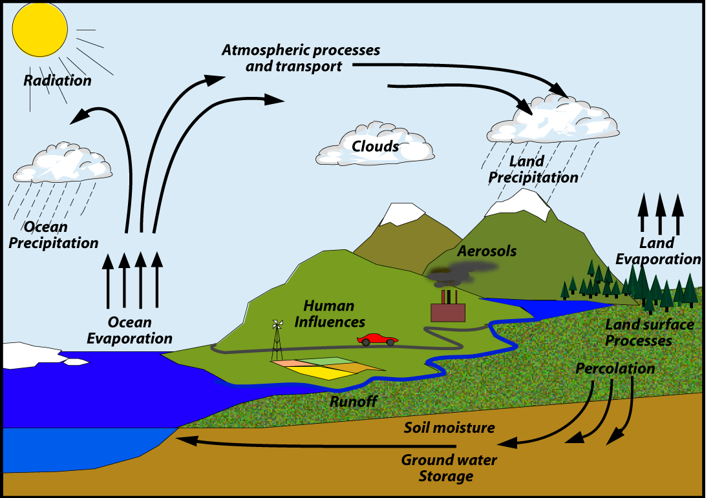
Earth observation
for water management
The water cycle (GEWEX)

Slide 34
Earth observation
contribution
General water resources assessment, for long-term planning and climate change scenarios
Hydrologic information systems, for (detailed) run-off calculations & (irrigation) system management
Soil moisture modelling,
Drought monitoring,
Water quality monitoring,
Snow cover monitoring,
Water supply utilities,
Others: salinisation monitoring & mapping, sediment transport monitoring, erosion monitoring & mapping, reservoir monitoring, rainwater harvesting, etc.

Slide 35
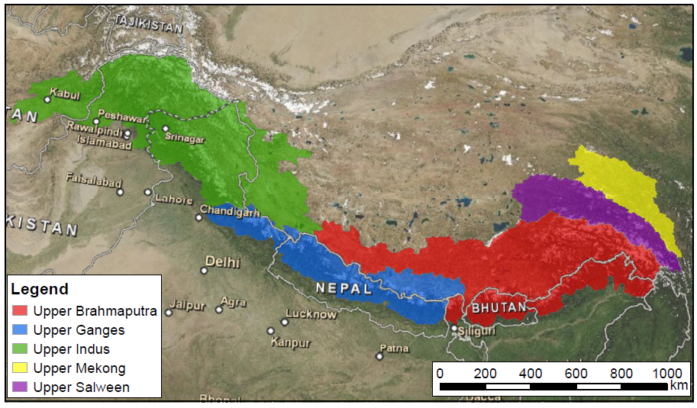
Example water resources
assessment
Overview upstream basin boundaries of the Indus, Ganges, Brahmaputra, Salween and Mekong river basins (FutureWater)

Slide 36
Water resources
assessment
Accurate and continuous observation of the long-term dynamics of the different key variables governing the energy and water cycle processes from global to local scale
For decision making: global synoptic information on water resources availability and quality for water governance, management and planning (+ adaptation to climate change)
Earth observation complemented with in-situ observations for validation, calibration and development of EO-derived products
Cost estimate: service 100 - 200 k€ per river basin,
data 1 - 10 k€ per scene, some data at no cost
Main challenges: cost, capacity, reduce uncertainty

Slide 37

Examples:
Uses and limitations of observations, data, forecasts, and other projections in decision support for selected sectors and regions (NASA; 2008): chapter 5 – decision support for water resources management
Water availability analysis for the Upper Indus, Ganges, Brahmaputra, Salween and Mekong river basins (FutureWater; 2013)
GEWEX: global and regional energy and water exchanges - research programme of the World Climate Research Programme intended to observe, comprehend and model the Earth's water cycle
See also: Advances in Earth observation for water cycle science (Fernandez-Prieto, van Oevelen, Su, Wagner; 2012)

Slide 38
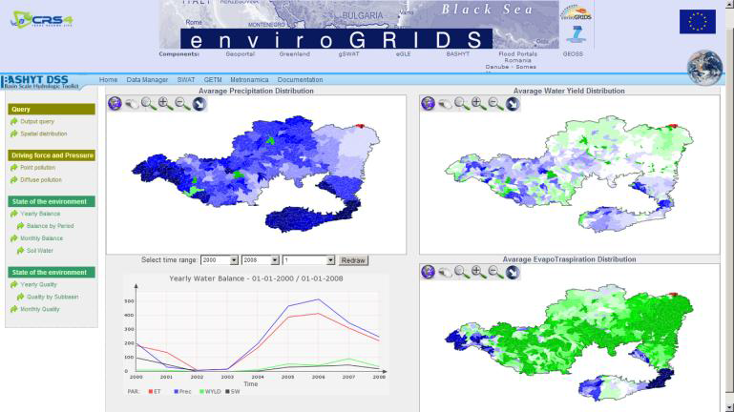
Example hydrologic
information systems
Water balance Danube basin mapped on a webGIS (source: enviroGRIDS, 2012)

Slide 39
Hydrologic
information systems
Land use and land cover mapping + change monitoring
Water abstraction estimate with respect to crop water demand estimates for irrigated areas
Refined land use / land cover mapping
Surface water bodies or water pools (location, extent, dynamics)
Digital elevation models and derived products
Estimates of basin-wide evapotranspiration and precipitation
Water and vegetation monitoring (entire aquifer)
Ground subsidence monitoring and its correlation with groundwater abstraction
Cost estimate: on case-by-case basis
Main challenges: cost, capacity, data access

Slide 40


Examples:
TIGER (ESA)
application of satellite remote sensing to support water resources management in Africa: results from the TIGER initiative
GDRC
Global Runoff Data Centre report series: hydrologic information – metadata
UML model of available catalogues
enviroGRIDS
includes hydrological model for the Danube basin
HYPE: large-scale, high-resolution modelling of water quantity and quality
hydrological modelling for Europe

Slide 41

More examples:
Cost and benefits of satellite-based tools for irrigation management (Vuolo et al.; 2013) overview and cost-benefit analysis of EO for irrigated agriculture in Austria
Landsat and water (USGS; 2014) case studies of the uses and benefits of Landsat imagery in water resources
Remote sensing for field scale monitoring of crop productivity and crop water consumption: Possibilities and limitations (UNESCO-IHE; 2015) presentation on the SEBAL tool and FruitLook, including cost-benefit estimates
Coupling VIS/NIR observations for crop characterisation and agro-hydrological model in irrigation management (IRRI-EYE; 2015) presentation on practical application of EO for irrigation management
Managing irrigation from space (TOPS; 2013) presentation on mapping crop water requirements with satellite observations and CIMIS data in California

Slide 42
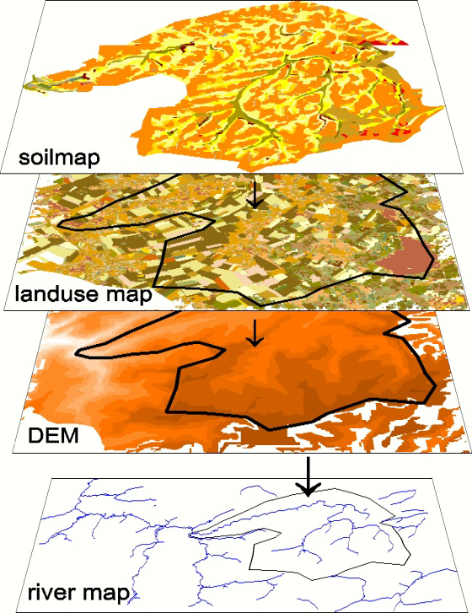
Example
soil moisture modelling
enviroGRIDS
soil and water assessment tool (SWAT): integration of different maps for soil and hydrological modelling

Slide 43
Soil moisture
modelling
Earth observation provides the base layers for soil moisture modelling: soil map, land use map, digital elevation model, river map
Combination with rainfall data, temperature data and evapotranspiration data (derived from or supported with EO)
Cost estimate: on case-by-case basis
Main challenges: capacity, access to data

Slide 44

Examples:
enviroGRIDS:
soil and water assessment tool (SWAT) for soil and hydrological modelling
DRYMON (NEO):
detection of soil moisture with satellites: direct measurement of water in the soil, based on daily observations, works under all weather conditions
GEWEX
European Space Agency's Soil Moisture and Ocean Salinity (SMOS) satellite http://smos.array.ca/web/smos
Soil moisture data for global challenges (Copernicus; 2014)
brochure on the use of EO for regularly updated, global soil moisture maps

Slide 45
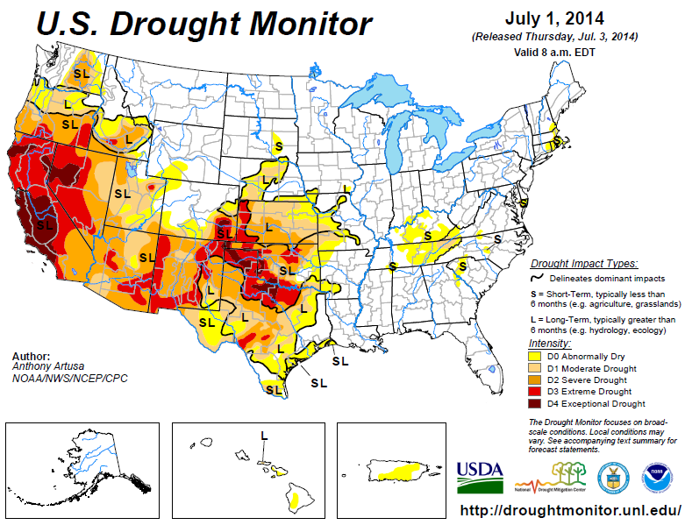
Example
drought monitoring
US drought monitor,
July 1, 2014 (Source: USDA)

Slide 46
Drought monitoring
Remote sensing component (NDVI) + climate component (precipitation index, drought severity index) + biophysical component (land use/land cover type, soil characteristics, elevation, ecological setting).
Currently mainly carried out by government agencies, but increasing involvement of private sector.
Cost estimate: annual continental coverage with a suite of early warning indicators, at 10-day update frequency ranges between 200 and 300 k€.
Main challenges: capacity, data access.

Slide 47



Examples:
The national drought information system implementation plan:
a pathway for national resilience (NIDIS; 2007) www.drought.gov
US drought monitor http://droughtmonitor.unl.edu/
Agriculture and Agri-Food Canada’s Drought Monitoring and Information System (AAFC; 2010) http://www.agr.gc.ca/eng/?id=1326402878459
Managing drought in the Southern Plains (Univ. of Nebraska; 2012)
Drought forecasting (ECMWF; 2012)
DROMAS drought monitor (GISAT; 2013)

Slide 48
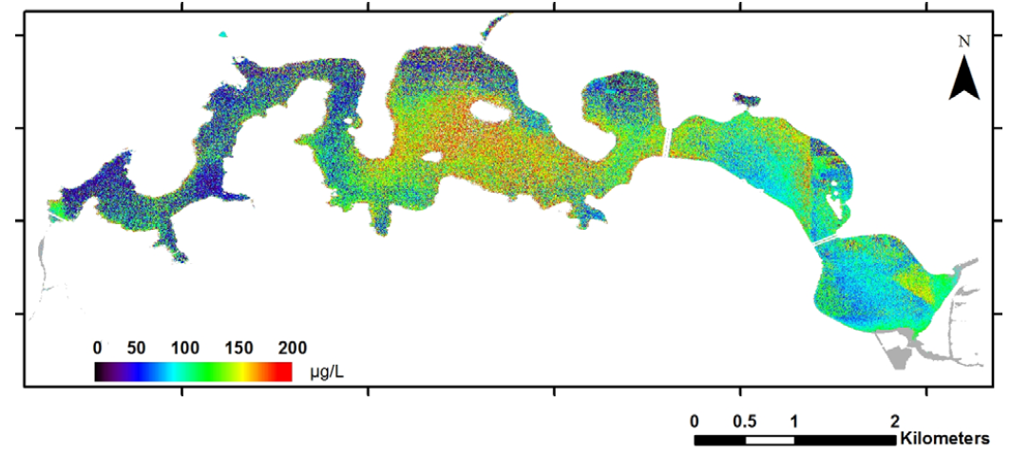
Example
water quality monitoring
Chlorophyll concentration in Lake Burley Griffin from a Worldview‐2 image 17 March 2010 (Source: Dekker, Hestir, 2012)

Slide 49
Water quality
monitoring
EO provides information about chlorophyll content, indicators of harmful algal blooms, coloured dissolved organic matter, suspended matter, vertical light attenuation, turbidity and bathymetry.
Other indicators are derived from analysis of habitats and time series of satellite images (emergent and submerged macrophytes, toxic chemicals, nitrate fertiliser run-off, etc.).
Cost estimate: 50-100k€ per watershed, derived from land-use information (one time step, at 5-10 meter resolution).
Main challenges: capacity, resolution, access to and availability of (in-situ) data, business model.

Slide 50


Examples:
Evaluating the feasibility of systematic inland water quality monitoring with satellite remote sensing
(CSIRO; 2012) overview of EO options for water quality monitoring in Australia
Real time monitoring of water quality parameters (BlueLeg monitor; 2012) handheld remote sensing for water quality that can be used to refine and corroborate EO findings
How clean is your favourite beach? (Copernicus; 2014) brochure on EO applications for water quality and compliance with EU directives

Slide 51
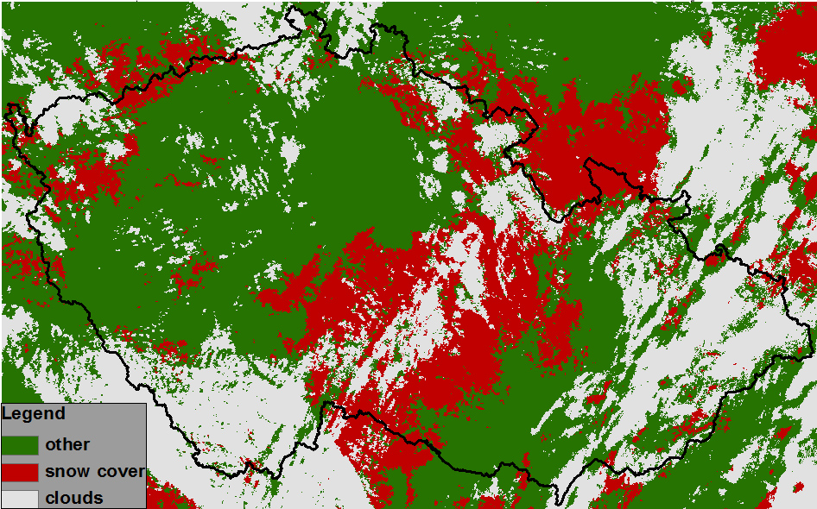
Example snow cover
monitoring
Snow cover
9th February 2009,
Czech Republic
(Source: Charles University)

Slide 52
Snow cover
monitoring
Earth observation provides the input for mapping of snow-covered areas and baseline glacier outlines, changes to the surface area, velocities and mass balance;
Application areas include hydropower, run-off estimates and information to the general public.
Cost estimate: 100-200k€ for annual monitoring of a catchment, 20-50k€ for a glacier baseline product.
Main challenges: capacity, data access, business model.

Slide 53


Examples:
Charles University / GISAT:
snow monitoring in the Czech Republic
Space Research Centre (CBK PAN):
snow monitoring in Poland
Facing the renewable energy challenge (Copernicus; 2014)
brochure on use of EO for snow cover, snow water equivalent & run-off estimation for hydropower

Slide 54
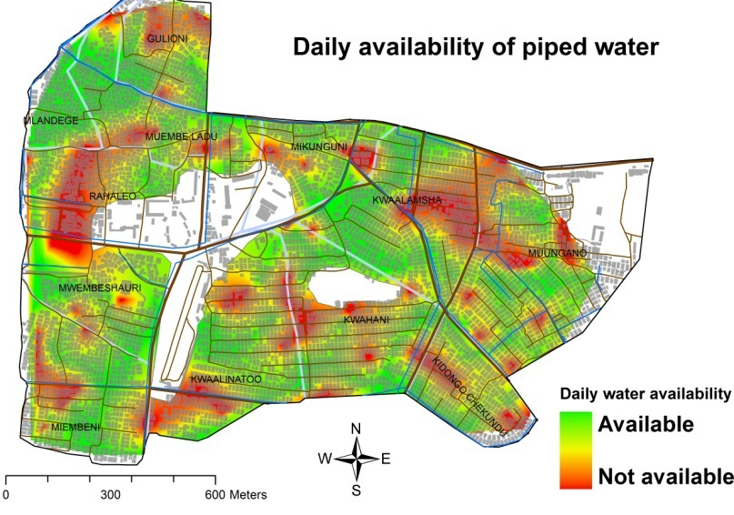
Example water supply
utilities
Availability
of piped water in slums
Source: Mwehe, 2013

Slide 55
Water supply
utilities
As in poor urban areas mostly no up-to-date and detailed maps are available, earth observation images serve as background and reference for mapping water supply utilities, analysis of utility performance, detection of unserved areas and damaged infrastructure, community participation, etc.
Cost estimate: on case-by-case basis;
Main challenges: capacity, cost, stakeholder buy-in.

Slide 56

Examples:
Tapping slum dwellers knowledge to improve water supply delivery in slums (Mwehe; 2013)
presentation on water supply problems in slum and how slum dwellers and service providers can be connected and local knowledge and spatial information can be used to improve the situation
WaterAid:
framework and practical tools (WaterPointMapper) to improve water supply and sanitation in poor areas
H2.0 inform and empower initiative:
initiative sponsored by google to improve water supply and sanitation in poor areas, making use of human sensor webs

Slide 57
Growth potential for
earth observation
Long-term planning water resources planning, climate change scenarios and for (detailed) run-off calculations & (irrigation) system management.
Main clients: government, water management agencies.
Drought monitoring.
Main clients: government, water management agencies, farmers.
Water quality monitoring.
Main clients: government, environmental agencies, NGOs.
Snow cover monitoring.
Main clients: government, general public.

Slide 58
3. Business development

Slide 59
Why is marketing / promotion of earth observation needed?
Public sector information (PSI)
Externalities (environmental accounting & payment for ecosystem services)
Global datasets, open access, data sharing, compatibility (GEO)

Slide 60
If public sector information is made available free-of-charge, demand will increase and, in the end, government revenue also, as companies will derive income from value-added products and services, and consequently pay more taxes (see figures in following slides).

Slide 61
Supply & Demand Public Sector Information
http://vimeo.com/63079712
Source: About GMES and data: geese and golden eggs (Sawyer, de Vries 2012)

Slide 62
Cost-benefit Public Sector Information
Source: About GMES and data: geese and golden eggs (Sawyer, de Vries 2012)

Slide 63
Re-use of Public Sector Information
Source: About GMES and data: geese and golden eggs (Sawyer, de Vries 2012)

Slide 64
Most earth observation applications deal with so-called externalities, such as impact on the environment.
It is difficult to capture these in terms of conventional cost-benefit models.
To tackle this, the following framework for analysis of earth observation applications is developed:

Slide 65
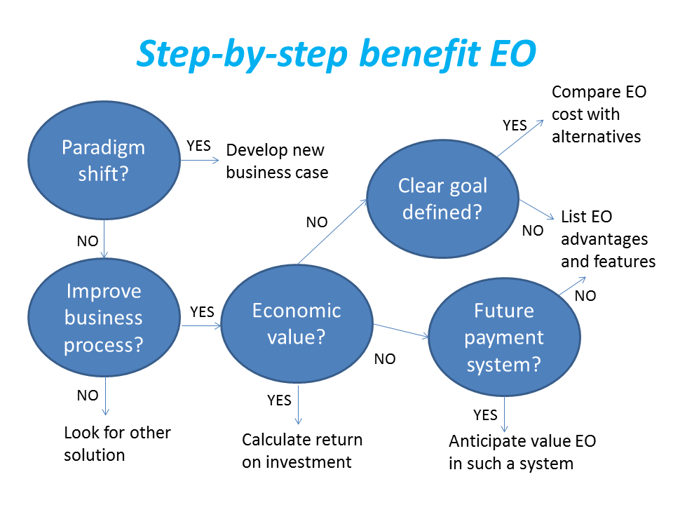
Framework for analysis
Step-by-step analysis of the benefits of earth observation (source: GEONetCab, 2013)

Slide 66
Key questions
Does the new application cause a paradigm shift?
Is the current business or organization process improved?
Does the application provide economic value that can be quantified?
Is a clear measurable goal defined to which the earth observation application contributes?
Is a future payment scheme or other economic mechanism foreseen in which the earth observation application fits?

Slide 67
Assessment of
geospatial solutions
Rating of characteristics of geospatial solutions:
fit-for-purpose
comparative advantage
complexity to user / ease- of-use
elegance
cost-benefit,
sustainability
resilience
reproduction capacity / flexibility
acceptance
level of knowledge transfer required
ethics, transparency, public accountability, objectivity & impartiality
Rating of business environment:
Willingness to pay (by clients)
Embedding (in organizational processes)
Openness (transparency and ease of doing business, access to markets)
Institutions (is the institutional environment conducive to doing business, acceptance of new solutions?)

Slide 68
Fit-for-purpose
An important, but often forgotten requirement:
Does the product or service do what it is supposed to do to solve a certain problem?
In other words: is it really a solution or just an attempt towards a solution?
Quantitative: not applicable
Qualitative (on scale of 1 to 5): based on description of what the EO solution actually does

Slide 69
Comparative
advantage
What it does significantly better than other solutions to the same problem.
For earth observation usually the comparative advantages of greater accuracy, better resolution in time and space, comprehensive overview of large areas and near real-time information provision are mentioned as comparative advantages.
Quantitative: calculation of degree in which the EO solution is better than alternatives
Qualitative (on scale of 1 to 5): based on listing of comparative advantages

Slide 70
Complexity (to user) /
ease-of-use
At all levels in the value chain the users (professionals and
end-users) are able to work with the product or service.
Quantitative: not applicable
Qualitative (on scale of 1 to 5): based on user testimonials and user surveys

Slide 71
Elegance
Once you get the idea behind this product or service, you want to be part of the community that uses it.
This sense of belonging facilitates the formation of user groups that provide valuable feedback.
Quantitative: none, or it should be the size of the user community
Qualitative (on scale of 1 to 5): based on user testimonials and user surveys

Slide 72
Cost-benefit
The cost-benefit of the product or service is quantified and sufficiently attractive, also in the long-term.
Quantitative: cost-benefit calculation
Qualitative (on scale of 1 to 5): based on quantitative assessment

Slide 73
Sustainability
The product or service can be delivered when it is needed.
There is a long-term perspective that guarantees delivery.
Sustainability concerns the following aspects:
Long-term data availability
Availability of finance/funds to provide the solution continuously for present and future use
Long-term institutional / governmental interest and support
Long-term user interest for a solution that addresses real needs
Quantitative: not applicable
Qualitative (on scale of 1 to 5): based on sensitivity analysis of the EO solution

Slide 74
Resilience
In case of extremes or breakdown in the value chain, the product or service can still be delivered at an acceptable level. Alternatives (plan B) are available (and developed).
Quantitative: cost-benefit calculation of plan B
Qualitative (on scale of 1 to 5): based on risk analysis of the EO solution

Slide 75
Reproduction
capacity / flexibility
The product or service can be easily applied or adapted for use in another region or another situation, while still providing the solution without (too much) extra cost.
Quantitative: calculation of reproduction costs for application in other regions or situations; measurement of spreading of actual use
Qualitative (on scale of 1 to 5): based on quantitative assessment and description of EO solution

Slide 76
Acceptance
The users intuitively get what the product or service is about and are interested. They accept it as a solution to their problem.
Quantitative: none, or survey results about acceptance. After introduction of the solution: number of clients and/or users
Qualitative (on scale of 1 to 5): based on user testimonials and user surveys

Slide 77
Level of knowledge
transfer required
The training requirements for professionals and other users along the value chain are clear and associated costs and efforts are acceptable.
Quantitative: cost and time required to get the users at the desired knowledge and skill level
Qualitative (on scale of 1 to 5): based on knowledge transfer plans and evaluation of training activities

Slide 78
Ethics, transparency,
public accountability,
objectivity & impartiality
Application of Earth observation increases the level of objectivity and impartiality in decision-making processes, including conflict resolution. The application improves transparency and public accountability. It raises no ethical issues or if it does, as in the case of privacy concerns, these are resolved in a satisfactory way for all parties concerned.
Quantitative: not applicable
Qualitative (on scale of 1 to 5): based on user testimonials and user surveys

Slide 79
Several attempts have been made to introduce environmental accounting and to enlarge the sphere of the conventional economy to include and quantify impact on ecosystems.
The following slides give some examples:

Slide 80







Environmental accounting & payment for ecosystem services
SEEA:
System of Environmental-Economic Accounts
(EC, FAO, IMF, OECD, UN, WB )
WAVES:
Wealth Accounting and the Valuation of Ecosystem Services (global partnership, led by World Bank)
TEEB:
The Economics of Ecosystems and Biodiversity
(group led by UNEP)

Slide 81
SEEA Conceptual Framework
Source: SEEA conceptual framework report (EC, FAO, IMF, OECD, UN, WB 2012)

Slide 82
For earth observation the work of the Group on Earth Observations (GEO) is essential to achieve the goal of a Global Earth Observations System of Systems (GEOSS), resulting in the shared GEO common infrastructure (GCI):

Slide 83
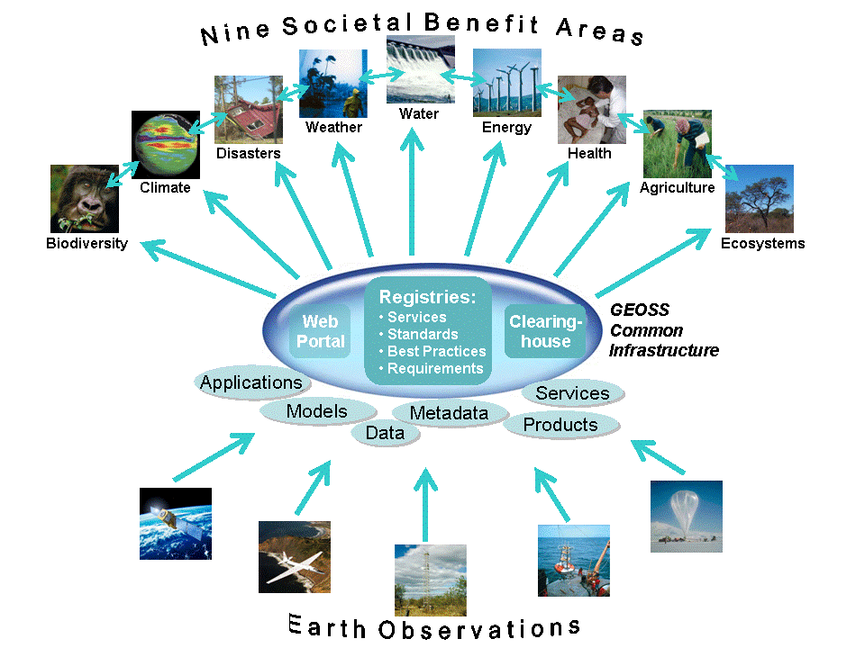

Group on Earth Observations

Slide 84
Marketing elements
Customer value propositions
Crossing the technology chasm
Creating shared value
Promotion tools

Slide 85
Customer value propositions capture the unique value of a product or services as perceived and appreciated by the customer.
Interestingly, they can differ completely from the features that the provider considers most important:

Slide 86
Customer Value Propositions
VALUE PROPOSITION | ALL BENEFITS | FAVOURABLE POINTS OF DIFFERENCE | RESONATING FOCUS
Consists of: | All benefits customers receive from a market offering | All favourable points of difference a market offering has relative to the next best alternative | The one or two points of difference whose improvement will deliver the greatest value to the customer
Answers the customer question: | “Why should our firm purchase your offering?” | “Why should our firm purchase your offering instead of your competitor’s?” | “What is most worthwhile for our firm to keep in mind about your offering?”
Requires: | Knowledge of own market offering | Knowledge of own market offering and next best alternative | Knowledge of how own marketing offering delivers value to customers, compared with next best alternative
Has the potential pitfall: | Benefit assertion | Value presumption | Requires customer value research
Source: Customer value propositions in business markets (HBR 2006)

Slide 87
Buyer behaviour & motivation
Type | Buyer behaviour | Motivation
Transactional sales | Intrinsic value buyers: “keep it cheap and easy to do business” | Understands the product Perceives it as substitutable Cost focus Resents time ‘wasted’ with sales people
Consultative sales | Extrinsic value buyers: “I don’t know the answer: help me analyse and solve the issue | Focus on how the product is used Interested in solutions and applications Values advice and help Needs the sales person
Source: Rethinking the sales force (Rackham, de Vincentis 1999)

Slide 88
Even when customer value propositions are well captured and formulated, introduction of solutions that involve new technology will have to overcome some hurdles.
This is called “crossing the technology chasm”:

Slide 89
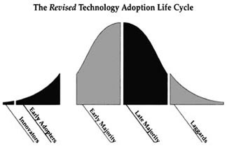
Crossing the technology chasm
Source: Crossing the chasm (Moore 1991)

Slide 90
Crossing the technology chasm
Most clients of EO products and services belong to the early and late majority.
They are pragmatists and are not prepared or willing to take substantial risk: the solution should work and be reliable.
Once convinced, the pragmatists will be long-term clients.
Source: Crossing the chasm (Moore 1991)

Slide 91
More information:
Creating & delivering your value proposition
– managing customer experience for profit
(Barnes, Blake, Pinder; 2009)
Customer value propositions in business markets
(Anderson, Narus, van Rossum [Harvard Business Review]; 2006)
Rethinking the sales force:
refining selling to create and capture customer value
(Rackham, de Vicentis; 1999)
Crossing the chasm
– marketing and selling high-tech products to mainstream customers
(Moore; 1991)

Slide 92
Creating shared value is a key element of successful implementation of earth observation solutions.
To achieve this, in most cases earth observation applications have to be integrated into more general (business or organizational) processes:

Slide 93
Create shared value
Involves cooperation between:
Public sector
Private sector
Social sector
Opportunity for earth observation (integrated) solutions:
Integrate EO in general business / organizational process
Integrate different EO (and GIS and navigation) functionalities

Slide 94
Based on all considerations dealt with in the previous slides, there are some practical approaches that can be applied in combination to promote earth observation applications:

Slide 95

Tools for earth observation marketing:
Success stories (in non-technical language, feasible, replication capacity, sustainable)
Marketing toolkits (international trends, earth observation examples, references)
Pilot projects, innovation funds, quick-wins (demonstration that EO actually works)
Promotion outside EO community (fairs, seminars, lunch-bag meetings, magazines)
Resource facilities for reference and capacity building (distributed, but connected, in different languages)
Source: Marketing earth observation products and services (Noort 2013)

Slide 96
Business elements
Business elements:
Proposal writing
Business procedures

Slide 97
Proposal writing is an art in itself.
During the GEONetCab and EOPOWER projects templates have been developed for writing successful proposals:

Slide 98
Proposal outline
1. Introduction / relevance
2. Objective(s)
3. Activities
4. Output
5. Management & evaluation
6. Risk assessment
7. Time schedule
8. Budget
Annexes
(more detailed version in separate document,
see www.eopower.eu or www.hcpinternational.com)

Slide 99


Other guides that may be useful:
Civicus: writing a funding proposal
Michigan State University: guide for writing a funding proposal
ESRI: writing a competitive GRANT application
REC: project proposal writing

Slide 100
If you run a company, compete for assignments and manage projects, a structured approach towards responsibilities, tasks, implementation and documentation is needed.
The following business procedures may be helpful:

Slide 101
Business procedures
1. On acquisition
2. On offers
3. On negotiation
4. On contracts
5. On project management
6. On travel & deployment
7. On deficiencies & complaints
8. On internal organization
9. On finance
(more detailed version in separate document,
see www.eopower.eu or www.hcpinternational.com)

Slide 102
Again:
SHARED PROBLEM
SHARED LANGUAGE
SHARED SOLUTION

Slide 103
4. Capacity Building

Slide 104
General
Marketing is promotion + capacity building.
Especially for the introduction of new technologies capacity building is important at all levels.
Capacity building is the instrument to increase
self-sufficiency and make solutions work.

Slide 105


General references for capacity building, open data and success stories
GEO Portal: www.earthobservations.org
Capacity building resource facility www.geocab.org
compilation of tutorials, references, open-source software, etc.
Satellites going local: share good practice (Eurisy handbooks) www.eurisy.org
Earth observation for green growth (ESA; 2013)

Slide 106

General references for capacity building, open data + call for proposals
Bringing GEOSS services into practice:
how to use data from the GEO portal and how to provide input
www.envirogrids.net
Science education through earth observation for high schools: basic tutorials on all kind of subjects
www.seos-project.eu
Securing water for food: call for proposals on innovative solutions
securingwaterforfood.org
Copernicus briefs: information on satellite applications for different topics
http://www.copernicus.eu/main/copernicus-briefs

Slide 107
More references open data
Open data for sustainable development (World Bank; 2015)
description of the benefits of open data for a wide range of development goals, including the SDGs http://pubdocs.worldbank.org/pubdocs/publicdoc/2015/8/904051440717425994/Open-Data-for-Sustainable-development-Final-New.pdf
Terms and conditions for the use and distribution of Sentinel data (European Parliament and European Commission; 2014)
standard stipulations related to free and open access to Sentinel data http://www.demarine.de/lr/c/document_library/get_file?uuid=c5067655-b7ad-4d71-b07b-6111808f4abd&groupId=13521
Towards a thriving data-driven economy (European Commission; 2014) policy document on the use of (open) data for a knowledge economy and society
http://ec.europa.eu/information_society/newsroom/cf/dae/document.cfm?doc_id=6210

Slide 108

Capacity building resources for water management:
The TIGER initiative – looking for water in Africa (ESA; 2011)
Technical material for water resources assessment
(WMO; 2012)
Guide to hydrological practices: part 1 & part 2 (WMO; 2009)
Water point mapper: user guide & configuration guide (WaterAid)
Remote sensing applications
chapter 6: Water & chapter 8: Groundwater (NRSC, 2010)
MetEd: tutorials and courses on meteorology and related subjects
https://www.meted.ucar.edu/training_detail.php

Slide 109
Capacity building resources for water management (2):
From cloud top temperature to rainfall
Blending TRMM and MSG (ITC; 2015)
3-day EOPOWER (self-study) course for professionals
http://menhir.itc.utwente.nl:5000/fbsharing/KGKOZXKU/

Slide 110
Further details:
Contact: Mark Noort
m.noort@hcpinternational.com
www.eopower.eu
www.hcpinternational.com

