Slide 1



Earth Observation for
Urban Management, Land Administration
& Spatial Data Infrastructures
International trends & developments
Earth observation applications
Business development
Capacity building

Slide 2

0. Introduction
Mark Noort, consultant, project manager
HCP international:
consulting, marketing of earth observation
Project director EOPOWER:
project for promotion & capacity building of
earth observation applications

Slide 3
Sequence:
General assessment of the state-of-the-art of earth observation
Major trends and developments in the application field
Description of earth observation solutions
Assessment of market potential for earth observation solutions and marketing instruments
Capacity building for successful application of earth observation solutions

Slide 4
Earth Observation helps you: save money save lives save the environment

Slide 5
Earth observation
applications
On the verge of reaching new user communities
These new user communities need to be involved
Weakest link / last mile aspects are important
Marketing needed: promotion & capacity building

Slide 6
Life cycle of products & services
Initialization
System analysis & design
Rapid prototyping
System development
Implementation
Post-implementation

Slide 7
Scope and definitions
Urban management: a set of instruments, activities, tasks and functions that assures that a city can function.
Land administration: the way in which the rules of land tenure are applied and made operational.
Spatial data infrastructure: a data infrastructure implementing a framework of geographic data, metadata, users and tools that are interactively connected in order to use spatial data in an efficient and flexible way.
Data infrastructure: a digital infrastructure promoting data sharing and consumption.
These subjects are transversal and relevant to all other toolkits.

Slide 8
Assessment of business & funding opportunities
Categories of urban management, land administration & spatial data infrastructures products & services
Life cycle phase of product or service
Regional context, level of technological & economic development
Optimum marketing mix

Slide 9
1. International trends & developments in urban management, land administration & spatial data infrastructures

Slide 10
Issues & trends
Urban management: increasing urbanization puts greater demands on urban management’
Need for proper land administration: necessary condition for (sustainable) economic development;
Spatial data infrastructures: needed to manage ever more complicated organizational and spatial structures effectively and efficiently;
Increasing demands from citizens on government + a trend towards citizen involvement.

Slide 11
Drivers
Urban management: increasing urbanisation requires more and improved urban management to cope with challenges;
Land administration: increased need for and importance of fit-for-purpose and transparent land administration as basic condition for economic development;
Spatial data infrastructures: society is getting more and more complicated and effective and efficient mechanisms are needed for governance.
At all levels: increased interest in and demand for public participation, interactivity, transparency and accountability.

Slide 12
Urban management
Rapid urban growth: need for management and planning;
Improve the urban living environment: infrastructure, services, health, environment;
Improve urban safety: risk management (natural and man-made disasters), crime, anticipating and mitigating climate change;
Increase community participation: e-governance, web-based consultation.

Slide 13
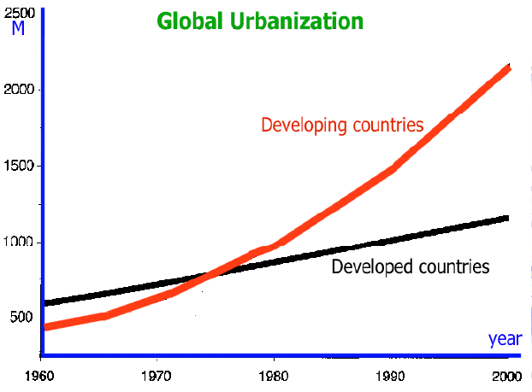
Absolute urban growth
Source: http://iwrmnotes.blogspot.com

Slide 14
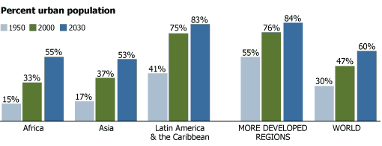
And relative urban growth
Source: www.prb.org

Slide 15

Example urban Africa:
Diversity of urban sizes
Large cities are growing at a faster rate than smaller cities
Great heterogeneity between countries in size distribution of their cities
Faster urban growth means faster slum growth
More and better infrastructure and services are needed
Source: Africa’s urbanization for development: understanding Africa’s urban challenges and opportunities (World Bank)

Slide 16

More information:
Building sustainability in an urbanizing world (World Bank; 2013). description of strategy options for smart and sustainable cities
Systems of cities – Harnessing urbanization for growth and poverty alleviation (World Bank; 2009) analysis of the challenges of urbanization and opportunities for economic growth and poverty reduction
Urban equity in development – Cities for life (UN-HABITAT; 2013) analysis of inequality in cities with advice to address the issue
Africa’s urbanization for development: understanding Africa’s urban challenges and opportunities (World Bank; 2008) description of urbanization developments in Africa with advice for policy makers

Slide 17
Land administration
A fit-for-purpose and transparent land administration system delivers:
Improvement of security of tenure;
Improved land resources management;
A reduction of land disputes;
Increased revenue generation;
Credit security.

Slide 18


Pro-poor land administration
The ten design elements of the pro-poor land recordation system (re-worked from Williamson et al., 2010: land administration for sustainable development)

Slide 19
Desirable characteristics of
property rights to land:
Long enough horizon to provide investment incentives
Defined in a way that makes them easy to observe, enforce and exchange
Administered and enforced by institutions that have both legal backing and social legitimacy and are accessible by and accountable to the holders of property rights
Rights and duties of individuals, within a group that holds communal rights, have to be clear
Institutions administering property rights need to be flexible enough to evolve over time in response to changing requirements
Source: Land policies for growth and poverty reduction – executive summary (World Bank)

Slide 20


More information:
Pro-poor land administration: principles for recording the land rights of the underrepresented (ITC; 2013) description of a pro-poor approach to land administration, as developed by the global land tool network (GLTN)
Crowd sourcing support of land administration (RICS; 2012) description of opportunities provided by crowd sourcing for land administration, including examples of crowd sourcing with mobile phones for other applications
Land policies for growth and poverty reduction - executive summary (World Bank; 2003) description of the basics for good land policies, showing empirical evidence of the link between tenure security and economic development and poverty reduction + an analysis of land markets and description of the situation in different regions of the world

Slide 21


More information (2):
The application of geospatial information – Land administration and management (UN-GGIM; 2015) paper describing issues pertaining to land administration and the benefits of using geospatial information for land administration
Innovations in land administration (ITC; 2015) presentation on land administration, tenure forms and innovations, with examples from Ethiopia
Fit-for-purpose land administration (FIG, World Bank; 2014) description of conditions and methodologies to build appropriate land administration systems that meet the needs of people and their relationship to land, support security of tenure for all and enable sustainable management of land use and natural resources

Slide 22
Spatial data
infrastructures
Implementation of SDI leads to positive cultural change in the stakeholder organizations with greater willingness to cooperate and share resources;
SDIs facilitate better coordination, avoidance of duplication and reduction of costs;
SDIs improve shared understanding among public agencies of the problems and issues;
SDIs facilitate building and supporting applications for citizens and local businesses related to land and property, planning, traffic, local services, as well as allowing new services from the private sector to be developed around addresses and locations.

Slide 23
SDI goals
Spatial data infrastructures: some lessons learned from UK and Europe (Source: ConsultingWhere, 2011)

Slide 24


More information:
Advanced regional spatial data infrastructures in Europe (JRC; 2009) comparison of different regional SDIs in Europe (and elsewhere) + recommendations
The socio-economic impact of the spatial data infrastructure of Catalonia (JRC; 2008) study into cost-benefit of SDI in Catalonia: mainly derived from internal efficiency (time saved by government staff) and external effectiveness (time saved by the general public) + potential democracy impact
Spatial data infrastructures: Some lessons learned from UK and Europe (ConsultingWhere; 2011) presentation with practical examples and lessons for setting up an SDI

Slide 25


More information (2):
Geospatial Science & Technology and Development (UNCTAD; 2012) report on the state-of-the-art of geospatial science and applications, including urban management, land administration and SDIs
Report on user requirements, costs, derived direct benefits, and current obstacles for a European and Global Spatial Data Infrastructure (EuroGEOSS; 2010) report describing the user requirements, costs, derived direct benefits, and current obstacles for a European and Global Spatial Data Infrastructure, with special emphasis on GEOSS and INSPIRE, based on a survey of (potential) users
National spatial data infrastructure: the case of Brazil (World Bank; 2010) report on how to establish and sustain a national SDI for Brazil

Slide 26

More information (3):
A conceptual model for developing interoperability specifications in spatial data infrastructures (JRC; 2012)
report describing requirements and best practices for interoperability of geographic and environmental information in Europe
European Directive (2007/2/EC) INSPIRE – update on building European Spatial Data Infrastructure (JRC; 2013) presentation explaining what INSPIRE is all about
United Nations e-government survey – E-government for the future we want (UNDESA; 2014)
report on status of and developments in e-government around the world

Slide 27
2. Earth observation applications

Slide 28
Earth observation for urban management, LA & SDI
LIDAR map from Manhattan, New York, USA

Slide 29
Earth observation
contribution
Urban management
Slum mapping and monitoring,
as special application of urban management
Land administration
Spatial data infrastructures play a role in all three (and other) earth observation applications

Slide 30
Example urban
management
Comparison of urban objects and land uses in Enschede,
the Netherlands,
by sensor and spatial resolution (each window represents
a 400 × 400 m area
on the ground)
(source: Remote sensing of urban and suburban areas, 2010)

Slide 31
Example urban management:
Impervious surfaces in urban Germany (Source: Urban remote sensing, 2010)

Slide 32
Urban management
Earth observation can provide a useful and direct indication of the physical form and morphology of urban land cover in cities;
Applications in urban population studies, health, environment, urban land use, heat islands, crime mapping, etc.;
Earth observation supports “smart growth” (a range of urban strategies that focuses on sustainability of development under different economic scenarios);
Cost estimate: on case-by-case basis;
Main challenges: cost, complexity, knowledge transfer.

Slide 33


Examples:
Urban remote sensing: how can earth observation support the sustainable development of urban environments? (Esch, et al.; 2010) article describing opportunities for remote sensing with examples on monitoring of urban sprawl, mapping of the percent impervious surface, mapping of urban heat islands (local heating potential), micro-climate model development and flood vulnerability and risk mapping
Remote sensing of urban and suburban areas (EARSEL; 2010) book with collection of state-of-the-art chapters on urban remote sensing, aimed at capacity building (with references) and a strong focus on science and techniques
Workshop report on sustainable urban development (NASA; 2009) urban heat islands, urban vulnerability to climate change, sustainability (including transportation and renewable energy), community participation, sustainable buildings, air quality and urban health, urban risk management

Slide 34

Examples (2):
Expanding cities – A growing concern (Copernicus; 2013) brochure on monitoring urban sprawl
Satellites help to design more habitable cities (Copernicus; 2013) brochure on identification and monitoring of urban heat islands
Keeping Europe on the move (Copernicus; 2014) brochure on monitoring road infrastructure and road planning
Satellites help to monitor infrastructure stability (Copernicus; 2013) brochure on monitoring subsidence of infrastructure in the urban environment
A conceptual list of indicators for urban planning and management based on earth observation (Chrysoulakis; 2014) overview of EO-based products and their suitability for urban management

Slide 35
Example
slum mapping
An example of
slum delineation in different contexts by an Indian expert.
City names:
(a) Ahmedabad (India),
(b) Nairobi (Kenya),
(c) Cape Town
(South Africa)
and
(d) Kisumu (Kenya).
(Source: ITC, 2012)

Slide 36
Slum mapping
Earth observation supports mapping and monitoring of features such as the access network, density of housing (roofs), shape of the area (unplanned), connectivity with neighbouring areas (poor) and location;
Earth observation facilitates change monitoring to assess the effect of development interventions;
Cost estimate: on case-by-case basis;
Main challenges: cost, complexity, knowledge transfer.

Slide 37

Examples:
An ontology of slums for image-based classification (ITC; 2012) article on how slums can be identified and development in slums monitored with the help of satellite images
Urban slum monitoring (UN-HABITAT; 2004) article describing methodology for urban slum monitoring with practical examples
Analysing sub-standard areas using high resolution remote sensing (VHR) imagery – Case study of Mumbai, India (ITC; 2013) same as above, but applied to Mumbai

Slide 38
Example
land administration
Digitised parcel boundaries with the help of satellite images in Ethiopia (source: WB, 2010)

Slide 39
Land administration
Earth observation facilitates rapid mapping and change monitoring;
Earth observation supports high-speed cadastral surveying, especially in rural areas;
Satellite images can provide the base layer for a participatory approach to land administration and increase transparency;
Cost estimate: on case-by-case basis;
Main challenges: cost, acceptance, knowledge transfer.

Slide 40

Examples:
An integrated approach for updating cadastral maps in Pakistan using satellite remote sensing data (ITC; 2012) article describing the use of remote sensing (aerial survey and satellite images) as part of the workflow for cadastral maps
The cadastral divide – A view from the bridge (ITC: 2012) article on geospatial technology for effective land administration systems
First experiences with high-resolution imagery-based adjudication approach in Ethiopia (ITC; 2010) chapter of the World Bank study ‘Innovations in land rights recognition, administration, and governance’ on the use of satellite images for a participatory approach with local communities in Ethiopia.
The Social Tenure Domain Model - A pro-poor land tool (FIG, ITC; 2010) description of a land administration methodology that accommodates communal (and other forms of) land rights (social tenure).

Slide 41
Growth potential for
earth observation
Urban management applications.
Main clients: municipalities, utilities, international organizations.
Slum mapping.
Main clients: municipalities, international organizations, NGOs.
Land administration.
Main clients: national government, international organizations.
Paying clients come primarily from the public sector.

Slide 42
3. Business development

Slide 43
Why is marketing / promotion of earth observation needed?
Public sector information (PSI)
Externalities (environmental accounting & payment for ecosystem services)
Global datasets, open access, data sharing, compatibility (GEO)

Slide 44
If public sector information is made available free-of-charge, demand will increase and, in the end, government revenue also, as companies will derive income from value-added products and services, and consequently pay more taxes (see figures in following slides).

Slide 45
Supply & Demand Public Sector Information
http://vimeo.com/63079712
Source: About GMES and data: geese and golden eggs (Sawyer, de Vries 2012)

Slide 46
Cost-benefit Public Sector Information
Source: About GMES and data: geese and golden eggs (Sawyer, de Vries 2012)

Slide 47
Re-use of Public Sector Information
Source: About GMES and data: geese and golden eggs (Sawyer, de Vries 2012)

Slide 48
Most earth observation applications deal with so-called externalities, such as impact on the environment.
It is difficult to capture these in terms of conventional cost-benefit models.
To tackle this, the following framework for analysis of earth observation applications is developed:

Slide 49
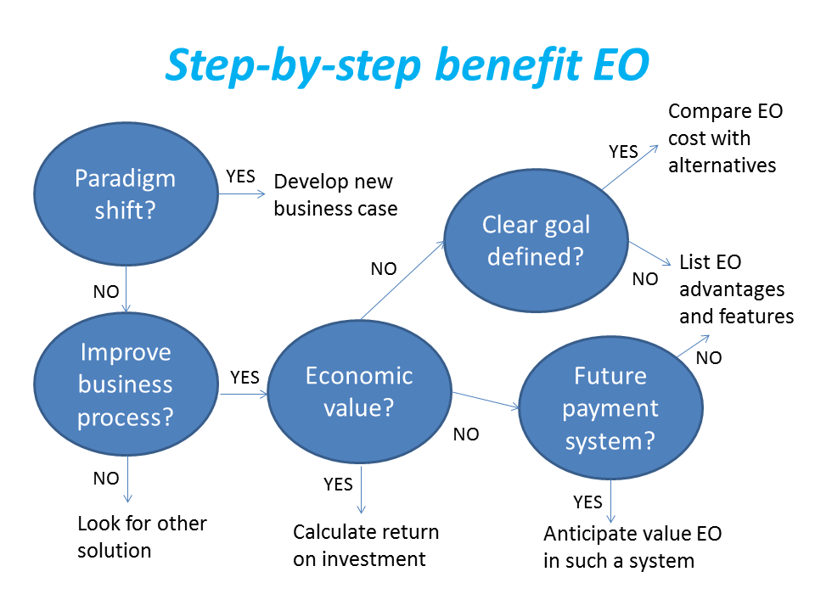
Framework for analysis
Step-by-step analysis of the benefits of earth observation (source: GEONetCab, 2013)

Slide 50
Key questions
Does the new application cause a paradigm shift?
Is the current business or organization process improved?
Does the application provide economic value that can be quantified?
Is a clear measurable goal defined to which the earth observation application contributes?
Is a future payment scheme or other economic mechanism foreseen in which the earth observation application fits?

Slide 51
Assessment of
geospatial solutions
Rating of characteristics of geospatial solutions:
fit-for-purpose
comparative advantage
complexity to user / ease- of-use
elegance
cost-benefit,
sustainability
resilience
reproduction capacity / flexibility
acceptance
level of knowledge transfer required
ethics, transparency, public accountability, objectivity & impartiality
Rating of business environment:
Willingness to pay (by clients)
Embedding (in organizational processes)
Openness (transparency and ease of doing business, access to markets)
Institutions (is the institutional environment conducive to doing business, acceptance of new solutions?)

Slide 52
Fit-for-purpose
An important, but often forgotten requirement:
Does the product or service do what it is supposed to do to solve a certain problem?
In other words: is it really a solution or just an attempt towards a solution?
Quantitative: not applicable
Qualitative (on scale of 1 to 5): based on description of what the EO solution actually does

Slide 53
Comparative advantage
What it does significantly better than other solutions to the same problem.
For earth observation usually the comparative advantages of greater accuracy, better resolution in time and space, comprehensive overview of large areas and near real-time information provision are mentioned as comparative advantages.
Quantitative: calculation of degree in which the EO solution is better than alternatives
Qualitative (on scale of 1 to 5): based on listing of comparative advantages

Slide 54
Complexity (to user) / ease-of-use
At all levels in the value chain the users (professionals and
end-users) are able to work with the product or service.
Quantitative: not applicable
Qualitative (on scale of 1 to 5): based on user testimonials and user surveys

Slide 55
Elegance
Once you get the idea behind this product or service, you want to be part of the community that uses it.
This sense of belonging facilitates the formation of user groups that provide valuable feedback.
Quantitative: none, or it should be the size of the user community
Qualitative (on scale of 1 to 5): based on user testimonials and user surveys

Slide 56
Cost-benefit
The cost-benefit of the product or service is quantified and sufficiently attractive, also in the long-term.
Quantitative: cost-benefit calculation
Qualitative (on scale of 1 to 5): based on quantitative assessment

Slide 57
Sustainability
The product or service can be delivered when it is needed.
There is a long-term perspective that guarantees delivery.
Sustainability concerns the following aspects:
Long-term data availability
Availability of finance/funds to provide the solution continuously for present and future use
Long-term institutional / governmental interest and support
Long-term user interest for a solution that addresses real needs
Quantitative: not applicable
Qualitative (on scale of 1 to 5): based on sensitivity analysis of the EO solution

Slide 58
Resilience
In case of extremes or breakdown in the value chain, the product or service can still be delivered at an acceptable level. Alternatives (plan B) are available (and developed).
Quantitative: cost-benefit calculation of plan B
Qualitative (on scale of 1 to 5): based on risk analysis of the EO solution

Slide 59
Reproduction
capacity / flexibility
The product or service can be easily applied or adapted for use in another region or another situation, while still providing the solution without (too much) extra cost.
Quantitative: calculation of reproduction costs for application in other regions or situations; measurement of spreading of actual use
Qualitative (on scale of 1 to 5): based on quantitative assessment and description of EO solution

Slide 60
Acceptance
The users intuitively get what the product or service is about and are interested. They accept it as a solution to their problem.
Quantitative: none, or survey results about acceptance. After introduction of the solution: number of clients and/or users
Qualitative (on scale of 1 to 5): based on user testimonials and user surveys

Slide 61
Level of knowledge
transfer required
The training requirements for professionals and other users along the value chain are clear and associated costs and efforts are acceptable.
Quantitative: cost and time required to get the users at the desired knowledge and skill level
Qualitative (on scale of 1 to 5): based on knowledge transfer plans and evaluation of training activities

Slide 62
Ethics, transparency,
public accountability,
objectivity & impartiality
Application of Earth observation increases the level of objectivity and impartiality in decision-making processes, including conflict resolution. The application improves transparency and public accountability. It raises no ethical issues or if it does, as in the case of privacy concerns, these are resolved in a satisfactory way for all parties concerned.
Quantitative: not applicable
Qualitative (on scale of 1 to 5): based on user testimonials and user surveys

Slide 63
Several attempts have been made to introduce environmental accounting and to enlarge the sphere of the conventional economy to include and quantify impact on ecosystems.
The following slides give some examples:

Slide 64







Environmental accounting & payment for ecosystem services
SEEA:
System of Environmental-Economic Accounts
(EC, FAO, IMF, OECD, UN, WB )
WAVES:
Wealth Accounting and the Valuation of Ecosystem Services (global partnership, led by World Bank)
TEEB:
The Economics of Ecosystems and Biodiversity
(group led by UNEP)

Slide 65
SEEA Conceptual Framework
Source: SEEA conceptual framework report (EC, FAO, IMF, OECD, UN, WB 2012)

Slide 66
For earth observation the work of the Group on Earth Observations (GEO) is essential to achieve the goal of a Global Earth Observations System of Systems (GEOSS), resulting in the shared GEO common infrastructure (GCI):

Slide 67
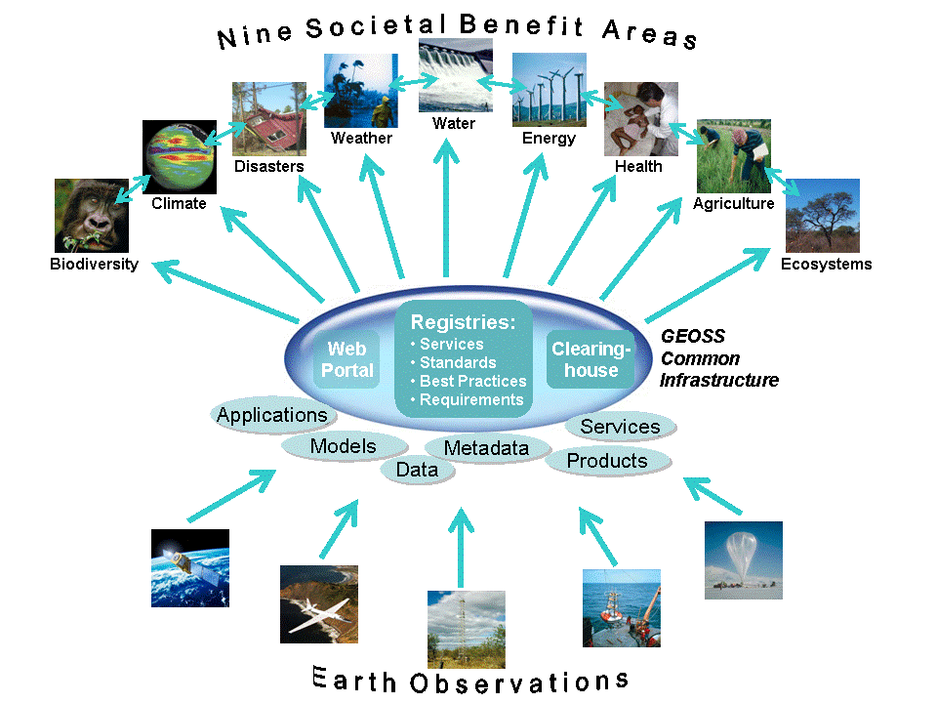

Group on Earth Observations

Slide 68
Marketing elements
Customer value propositions
Crossing the technology chasm
Creating shared value
Promotion tools

Slide 69
Customer value propositions capture the unique value of a product or services as perceived and appreciated by the customer.
Interestingly, they can differ completely from the features that the provider considers most important:

Slide 70
Customer Value Propositions
VALUE PROPOSITION | ALL BENEFITS | FAVOURABLE POINTS OF DIFFERENCE | RESONATING FOCUS
Consists of: | All benefits customers receive from a market offering | All favourable points of difference a market offering has relative to the next best alternative | The one or two points of difference whose improvement will deliver the greatest value to the customer
Answers the customer question: | “Why should our firm purchase your offering?” | “Why should our firm purchase your offering instead of your competitor’s?” | “What is most worthwhile for our firm to keep in mind about your offering?”
Requires: | Knowledge of own market offering | Knowledge of own market offering and next best alternative | Knowledge of how own marketing offering delivers value to customers, compared with next best alternative
Has the potential pitfall: | Benefit assertion | Value presumption | Requires customer value research
Source: Customer value propositions in business markets (HBR 2006)

Slide 71
Buyer behaviour & motivation
Type | Buyer behaviour | Motivation
Transactional sales | Intrinsic value buyers: “keep it cheap and easy to do business” | Understands the product Perceives it as substitutable Cost focus Resents time ‘wasted’ with sales people
Consultative sales | Extrinsic value buyers: “I don’t know the answer: help me analyse and solve the issue | Focus on how the product is used Interested in solutions and applications Values advice and help Needs the sales person
Source: Rethinking the sales force (Rackham, de Vincentis 1999)

Slide 72
Even when customer value propositions are well captured and formulated, introduction of solutions that involve new technology will have to overcome some hurdles.
This is called “crossing the technology chasm”:

Slide 73
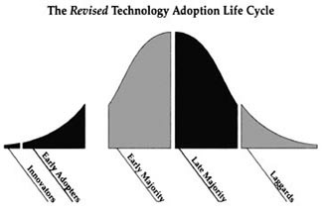
Crossing the technology chasm
Source: Crossing the chasm (Moore 1991)

Slide 74
Crossing the technology chasm
Most clients of EO products and services belong to the early and late majority,
They are pragmatists and are not prepared or willing to take substantial risk: the solution should work and be reliable.
Once convinced, the pragmatists will be long-term clients.
Source: Crossing the chasm (Moore 1991)

Slide 75
More information:
Creating & delivering your value proposition
– managing customer experience for profit
(Barnes, Blake, Pinder; 2009)
Customer value propositions in business markets
(Anderson, Narus, van Rossum [Harvard Business Review]; 2006)
Rethinking the sales force:
refining selling to create and capture customer value
(Rackham, de Vicentis; 1999)
Crossing the chasm
– marketing and selling high-tech products to mainstream customers
(Moore; 1991)

Slide 76
Creating shared value is a key element of successful implementation of earth observation solutions.
To achieve this, in most cases earth observation applications have to be integrated into more general (business or organizational) processes:

Slide 77
Create shared value
Involves cooperation between:
Public sector
Private sector
Social sector
Opportunity for earth observation (integrated) solutions:
Integrate EO in general business / organizational process
Integrate different EO (and GIS and navigation) functionalities

Slide 78
Based on all considerations dealt with in the previous slides, there are some practical approaches that can be applied in combination to promote earth observation applications:

Slide 79

Tools for earth observation marketing:
Success stories (in non-technical language, feasible, replication capacity, sustainable)
Marketing toolkits (international trends, earth observation examples, references)
Pilot projects, innovation funds, quick-wins (demonstration that EO actually works)
Promotion outside EO community (fairs, seminars, lunch-bag meetings, magazines)
Resource facilities for reference and capacity building (distributed, but connected, in different languages)
Source: Marketing earth observation products and services (Noort 2013)

Slide 80
Business elements
Business elements:
Proposal writing
Business procedures

Slide 81
Proposal writing is an art in itself.
During the GEONetCab and EOPOWER projects templates have been developed for writing successful proposals:

Slide 82
Proposal outline
1. Introduction / relevance
2. Objective(s)
3. Activities
4. Output
5. Management & evaluation
6. Risk assessment
7. Time schedule
8. Budget
Annexes
(more detailed version in separate document,
see www.eopower.eu or www.hcpinternational.com)

Slide 83


Other guides that may be useful:
Civicus: writing a funding proposal
Michigan State University: guide for writing a funding proposal
ESRI: writing a competitive GRANT application
REC: project proposal writing

Slide 84
If you run a company, compete for assignments and manage projects, a structured approach towards responsibilities, tasks, implementation and documentation is needed.
The following business procedures may be helpful:

Slide 85
Business procedures
1. On acquisition
2. On offers
3. On negotiation
4. On contracts
5. On project management
6. On travel & deployment
7. On deficiencies & complaints
8. On internal organization
9. On finance
(more detailed version in separate document,
see www.eopower.eu or www.hcpinternational.com)

Slide 86
Again:
SHARED PROBLEM
SHARED LANGUAGE
SHARED SOLUTION

Slide 87
4. Capacity Building

Slide 88
General
Marketing is promotion + capacity building.
Especially for the introduction of new technologies capacity building is important at all levels.
Capacity building is the instrument to increase
self-sufficiency and make solutions work.

Slide 89


General references for capacity building, open data and success stories
GEO Portal: www.earthobservations.org
Capacity building resource facility www.geocab.org
compilation of tutorials, references, open-source software, etc.
Satellites going local: share good practice (Eurisy handbooks) www.eurisy.org
Earth observation for green growth (ESA; 2013)

Slide 90

General references for capacity building, open data (2)
Bringing GEOSS services into practice:
how to use data from the GEO portal and how to provide input
www.envirogrids.net
Science education through earth observation for high schools: basic tutorials on all kind of subjects
www.seos-project.eu
Copernicus briefs:
information on satellite applications for different topics
http://www.copernicus.eu/main/copernicus-briefs

Slide 91
More references open data
Open data for sustainable development (World Bank; 2015)
description of the benefits of open data for a wide range of development goals, including the SDGs http://pubdocs.worldbank.org/pubdocs/publicdoc/2015/8/904051440717425994/Open-Data-for-Sustainable-development-Final-New.pdf
Terms and conditions for the use and distribution of Sentinel data (European Parliament and European Commission; 2014)
standard stipulations related to free and open access to Sentinel data http://www.demarine.de/lr/c/document_library/get_file?uuid=c5067655-b7ad-4d71-b07b-6111808f4abd&groupId=13521
Towards a thriving data-driven economy (European Commission; 2014) policy document on the use of (open) data for a knowledge economy and society
http://ec.europa.eu/information_society/newsroom/cf/dae/document.cfm?doc_id=6210

Slide 92
Capacity building resources for urban management:
Remote sensing of urban and suburban areas (EARSEL; 2010) book with collection of state-of-the-art chapters on urban remote sensing, aimed at capacity building (with references) and a strong focus on science and techniques
Remote sensing applications – Chapter 5: urban and regional planning (NRSC; 2010)
For slum mapping and land administration:
see earth observation applications references

Slide 93
Further details:
Contact: Mark Noort
m.noort@hcpinternational.com
www.eopower.eu
www.hcpinternational.com

