Slide 1



Earth Observation for
Marine Resources & Environment
International trends & developments
Earth observation applications
Business development
Capacity building

Slide 2

0. Introduction
Mark Noort, consultant, project manager
HCP international:
consulting, marketing of earth observation
Project director EOPOWER:
project for promotion & capacity building of
earth observation applications

Slide 3
Sequence:
General assessment of the state-of-the-art of earth observation
Major trends and developments in the application field
Description of earth observation solutions
Assessment of market potential for earth observation solutions and marketing instruments
Capacity building for successful application of earth observation solutions

Slide 4
Earth Observation helps you: save money save lives save the environment

Slide 5
Earth observation
applications
On the verge of reaching new user communities
These new user communities need to be involved
Weakest link / last mile aspects are important
Marketing needed: promotion & capacity building

Slide 6
Life cycle of products & services
Initialization
System analysis & design
Rapid prototyping
System development
Implementation
Post-implementation

Slide 7
Scope
Marine resources are
physical and biological entities that are found in seas and oceans that are beneficial to man
The “marine environment” can be described as:
the oceans, seas, bays, estuaries, and other major water bodies, including their surface interface and interaction, with the atmosphere and with the land seaward of the mean high water mark
Climate aspects are dealt with more in detail in the climate toolkit, disasters (hurricanes, flooding, tsunamis, etc.) in the disaster management toolkit and offshore wind and tidal energy in the energy and mining toolkit. Other aspects of coastal zone management are part of this toolkit.

Slide 8
Assessment of business & funding opportunities
Categories of marine resources & environment products & services
Life cycle phase of product or service
Regional context, level of technological & economic development
Optimum marketing mix

Slide 9
1. International trends & developments in marine resources & environment

Slide 10
Issues & trends in
marine resources
& environment
More attention for:
(sustainable) fisheries management
management of extreme events (flooding, safety, pollution, etc.) -> in disaster management toolkit
management of marine and coastal ecosystems
effects of climate change -> in climate toolkit
more effective and efficient exploitation of resources (oil, wind, tidal, etc.) -> in energy and mining toolkit
community participation and public awareness

Slide 11
Drivers
Increased urbanization and population growth in coastal zones;
Increased pressure on land use in coastal zones;
Overexploitation of fish stocks;
Pollution of oceans (acidification, oil spills, plastic soup, etc.);
Adverse effects of climate change, including sea level rise;
Increased exploitation of natural resources, including in arctic zones.

Slide 12
Sustainable fisheries
management
Priorities: protection of fishery resources; fostering food security and improving livelihoods; management and reduction of resource-use conflicts;
Climate change: availability of aquatic foods will vary; stability of supply will be impacted; access to aquatic food will be affected; utilization of aquatic products will be impacted;
Goals: more food is produced sustainably; demand for the most resource-intense types of food is contained; waste in all areas of the food system is minimized; the political and economic governance of the food system is improved.

Slide 13

More information:
The state of world fisheries and aquaculture (FAO; 2014) comprehensive overview of actual situation and trends
Climate change implications for fisheries and aquaculture (FAO; 2009) overview of current scientific knowledge
Fisheries management (FAO; 2011) marine protected areas and fisheries
Marine protected areas (FAO; 2011) country case studies on policy, governance and institutional issues (Brazil, India, Palau and Senegal)
Technical guidelines for responsible fisheries (FAO)

Slide 14
Management of marine &
coastal ecosystems
Protection of: biological diversity, individual species, habitat, restoration of degraded areas;
Improvement of livelihoods and non-monetary benefits;
Maintenance of effective management and legal structures and strategies;
Development and implementation of integrated coastal zone management (ICZM) and ecosystems approach;
Biodiversity and ecosystem monitoring, leading to ecosystem valuation as input for better governance that reconciles the use and protection of the marine and coastal environment.

Slide 15
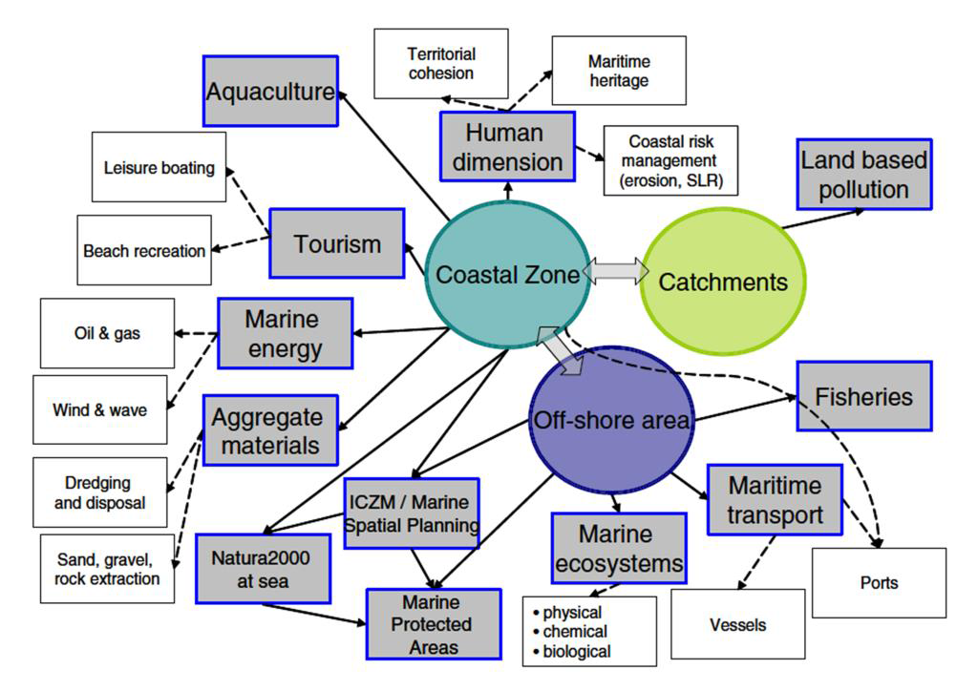
ICZM
The coastal zone as the “hinge” between terrestrial and maritime spaces
(Source: PEGASO project, 2013; Meiner, 2010: Integrated maritime policy for the European Union)

Slide 16



More information:
Green economy in a blue world (UNEP; 2012) overview of options to combine economic development with sustainable management of the marine environment
Census of marine life (CoML; 2010) highlights of a decade of discovery and summary of the first census: overview of global inventory of marine life in the past decade www.coml.org
SAHFOS (global marine) ecological status reports 2014, 2011, 2010, 2009, 2008 overview of monitoring marine biodiversity by means of the continuous plankton recorder survey: trends for each of the world’s oceans with respect to ecosystems and climate change

Slide 17


More information (2):
Large Marine Ecosystems (Swedish agency for marine and water management; 2012)
study of the concept of large marine ecosystems and its institutional relevance for ecosystem-based management and development
IGBP marine ecosystems and climate change
overview of changes due to human intervention and/or climate change
Attaining an operational marine biodiversity observation network (BON) (Consortium for Ocean Leadership; 2010)
description of methodology and options for a marine biodiversity observation network

Slide 18
Community participation &
public awareness
Take into account changes in livelihoods and catching or farming opportunities;
Some societies and communities will need to adjust to species not traditionally consumed;
Enhancement of awareness and knowledge about sustainable use and effects of climate change (with local producers and with consumers);
Attention for compatibility management and local cultures;
Stakeholder participation and representation;
Capacity building to improve technical and organisational structures.

Slide 19
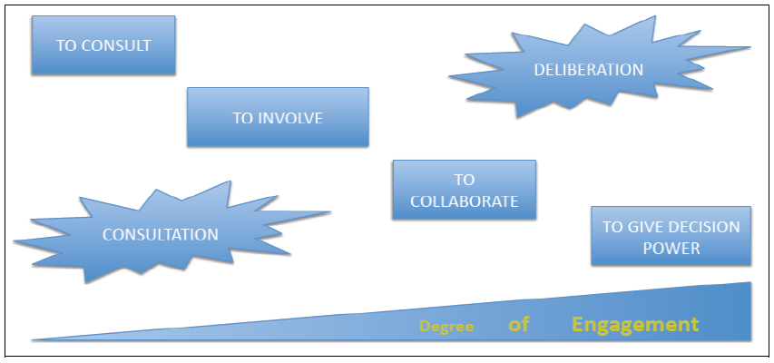
Community participation & public awareness
The relation between participation steps and engagement power (Source: PEGASO project, 2013)

Slide 20

More information:
Participatory methods for ICZM implementation (PEGASO; 2011)
Other references: see previous slides
Source: Census of Marine Life; 2010

Slide 21
2. Earth observation applications

Slide 22
Earth observation for
marine resources
& environment
Source:
Ocean from space (Robinson;2010)

Slide 23
Earth observation
contribution
Analysis and monitoring of marine and coastal ecosystems
Ocean topography, temperature and currents,
Satellite-based fishing,
Marine and coastal safety,
Ocean weather,
Climate change (in climate toolkit).

Slide 24
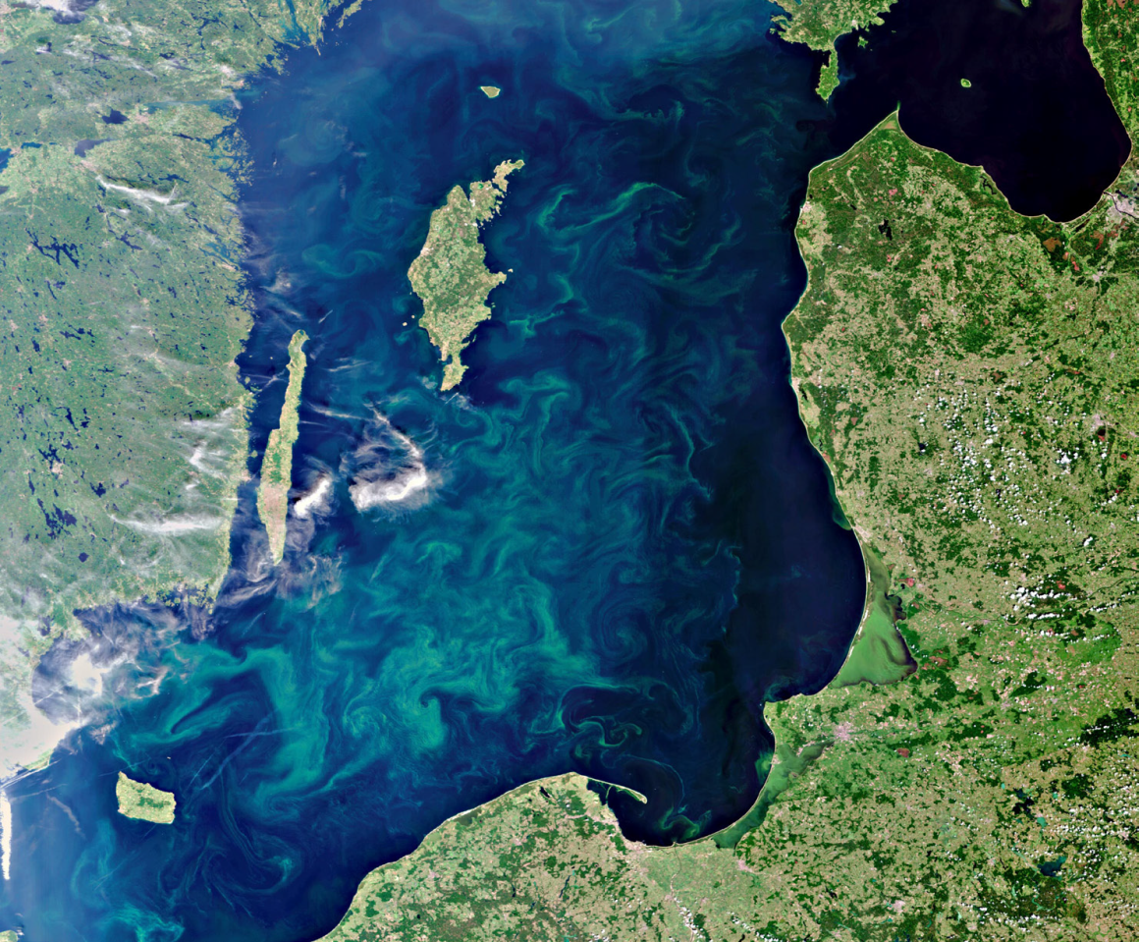
Example marine and
coastal ecosystems
Extensive blooms of blue-green algae in the Baltic Sea were captured by the MERIS sensor on Europe's ENVISAT satellite on 11 July 2010 (Source: ESA, the plague of toxic algae, Copernicus, 2013)

Slide 25
Marine and
coastal ecosystems
Measurement of environmental parameters: chlorophyll concentration, transparency, sediment concentration, algal bloom occurrence
Metocean and hydrographic information, coastal morphology
Assessment of coastal habitats such as sea grass beds, coastal mudflats, mangroves and coral reefs
Water quality monitoring and pollution detection
Cost estimate: on case-by-case basis, monitoring of national waters: 50 – 150 k€ / country, historical analysis of environmental conditions: 2k€ / region
Main challenges: acceptance, capacity

Slide 26


Examples:
MyOcean www.myocean.eu
marine safety, marine resources, coastal & marine environment, weather & seasonal forecasting
SAHFOS (global marine) ecological status reports 2014, 2011, 2010, 2009, 2008 overview of monitoring marine biodiversity by means of the continuous plankton recorder survey: trends for each of the world’s oceans with respect to ecosystems and climate change
Census of Marine Life www.coml.org
Argo floats www.argo.net
collection of 1,000,000 temperature/salinity profiles, each of which consists of up to 1,000 measurements of temperature and salinity at varying depths

Slide 27



More examples:
Earth observation for aquatic ecosystems (CSIRO; 2012) presentation with examples on coral reef and ecosystems monitoring in Australia
The plague of toxic algae (Copernicus; 2013) factsheet/brochure
Development of satellite method for Baltic ecosystem monitoring (SRC PAS) GEONetCab success story
Satellite remote sensing in support of an integrated ocean observing system (Muller-Karger; 2013) description of remote sensing products and sensors for ocean monitoring
Remote sensing of sea shelf ecosystems (ESF Marine Board; 2012) overview of EO-derived parameters and products for sea shelf applications

Slide 28
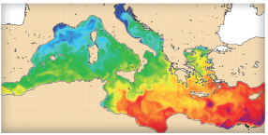
Example ocean topography, temperature and currents
Sea surface temperature in the Mediterranean (source: MyOcean)

Slide 29
Ocean topography,
temperature and currents
Measurement of sea surface height, sea surface temperature, ocean colour, wind vector, sea state (significant wave height & directional wave spectra) and sea ice parameters
Used for sea level change, ocean circulation, ocean tides, ocean surface wind wave studies, El Niño studies, cyclone/hurricane studies, rainfall studies, weather forecasting, storm detection, near-shore modelling
For the benefit of ship routing, oil production, maritime safety, satellite based fishery & sustainable fisheries management, ecosystem management, coastal zone management and solutions, pollution tracking and mitigation
Cost estimate: on case-by-case basis, general forecasts are free
Main challenges: cost, complexity.

Slide 30

Examples:
MyOcean www.myocean.eu
marine safety, marine resources, coastal & marine environment, weather & seasonal forecasting
Global ocean data assimilation experiment (GODAE) improved standardisation, modelling, forecasting and a cost-effective and sustainable ocean observing system (ended 2009)
Promotion of satellite derived bathymetry (SDB) & other satellite remote sensing EO downstream services for the marine economy (Martin-Lauzer; 2012) presentation on methodology and applications of EO for bathymetry + market considerations
Looking for great ocean garbage patches (Copernicus; 2015) brochure on the use of EO for detecting marine litter

Slide 31
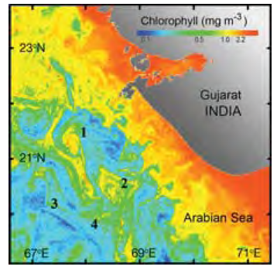
Example
satellite-based fishing
Chlorophyll image of northwest India on 29 February 2006
generated from
the Indian OCM sensor.
Oceanic features such as cyclonic eddies
(1 and 2 on the image) and fronts (3 and 4) are known to be productive sites and are hence relevant for fishery exploration
(Source:
IOC, 2008 / Credit: R.M. Dwivedi, Indian Space Research Organisation, India)

Slide 32
Satellite-based
fishing
Earth observation helps identify optimum fishing grounds and conditions
Through earth observation and GIS data are combined on bathymetry, light houses, landing centres, sectors, Potential Fishing Zone (PFZ) lines, sea surface temperature and chlorophyll
Earth observation supports detection of illegal fishing
Earth observation enhances monitoring of aquaculture activities
Cost estimate: on case-by-case basis
Main challenges: capacity, data access, revisit time.

Slide 33


Examples:
Ocean Data and Information System (ODIS, INCOIS)
www.incois.gov.in/Incois/marine_fisheries_main.jsp
web-based provision of potential fishing zone information and ocean state forecast in the Indian Ocean
Ocean colour radiometry and fisheries (IOC; 2008) description of use of satellite data that characterize oceanic properties of habitat and ecosystems that influence living marine resources at spatial and temporal resolutions that are impossible to achieve any other way
Satellites support sustainable fishing (Copernicus; 2013) factsheet/brochure
Satellites support sustainable aquaculture development (Copernicus; 2013) factsheet/brochure
FARO www.faro-project.org research on sustainable fisheries management

Slide 34
More examples:
Determination of potential fishing grounds of Rastrelliger kanagurta using satellite remote sensing and GIS technique (Nurdin et al; 2015) article describing the use of EO for the identification of potential fishing grounds in East Asia
The efficiency of using remote sensing for fisheries enforcement: Application to the Mediterranean bluefin tuna fishery (Cicuendez Perez et al; 2013) article describing the methodology and costs involved for using EO for fishery control
Application of multi-sensor satellite and fishery data, statistical models and marine-GIS to detect habitat preferences of skipjack tuna (Mugo et al) article describing the integration of EO-derived parameters and GIS to monitor tuna habitats

Slide 35
More examples (2):
Where are the jellyfish? (Copernicus; 2015) brochure on the use of EO for detecting jellyfish (to avoid blocking up of fishing nets and reduce hazard to swimmers)

Slide 36
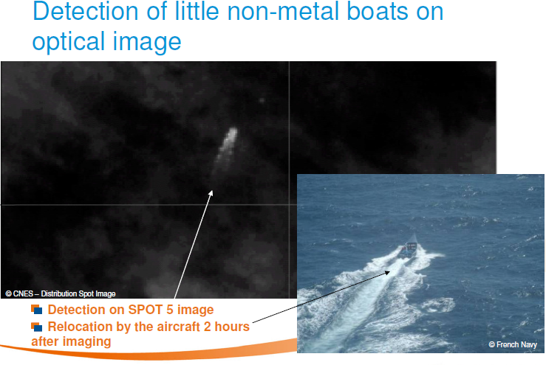
Example marine and
coastal safety
Maritime surveillance
(Source: Airbus Defence and Space, 2011)

Slide 37
Marine and
coastal safety
Earth observation facilitates situation awareness of the overall maritime domain, effectiveness from early warning to interception and optimised operation planning at sea
Application areas: ship routing, maneuvering & performance traffic control, smuggling, illegal fishing, oil dumping & pollution monitoring, illegal immigration, piracy, safety, search & rescue
See also ocean weather: waves, hurricanes, squall, sea ice, etc.
Cost estimate: on case-by-case basis, near real-time detection of bigger vessels 0.5 – 1 k€ / day, detection of anomalous behaviour 3 – 6 k€ / day, monitoring object of interest:
2.5 – 5 k€ / day
Main challenges: cost, complexity, revisit time.

Slide 38




Examples:
MyOcean www.myocean.eu
marine safety, marine resources, coastal & marine environment, weather & seasonal forecasting
Pirate ship tracked by satellite (Copernicus; 2013) factsheet/brochure
Fugro, BMT Argoss, Airbus Defence and Space
company brochures on marine safety
Satellite based services for maritime environment monitoring and maritime situational awareness (Kongsberg Satellite Services; 2013) presentation with examples of SAR-based vessel detection (for oil spills, fisheries control, safety & security)

Slide 39
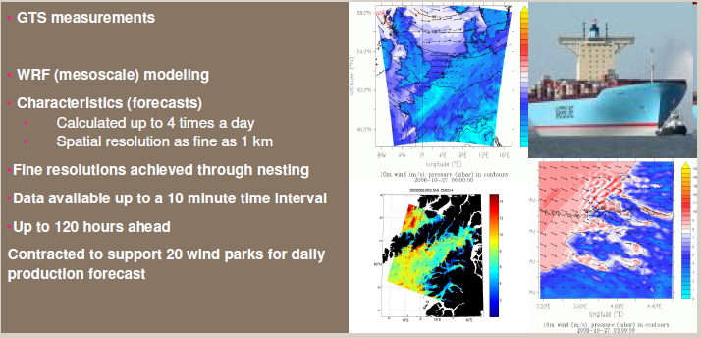
Example
ocean weather
High-resolution weather forecasting (Source: BMT Argoss, 2011)

Slide 40
Ocean weather
Earth observation provides wind and wave data, surface currents, sea surface temperature, marine frontal structures
Weather forecast products and services: 3-day or 5-day site-specific or route specific weather forecasts - once or twice daily in a range of formats, regional wave model data for weather sensitive areas, hurricane forecasts, squall warning service, hindcast studies of weather events for insurance purposes, provision of extensive climatology data, sea ice forecast
Cost estimate: most general weather forecast data and information are provided for free
Main challenges: capacity, complexity, business model.

Slide 41

Examples:
MyOcean www.myocean.eu
marine safety, marine resources, coastal & marine environment, weather & seasonal forecasting
Fugro, BMT Argoss
company brochures on weather forecasting

Slide 42
Growth potential for
earth observation
Support to management of marine and coastal ecosystems.
Main clients: governments, NGOs.
Satellite-based fishing.
Main clients: government, fishing companies.
Marine and coastal safety.
Main clients: government, energy companies, shipping companies.
Ocean weather.
Main clients: energy companies, shipping companies, government.

Slide 43
3. Business development

Slide 44
Why is marketing / promotion of earth observation needed?
Public sector information (PSI)
Externalities (environmental accounting & payment for ecosystem services)
Global datasets, open access, data sharing, compatibility (GEO)

Slide 45
If public sector information is made available free-of-charge, demand will increase and, in the end, government revenue also, as companies will derive income from value-added products and services, and consequently pay more taxes (see figures in following slides).

Slide 46
Supply & Demand Public Sector Information
http://vimeo.com/63079712
Source: About GMES and data: geese and golden eggs (Sawyer, de Vries 2012)

Slide 47
Cost-benefit Public Sector Information
Source: About GMES and data: geese and golden eggs (Sawyer, de Vries 2012)

Slide 48
Re-use of Public Sector Information
Source: About GMES and data: geese and golden eggs (Sawyer, de Vries 2012)

Slide 49
Most earth observation applications deal with so-called externalities, such as impact on the environment.
It is difficult to capture these in terms of conventional cost-benefit models.
To tackle this, the following framework for analysis of earth observation applications is developed:

Slide 50
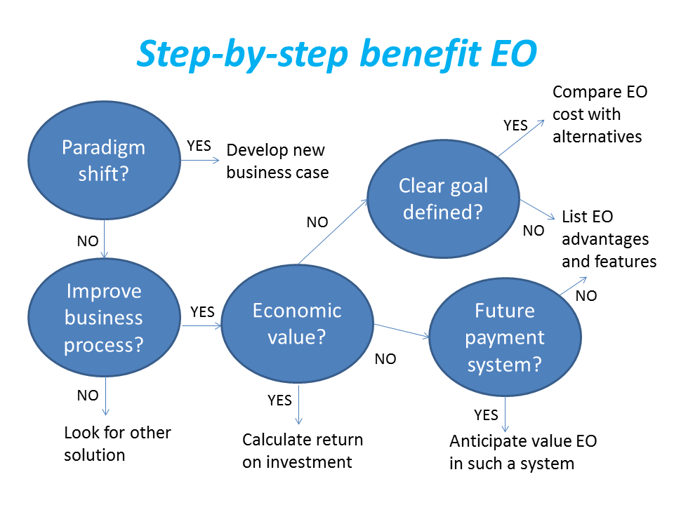
Framework for analysis
Step-by-step analysis of the benefits of earth observation (source: GEONetCab, 2013)

Slide 51
Key questions
Does the new application cause a paradigm shift?
Is the current business or organization process improved?
Does the application provide economic value that can be quantified?
Is a clear measurable goal defined to which the earth observation application contributes?
Is a future payment scheme or other economic mechanism foreseen in which the earth observation application fits?

Slide 52
Assessment of
geospatial solutions
Rating of characteristics of geospatial solutions:
fit-for-purpose
comparative advantage
complexity to user / ease- of-use
elegance
cost-benefit,
sustainability
resilience
reproduction capacity / flexibility
acceptance
level of knowledge transfer required
ethics, transparency, public accountability, objectivity & impartiality
Rating of business environment:
Willingness to pay (by clients)
Embedding (in organizational processes)
Openness (transparency and ease of doing business, access to markets)
Institutions (is the institutional environment conducive to doing business, acceptance of new solutions?)

Slide 53
Fit-for-purpose
An important, but often forgotten requirement:
Does the product or service do what it is supposed to do to solve a certain problem?
In other words: is it really a solution or just an attempt towards a solution?
Quantitative: not applicable
Qualitative (on scale of 1 to 5): based on description of what the EO solution actually does

Slide 54
Comparative advantage
What it does significantly better than other solutions to the same problem.
For earth observation usually the comparative advantages of greater accuracy, better resolution in time and space, comprehensive overview of large areas and near real-time information provision are mentioned as comparative advantages.
Quantitative: calculation of degree in which the EO solution is better than alternatives
Qualitative (on scale of 1 to 5): based on listing of comparative advantages

Slide 55
Complexity (to user) / ease-of-use
At all levels in the value chain the users (professionals and
end-users) are able to work with the product or service.
Quantitative: not applicable
Qualitative (on scale of 1 to 5): based on user testimonials and user surveys

Slide 56
Elegance
Once you get the idea behind this product or service, you want to be part of the community that uses it.
This sense of belonging facilitates the formation of user groups that provide valuable feedback.
Quantitative: none, or it should be the size of the user community
Qualitative (on scale of 1 to 5): based on user testimonials and user surveys

Slide 57
Cost-benefit
The cost-benefit of the product or service is quantified and sufficiently attractive, also in the long-term.
Quantitative: cost-benefit calculation
Qualitative (on scale of 1 to 5): based on quantitative assessment

Slide 58
Sustainability
The product or service can be delivered when it is needed.
There is a long-term perspective that guarantees delivery.
Sustainability concerns the following aspects:
Long-term data availability
Availability of finance/funds to provide the solution continuously for present and future use
Long-term institutional / governmental interest and support
Long-term user interest for a solution that addresses real needs
Quantitative: not applicable
Qualitative (on scale of 1 to 5): based on sensitivity analysis of the EO solution

Slide 59
Resilience
In case of extremes or breakdown in the value chain, the product or service can still be delivered at an acceptable level. Alternatives (plan B) are available (and developed).
Quantitative: cost-benefit calculation of plan B
Qualitative (on scale of 1 to 5): based on risk analysis of the EO solution

Slide 60
Reproduction
capacity / flexibility
The product or service can be easily applied or adapted for use in another region or another situation, while still providing the solution without (too much) extra cost.
Quantitative: calculation of reproduction costs for application in other regions or situations; measurement of spreading of actual use
Qualitative (on scale of 1 to 5): based on quantitative assessment and description of EO solution

Slide 61
Acceptance
The users intuitively get what the product or service is about and are interested. They accept it as a solution to their problem.
Quantitative: none, or survey results about acceptance. After introduction of the solution: number of clients and/or users
Qualitative (on scale of 1 to 5): based on user testimonials and user surveys

Slide 62
Level of knowledge
transfer required
The training requirements for professionals and other users along the value chain are clear and associated costs and efforts are acceptable.
Quantitative: cost and time required to get the users at the desired knowledge and skill level
Qualitative (on scale of 1 to 5): based on knowledge transfer plans and evaluation of training activities

Slide 63
Ethics, transparency,
public accountability,
objectivity & impartiality
Application of Earth observation increases the level of objectivity and impartiality in decision-making processes, including conflict resolution. The application improves transparency and public accountability. It raises no ethical issues or if it does, as in the case of privacy concerns, these are resolved in a satisfactory way for all parties concerned.
Quantitative: not applicable
Qualitative (on scale of 1 to 5): based on user testimonials and user surveys

Slide 64
Several attempts have been made to introduce environmental accounting and to enlarge the sphere of the conventional economy to include and quantify impact on ecosystems.
The following slides give some examples:

Slide 65






Environmental accounting & payment for ecosystem services
SEEA:
System of Environmental-Economic Accounts
(EC, FAO, IMF, OECD, UN, WB )
WAVES:
Wealth Accounting and the Valuation of Ecosystem Services (global partnership, led by World Bank)
TEEB:
The Economics of Ecosystems and Biodiversity
(group led by UNEP)

Slide 66
SEEA Conceptual Framework
Source: SEEA conceptual framework report (EC, FAO, IMF, OECD, UN, WB 2012)

Slide 67
For earth observation the work of the Group on Earth Observations (GEO) is essential to achieve the goal of a Global Earth Observations System of Systems (GEOSS), resulting in the shared GEO common infrastructure (GCI):

Slide 68
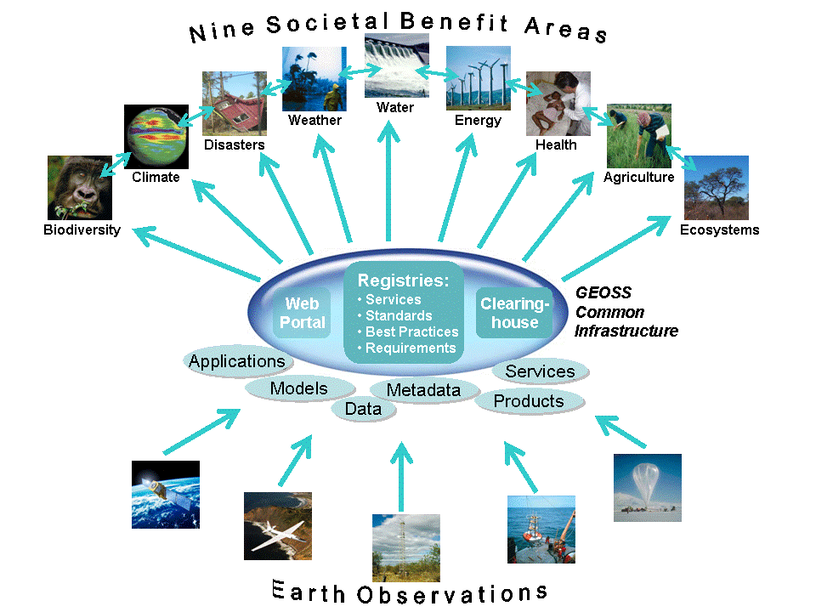

Group on Earth Observations

Slide 69
Marketing elements
Customer value propositions
Crossing the technology chasm
Creating shared value
Promotion tools

Slide 70
Customer value propositions capture the unique value of a product or services as perceived and appreciated by the customer.
Interestingly, they can differ completely from the features that the provider considers most important:

Slide 71
Customer Value Propositions
VALUE PROPOSITION | ALL BENEFITS | FAVOURABLE POINTS OF DIFFERENCE | RESONATING FOCUS
Consists of: | All benefits customers receive from a market offering | All favourable points of difference a market offering has relative to the next best alternative | The one or two points of difference whose improvement will deliver the greatest value to the customer
Answers the customer question: | “Why should our firm purchase your offering?” | “Why should our firm purchase your offering instead of your competitor’s?” | “What is most worthwhile for our firm to keep in mind about your offering?”
Requires: | Knowledge of own market offering | Knowledge of own market offering and next best alternative | Knowledge of how own marketing offering delivers value to customers, compared with next best alternative
Has the potential pitfall: | Benefit assertion | Value presumption | Requires customer value research
Source: Customer value propositions in business markets (HBR 2006)

Slide 72
Buyer behaviour & motivation
Type | Buyer behaviour | Motivation
Transactional sales | Intrinsic value buyers: “keep it cheap and easy to do business” | Understands the product Perceives it as substitutable Cost focus Resents time ‘wasted’ with sales people
Consultative sales | Extrinsic value buyers: “I don’t know the answer: help me analyse and solve the issue | Focus on how the product is used Interested in solutions and applications Values advice and help Needs the sales person
Source: Rethinking the sales force (Rackham, de Vincentis 1999)

Slide 73
Even when customer value propositions are well captured and formulated, introduction of solutions that involve new technology will have to overcome some hurdles.
This is called “crossing the technology chasm”:

Slide 74
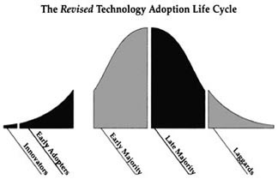
Crossing the technology chasm
Source: Crossing the chasm (Moore 1991)

Slide 75
Crossing the technology chasm
Most clients of EO products and services belong to the early and late majority,
They are pragmatists and are not prepared or willing to take substantial risk: the solution should work and be reliable.
Once convinced, the pragmatists will be long-term clients.
Source: Crossing the chasm (Moore 1991)

Slide 76
More information:
Creating & delivering your value proposition
– managing customer experience for profit
(Barnes, Blake, Pinder; 2009)
Customer value propositions in business markets
(Anderson, Narus, van Rossum [Harvard Business Review]; 2006)
Rethinking the sales force:
refining selling to create and capture customer value
(Rackham, de Vicentis; 1999)
Crossing the chasm
– marketing and selling high-tech products to mainstream customers
(Moore; 1991)

Slide 77
Creating shared value is a key element of successful implementation of earth observation solutions.
To achieve this, in most cases earth observation applications have to be integrated into more general (business or organizational) processes:

Slide 78
Create shared value
Involves cooperation between:
Public sector
Private sector
Social sector
Opportunity for earth observation (integrated) solutions:
Integrate EO in general business / organizational process
Integrate different EO (and GIS and navigation) functionalities

Slide 79
Based on all considerations dealt with in the previous slides, there are some practical approaches that can be applied in combination to promote earth observation applications:

Slide 80

Tools for earth observation marketing:
Success stories (in non-technical language, feasible, replication capacity, sustainable)
Marketing toolkits (international trends, earth observation examples, references)
Pilot projects, innovation funds, quick-wins (demonstration that EO actually works)
Promotion outside EO community (fairs, seminars, lunch-bag meetings, magazines)
Resource facilities for reference and capacity building (distributed, but connected, in different languages)
Source: Marketing earth observation products and services (Noort 2013)

Slide 81
Business elements
Business elements:
Proposal writing
Business procedures

Slide 82
Proposal writing is an art in itself.
During the GEONetCab and EOPOWER projects templates have been developed for writing successful proposals:

Slide 83
Proposal outline
1. Introduction / relevance
2. Objective(s)
3. Activities
4. Output
5. Management & evaluation
6. Risk assessment
7. Time schedule
8. Budget
Annexes
(more detailed version in separate document,
see www.eopower.eu or www.hcpinternational.com)

Slide 84


Other guides that may be useful:
Civicus: writing a funding proposal
Michigan State University: guide for writing a funding proposal
ESRI: writing a competitive GRANT application
REC: project proposal writing

Slide 85
If you run a company, compete for assignments and manage projects, a structured approach towards responsibilities, tasks, implementation and documentation is needed.
The following business procedures may be helpful:

Slide 86
Business procedures
1. On acquisition
2. On offers
3. On negotiation
4. On contracts
5. On project management
6. On travel & deployment
7. On deficiencies & complaints
8. On internal organization
9. On finance
(more detailed version in separate document,
see www.eopower.eu or www.hcpinternational.com)

Slide 87
Again:
SHARED PROBLEM
SHARED LANGUAGE
SHARED SOLUTION

Slide 88
4. Capacity Building

Slide 89
General
Marketing is promotion + capacity building.
Especially for the introduction of new technologies capacity building is important at all levels.
Capacity building is the instrument to increase
self-sufficiency and make solutions work.

Slide 90


General references for capacity building, open data and success stories
GEO Portal: www.earthobservations.org
Capacity building resource facility www.geocab.org
compilation of tutorials, references, open-source software, etc.
Satellites going local: share good practice (Eurisy handbooks) www.eurisy.org
Earth observation for green growth (ESA, 2013)

Slide 91


General references for capacity building, open data (2)
Bringing GEOSS services into practice:
how to use data from the GEO portal and how to provide input
www.envirogrids.net
Science education through earth observation for high schools: basic tutorials on all kind of subjects, including coral reefs, ocean colour, currents and maritime pollution www.seos-project.eu
Copernicus briefs:
information on satellite applications for different topics
http://www.copernicus.eu/main/copernicus-briefs
MetEd: tutorials and courses on meteorology and related subjects
https://www.meted.ucar.edu/training_detail.php

Slide 92
More references open data
Open data for sustainable development (World Bank; 2015)
description of the benefits of open data for a wide range of development goals, including the SDGs http://pubdocs.worldbank.org/pubdocs/publicdoc/2015/8/904051440717425994/Open-Data-for-Sustainable-development-Final-New.pdf
Terms and conditions for the use and distribution of Sentinel data (European Parliament and European Commission; 2014)
standard stipulations related to free and open access to Sentinel data http://www.demarine.de/lr/c/document_library/get_file?uuid=c5067655-b7ad-4d71-b07b-6111808f4abd&groupId=13521
Towards a thriving data-driven economy (European Commission; 2014) policy document on the use of (open) data for a knowledge economy and society
http://ec.europa.eu/information_society/newsroom/cf/dae/document.cfm?doc_id=6210

Slide 93



Capacity building resources for marine resources & environment (1):
PEGASO project
background documentation, tutorials, indicators and factsheets for integrated coastal zone management
www.pegaso.eu
Handbook of satellite remote sensing image interpretation (IOCCG; 2011)
case studies on air/water quality, phytoplankton and macro algae, fisheries and aquaculture, marine ecosystem characterization + exercises
www.ioccg.org/handbook.html
BILKO
learning and teaching system for remote sensing to oceanography and coastal management, includes free software
http://www.noc.soton.ac.uk/bilko/

Slide 94

Capacity building resources for marine resources & environment (2):
African Marine Atlas
geoportal for marine and coastal information on Africa
www.africanmarineatlas.net
Remote sensing applications chapter 9: Oceans
(NRSC; 2010)
Discovering the ocean from space - the unique applications of satellite oceanography (Robinson; 2010)
Introduction to physical oceanography (Stewart; 2008)

Slide 95
Further details:
Contact: Mark Noort
m.noort@hcpinternational.com
www.eopower.eu
www.hcpinternational.com

