Slide 1



Earth Observation for
Health
International trends & developments
Earth observation applications
Business development
Capacity building

Slide 2

0. Introduction
Mark Noort, consultant, project manager
HCP international:
consulting, marketing of earth observation
Project director EOPOWER:
project for promotion & capacity building of
earth observation applications

Slide 3
Sequence:
General assessment of the state-of-the-art of earth observation
Major trends and developments in the application field
Description of earth observation solutions
Assessment of market potential for earth observation solutions and marketing instruments
Capacity building for successful application of earth observation solutions

Slide 4
Earth Observation helps you: save money save lives save the environment

Slide 5
Earth observation
applications
On the verge of reaching new user communities
These new user communities need to be involved
Weakest link / last mile aspects are important
Marketing needed: promotion & capacity building

Slide 6
Life cycle of products & services
Initialization
System analysis & design
Rapid prototyping
System development
Implementation
Post-implementation

Slide 7
Scope
Health:
Health is a state of complete physical, mental and social well-being and not merely the absence of disease or infirmity.
Air quality: The state of the air around us. Good air quality refers to clean, clear, unpolluted air.
Disease: Any condition that causes pain, dysfunction, distress, social problems, or death to the person afflicted, or similar problems for those in contact with the person.
Environmental aspects are dealt with more in detail in the environmental toolkit, industrial accidents and other disaster-related aspects in the disaster management toolkit.

Slide 8
Assessment of business & funding opportunities
Categories of health products & services
Life cycle phase of product or service
Regional context, level of technological & economic development
Optimum marketing mix

Slide 9
1. International trends & developments in health

Slide 10
Issues & trends in
health
Importance of monitoring and improving air quality (pollution, aeroallergens, dust storms);
Improved options for early warning for possible health hazards, such as sand and dust storms
Increased opportunities and possibilities for fighting diseases (malaria, meningitis, dengue, rift fever, West-Nile virus, cholera, etc.);
Increased attention for the relation between climate change and health.

Slide 11
Drivers (1)
Negative:
Increasing population;
Economic growth;
Increasing urbanisation;
Increasing (energy) consumption;
Increasing mobilisation -> motor vehicles;
Lead to increased pollution of air, water and soil.

Slide 12
Drivers (2)
Positive:
New, cleaner technologies available
Increased attention for environmental issues
Increased attention for sustainable economic development
Improved living standards and increased life expectancy
Improved monitoring, forecasting and early warning
Improved understanding of processes affecting human health

Slide 13
Air quality
Healthcare costs associated with poor air quality:
€ 189 billion/year (Europe) + reduced life expectancy;
The WHO estimates that by reducing illness caused by airborne PM the EU could save up to € 29 billion/year
Particulate matter (PM) and ozone (O₃) are most harmful for human health;
Emission reduction does not always cause a drop in atmospheric concentrations, especially for PM and O₃;
Pollutants of interest: PM, ground-level O₃, nitrogen oxides, sulfur dioxide, carbon monoxide, heavy metals, benzene and benzo(a)pyrene.

Slide 14

Type and sources of air pollutants
Optical remote sensing for measurement and monitoring of emission flux (source: EPA Handbook; 2011)

Slide 15
Particulate matter, relative size
(source: EPA; 2010)

Slide 16
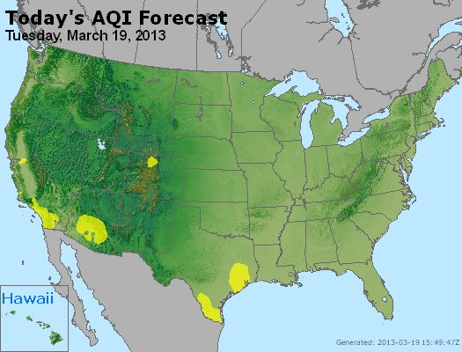

Air Quality Index map of the US
AIRnow website: http://airnow.gov/

Slide 17



More information:
Air quality in Europe – 2015 report (EEA; 2015)
AirBase database:
http://www.eea.europa.eu/themes/air/air-quality/map/airbase
Air Quality Index – a guide to air quality and your health (EPA; 2009) brochure that explains air quality index, causes of air quality variation (ozone, particle pollution, sulfur dioxide, carbon monoxide), health effects and possible action (avoidance)
The EveryAware sensor box: a tool for community-based air quality monitoring (Elen et al.; 2012) description of sensor box that users can apply to measure / monitor air traffic pollution

Slide 18
Sand & dust storms
Sand and dust storms affect air quality (sand and dust particles, transport of pollutants);
Sand and dust storms are responsible for worsening of asthma and other respiratory diseases, meningitis and other negative health effects;
Sand and dust storms cause general damage (dust cover, reduced plant growth decreased visibility) ;
Early warning can reduce impact: better forecasts enable better preparation (lives saved, reduced exposure, reduced damage).

Slide 19
Air quality: sand and dust
Sand and dust storm over Japan (MODIS image; 2002)

Slide 20

Dust storm life cycle
Dust storm early warning (source: UNEP)

Slide 21

Information flow SDS-WAS
Sand and dust storm warning, advisory and assessment system
(source: WMO)

Slide 22


More information:
Forecasting and early warning of dust storms - UNEP global environmental alert service (UNEP; 2013) presents general process and role of forecasting and early warning
Dust and sand storms (Ministry of the Environment Japan; 2008) description of how the sand and dust storm mechanism works and the usefulness of improved forecasts and early warning
WMO sand and dust storm warning, advisory and assessment system (SDS-WAS) – science and implementation plan 2015 – 2020 (WMO; 2014) research to improve forecasts, modelling and information to user communities, plus description of previous achievements

Slide 23
Fighting diseases
Infectious disease and disease vectors: environmental factors (land and water surface temperatures, rainfall, water depth, marine organisms) contribute to disease outbreaks, changes in weather and climatic conditions (example: cholera).
Initiatives are undertaken for the prevention and control of malaria in Africa;
A comprehensive approach is needed, including a suitability analysis of transmission and vulnerability risk indicators.

Slide 24

Epidemics forecasting & environmental factors
User cycle framework (Source: EO priorities infectious diseases; 2010)

Slide 25


More information:
WHO/UNICEF HealthMapper http://healthmapper.software.informer.com/
Malaria Early Warning Systems − Concepts, indicators and partners − A framework for field research in Africa (WHO; 2001) description of approach for Roll Back Malaria initiative
Use of Google Earth™ to strengthen public health capacity and facilitate management of vector-borne diseases in resource-poor environments (Lozano-Fuentes et al.; 2008) search for novel, inexpensive solutions in Mexico

Slide 26

More information (2):
Environmental health risks (EO2HEAVEN; 2013) description of relationships between environmental changes and their impact on human health
The landscape configuration of zoonotic transmission of the Ebola virus disease in West and Central Africa: Interaction between population density and vegetation cover (Walsh & Habeeb; 2015) article identifying interaction between human population density and vegetation cover as the single most important factor associated with ebola transmission

Slide 27
Climate change
and health
Areas of concern:
Infections: malaria, diarrhea, meningitis, dengue fever are the most important ones;
Emergencies: floods and cyclones, drought, airborne dispersion of hazardous materials;
Emerging environmental challenges: heat stress, UV radiation, pollen, air pollution.
Need for:
Indicators to monitor climate-change-related health outcomes within surveillance systems;
Development of early warning systems;
Improved decision support for vulnerability and adaptation assessment, operational predictions and understanding of the decision making process.

Slide 28


More information:
Global climate change impacts in the United States (US global change research program; 2009)
predicts: increase in risk of illness and death related to extreme heat and heat waves, reduced extreme cold, challenge to meet air quality standards, more extreme weather events (storms, floods, wild fires), increase of some diseases transmitted by food, water or insects (west nile, lyme, salmonella, etc.), increased pollen health risk
Human health, climate change 2007: impacts, adaptation and vulnerability (IPCC; 2007)
covers: heat and cold effects on health, wind, storms and floods, drought, nutrition and food security, food safety, water and disease, air quality and disease, aeroallergens and disease, vector-borne, rodent-borne and other infectious diseases, occupational health and UV radiation
Atlas of health and climate change (WHO / WMO; 2012)

Slide 29
2. Earth observation applications

Slide 30
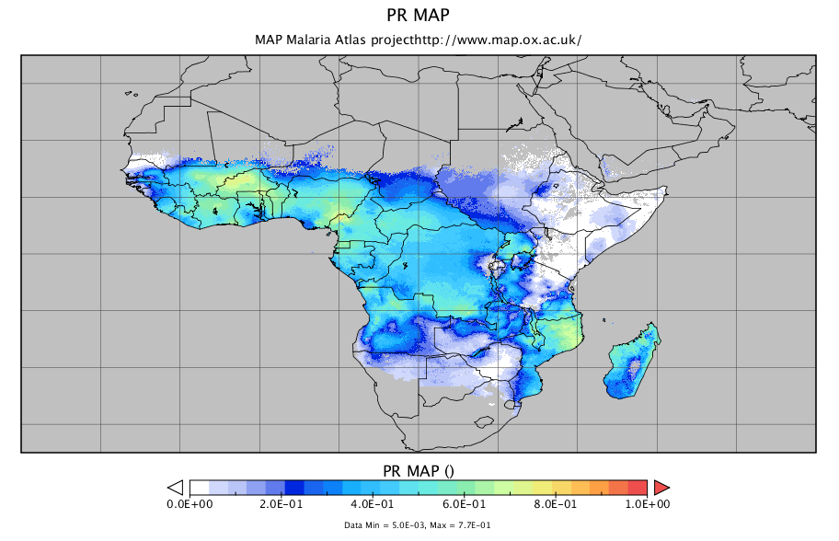
Earth observation for
health
Malaria Parasitic Rate map, derived from field data and a Bayesian regression model with rain and temperature inputs (source: ECWMF; 2012)

Slide 31
Earth observation
contribution
Air quality forecasting / early warning / monitoring
Epidemics forecasting
Relationships between diseases and environmental factors
All these categories, particularly the 2nd & 3rd, are of course linked, the time/response factor providing the main distinction.

Slide 32
Example air quality forecasting /
early warning / monitoring
Mean density of nitrogen oxide for the period January 2003 – June 2004
(Source: Copernicus; 2013)

Slide 33
Air quality forecasting / early warning / monitoring
Earth observation measures air masses (monitoring of extent and source of emissions);
Earth observation tracks impact from fires;
Earth observation tracks dust and sand storms (meningitis, other diseases);
Earth observation supports monitoring of trace species in the air (carbon monoxide, ozone)
Cost estimate: obtaining emission datasets for new regions and cities is expensive, implementation cost 100 k€ / continent / year, daily forecast at local level 100 k€ / year for set-up and 30 k€ / year for operation
Main challenges: cost, complexity, capacity.

Slide 34


Examples:
Monitoring the air we breathe (Copernicus; 2013) brochure on air quality monitoring and forecasts to protect human health in Europe
Air quality monitoring and analysis in Central America and the Caribbean (SERVIR-Air; 2009) description of the use of EO for an air quality monitoring system and public information, including a ‘SmogBlog’ (as in the US), agricultural fires, volcanic eruptions, Saharan dust + capacity building http://www.servir.net/
Particulate matter in the atmosphere of Dakar, Senegal (Leon et al.; 2012) pilot on monitoring of particulate matter, measurement of aerosol optical depth, specifically aimed at Sahara desert dust; combination of in-situ and EO; satellite observations can detect gradient & therefore hotspots of emission
Air pollution using remote sensing and GIS, Cyprus (CUT; 2011) case study on the use of satellite observations for air pollution monitoring and modelling

Slide 35
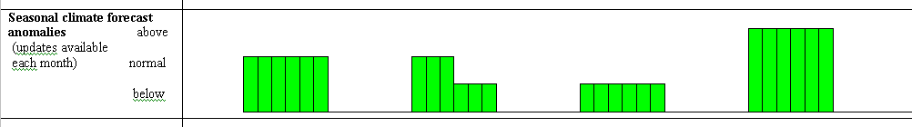
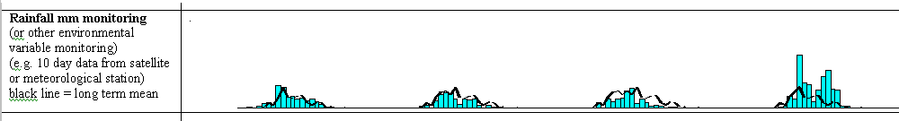
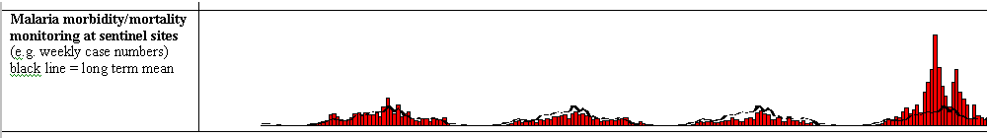
Example epidemics forecasting
Case surveillance alone = late warning
Integrated Malaria Early Warning System gathering cumulative evidence for early and focused epidemic preparedness and response (Source: WHO; 2004)

Slide 36
Epidemics forecasting
Earth observation provides input for models and indicators for health impact;
Earth observation contributes to development of early warning systems land decision support;
Earth observation is instrumental in compliance monitoring of agreements and regulations;
Cost estimate: on case-by-case basis
Main challenges: cost, complexity, capacity.

Slide 37


Examples:
How satellites track a mass killer (Copernicus; 2013) brochure on how satellite data help model the prevalence and spread of malaria and the dynamics of disease outbreaks
CNES strategy, satellite data and modeling for public health (CNES; 2011) presentation of the CNES programmes on e-health: telemedicine and tele-epidemiology
A prototype Malaria Early Warning System (ECMWF; 2012) presentation on the set-up of a malaria early warning system, based on the relation between malaria and weather and climate

Slide 38
Useful sites for early warning
IRI, Columbia University http://iridl.ldeo.columbia.edu/maproom/.Health/ (malaria, meningitis)
CNES RedGems http://www.redgems.org/ (malaria, rift valley fever, dengue, vibrio diseases and cholera)
NASA SERVIR http://www.nasa.gov/mission_pages/servir/index.html (general)
ISID Pro-MED http://www.promedmail.org/pls/otn/f?p=2400:1000 (diseases general)
USAID FEWSNET http://earlywarning.usgs.gov/adds/ (famine)

Slide 39
Example diseases and
environmental factors
Distribution of city blocks with dengue cases, derived from Google Earth, Chetumal, Quintana Roo, Mexico, 2006 ( Source: Lozano-Fuentes et al.; 2008)

Slide 40
Diseases and
environmental factors
Earth observation supports analysis and modelling of the occurrence and spreading of infectious diseases and disease vectors by measuring environmental factors (land and water surface temperatures, rainfall, water depth, marine organisms) and changes in weather and climatic conditions;
Earth observation facilitates improved decision support for vulnerability and adaptation assessment, operational predictions and understanding of the decision making process
Cost estimate: on case-by-case basis
Main challenges: complexity (from data to information, modelling), elegance, capacity.

Slide 41


Examples:
Use of Google Earth™ to strengthen public health capacity and facilitate management of vector-borne diseases in resource-poor environments (Lozano-Fuentes et al.; 2008) case study from Mexico; Google Earth images used to extract urban infrastructure patterns; positive aspects: easy to use and easy to learn; negative: spatial analysis and modelling capacity is limited
Environmental health risks (EO2HEAVEN; 2013) description of relationships between environmental changes and their impact on human health, with earth observation applications as central element
Connecting ecosystems, biodiversity, and human health: using earth observations to reduce and prevent infectious diseases (EPA; 2010) presentation on establishing links between human health and environmental factors with a call for integrated tools and approaches that link ecology to human health

Slide 42
More examples (2):
MODIS and vector-borne diseases (Neteler & Metz; 2014) description of the use of MODIS products for tick-borne, rodent-borne and mosquito-borne disease vectors
Validation of a remote sensing model to identify simulium damnosum s.l. breeding sites in Sub-Saharan Africa (Jacob et al.; 2013) article on the use of remote sensing to determine suitable habitats and seasonal variation related to river blindness
Interactions between population dynamics, land use changes and malaria in Kigali city, Rwanda: added value of geospatial techniques for identifying urban malaria hotspots (Bizimana et al.; 2013) presentation on environmental factors related to malaria transmission

Slide 43
More examples (3):
Tracing the outbreak of ebola (Copernicus; 2014) brochure on the use of EO to identify areas that are likely to attract the main vectors of the ebola virus, such as isolated rural settlements surrounded by dense tropical forests and oil palm cultivations

Slide 44
Growth potential for
earth observation
Scientists, public health organizations, NGOs and the general public are the main players;
Mainly G2G or B2G market, governments or international organizations are in virtually in all cases the paying client;
Opportunities for businesses in developing countries: refinement of existing models for local circumstances and processing of actual data flows;
Air quality is particularly relevant in the large, densely populated urban areas.

Slide 45
3. Business development

Slide 46
Why is marketing / promotion of earth observation needed?
Public sector information (PSI)
Externalities (environmental accounting & payment for ecosystem services)
Global datasets, open access, data sharing, compatibility (GEO)

Slide 47
If public sector information is made available free-of-charge, demand will increase and, in the end, government revenue also, as companies will derive income from value-added products and services, and consequently pay more taxes (see figures in following slides).

Slide 48
Supply & Demand Public Sector Information
http://vimeo.com/63079712
Source: About GMES and data: geese and golden eggs (Sawyer, de Vries 2012)

Slide 49
Cost-benefit Public Sector Information
Source: About GMES and data: geese and golden eggs (Sawyer, de Vries 2012)

Slide 50
Re-use of Public Sector Information
Source: About GMES and data: geese and golden eggs (Sawyer, de Vries 2012)

Slide 51
Most earth observation applications deal with so-called externalities, such as impact on the environment.
It is difficult to capture these in terms of conventional cost-benefit models.
To tackle this, the following framework for analysis of earth observation applications is developed:

Slide 52
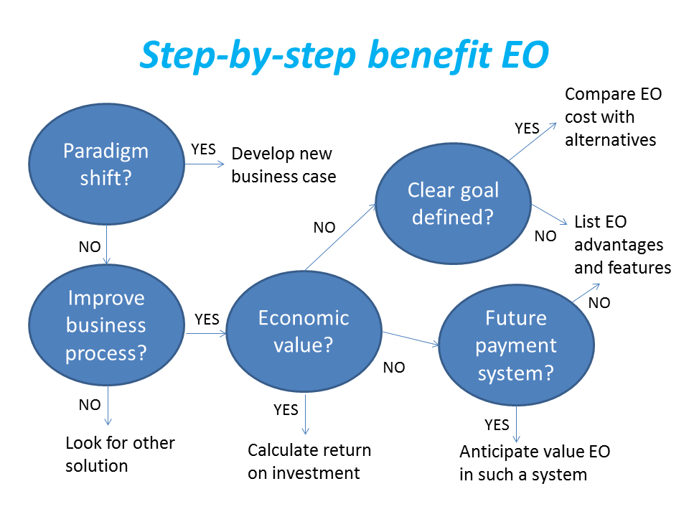
Framework for analysis
Step-by-step analysis of the benefits of earth observation (source: GEONetCab, 2013)

Slide 53
Key questions
Does the new application cause a paradigm shift?
Is the current business or organization process improved?
Does the application provide economic value that can be quantified?
Is a clear measurable goal defined to which the earth observation application contributes?
Is a future payment scheme or other economic mechanism foreseen in which the earth observation application fits?

Slide 54
Assessment of
geospatial solutions
Rating of characteristics of geospatial solutions:
fit-for-purpose
comparative advantage
complexity to user / ease- of-use
elegance
cost-benefit,
sustainability
resilience
reproduction capacity / flexibility
acceptance
level of knowledge transfer required
ethics, transparency, public accountability, objectivity & impartiality
Rating of business environment:
Willingness to pay (by clients)
Embedding (in organizational processes)
Openness (transparency and ease of doing business, access to markets)
Institutions (is the institutional environment conducive to doing business, acceptance of new solutions?)

Slide 55
Fit-for-purpose
An important, but often forgotten requirement:
Does the product or service do what it is supposed to do to solve a certain problem?
In other words: is it really a solution or just an attempt towards a solution?
Quantitative: not applicable
Qualitative (on scale of 1 to 5): based on description of what the EO solution actually does

Slide 56
Comparative advantage
What it does significantly better than other solutions to the same problem.
For earth observation usually the comparative advantages of greater accuracy, better resolution in time and space, comprehensive overview of large areas and near real-time information provision are mentioned as comparative advantages.
Quantitative: calculation of degree in which the EO solution is better than alternatives
Qualitative (on scale of 1 to 5): based on listing of comparative advantages

Slide 57
Complexity (to user) / ease-of-use
At all levels in the value chain the users (professionals and
end-users) are able to work with the product or service.
Quantitative: not applicable
Qualitative (on scale of 1 to 5): based on user testimonials and user surveys

Slide 58
Elegance
Once you get the idea behind this product or service, you want to be part of the community that uses it.
This sense of belonging facilitates the formation of user groups that provide valuable feedback.
Quantitative: none, or it should be the size of the user community
Qualitative (on scale of 1 to 5): based on user testimonials and user surveys

Slide 59
Cost-benefit
The cost-benefit of the product or service is quantified and sufficiently attractive, also in the long-term.
Quantitative: cost-benefit calculation
Qualitative (on scale of 1 to 5): based on quantitative assessment

Slide 60
Sustainability
The product or service can be delivered when it is needed.
There is a long-term perspective that guarantees delivery.
Sustainability concerns the following aspects:
Long-term data availability
Availability of finance/funds to provide the solution continuously for present and future use
Long-term institutional / governmental interest and support
Long-term user interest for a solution that addresses real needs
Quantitative: not applicable
Qualitative (on scale of 1 to 5): based on sensitivity analysis of the EO solution

Slide 61
Resilience
In case of extremes or breakdown in the value chain, the product or service can still be delivered at an acceptable level. Alternatives (plan B) are available (and developed).
Quantitative: cost-benefit calculation of plan B
Qualitative (on scale of 1 to 5): based on risk analysis of the EO solution

Slide 62
Reproduction
capacity / flexibility
The product or service can be easily applied or adapted for use in another region or another situation, while still providing the solution without (too much) extra cost.
Quantitative: calculation of reproduction costs for application in other regions or situations; measurement of spreading of actual use
Qualitative (on scale of 1 to 5): based on quantitative assessment and description of EO solution

Slide 63
Acceptance
The users intuitively get what the product or service is about and are interested. They accept it as a solution to their problem.
Quantitative: none, or survey results about acceptance. After introduction of the solution: number of clients and/or users
Qualitative (on scale of 1 to 5): based on user testimonials and user surveys

Slide 64
Level of knowledge
transfer required
The training requirements for professionals and other users along the value chain are clear and associated costs and efforts are acceptable.
Quantitative: cost and time required to get the users at the desired knowledge and skill level
Qualitative (on scale of 1 to 5): based on knowledge transfer plans and evaluation of training activities

Slide 65
Ethics, transparency,
public accountability,
objectivity & impartiality
Application of Earth observation increases the level of objectivity and impartiality in decision-making processes, including conflict resolution. The application improves transparency and public accountability. It raises no ethical issues or if it does, as in the case of privacy concerns, these are resolved in a satisfactory way for all parties concerned.
Quantitative: not applicable
Qualitative (on scale of 1 to 5): based on user testimonials and user surveys

Slide 66
Several attempts have been made to introduce environmental accounting and to enlarge the sphere of the conventional economy to include and quantify impact on ecosystems.
The following slides give some examples:

Slide 67







Environmental accounting & payment for ecosystem services
SEEA:
System of Environmental-Economic Accounts
(EC, FAO, IMF, OECD, UN, WB )
WAVES:
Wealth Accounting and the Valuation of Ecosystem Services (global partnership, led by World Bank)
TEEB:
The Economics of Ecosystems and Biodiversity
(group led by UNEP)

Slide 68
SEEA Conceptual Framework
Source: SEEA conceptual framework report (EC, FAO, IMF, OECD, UN, WB 2012)

Slide 69
For earth observation the work of the Group on Earth Observations (GEO) is essential to achieve the goal of a Global Earth Observations System of Systems (GEOSS), resulting in the shared GEO common infrastructure (GCI):

Slide 70
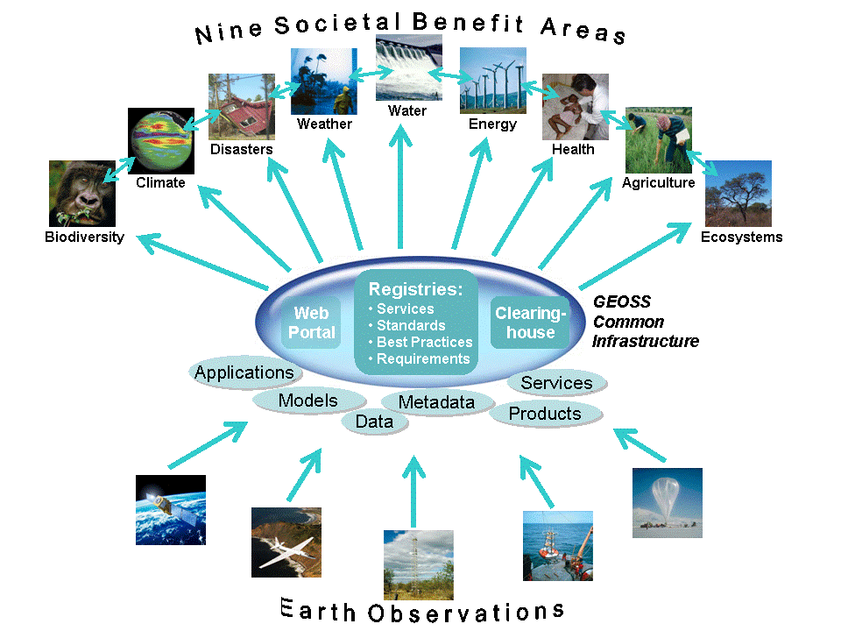

Group on Earth Observations

Slide 71
Marketing elements
Customer value propositions
Crossing the technology chasm
Creating shared value
Promotion tools

Slide 72
Customer value propositions capture the unique value of a product or services as perceived and appreciated by the customer.
Interestingly, they can differ completely from the features that the provider considers most important:

Slide 73
Customer Value Propositions
VALUE PROPOSITION | ALL BENEFITS | FAVOURABLE POINTS OF DIFFERENCE | RESONATING FOCUS
Consists of: | All benefits customers receive from a market offering | All favourable points of difference a market offering has relative to the next best alternative | The one or two points of difference whose improvement will deliver the greatest value to the customer
Answers the customer question: | “Why should our firm purchase your offering?” | “Why should our firm purchase your offering instead of your competitor’s?” | “What is most worthwhile for our firm to keep in mind about your offering?”
Requires: | Knowledge of own market offering | Knowledge of own market offering and next best alternative | Knowledge of how own marketing offering delivers value to customers, compared with next best alternative
Has the potential pitfall: | Benefit assertion | Value presumption | Requires customer value research
Source: Customer value propositions in business markets (HBR 2006)

Slide 74
Buyer behaviour & motivation
Type | Buyer behaviour | Motivation
Transactional sales | Intrinsic value buyers: “keep it cheap and easy to do business” | Understands the product Perceives it as substitutable Cost focus Resents time ‘wasted’ with sales people
Consultative sales | Extrinsic value buyers: “I don’t know the answer: help me analyse and solve the issue | Focus on how the product is used Interested in solutions and applications Values advice and help Needs the sales person
Source: Rethinking the sales force (Rackham, de Vincentis 1999)

Slide 75
Even when customer value propositions are well captured and formulated, introduction of solutions that involve new technology will have to overcome some hurdles.
This is called “crossing the technology chasm”:

Slide 76
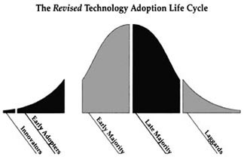
Crossing the technology chasm
Source: Crossing the chasm (Moore 1991)

Slide 77
Crossing the technology chasm
Most clients of EO products and services belong to the early and late majority,
They are pragmatists and are not prepared or willing to take substantial risk: the solution should work and be reliable.
Once convinced, the pragmatists will be long-term clients.
Source: Crossing the chasm (Moore 1991)

Slide 78
More information:
Creating & delivering your value proposition
– managing customer experience for profit
(Barnes, Blake, Pinder; 2009)
Customer value propositions in business markets
(Anderson, Narus, van Rossum [Harvard Business Review]; 2006)
Rethinking the sales force:
refining selling to create and capture customer value
(Rackham, de Vicentis; 1999)
Crossing the chasm
– marketing and selling high-tech products to mainstream customers
(Moore; 1991)

Slide 79
Creating shared value is a key element of successful implementation of earth observation solutions.
To achieve this, in most cases earth observation applications have to be integrated into more general (business or organizational) processes:

Slide 80
Create shared value
Involves cooperation between:
Public sector
Private sector
Social sector
Opportunity for earth observation (integrated) solutions:
Integrate EO in general business / organizational process
Integrate different EO (and GIS and navigation) functionalities

Slide 81
Based on all considerations dealt with in the previous slides, there are some practical approaches that can be applied in combination to promote earth observation applications:

Slide 82

Tools for earth observation marketing:
Success stories (in non-technical language, feasible, replication capacity, sustainable)
Marketing toolkits (international trends, earth observation examples, references)
Pilot projects, innovation funds, quick-wins (demonstration that EO actually works)
Promotion outside EO community (fairs, seminars, lunch-bag meetings, magazines)
Resource facilities for reference and capacity building (distributed, but connected, in different languages)
Source: Marketing earth observation products and services (Noort 2013)

Slide 83
Business elements
Business elements:
Proposal writing
Business procedures

Slide 84
Proposal writing is an art in itself.
During the GEONetCab and EOPOWER projects templates have been developed for writing successful proposals:

Slide 85
Proposal outline
1. Introduction / relevance
2. Objective(s)
3. Activities
4. Output
5. Management & evaluation
6. Risk assessment
7. Time schedule
8. Budget
Annexes
(more detailed version in separate document,
see www.eopower.eu or www.hcpinternational.com)

Slide 86


Other guides that may be useful:
Civicus: writing a funding proposal
Michigan State University: guide for writing a funding proposal
ESRI: writing a competitive GRANT application
REC: project proposal writing

Slide 87
If you run a company, compete for assignments and manage projects, a structured approach towards responsibilities, tasks, implementation and documentation is needed.
The following business procedures may be helpful:

Slide 88
Business procedures
1. On acquisition
2. On offers
3. On negotiation
4. On contracts
5. On project management
6. On travel & deployment
7. On deficiencies & complaints
8. On internal organization
9. On finance
(more detailed version in separate document,
see www.eopower.eu or www.hcpinternational.com)

Slide 89
Again:
SHARED PROBLEM
SHARED LANGUAGE
SHARED SOLUTION

Slide 90
4. Capacity Building

Slide 91
General
Marketing is promotion + capacity building.
Especially for the introduction of new technologies capacity building is important at all levels.
Capacity building is the instrument to increase
self-sufficiency and make solutions work.

Slide 92

General references for capacity building, open data and success stories
GEO Portal: www.earthobservations.org
Capacity building resource facility www.geocab.org
compilation of tutorials, references, open-source software, etc.
Satellites going local: share good practice (Eurisy handbooks) www.eurisy.org
Earth observation for green growth (ESA; 2013)

Slide 93

General references for capacity building, open data (2)
Bringing GEOSS services into practice:
how to use data from the GEO portal and how to provide input
www.envirogrids.net
Science education through earth observation for high schools: basic tutorials on all kind of subjects
www.seos-project.eu
Copernicus briefs:
information on satellite applications for different topics
http://www.copernicus.eu/main/copernicus-briefs

Slide 94
More references open data
Open data for sustainable development (World Bank; 2015)
description of the benefits of open data for a wide range of development goals, including the SDGs http://pubdocs.worldbank.org/pubdocs/publicdoc/2015/8/904051440717425994/Open-Data-for-Sustainable-development-Final-New.pdf
Terms and conditions for the use and distribution of Sentinel data (European Parliament and European Commission; 2014)
standard stipulations related to free and open access to Sentinel data http://www.demarine.de/lr/c/document_library/get_file?uuid=c5067655-b7ad-4d71-b07b-6111808f4abd&groupId=13521
Towards a thriving data-driven economy (European Commission; 2014) policy document on the use of (open) data for a knowledge economy and society
http://ec.europa.eu/information_society/newsroom/cf/dae/document.cfm?doc_id=6210

Slide 95




Capacity building resources for health:
Environmental health risks (EO2HEAVEN; 2013) description of relationships between environmental changes and their impact on human health, with earth observation applications as central element and attention for stakeholder involvement and capacity building
Approaches to GIS programs in health education (ESRI; 2011) short examples from different universities (no EO as such, but related)
Optical remote sensing for measurement and monitoring of emission flux (EPA; 2011) again, not strictly EO, but the handbook explains remote sensing techniques with similar underlying processes, including optical, LIDAR and thermal infrared
SERVIR and public health (SERVIR; 2012) examples of projects and capacity building activities that use EO to support public health initiatives in developing countries
IMPACTMIN project information on health aspects related to mining http://www.impactmin.eu

Slide 96
Further details:
Contact: Mark Noort
m.noort@hcpinternational.com
www.eopower.eu
www.hcpinternational.com

