Slide 1



Earth Observation for
Forest Management
International trends & developments
Earth observation applications
Business development
Capacity building

Slide 2

0. Introduction
Mark Noort, consultant, project manager
HCP international:
consulting, marketing of earth observation
Project director EOPOWER:
project for promotion & capacity building of
earth observation applications

Slide 3
Sequence:
General assessment of the state-of-the-art of earth observation
Major trends and developments in the application field
Description of earth observation solutions
Assessment of market potential for earth observation solutions and marketing instruments
Capacity building for successful application of earth observation solutions

Slide 4
Earth Observation helps you: save money save lives save the environment

Slide 5
Earth observation
applications
On the verge of reaching new user communities
These new user communities need to be involved
Weakest link / last mile aspects are important
Marketing needed: promotion & capacity building

Slide 6
Life cycle of products & services
Initialization
System analysis & design
Rapid prototyping
System development
Implementation
Post-implementation

Slide 7
Scope
Forest:
a dense growth of trees, plants, and underbrush covering a large area (very simplified definition/description)
Forest management:
is a branch of forestry concerned with the overall administrative, economic, legal and social aspects and with the essentially scientific and technical aspects, especially silviculture, protection, and forest regulation.
Climate aspects are dealt with more in detail in the climate toolkit, forest fires in the disaster management toolkit, environmental aspects in the environmental management toolkit.

Slide 8
Assessment of business & funding opportunities
Categories of forest management products & services
Life cycle phase of product or service
Regional context, level of technological & economic development
Optimum marketing mix

Slide 9
1. International trends & developments in forest management

Slide 10
Issues & trends in
forest management
Increased attention for forest governance, including certification
More detailed and accurate (global) monitoring of forests and deforestation
More involvement of the general public: participation, interactivity and citizens’ observatories
Possible effects of deforestation and sustainable forest management on climate change (including carbon accounting)
-> in climate toolkit

Slide 11
Drivers
(Increasing) demand for timber and wood as fuel;
Increased pressure on land, conversion of forests into agricultural (and urban) land;
Recognition of cardinal role of forests in carbon sequestration;
Increased attention for biodiversity loss and conservation of ecosystems;
Esthetic and recreational value of forests.

Slide 12
Forest governance
and certification
Based on three pillars:
Policy, legal, institutional and regulatory frameworks
Planning and decision-making processes
Implementation enforcement and compliance
and a number of cross-cutting aspects:
accountability, effectiveness, efficiency, fairness/equity, participation, transparency + description of subcomponents and indicators
The International Tropical Timber Organization (ITTO) and the Forest Stewardship Council (FSC) developed criteria and indicators for sustainable forest management and certification: FSC label required by customers and therefore by producers

Slide 13



More information:
Framework for assessing and monitoring forest governance (PROFOR, FAO; 2011) framework for description, diagnosis, monitoring, assessment and reporting on the state of governance in a country’s forest sector.
Impact of the global forest industry on atmospheric greenhouse gases (FAO; 2010) assessment of the influence of the forest products (roundwood, processed wood products and pulp and paper) value chain on atmospheric greenhouse gases with the aim to make management practices more sustainable
Sustaining forests - investing in our common future (UNEP; 2011) assessment of forest assets values, threats and policy and market solutions for sustainable forest management

Slide 14


More information (2):
Forest sourcebook (World Bank; 2008) comprehensive overview of forest management, including a discussion of remote sensing applications
+ cost comparison between RS and conventional monitoring
ICT for data collection and monitoring & evaluation - Opportunities and guidance on mobile applications for forest and agricultural sectors (World Bank; 2013) discussion of (feasibility of) remote sensing applications, challenges and opportunities
The High Conservation Value Forest toolkit (Proforest; 2003) toolkit for identification of high conservation values, with the aim to improve decision making, management and protection of forests

Slide 15
Forest and deforestation
monitoring
FAO Forest Resource Assessment 2010 outcomes:
improved knowledge on land cover and land use changes related to forests, especially deforestation, afforestation and natural expansion of forests;
information on the rate of change between 1990 and 2005 at global, biome and regional levels;
a global framework and method for monitoring forest change;
easy access to satellite imagery through an internet-based data portal;
enhanced capacity in many countries for monitoring, assessing and reporting on forest area and forest area

Slide 16
More information:
Global forest resource assessment (FAO; 2015)
global assessment of status and trends for all types of forests; comparison between 1990, 2000, 2005, 2010 and 2015
Global forest land-use change 1990 – 2005 (FAO; 2012) remote sensing analysis of global forests, comparison with FAO forest resource assessment
Global ecological forest classification and forest protected area gap analysis (UNEP; 2008) update of the 2000 UNEP-WCMC global forest map and assessment of ecoregions, forest cover and gap analysis of protected areas to indicate priorities for conservation and promote sustainable forest management

Slide 17
Participation, interactivity
and citizens’ observatories
Increased flow of open and accessible data and information (government to individuals, CSOs to individuals, social media).
Increased awareness and involvement of general public (changing consumer preferences -> certified products, reasonable labour conditions, sustainable exploitation of resources), public opinion, participation in monitoring).
Community forest management (sustainability, income generation from natural resources or payment for ecosystem services, attention for biodiversity, health, culture).

Slide 18


More information:
Interactive forest cover atlas of Cameroon (WRI) http://www.wri.org/publication/interactive-forestry-atlas-cameroon-version-2-0
Forestracker: http://cincs.com/research/trackers/
Marketracker: http://carboncreditcapital.com/resources-publications/market-trackers/
REDD+ and community forestry: lessons learned from an exchange of Brazilian experiences with Africa (World Bank; 2012) description of an exchange between Brazil and Africa on lessons learned about the role of community forestry as a strategy to achieve the goals of REDD+

Slide 19
2. Earth observation applications

Slide 20
Earth observation for
forest management
Landsat 1992 Landsat 2001 Likely areas of
deforestation
Automatic change detection

Slide 21
Earth observation
contribution
Global / regional forest monitoring
National / local forest monitoring
Support to operational forest management
Fire monitoring and prevention
(see disaster toolkit)
Carbon accounting
(see climate toolkit)

Slide 22
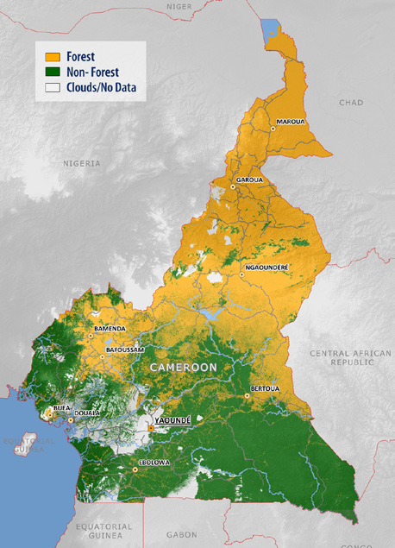
Example global / regional
forest monitoring
Map of forested areas in 2000 produced on the basis of Landsat satellite data. White areas show where no cloud-free images were acquired over the course of the year.
(by GAF AG, source: Copernicus; 2013)

Slide 23
Global / regional forest
monitoring
Earth observation provides a comprehensive view for forest classification and monitoring
Data series are available for historical and statistical analysis and analysis of whole regions
Earth observation provides a solid basis for verification and reporting
Earth observation supports biomass estimation
Cost estimate: mapping different forest types, data 1,500 k€ / 100,000 km², mapping 350 – 500 k€ / 100,000 km²
Main challenges: business model.

Slide 24


Examples:
Integrating remote-sensing and groundbased observations for estimation of emissions and removals of greenhouse gases in forests (GFOI; 2014) methods and guidance from the Global Forest Observation Initiative
Global forest resource assessment (FAO; 2010)
global assessment of status and trends for all types of forests; comparison between 1990, 2000, 2005 and 2010, including a remote sensing forest survey
REDD⁺ reducing Emissions from Deforestation and forest Degradation in developing countries
GOFC-GOLD Global Observation for Forest Cover and Land Dynamics
Preserving forests, cutting carbon (Copernicus; 2013)
brochure on earth observation support for objective measurement, reporting and verification of information on forests

Slide 25
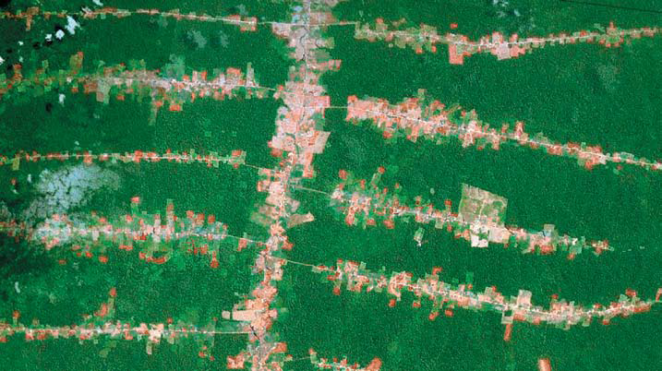
Example national / local
forest monitoring
A Landsat TM image shows in detail houses that have been built and fields that have been cleared along parallel “fishbone” lines in the tropical rainforest of Brazil. (Source: NASA)

Slide 26
National / local forest
monitoring
All aspects of the global / regional forest monitoring apply
Earth observation facilitates identification of the different stages of forest development
Earth observation can be used for detection of illegal logging and more detailed classification
Cost estimate: see global / regional forest monitoring, index forest fragmentation on case-by-case basis
Main challenges: cost, business model.

Slide 27



Examples:
Earth observation for sustainable development of forest (EOSD) (Natural Resources Canada; 2010) building a next generation forest measuring and monitoring system for Canada: description of land cover mapping, applications, change monitoring and a forest information system
Land system modelling for a sustainable world (INPE; 2013) presentation showing deforestation monitoring and forest modelling in Brazil
Monitoring of tropical forests and agricultural areas with radar (SarVision; 2011) methodology overview by the Dutch company SarVision

Slide 28


Examples (2):
Forestry and forest management (Earth from Space; 2009)
articles on remote sensing for forest monitoring in Russia by the company Scanex
Satellites support monitoring of Europe’s green lungs (Copernicus; 2013) brochure on earth observation for forest monitoring in Europe
Forest cover and deforestation in Belize 1980-2010 (SERVIR; 2010) use of remote sensing for change detection and analysis

Slide 29
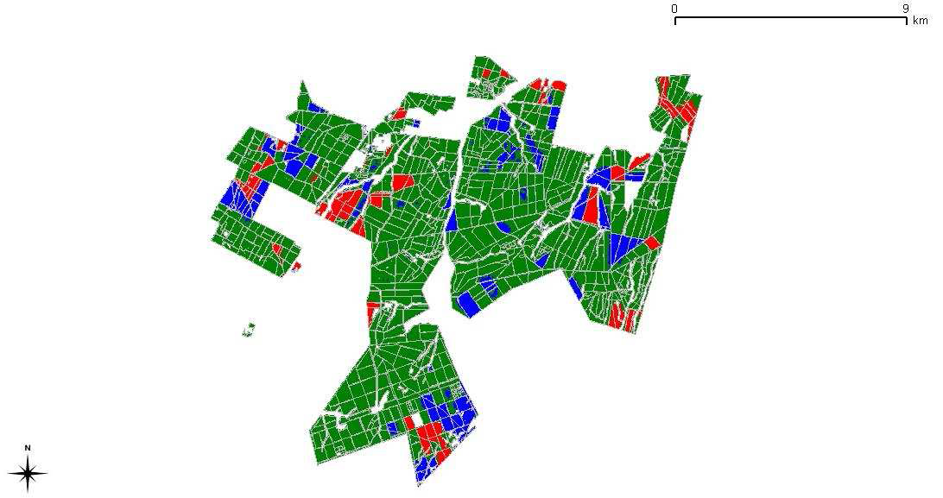
Example support to operational
forest management
Clear-cut and re-growth based on multi-temporal ALOS PALSAR-1 data (August 2007 - August 2008). Red colour corresponds to harvested before 2008 and re-establishment, brown to harvested before 2008 and no re-establishment, blue and cyan harvested in 2008 and no re-establishment. (Source: Case studies for ASI/FSC, service delivery report; 2011)

Slide 30
Support to operational
forest management
All aspects of the forest monitoring categories apply
Earth observation supports identification of new plantings, road systems, total annual cut, overcutting, illegal logging, etc.
Earth observation facilitates early detection of disasters (fire) and pests and diseases
Cost estimate: mapping different forest types, data 1,500 k€ / 100,000 km2, inventory 4 € / ha optical + 4 € / ha SAR, monitoring 4 € / ha optical + 4 € / ha SAR (FSC)
Main challenges: cost, complexity (data calibration), elegance, capacity.

Slide 31


Examples:
Sustainable forest management- Support to the Forest Stewardship Council - Service delivery report –Top down case studies for ASI/FSC + reports on Swedish, Russian & South African trials (FSC; 2011) results of a feasibility study on the use of earth observation for operational and sustainable forest management + reports on different trials with evaluation by forest management
The experience of applying high resolution radar imagery for monitoring of logging in Moscow Region (Earth from Space; 2010) description of the use of radar images for illegal logging detection and forest management
Earth observation capacity building activities in the Giant Mountains national park (CUNI; 2013) description of the use of earth observation for forest health assessment in the Czech Republic

Slide 32
More examples:
The use of remote sensing techniques in operational forestry (Suarez et al.; 2004) description of remote sensing for British forestry, including a cost comparison
Use of remote sensing in research and industry: an international perspective (Watt; 2014) presentation on the use and costs of remote sensing for forestry

Slide 33
Growth potential for
earth observation
Monitoring for environmental and certification purposes.
Main clients: governments, international organizations, NGOs.
Support to operational forest management.
Main clients: forestry companies.

Slide 34
3. Business development

Slide 35
Why is marketing / promotion of earth observation needed?
Public sector information (PSI)
Externalities (environmental accounting & payment for ecosystem services)
Global datasets, open access, data sharing, compatibility (GEO)

Slide 36
If public sector information is made available free-of-charge, demand will increase and, in the end, government revenue also, as companies will derive income from value-added products and services, and consequently pay more taxes (see figures in following slides).

Slide 37
Supply & Demand Public Sector Information
http://vimeo.com/63079712
Source: About GMES and data: geese and golden eggs (Sawyer, de Vries 2012)

Slide 38
Cost-benefit Public Sector Information
Source: About GMES and data: geese and golden eggs (Sawyer, de Vries 2012)

Slide 39
Re-use of Public Sector Information
Source: About GMES and data: geese and golden eggs (Sawyer, de Vries 2012)

Slide 40
Most earth observation applications deal with so-called externalities, such as impact on the environment.
It is difficult to capture these in terms of conventional cost-benefit models.
To tackle this, the following framework for analysis of earth observation applications is developed:

Slide 41
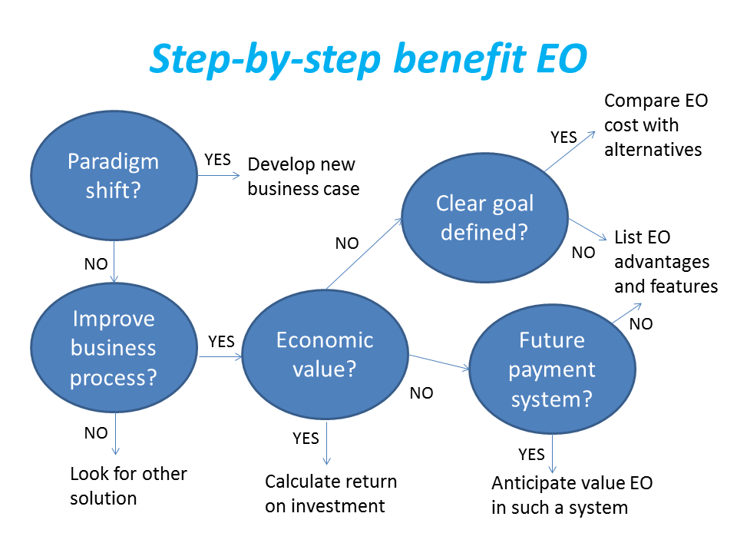
Framework for analysis
Step-by-step analysis of the benefits of earth observation (source: GEONetCab, 2013)

Slide 42
Key questions
Does the new application cause a paradigm shift?
Is the current business or organization process improved?
Does the application provide economic value that can be quantified?
Is a clear measurable goal defined to which the earth observation application contributes?
Is a future payment scheme or other economic mechanism foreseen in which the earth observation application fits?

Slide 43
Assessment of
geospatial solutions
Rating of characteristics of geospatial solutions:
fit-for-purpose
comparative advantage
complexity to user / ease- of-use
elegance
cost-benefit,
sustainability
resilience
reproduction capacity / flexibility
acceptance
level of knowledge transfer required
ethics, transparency, public accountability, objectivity & impartiality
Rating of business environment:
Willingness to pay (by clients)
Embedding (in organizational processes)
Openness (transparency and ease of doing business, access to markets)
Institutions (is the institutional environment conducive to doing business, acceptance of new solutions?)

Slide 44
Fit-for-purpose
An important, but often forgotten requirement:
Does the product or service do what it is supposed to do to solve a certain problem?
In other words: is it really a solution or just an attempt towards a solution?
Quantitative: not applicable
Qualitative (on scale of 1 to 5): based on description of what the EO solution actually does

Slide 45
Comparative advantage
What it does significantly better than other solutions to the same problem.
For earth observation usually the comparative advantages of greater accuracy, better resolution in time and space, comprehensive overview of large areas and near real-time information provision are mentioned as comparative advantages.
Quantitative: calculation of degree in which the EO solution is better than alternatives
Qualitative (on scale of 1 to 5): based on listing of comparative advantages

Slide 46
Complexity (to user) / ease-of-use
At all levels in the value chain the users (professionals and
end-users) are able to work with the product or service.
Quantitative: not applicable
Qualitative (on scale of 1 to 5): based on user testimonials and user surveys

Slide 47
Elegance
Once you get the idea behind this product or service, you want to be part of the community that uses it.
This sense of belonging facilitates the formation of user groups that provide valuable feedback.
Quantitative: none, or it should be the size of the user community
Qualitative (on scale of 1 to 5): based on user testimonials and user surveys

Slide 48
Cost-benefit
The cost-benefit of the product or service is quantified and sufficiently attractive, also in the long-term.
Quantitative: cost-benefit calculation
Qualitative (on scale of 1 to 5): based on quantitative assessment

Slide 49
Sustainability
The product or service can be delivered when it is needed.
There is a long-term perspective that guarantees delivery.
Sustainability concerns the following aspects:
Long-term data availability
Availability of finance/funds to provide the solution continuously for present and future use
Long-term institutional / governmental interest and support
Long-term user interest for a solution that addresses real needs
Quantitative: not applicable
Qualitative (on scale of 1 to 5): based on sensitivity analysis of the EO solution

Slide 50
Resilience
In case of extremes or breakdown in the value chain, the product or service can still be delivered at an acceptable level. Alternatives (plan B) are available (and developed).
Quantitative: cost-benefit calculation of plan B
Qualitative (on scale of 1 to 5): based on risk analysis of the EO solution

Slide 51
Reproduction
capacity / flexibility
The product or service can be easily applied or adapted for use in another region or another situation, while still providing the solution without (too much) extra cost.
Quantitative: calculation of reproduction costs for application in other regions or situations; measurement of spreading of actual use
Qualitative (on scale of 1 to 5): based on quantitative assessment and description of EO solution

Slide 52
Acceptance
The users intuitively get what the product or service is about and are interested. They accept it as a solution to their problem.
Quantitative: none, or survey results about acceptance. After introduction of the solution: number of clients and/or users
Qualitative (on scale of 1 to 5): based on user testimonials and user surveys

Slide 53
Level of knowledge
transfer required
The training requirements for professionals and other users along the value chain are clear and associated costs and efforts are acceptable.
Quantitative: cost and time required to get the users at the desired knowledge and skill level
Qualitative (on scale of 1 to 5): based on knowledge transfer plans and evaluation of training activities

Slide 54
Ethics, transparency,
public accountability,
objectivity & impartiality
Application of Earth observation increases the level of objectivity and impartiality in decision-making processes, including conflict resolution. The application improves transparency and public accountability. It raises no ethical issues or if it does, as in the case of privacy concerns, these are resolved in a satisfactory way for all parties concerned.
Quantitative: not applicable
Qualitative (on scale of 1 to 5): based on user testimonials and user surveys

Slide 55
Several attempts have been made to introduce environmental accounting and to enlarge the sphere of the conventional economy to include and quantify impact on ecosystems.
The following slides give some examples:

Slide 56






Environmental accounting & payment for ecosystem services
SEEA:
System of Environmental-Economic Accounts
(EC, FAO, IMF, OECD, UN, WB )
WAVES:
Wealth Accounting and the Valuation of Ecosystem Services (global partnership, led by World Bank)
TEEB:
The Economics of Ecosystems and Biodiversity
(group led by UNEP)

Slide 57
SEEA Conceptual Framework
Source: SEEA conceptual framework report (EC, FAO, IMF, OECD, UN, WB 2012)

Slide 58
For earth observation the work of the Group on Earth Observations (GEO) is essential to achieve the goal of a Global Earth Observations System of Systems (GEOSS), resulting in the shared GEO common infrastructure (GCI):

Slide 59
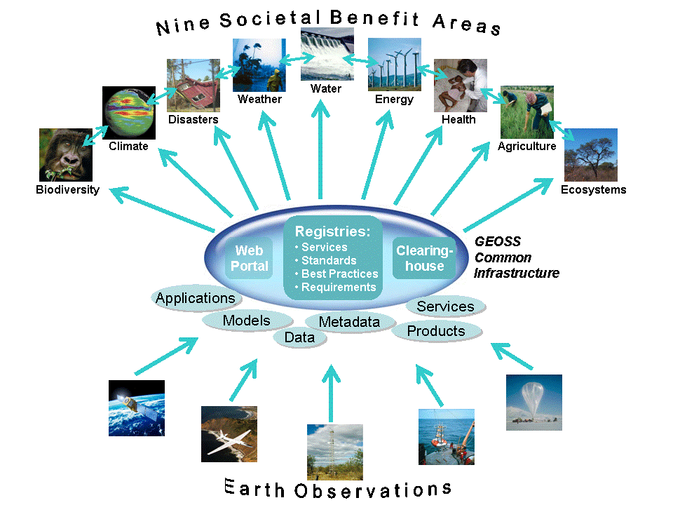

Group on Earth Observations

Slide 60
Marketing elements
Customer value propositions
Crossing the technology chasm
Creating shared value
Promotion tools

Slide 61
Customer value propositions capture the unique value of a product or services as perceived and appreciated by the customer.
Interestingly, they can differ completely from the features that the provider considers most important:

Slide 62
Customer Value Propositions
VALUE PROPOSITION | ALL BENEFITS | FAVOURABLE POINTS OF DIFFERENCE | RESONATING FOCUS
Consists of: | All benefits customers receive from a market offering | All favourable points of difference a market offering has relative to the next best alternative | The one or two points of difference whose improvement will deliver the greatest value to the customer
Answers the customer question: | “Why should our firm purchase your offering?” | “Why should our firm purchase your offering instead of your competitor’s?” | “What is most worthwhile for our firm to keep in mind about your offering?”
Requires: | Knowledge of own market offering | Knowledge of own market offering and next best alternative | Knowledge of how own marketing offering delivers value to customers, compared with next best alternative
Has the potential pitfall: | Benefit assertion | Value presumption | Requires customer value research
Source: Customer value propositions in business markets (HBR 2006)

Slide 63
Buyer behaviour & motivation
Type | Buyer behaviour | Motivation
Transactional sales | Intrinsic value buyers: “keep it cheap and easy to do business” | Understands the product Perceives it as substitutable Cost focus Resents time ‘wasted’ with sales people
Consultative sales | Extrinsic value buyers: “I don’t know the answer: help me analyse and solve the issue | Focus on how the product is used Interested in solutions and applications Values advice and help Needs the sales person
Source: Rethinking the sales force (Rackham, de Vincentis 1999)

Slide 64
Even when customer value propositions are well captured and formulated, introduction of solutions that involve new technology will have to overcome some hurdles.
This is called “crossing the technology chasm”:

Slide 65
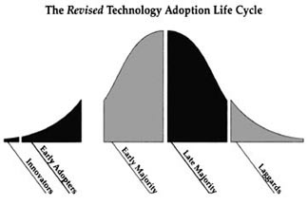
Crossing the technology chasm
Source: Crossing the chasm (Moore 1991)

Slide 66
Crossing the technology chasm
Most clients of EO products and services belong to the early and late majority,
They are pragmatists and are not prepared or willing to take substantial risk: the solution should work and be reliable.
Once convinced, the pragmatists will be long-term clients.
Source: Crossing the chasm (Moore 1991)

Slide 67
More information:
Creating & delivering your value proposition
– managing customer experience for profit
(Barnes, Blake, Pinder; 2009)
Customer value propositions in business markets
(Anderson, Narus, van Rossum [Harvard Business Review]; 2006)
Rethinking the sales force:
refining selling to create and capture customer value
(Rackham, de Vicentis; 1999)
Crossing the chasm
– marketing and selling high-tech products to mainstream customers
(Moore; 1991)

Slide 68
Creating shared value is a key element of successful implementation of earth observation solutions.
To achieve this, in most cases earth observation applications have to be integrated into more general (business or organizational) processes:

Slide 69
Create shared value
Involves cooperation between:
Public sector
Private sector
Social sector
Opportunity for earth observation (integrated) solutions:
Integrate EO in general business / organizational process
Integrate different EO (and GIS and navigation) functionalities

Slide 70
Based on all considerations dealt with in the previous slides, there are some practical approaches that can be applied in combination to promote earth observation applications:

Slide 71

Tools for earth observation marketing:
Success stories (in non-technical language, feasible, replication capacity, sustainable)
Marketing toolkits (international trends, earth observation examples, references)
Pilot projects, innovation funds, quick-wins (demonstration that EO actually works)
Promotion outside EO community (fairs, seminars, lunch-bag meetings, magazines)
Resource facilities for reference and capacity building (distributed, but connected, in different languages)
Source: Marketing earth observation products and services (Noort 2013)

Slide 72
Business elements
Business elements:
Proposal writing
Business procedures

Slide 73
Proposal writing is an art in itself.
During the GEONetCab and EOPOWER projects templates have been developed for writing successful proposals:

Slide 74
Proposal outline
1. Introduction / relevance
2. Objective(s)
3. Activities
4. Output
5. Management & evaluation
6. Risk assessment
7. Time schedule
8. Budget
Annexes
(more detailed version in separate document,
see www.eopower.eu or www.hcpinternational.com)

Slide 75


Other guides that may be useful:
Civicus: writing a funding proposal
Michigan State University: guide for writing a funding proposal
ESRI: writing a competitive GRANT application
REC: project proposal writing

Slide 76
If you run a company, compete for assignments and manage projects, a structured approach towards responsibilities, tasks, implementation and documentation is needed.
The following business procedures may be helpful:

Slide 77
Business procedures
1. On acquisition
2. On offers
3. On negotiation
4. On contracts
5. On project management
6. On travel & deployment
7. On deficiencies & complaints
8. On internal organization
9. On finance
(more detailed version in separate document,
see www.eopower.eu or www.hcpinternational.com)

Slide 78
Again:
SHARED PROBLEM
SHARED LANGUAGE
SHARED SOLUTION

Slide 79
4. Capacity Building

Slide 80
General
Marketing is promotion + capacity building.
Especially for the introduction of new technologies capacity building is important at all levels.
Capacity building is the instrument to increase
self-sufficiency and make solutions work.

Slide 81


General references for capacity building, open data and success stories
GEO Portal: www.earthobservations.org
Capacity building resource facility www.geocab.org
compilation of tutorials, references, open-source software, etc.
Satellites going local: share good practice (Eurisy handbooks) www.eurisy.org
Earth observation for green growth (ESA, 2013)

Slide 82

General references for capacity building, open data (2)
Bringing GEOSS services into practice:
how to use data from the GEO portal and how to provide input
www.envirogrids.net
Science education through earth observation for high schools: basic tutorials on all kind of subjects
www.seos-project.eu
Copernicus briefs:
information on satellite applications for different topics
http://www.copernicus.eu/main/copernicus-briefs

Slide 83
More references open data
Open data for sustainable development (World Bank; 2015)
description of the benefits of open data for a wide range of development goals, including the SDGs http://pubdocs.worldbank.org/pubdocs/publicdoc/2015/8/904051440717425994/Open-Data-for-Sustainable-development-Final-New.pdf
Terms and conditions for the use and distribution of Sentinel data (European Parliament and European Commission; 2014)
standard stipulations related to free and open access to Sentinel data http://www.demarine.de/lr/c/document_library/get_file?uuid=c5067655-b7ad-4d71-b07b-6111808f4abd&groupId=13521
Towards a thriving data-driven economy (European Commission; 2014) policy document on the use of (open) data for a knowledge economy and society
http://ec.europa.eu/information_society/newsroom/cf/dae/document.cfm?doc_id=6210

Slide 84


Capacity building resources for forest management:
The forest governance toolkit (WRI; 2009) general toolkit for sustainable forest management
Sustainable forest finance toolkit (PwC, WBCSD) financial toolkit for sustainable forest management
The High Conservation Value Forest toolkit (Proforest; 2003) toolkit for identification of high conservation values, with the aim to improve decision making, management and protection of forests
Remote sensing applications – Chapter 3: forest and vegetation (NRSC; 2010)
Sustainable forest management (FSC; 2011) feasibility study on the use of earth observation for operational and sustainable forest management

Slide 85

Capacity building resources for forest management (2):
Earth observation for forest biomass and carbon mapping
Case study: Afram Headwaters Forest Reserve, Ghana (ITC; 2015)
3-day EOPOWER (self-study) course for professionals
http://menhir.itc.utwente.nl:5000/fbsharing/KGKOZXKU/
Manual on deforestation, degradation and fragmentation using remote sensing and GIS (FAO; 2007)
description of the use of remote sensing to estimate and monitor deforestation, degradation and fragmentation (in Asia and Oceania)

Slide 86
Further details:
Contact: Mark Noort
m.noort@hcpinternational.com
www.eopower.eu
www.hcpinternational.com

