Slide 1



Earth Observation for
Environmental Management
International trends & developments
Earth observation applications
Business development
Capacity building

Slide 2

0. Introduction
Mark Noort, consultant, project manager
HCP international:
consulting, marketing of earth observation
Project director EOPOWER:
project for promotion & capacity building of
earth observation applications

Slide 3
Sequence:
General assessment of the state-of-the-art of earth observation
Major trends and developments in the application field
Description of earth observation solutions
Assessment of market potential for earth observation solutions and marketing instruments
Capacity building for successful application of earth observation solutions

Slide 4
Earth Observation helps you: save money save lives save the environment

Slide 5
Earth observation
applications
On the verge of reaching new user communities
These new user communities need to be involved
Weakest link / last mile aspects are important
Marketing needed: promotion & capacity building

Slide 6
Life cycle of products & services
Initialization
System analysis & design
Rapid prototyping
System development
Implementation
Post-implementation

Slide 7
Scope (1)
The term “environment” may be defined as:
the sum total of all surroundings of a living organism, including natural forces and other living things, which provide conditions for development and growth as well as of danger and damage
“Ecology” can be described as:
the air, water, minerals, organisms, and all other external factors surrounding and affecting a given organism at any time
“Biodiversity” can be described as:
the variability among living organisms from all sources including, inter alia, terrestrial, marine and other aquatic ecosystems and the ecological complexes of which they are part; this includes diversity within species, between species and of ecosystems

Slide 8
Scope (2)
A definition of “Environmental resource management” is: environmental resource management is the management of the interaction and impact of human societies on the environment
Climate aspects will be dealt with more in detail in the climate toolkit; the marine environment toolkit and the forest management toolkit cover environmental aspects related to these topics.

Slide 9
Assessment of business & funding opportunities
Categories of environmental management products & services
Life cycle phase of product or service
Regional context, level of technological & economic development
Optimum marketing mix

Slide 10
1. International trends & developments in environmental management

Slide 11
Issues & trends in
environmental
management
Addressing environmental challenges; leading to a
Move towards a green economy; including
Payment for ecosystem services.

Slide 12
Drivers
Economic growth;
Population growth;
Overexploitation of resources, such as in agriculture and fisheries;
Environmental assets are not valued or undervalued in the current economic system;
Lack of awareness, knowledge and consensus about what affects the environment and what the consequences are.

Slide 13
Environmental
challenges
There are many environmental challenges, classification and priorities depend on viewpoints and aspect perception:
Freshwater scarcity, climate change, habitat change, invasive species, overexploitation of oceans, nutrient overloading (TEEB for business);
Cross-cutting issues, food – biodiversity & land issues, freshwater & marine issues, climate change issues, energy – technology & waste issues (UNEP);
Depletion of natural capital, climate change, biodiversity loss, emissions & waste generation, pollution (EEA);
Climate change, energy efficiency & renewable energy sources, management of ecosystems & biodiversity, forest loss, desertification & land degradation, water resources (EC).

Slide 14
In schematic form: DPSIR framework

Slide 15

Resulting in: policy priorities
Better implementation and further strengthening of current environmental priorities;
Dedicated management of natural capital and ecosystem services;
Coherent integration of environmental considerations across the many sectoral policy domains;
Transformation to a green economy.

Slide 16


More information:
Global environmental outlook 5 (UNEP; 2012) and regional environmental outlook series http://www.unep.org/geo/
21 issues for the 21st century (UNEP; 2012) results of the UNEP foresight process on emerging environmental Issues
The European environment (EEA; 2010) state and outlook + updates
Living planet report 2014 - Species and spaces, people and places (WWF; 2014) report on the Living Planet Index with information on populations of mammals, birds, reptiles, amphibians and fish

Slide 17
Green economy
Environmentally oriented policies and public investment as life insurance (rather than luxury);
Policy tools:
Toolbox of good practices
Green economy indicators
Green economy roadmap
Sustainable development goals (SDGs);
Distinction between green/sustainable growth or green economy:
green economy has absolute decoupling (resource use declines irrespective of the growth rate of the economic driver) as aim.

Slide 18




More information:
Towards a green infrastructure for Europe (Actema, Ecosystems, RIKS, TERSYN, CSIC; 2009) developing new concepts for integration of Natura 2000 network into a broader countryside
Creating a national strategy for environmental intelligence (IGES; 2011) the forum on earth observations 5
Green economy in the European Union (UNEP; 2012)
supporting briefing
Green economy in action (UNDP; 2012) articles and excerpts that illustrate green economy and sustainable development efforts
Key Issues on Green Economy at Rio+20 (IGES; 2012)

Slide 19



More information (2):
Impacts of the cradle to cradle certified products program (Cradle to Cradle Product Innovations Institute; 2014) conceptual framework for cradle-to-cradle methodology and examples of certified products
Business innovation in a living economy (Worldwatch Institute Europe; 2013) survey results and examples on how to build a green economy
Unleashing the power of the circular economy (IMSA; 2013) description of obstacles and steps to reach a circular economy

Slide 20
Payment for
ecosystem services
Measures to represent benefits: monetary, quantitative (indices, indexes, risk), qualitative (stories, maps, perception);
Market profiles:
Carbon: compliant & voluntary carbon forestry
Water: compliant water quality trading, voluntary watershed management payments, government-mediated watershed PES
Biodiversity: compliant & voluntary biodiversity offsets, government-mediated biodiversity PES, individual fisheries quotas
Bundled: certified agricultural products;
Certification & labelling.

Slide 21




More information:
The economics of ecosystems and biodiversity (TEEB)
many reports, such as “Natural capital at risk: the top 100 externalities of business” (TEEB; 2013)
System of environmental-economic accounting (SEEA, UN)
many (strategy) reports + central framework report (2012)
The global partnership on wealth accounting and the valuation of ecosystem services (WAVES)
many (annual) reports on activities and systems in different countries
Environmental performance index (EPI, YCELP, CIESIN; 2012) + pilot trend environmental performance index
PES and cocoa (CREM; 2011) securing future supplies and preserving biodiversity by paying cocoa farmers for ecosystem services

Slide 22



More information (2):
Measuring and valuing environmental impacts (NBS; 2011)
introduction on how to measure and value an organisation’s environmental impact
Calculation methodology for the national footprint accounts, 2010 edition (Global Footprint Network)
description of ecological footprint accounting
Framework for the development of environmental statistics (FDES) (UNDESA; 2013)
detailed methodology on how to do environmental statistics

Slide 23
2. Earth observation applications

Slide 24
Earth observation for
environmental
management
Shared environmental information system (SEIS)

Slide 25
Earth observation contribution
Terrestrial and freshwater ecosystems, identification and monitoring at global or continental level (for marine and coastal ecosystems see climate toolkit),
Bio-geophysical variables,
Local applications, for national parks and other protected areas,
Biodiversity modelling and monitoring, including invasive species monitoring and ecological forecasting,
Environmental accounting.
Note: there is quite some overlap between the different categories

Slide 26
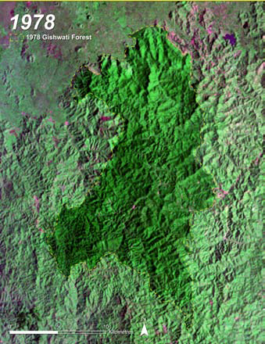
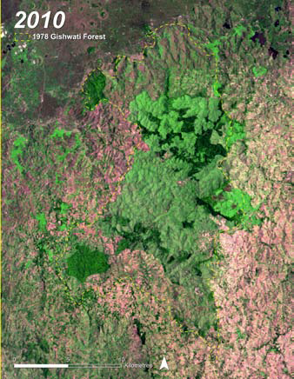
Example terrestrial and
freshwater ecosystems
Conversion from forest to rangeland and farmland from 1978 to 2010 in Gishwati former forest reserve, Rwanda (Source: Atlas of Rwanda’s changing environment, 2011)

Slide 27
Terrestrial and
freshwater ecosystems
Earth observation is an excellent instrument for mapping and monitoring of land cover, land use, changes, classification and historical trends
Earth observation is a valuable tool for assessing the status of ecosystem goods and services, provided by the regulation, habitat, production, and information functions of ecosystems
Evaluating ecosystem services in support of sustainable ecosystem management requires the use of (spatial) models
Until now mainly government or scientific activity
Cost estimate: on case-by-case basis.
Main challenges: cost, capacity, data access, business model

Slide 28



Examples:
A new map of standardized terrestrial ecosystems of Africa (AAG; 2013) overview of integrated and comprehensive ecosystem mapping exercise
A new map of standardized terrestrial ecosystems of the conterminous United States (USGS; 2009) overview of integrated and comprehensive ecosystem mapping exercise
Access to global land cover reference datasets and their suitability for land cover mapping activities (GOFC-GOLD; 2014) presentation that compares current global land cover datasets for different purposes
Examples of datasets: GlobCover (ESA), 30 meter global land cover product (China)

Slide 29



More examples:
Mapping wetlands using earth observation techniques (MEDWET; 2007) overview of integrated and comprehensive ecosystem mapping exercise for Mediterranean wetlands
Earth observation for aquatic ecosystems (CSIRO; 2012) overview presentation of earth observation for water quality monitoring and management in Australia
Atlas of Rwanda’s changing environment (REMA; 2011) implications for climate change resilience covering hotspots, such as population growth, urbanization, wetlands, forests, mining and transboundary issues

Slide 30

More examples (2):
Terrestrial ecosystems from space: A review of earth observation products for macroecology applications (Pfeifer et al.; 2011) description and comparison of different EO applications for land cover, vegetation biogeophysical structure and productivity, radiative transfer and carbon flux
Remote sensing of ecosystem health: Opportunities, challenges, and future perspectives (Li; 2014) description of methodologies, opportunities and challenge for the use of EO for ecosystem health assessment
Meeting environmental challenges with remote sensing imagery (AGI; 2013) examples of the use of remote sensing for environmental purposes

Slide 31

More examples (3):
Wetlands – Unexpected treasures (Copernicus; 2015) brochure on the use of EO for mapping and monitoring of wetland ecosystems

Slide 32
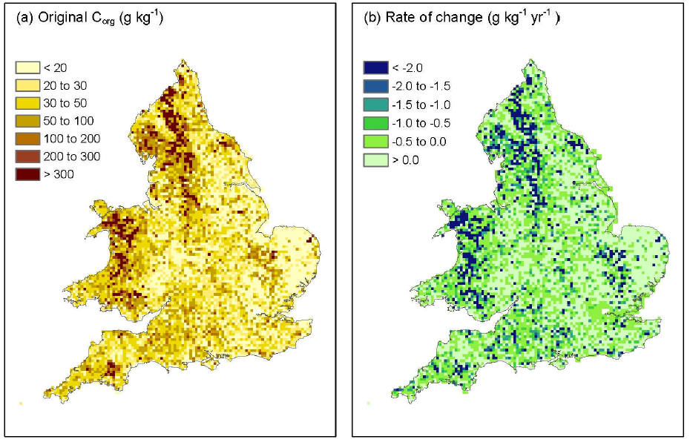
Example
bio-geophysical variables
Change in soil organic content in England and Wales between 1978 and 2003
(source: Bellamy et al., 2005)

Slide 33
Bio-geophysical
variables
Earth observation facilitates measurement and assessment of individual bio-geophysical variables, such as vegetation, soil, radiation, water cycle and essential climate variables (ECVs)
Bio-geophysical parameters provide the backbone for analysis and decision-making in environmental management
Data gathering and analysis mainly carried out by governments, international organizations and academia; private sector uses / assembles / analyses bio-geophysical data mainly for specific purposes, such as precision agriculture
Cost estimate: on case-by-case basis
Main challenges: cost, capacity, data access.

Slide 34

Examples:
Global energy and water cycle experiment (GEWEX)
www.gewex.org
Essential climate variables (ECV; GCOS)
www.wmo.int/pages/prog/gcos/index.php?name=EssentialClimateVariables
The state of soil in Europe (JRC, EEA; 2012)
update on soil of “the European environment” (EEA; 2010)
Biophysical modelling and analysis of ecosystem services in an ecosystem accounting context (Hein; 2014)
description of indicators and mapping methods for ecosystem services, including an overview of global datasets
More background info in the toolkits on water management and climate

Slide 35
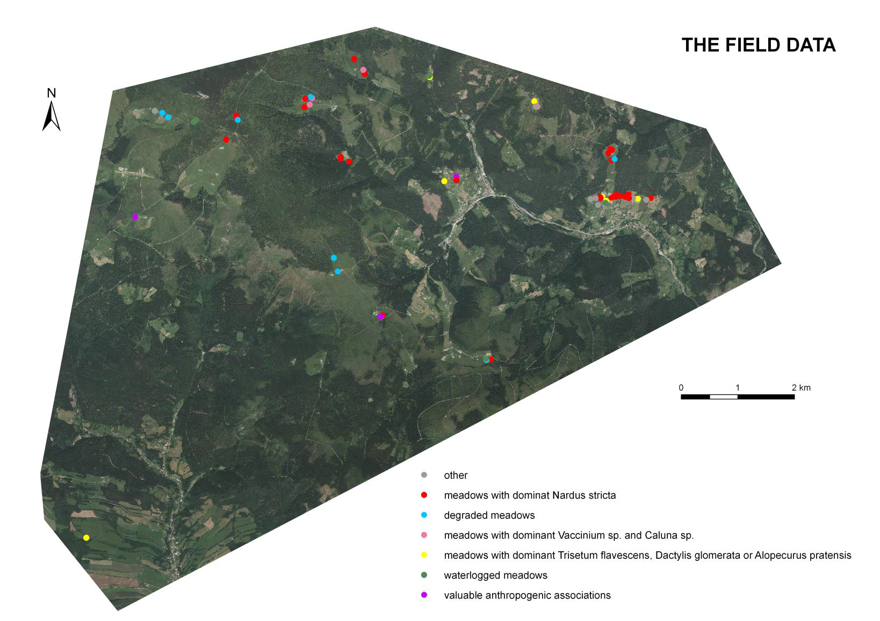
Example
local applications
Monitoring of meadows
and forest health
In Giant Mountains
national park
(Czech Republic)

Slide 36
Local applications
Earth observation helps managers of national parks and protected areas improve park management
Earth observation provides valuable information on plant health, habitats, changes and relations between different factors that cannot be derived, or only at high cost, by in-situ analysis
Earth observation is instrumental in delineating optimum national park borders and environmental corridors
Cost estimate: on case-by-case basis
Main challenges: capacity, data access, business model.

Slide 37


Examples:
Impact of oil palm plantations on peatland conversion in Sarawak 2005 – 2010 (SARVision; 2011) study using remote sensing showing deforestation for oil palm expansion
Satellite-based monitoring of protected natural areas of the Samara Region (Scanex; 2013) description of monitoring of a protected area in Russia to detect changes from natural causes, fires and anthropogenic impact
Cooperation with Giant (Krkonoše) Mountains national park (on forests, meadows, snow cover, land use development, cover temperature, etc.) and Šumava national park (bark beetle pest) in the Czech Republic (Charles University)

Slide 38
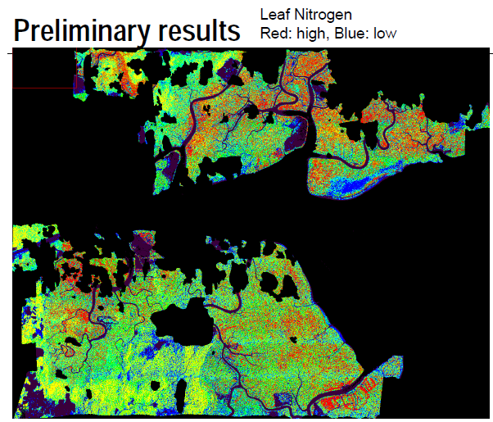
Example biodiversity
modelling and monitoring
Mangrove degradation using leaf nitrogen as (an) indicator:
damage declines the level of nutrients
(Source: ITC, 2010)

Slide 39
Biodiversity modelling
and monitoring
Earth observation helps predicting the impact of habitat loss and fragmentation on biodiversity elements and ecosystems processes
Earth observation facilitates the inclusion of individual species or functional types in ecosystem modelling and models (linked to carbon)
Models of landscape dynamics, using geospatial data, generate maps of suitable habitat over time for input to meta-population models
Cost estimate: on case-by-case basis, 110 k€ / year (globally) for general monitoring of invasive species
Main challenges: capacity, data access.

Slide 40




Examples:
Earth observation for biodiversity monitoring: A review of current approaches and future opportunities for tracking progress towards the Aichi biodiversity targets (GEOBON, 2014) description of best practices for the use of EO for biodiversity applications
Making earth observation work for UK biodiversity - Conservation phase 1 (JNCC; 2014) study on effectiveness of using earth observation for biodiversity in the United Kingdom
Satellite remote sensing for biodiversity research and conservation applications (CEOS; 2012) workshop report on the use, opportunities and barriers related to EO applications for biodiversity

Slide 41

More examples:
Adequacy of biodiversity observation systems to support the CBD 2020 Targets (GEOBON, 2011) comprehensive overview of needed and existing observation systems for the Convention on Biological Diversity by the GEO Biodiversity Observation Network
Phenology related measures and indicators at varying spatial scales (EBONE; 2012) investigation of phenology information for habitat classification using SPOT VGT and MODIS NDVI data
Geospatial tools address emerging issues in spatial ecology (Skidmore et al.; 2011) overview of the usefulness of geospatial applications for biodiversity and ecology

Slide 42
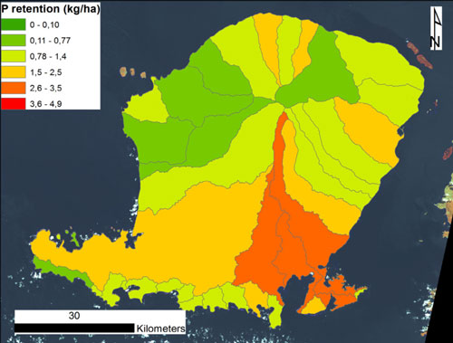
Example
environmental accounting
EO-derived phosphorus retention map for Lombok, Indonesia, in support of nutrient retention policies (source: Metria, 2014)

Slide 43
Environmental
accounting
Earth observation provides the basis for monitoring, reporting and verification for environmental accounting
Increased precision of quantification of carbon stocks and ecosystem type classification with EO result in more precise proxies for PES schemes
Cost estimate: 350 k€ / year for update of ecological footprint, same for water footprint, 10 k€ / year / country for nitrogen footprint, same for carbon footprint; payment for ecosystem services on case-by-case basis, incremental cost for reaching observation adequacy globally estimated at 1,000 – 10,000 k€ / year
Main challenges: capacity, access to data & technology, business model

Slide 44



Examples:
Remote sensing for payment for ecosystem services is increasingly used by organizations, such as the World Wide Fund for Nature (WWF) and Conservation International.
Quite a number of pilot projects are implemented:
4 different trials in Asia and South America (Metria, GeoVille, Argans)
Indigenous territories in the Mataven area, Colombia, the gorilla habitat in the Great Lakes region of Africa and the peat swamps of Kalimantan, Indonesia (SarVision)

Slide 45
Growth potential for
earth observation
Mapping and monitoring of terrestrial and freshwater ecosystems and biodiversity.
Main clients: government, NGOs.
Protected area management.
Main clients: government, national park management, NGOs.
Measurement, reporting and verification for environmental accounting (including payment for ecosystem services).
Main clients: government, environment agencies, NGOs, CSR of big (multinational) companies, local communities.

Slide 46
3. Business development

Slide 47
Why is marketing / promotion of earth observation needed?
Public sector information (PSI)
Externalities (environmental accounting & payment for ecosystem services)
Global datasets, open access, data sharing, compatibility (GEO)

Slide 48
If public sector information is made available free-of-charge, demand will increase and, in the end, government revenue also, as companies will derive income from value-added products and services, and consequently pay more taxes (see figures in following slides).

Slide 49
Supply & Demand Public Sector Information
http://vimeo.com/63079712
Source: About GMES and data: geese and golden eggs (Sawyer, de Vries 2012)

Slide 50
Cost-benefit Public Sector Information
Source: About GMES and data: geese and golden eggs (Sawyer, de Vries 2012)

Slide 51
Re-use of Public Sector Information
Source: About GMES and data: geese and golden eggs (Sawyer, de Vries 2012)

Slide 52
Most earth observation applications deal with so-called externalities, such as impact on the environment.
It is difficult to capture these in terms of conventional cost-benefit models.
To tackle this, the following framework for analysis of earth observation applications is developed:

Slide 53
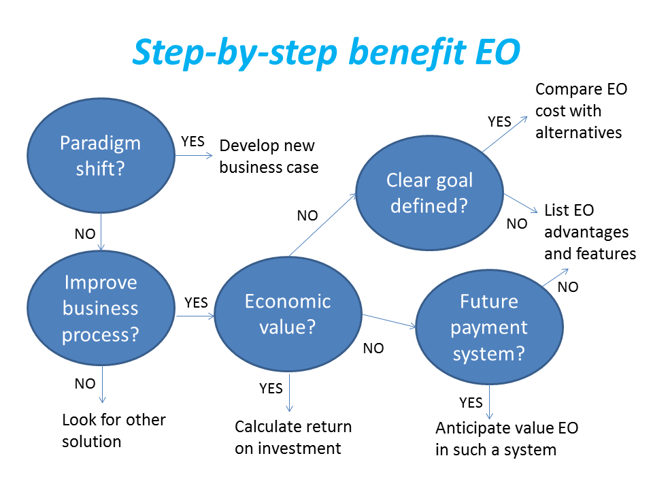
Framework for analysis
Step-by-step analysis of the benefits of earth observation (source: GEONetCab, 2013)

Slide 54
Key questions
Does the new application cause a paradigm shift?
Is the current business or organization process improved?
Does the application provide economic value that can be quantified?
Is a clear measurable goal defined to which the earth observation application contributes?
Is a future payment scheme or other economic mechanism foreseen in which the earth observation application fits?

Slide 55
Assessment of
geospatial solutions
Rating of characteristics of geospatial solutions:
fit-for-purpose
comparative advantage
complexity to user / ease- of-use
elegance
cost-benefit,
sustainability
resilience
reproduction capacity / flexibility
acceptance
level of knowledge transfer required
ethics, transparency, public accountability, objectivity & impartiality
Rating of business environment:
Willingness to pay (by clients)
Embedding (in organizational processes)
Openness (transparency and ease of doing business, access to markets)
Institutions (is the institutional environment conducive to doing business, acceptance of new solutions?)

Slide 56
Fit-for-purpose
An important, but often forgotten requirement:
Does the product or service do what it is supposed to do to solve a certain problem?
In other words: is it really a solution or just an attempt towards a solution?
Quantitative: not applicable
Qualitative (on scale of 1 to 5): based on description of what the EO solution actually does

Slide 57
Comparative advantage
What it does significantly better than other solutions to the same problem.
For earth observation usually the comparative advantages of greater accuracy, better resolution in time and space, comprehensive overview of large areas and near real-time information provision are mentioned as comparative advantages.
Quantitative: calculation of degree in which the EO solution is better than alternatives
Qualitative (on scale of 1 to 5): based on listing of comparative advantages

Slide 58
Complexity (to user) / ease-of-use
At all levels in the value chain the users (professionals and
end-users) are able to work with the product or service.
Quantitative: not applicable
Qualitative (on scale of 1 to 5): based on user testimonials and user surveys

Slide 59
Elegance
Once you get the idea behind this product or service, you want to be part of the community that uses it.
This sense of belonging facilitates the formation of user groups that provide valuable feedback.
Quantitative: none, or it should be the size of the user community
Qualitative (on scale of 1 to 5): based on user testimonials and user surveys

Slide 60
Cost-benefit
The cost-benefit of the product or service is quantified and sufficiently attractive, also in the long-term.
Quantitative: cost-benefit calculation
Qualitative (on scale of 1 to 5): based on quantitative assessment

Slide 61
Sustainability
The product or service can be delivered when it is needed.
There is a long-term perspective that guarantees delivery.
Sustainability concerns the following aspects:
Long-term data availability
Availability of finance/funds to provide the solution continuously for present and future use
Long-term institutional / governmental interest and support
Long-term user interest for a solution that addresses real needs
Quantitative: not applicable
Qualitative (on scale of 1 to 5): based on sensitivity analysis of the EO solution

Slide 62
Resilience
In case of extremes or breakdown in the value chain, the product or service can still be delivered at an acceptable level. Alternatives (plan B) are available (and developed).
Quantitative: cost-benefit calculation of plan B
Qualitative (on scale of 1 to 5): based on risk analysis of the EO solution

Slide 63
Reproduction
capacity / flexibility
The product or service can be easily applied or adapted for use in another region or another situation, while still providing the solution without (too much) extra cost.
Quantitative: calculation of reproduction costs for application in other regions or situations; measurement of spreading of actual use
Qualitative (on scale of 1 to 5): based on quantitative assessment and description of EO solution

Slide 64
Acceptance
The users intuitively get what the product or service is about and are interested. They accept it as a solution to their problem.
Quantitative: none, or survey results about acceptance. After introduction of the solution: number of clients and/or users
Qualitative (on scale of 1 to 5): based on user testimonials and user surveys

Slide 65
Level of knowledge
transfer required
The training requirements for professionals and other users along the value chain are clear and associated costs and efforts are acceptable.
Quantitative: cost and time required to get the users at the desired knowledge and skill level
Qualitative (on scale of 1 to 5): based on knowledge transfer plans and evaluation of training activities

Slide 66
Ethics, transparency,
public accountability,
objectivity & impartiality
Application of Earth observation increases the level of objectivity and impartiality in decision-making processes, including conflict resolution. The application improves transparency and public accountability. It raises no ethical issues or if it does, as in the case of privacy concerns, these are resolved in a satisfactory way for all parties concerned.
Quantitative: not applicable
Qualitative (on scale of 1 to 5): based on user testimonials and user surveys

Slide 67
Several attempts have been made to introduce environmental accounting and to enlarge the sphere of the conventional economy to include and quantify impact on ecosystems.
The following slides give some examples:

Slide 68





Environmental accounting & payment for ecosystem services
SEEA:
System of Environmental-Economic Accounts
(EC, FAO, IMF, OECD, UN, WB )
WAVES:
Wealth Accounting and the Valuation of Ecosystem Services (global partnership, led by World Bank)
TEEB:
The Economics of Ecosystems and Biodiversity
(group led by UNEP)

Slide 69
SEEA Conceptual Framework
Source: SEEA conceptual framework report (EC, FAO, IMF, OECD, UN, WB 2012)

Slide 70
For earth observation the work of the Group on Earth Observations (GEO) is essential to achieve the goal of a Global Earth Observations System of Systems (GEOSS), resulting in the shared GEO common infrastructure (GCI):

Slide 71
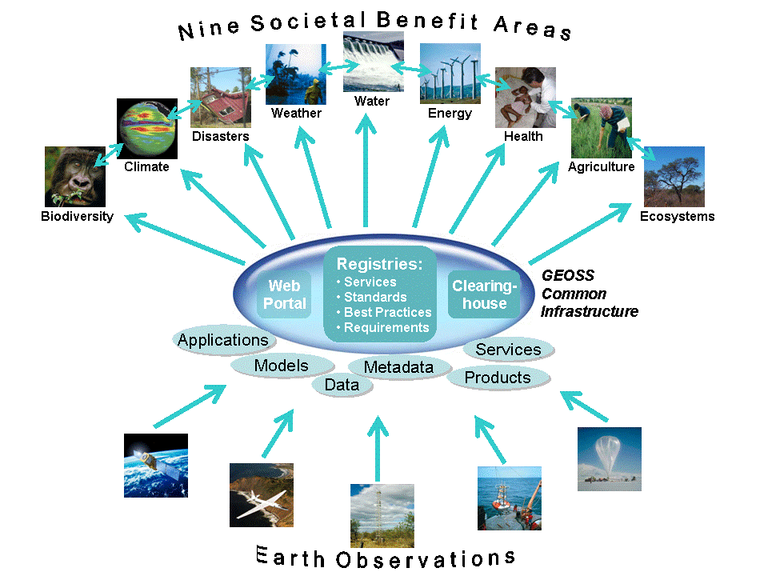

Group on Earth Observations

Slide 72
Marketing elements
Customer value propositions
Crossing the technology chasm
Creating shared value
Promotion tools

Slide 73
Customer value propositions capture the unique value of a product or services as perceived and appreciated by the customer.
Interestingly, they can differ completely from the features that the provider considers most important:

Slide 74
Customer Value Propositions
VALUE PROPOSITION | ALL BENEFITS | FAVOURABLE POINTS OF DIFFERENCE | RESONATING FOCUS
Consists of: | All benefits customers receive from a market offering | All favourable points of difference a market offering has relative to the next best alternative | The one or two points of difference whose improvement will deliver the greatest value to the customer
Answers the customer question: | “Why should our firm purchase your offering?” | “Why should our firm purchase your offering instead of your competitor’s?” | “What is most worthwhile for our firm to keep in mind about your offering?”
Requires: | Knowledge of own market offering | Knowledge of own market offering and next best alternative | Knowledge of how own marketing offering delivers value to customers, compared with next best alternative
Has the potential pitfall: | Benefit assertion | Value presumption | Requires customer value research
Source: Customer value propositions in business markets (HBR 2006)

Slide 75
Buyer behaviour & motivation
Type | Buyer behaviour | Motivation
Transactional sales | Intrinsic value buyers: “keep it cheap and easy to do business” | Understands the product Perceives it as substitutable Cost focus Resents time ‘wasted’ with sales people
Consultative sales | Extrinsic value buyers: “I don’t know the answer: help me analyse and solve the issue | Focus on how the product is used Interested in solutions and applications Values advice and help Needs the sales person
Source: Rethinking the sales force (Rackham, de Vincentis 1999)

Slide 76
Even when customer value propositions are well captured and formulated, introduction of solutions that involve new technology will have to overcome some hurdles.
This is called “crossing the technology chasm”:

Slide 77
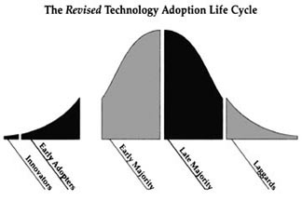
Crossing the technology chasm
Source: Crossing the chasm (Moore 1991)

Slide 78
Crossing the technology chasm
Most clients of EO products and services belong to the early and late majority.
They are pragmatists and are not prepared or willing to take substantial risk: the solution should work and be reliable.
Once convinced, the pragmatists will be long-term clients.
Source: Crossing the chasm (Moore 1991)

Slide 79
More information:
Creating & delivering your value proposition
– managing customer experience for profit
(Barnes, Blake, Pinder; 2009)
Customer value propositions in business markets
(Anderson, Narus, van Rossum [Harvard Business Review]; 2006)
Rethinking the sales force:
refining selling to create and capture customer value
(Rackham, de Vicentis; 1999)
Crossing the chasm
– marketing and selling high-tech products to mainstream customers
(Moore; 1991)

Slide 80
Creating shared value is a key element of successful implementation of earth observation solutions.
To achieve this, in most cases earth observation applications have to be integrated into more general (business or organizational) processes:

Slide 81
Create shared value
Involves cooperation between:
Public sector
Private sector
Social sector
Opportunity for earth observation (integrated) solutions:
Integrate EO in general business / organizational process
Integrate different EO (and GIS and navigation) functionalities

Slide 82
Based on all considerations dealt with in the previous slides, there are some practical approaches that can be applied in combination to promote earth observation applications:

Slide 83

Tools for earth observation marketing:
Success stories (in non-technical language, feasible, replication capacity, sustainable)
Marketing toolkits (international trends, earth observation examples, references)
Pilot projects, innovation funds, quick-wins (demonstration that EO actually works)
Promotion outside EO community (fairs, seminars, lunch-bag meetings, magazines)
Resource facilities for reference and capacity building (distributed, but connected, in different languages)
Source: Marketing earth observation products and services (Noort 2013)

Slide 84
Business elements
Business elements:
Proposal writing
Business procedures

Slide 85
Proposal writing is an art in itself.
During the GEONetCab and EOPOWER projects templates have been developed for writing successful proposals:

Slide 86
Proposal outline
1. Introduction / relevance
2. Objective(s)
3. Activities
4. Output
5. Management & evaluation
6. Risk assessment
7. Time schedule
8. Budget
Annexes
(more detailed version in separate document,
see www.eopower.eu or www.hcpinternational.com)

Slide 87


Other guides that may be useful:
Civicus: writing a funding proposal
Michigan State University: guide for writing a funding proposal
ESRI: writing a competitive GRANT application
REC: project proposal writing

Slide 88
If you run a company, compete for assignments and manage projects, a structured approach towards responsibilities, tasks, implementation and documentation is needed.
The following business procedures may be helpful:

Slide 89
Business procedures
1. On acquisition
2. On offers
3. On negotiation
4. On contracts
5. On project management
6. On travel & deployment
7. On deficiencies & complaints
8. On internal organization
9. On finance
(more detailed version in separate document,
see www.eopower.eu or www.hcpinternational.com)

Slide 90
Again:
SHARED PROBLEM
SHARED LANGUAGE
SHARED SOLUTION

Slide 91
4. Capacity Building

Slide 92
General
Marketing is promotion + capacity building.
Especially for the introduction of new technologies capacity building is important at all levels.
Capacity building is the instrument to increase
self-sufficiency and make solutions work.

Slide 93


General references for capacity building, open data and success stories
GEO Portal: www.earthobservations.org
Capacity building resource facility www.geocab.org
compilation of tutorials, references, open-source software, etc.
Satellites going local: share good practice (Eurisy handbooks) www.eurisy.org
Earth observation for green growth (ESA; 2013)

Slide 94

General references for capacity building, open data (2)
Bringing GEOSS services into practice:
how to use data from the GEO portal and how to provide input
www.envirogrids.net
Science education through earth observation for high schools: basic tutorials on all kind of subjects, including environment-related topics
www.seos-project.eu
Copernicus briefs:
information on satellite applications for different topics
http://www.copernicus.eu/main/copernicus-briefs

Slide 95
More references open data
Open data for sustainable development (World Bank; 2015)
description of the benefits of open data for a wide range of development goals, including the SDGs http://pubdocs.worldbank.org/pubdocs/publicdoc/2015/8/904051440717425994/Open-Data-for-Sustainable-development-Final-New.pdf
Terms and conditions for the use and distribution of Sentinel data (European Parliament and European Commission; 2014)
standard stipulations related to free and open access to Sentinel data http://www.demarine.de/lr/c/document_library/get_file?uuid=c5067655-b7ad-4d71-b07b-6111808f4abd&groupId=13521
Towards a thriving data-driven economy (European Commission; 2014) policy document on the use of (open) data for a knowledge economy and society
http://ec.europa.eu/information_society/newsroom/cf/dae/document.cfm?doc_id=6210

Slide 96


Capacity building resources for environmental management (1):
The GBIF data portal: a practical “hands-on” tutorial
user guide to Global Biodiversity Information Facility www.gbif.org
Guidelines for Biodiversity Monitoring and for Protected Areas (UNEP) practical guide on how to go about it: definitions, scope, approach, sampling, monitoring
LULC applications – ESA advanced training course on land remote sensing (Caetano, 2009)
presentation with practical EO examples for land use / land cover

Slide 97


Capacity building resources for environmental management (2):
AfroMaison
documents and examples on environmental decision-making
www.afromaison.net
enviroGRIDS – the story of data on the environment
http://www.youtube.com/watch?v=9SKOwQDFhYI&sns=em
Sourcebook on remote sensing and biodiversity indicators (CBD, 2007) description of how remote sensing can be used for biodiversity monitoring with examples

Slide 98



Capacity building resources for environmental management (3):
Mapping wetlands using earth observation techniques (Fitoka & Kiramitsoglou (eds); 2008)
part II gives an overview on how to use EO and part III provides case studies
Earth observation for biodiversity conservation
Land cover mapping for biodiversity conservation (ITC; 2015)
3-day EOPOWER (self-study) course for professionals
http://menhir.itc.utwente.nl:5000/fbsharing/KGKOZXKU/

Slide 99



Capacity building resources for environmental management (4):
InVEST +VERSION+ User’s Guide (The Natural Capital Project; 2015)
description of how to use the InVEST tool to map and value ecosystem services
http://data.naturalcapitalproject.org/nightly-build/invest-users-guide/html/#pdf-version-of-the-user-s-guide
EPA tutorials DPSIR http://www.epa.gov/ged/tutorial/index.htm

Slide 100
Further details:
Contact: Mark Noort
m.noort@hcpinternational.com
www.eopower.eu
www.hcpinternational.com

