Slide 1



Earth Observation for
Energy & Mining
International trends & developments
Earth observation applications
Business development
Capacity building

Slide 2

0. Introduction
Mark Noort, consultant, project manager
HCP international:
consulting, marketing of earth observation
Project director EOPOWER:
project for promotion & capacity building of
earth observation applications

Slide 3
Sequence:
General assessment of the state-of-the-art of earth observation
Major trends and developments in the application field
Description of earth observation solutions
Assessment of market potential for earth observation solutions and marketing instruments
Capacity building for successful application of earth observation solutions

Slide 4
Earth Observation helps you: save money save lives save the environment

Slide 5
Earth observation
applications
On the verge of reaching new user communities
These new user communities need to be involved
Weakest link / last mile aspects are important
Marketing needed: promotion & capacity building

Slide 6
Life cycle of products & services
Initialization
System analysis & design
Rapid prototyping
System development
Implementation
Post-implementation

Slide 7
Scope
Energy resources:
anything that can be used as a source of energy
Energy:
property of objects, transferable among them via fundamental interactions, which can be converted in form but not created or destroyed
Mining can be described as:
the extraction of valuable minerals or other geological materials from the earth, which are of economic interest to the miner
Climate aspects are dealt with more in detail in the climate toolkit, hydropower aspects are also covered in the water management toolkit, environmental impact of mining and energy resources relates to subjects dealt with in the environmental management toolkit.

Slide 8
Assessment of business & funding opportunities
Categories of energy & mining products & services
Life cycle phase of product or service
Regional context, level of technological & economic development
Optimum marketing mix

Slide 9
1. International trends & developments in energy & mining

Slide 10
Issues & trends in
energy & mining
Increased attention for renewable energy and new energy sources (including biofuel)
Increased attention for energy saving, more efficient use of resources and recycling
Search for new mining deposits (including rare earths) and transport chains
Increased attention for environmental aspects of mining
Anticipation on the possible effects of climate change
-> in climate toolkit

Slide 11
Drivers
Increasing demand for energy and mining products (growing population, increasing urbanization, growing economy);
Adaptation to climate change: changing trends, increasing variability, greater extremes and large inter-annual variations in climate parameters are expected;
Possible depletion of fossil fuels and mining deposits;
Concerns about vulnerability of nuclear energy to disasters;
Negative environmental impact of mining and extraction of fossil fuels.

Slide 12
Renewable energy &
new energy sources
Renewable energy sources: solar energy, wind energy (onshore, land-based and offshore), bioenergy, hydropower, geothermal energy;
Electricity generation from renewable energy is increasing;
Employed to improve energy security and encourage economic development (less dependency on fossil fuels);
Less impact on climate and environment than fossil fuels;
Efficiency, storage and cost-effectiveness need to be improved.

Slide 13


More information:
Renewable energy projects handbook (WEC; 2004)
overview of renewable energy options, potential and main features of each type of renewable energy + political and financial considerations, project checklist and a description of the environmental credits acquisition process
Global Energy Information System www.worldenergy.org
case studies on renewable energy from different countries
Promise of renewables (CSIS; 2012)
commentary on trends, developments, problems: renewable is more expensive than fossil, but investment is growing

Slide 14

More information solar energy:
Solar energy perspectives (IEA; 2011)
comprehensive overview: if you want use solar energy, start here!
Renewable energy essentials: Solar heating and cooling (IEA; 2012) short overview of markets and potential
Renewable energy essentials: Concentrating solar thermal power (IEA; 2009) short overview of markets and potential
Technology roadmap: Solar photovoltaic energy (IEA; 2010)
plan for future action, based on current and anticipated trends
Technology roadmap: Solar heating & cooling (IEA; 2009)
plan for future action, based on current and anticipated trends

Slide 15
More information wind energy:
Technology roadmap: Wind energy (IEA; 2013)
plan for future action, based on current and anticipated trends and stressing the importance of standards for resource assessment, sharing of wind resource data and improving wind forecasting accuracy
Renewable energy essentials: Wind (IEA; 2008)
short overview of markets and potential

Slide 16
More information bioenergy:
Biofuels: policies, standards and technologies (WEC; 2010)
overview of the current state of affairs, including sustainability criteria
Good practice guidelines: Bioenergy project development & biomass supply (IEA; 2007)
guide towards a sustainable and profitable approach

Slide 17
More information hydropower & geothermal:
Renewable energy essentials: Hydropower (IEA; 2010)
short overview of markets and potentials
Renewable energy essentials: Geothermal (IEA; 2010)
short overview of markets and potentials

Slide 18
Energy saving
Energy efficiency supports different goals: energy security, adaptation to and mitigation of the effects of climate change, economic development;
A significant proportion of the energy efficiency improvement potential is not realised, mainly because of market barriers;
Policy options:
a) address contract design to ensure end-users face energy prices,
b) regulate the level of energy efficiency in appliances and buildings,
c) improve access to information about energy efficiency performances.

Slide 19
Example
Frankfurt refurbishment using passive housing technology.
Top photos: the building before and after refurbishment. Bottom images: infrared visualization of the heat losses before and after the refurbishment (Source: Passive House Institute Darmstadt)

Slide 20
More information:
Mind the gap: Energy efficiency (IEA; 2007)
comprehensive discussion of barriers and solutions with respect to achieving energy efficiency, based on agency theory
Technology roadmap: Energy-efficient buildings envelopes (IEA; 2013)
graphic visualization of roadmap and targets

Slide 21
Mining deposits &
transport chains
Increasing demand for raw materials;
Trends towards securing strategic flow of resources and independent supply (national / regional interest);
Increased sophistication of exploration, enabling mining in environmentally sensitive areas, such as the arctic and tropical forests;
Concerns about health, safety (and income) risks;
More attention for stakeholder participation, poverty effects and sustainability, environmental, climate aspects.

Slide 22

More information:
Trends in the mining and metals industry (ICMM; 2012)
overview of trends, main deposits and mining’s contribution to sustainable development
Measurement, reporting and verification and the mining and metals industry (ICMM; 2011)
description of MRV for climate change and sustainable mining
Approaches to understanding development outcomes from mining (ICMM; 2013)
best practices description and overview and assessment of different valuation tools and methods and their feasibility for measuring the impact of mining on social and economic development

Slide 23

More information (2):
Metals & mining – Research brief (SASB; 2014)
sustainability aspects and accounting metrics, from a global (and US) perspective

Slide 24
Environmental aspects
of mining
More attention for preventing environmental pollution during all phases of the mining cycle;
More attention for disaster prevention and risk management;
More emphasis on corporate social responsibility (CSR);
More priority for sustainable use of inputs for the mining process;
More regulation (and enforcement) on handling of mining waste.

Slide 25


More information:
Report on socio-economic indicators, drivers and best practice across the chosen sites (IMPACTMIN; 2010)
Report on the study of mining and society and its implications (IMPACTMIN; 2011)
Indicators (EO-MINERS; 2012) on:
D : air quality and other nuisances
E : water quality
G : geotechnical hazards and accidents
H : industrial and other accidents

Slide 26
2. Earth observation applications

Slide 27
Earth observation for
energy & mining
This coloured Envisat
ASAR radar image,
which is normally black and white, shows the wind fields over the North Sea around Denmark and northern Germany in September 2009.
Speed values range from
0–32 km per second.
Wind speeds and directions are indicated by the size and colour of the arrows.
(Source: EEA & ESA)

Slide 28
Earth observation
contribution
Resource assessment and exploration support for renewable energy
Resource assessment and exploration support for mining and fossil fuel extraction
Pipeline monitoring
Optimization of biofuel production
(see agriculture toolkit)
Effect of climate change on energy requirements (and vice versa)
(see climate toolkit)
Urban heat islands and sustainable building design
(see urban management, land administration and SDI toolkit)

Slide 29
Example renewable
energy
Energy resource map: Annual solar irradiance in the Mediterranean region (kWh/m2).
(Source: DLR)

Slide 30
Renewable
energy
Earth observation provides data on irradiation, cloud cover, wind velocity, wind direction, wind shear, air temperature, relative humidity, topography/elevation, surface roughness, wave height, etc.
Data series are available for historical and statistical analysis and analysis of whole regions
Cost estimate: renewable energy resource assessment
2 – 10 € / km²
Main challenges: cost, capacity, business model.

Slide 31


Examples:
Space-based environmental information for solar energy industries (ENVISOLAR; 2007) www.envisolar.com
brochure with overview of services and examples, including services for investment decisions, plant management, utilities, time-series services for science and consulting and a description of the PV-calculator tool
MESoR (management and exploitation of solar energy knowledge)
www.mesor.net continued at www.webservice-energy.org/
Description of solar resource products, summary of benchmarking results and examples of use (MESoR; 2009)
overview of and comparison (benchmarking) of different methods for measuring irradiation + 20 use cases
Needs for new solar radiation services to faster deploy the market for solar energy applications and optimize grid integration (MESoR; 2009)
recommendations for improvements in observations and forecasts

Slide 32


More examples (2):
RETScreen international (Natural Resources Canada)
brochure on RETScreen initiative www.retscreen.net
Clean energy projects, RETScreen engineering & cases textbook (RETScreen; 2005)
description of clean energy decision-making software; uses worldwide database of NASA satellite-derived meteorological data (NASA surface meteorology and solar energy dataset (SSE)) from a ten-year period
(1983 – 1993)
Solar energy data for developing countries
(GEO-ECP; 2007)
short description of, and links to, SSE, Helioclim and SODA

Slide 33



More examples (3):
Results of solar resource assessments in the UNEP/SWERA project (Renné; 2005)
article with summary of the results in the 13 SWERA countries
Global atlas for solar and wind energy end-user needs assessment (Caner; 2012)
presentation of the end-user assessment for SWERA products (policy-makers, developers, NGOs/universities, global modelling community). SWERA is used as first data source (to identify high-potential areas), but is not enough for decision-making. More capacity building needed.
Solar and wind energy resource assessment (GEF; 2011)
success story with summary of SWERA achievements
Highlighting Earth’s solar resources from space (Copernicus: 2013) brochure on earth observation for solar energy

Slide 34

More examples (4):
Enhancing information for renewable energy technology deployment in Brazil, China, and South Africa
(UNEP, 2011) description of resource assessment for solar and wind energy in the three countries + comparison between the countries
Terminal evaluation of UNEP GEF project solar and wind evaluation report of the SWERA project with lessons learned and recommendations (establishment of a knowledge network)
User manual for SWERA: designing renewable resource assessment projects and using assessment products (UNEP) user manual for SWERA and related products + guidance on where to find information

Slide 35

More examples (5):
Satellite based services for the wind industry (Furevik; 2005)
article describing the use of EO data for wind farms (wind measurements over the ocean, wave statistics, tidal heights and currents, terrain roughness, orography)
Wind energy forecasting (Brower; 2011)
presentation describing forecasting systems, models, time horizons and forecast performance + recommendations to improve wind forecasting in the United States
Assessment of wind resources and annual energy production of wind farms (Hasager; 2012)
presentation on the use of earth observation for WAsP (wind atlas analysis and application programme) in Denmark
Space supports Europe’s energy future (Copernicus; 2013)
brochure on earth observation for wind energy

Slide 36


More examples (6):
Facing the renewable energy challenge (Copernicus; 2014)
brochure on use of EO for snow cover, snow water equivalent & run-off estimation for hydropower
Best practices handbook for the collection and use of solar resource data for solar energy applications (NREL; 2015)
general handbook, including the use of remote sensing
Global renewable energy atlas (IRENA) http://irena.masdar.ac.ae/
web-based facility with maps on renewable energy
Earth observation and renewable energy (ESA; 2013)
presentation on EO products for renewable energy
Distribution of wind and solar energy resources in Tanzania and Mozambique (Chalmers University of Technology; 2011)
example of feasibility assessment for wind and solar energy, based on EO products

Slide 37
Example mining and
fossil fuel extraction
Landsat ETM+ satellite image of the Catanda carbonatite massif (Angola)
superimposed
on DEM
(Source: AEGOS project)

Slide 38
Mining and fossil
fuel extraction
Earth observation is used for geological mapping (exploring of new mineral deposits), optimal planning of seismic surveys and monitoring of the impact of mining and fossil fuel extraction (land use change, air quality, soil quality, water quality, presence of roads, indicators of socio-economic effects, risk management, site rehabilitation)
Earth observation can be applied in remote areas and access to data is not restricted
Cost estimate: geological mapping 2 – 16 k€ for an area of
20 x 20 km, habitat / impact assessment 20 – 25 k€ per mining operation, geotechnical assessment 10 – 15 k€ per mining operation, mine waste monitoring 10 – 50 k€ / year
Main challenges: cost, complexity, capacity.

Slide 39


Examples:
Review of spin-off projects based on AEGOS, preparation of a road map for AEGOS test beds (AEGOS; 2011)
description of 8 geological mapping initiatives in Africa
The spatial data infrastructure for georesources in Africa (Urvois, AEGOS; 2013) overview presentation of the AEGOS initiative
ERS in oil and gas industry (Earth from Space; 2011)
special issue dedicated to GIS and remote sensing for oil and gas by the Russian company Scanex
Satellite monitoring of the diamond field in the Archangelsk Region (Earth from Space; 2013)
article on earth observation for environmental impact of diamond mining by the Russian company Scanex

Slide 40
More examples (2):
Report on the limitations and potentials of satellite EO data (IMPACTMIN; 2010)
assessment of the feasibility of different earth observation sensors and techniques for monitoring the environmental impact of mining
Indicators and earth observation products for the assessment of the extractive industry environmental and societal impacts (EO-MINERS; 2013)
report series on earth observation and the impact of mining with case studies in South Africa, Czech Republic and Kyrgyzstan
Earth observation and what it can tell us about the impacts of mining (EO-MINERS)
leaflet summarising the contribution of earth observation to monitoring the impact of mining

Slide 41
More examples (3):
Mining sector assessment – Mining in the Canadian North: opportunities for the remote sensing technologies to add value to the sector (LookNorth; 2012)
qualitative assessment of the added value of EO related to mineral exploration, deposit evaluation, mine feasibility/planning, mine construction and operation and mine closure

Slide 42

One Geology:
Geological maps for more than 70 countries
including information on geothermal showcases in Australia and France, and the digital energy map of the UK
www.onegeology.org
Initiatives,
such as AEGOS,
One Geology, IMPACTMIN,
EO-MINERS and EnerGEO
also support
energy resources
assessment!

Slide 43
Example pipeline
monitoring
Ground monitoring and route planning service
(Source:
PIPEMON project)

Slide 44
Pipeline
monitoring
Earth observation enables remote monitoring, with increased frequency and accuracy, reduced need for on-site inspections, early detection of stresses and leaks, encroachment monitoring and enhanced network performance and safety, route planning and ground motion monitoring
Cost estimate: on case-by-case basis
Main challenges: cost, cost-benefit, protection of sensitive data.

Slide 45

Examples:
Oil and gas spill and pipeline condition assessment using remote sensing (EPA)
overview of methodologies for pipeline monitoring in the US
Pipeline monitoring service (PIPEMON; 2006)
service portfolio specifications
Ground motion monitoring service (PIPEMON; 2005)
leaflet

Slide 46
Growth potential for
earth observation
Resource assessment and monitoring for renewable energy, especially wind and solar.
Main clients: governments, energy companies.
Resource assessment and monitoring for mining and fossil fuel extraction, including environmental impact.
Main clients: governments, mining companies, energy companies, NGOs.

Slide 47
3. Business development

Slide 48
Why is marketing / promotion of earth observation needed?
Public sector information (PSI)
Externalities (environmental accounting & payment for ecosystem services)
Global datasets, open access, data sharing, compatibility (GEO)

Slide 49
If public sector information is made available free-of-charge, demand will increase and, in the end, government revenue also, as companies will derive income from value-added products and services, and consequently pay more taxes (see figures in following slides).

Slide 50
Supply & Demand Public Sector Information
http://vimeo.com/63079712
Source: About GMES and data: geese and golden eggs (Sawyer, de Vries 2012)

Slide 51
Cost-benefit Public Sector Information
Source: About GMES and data: geese and golden eggs (Sawyer, de Vries 2012)

Slide 52
Re-use of Public Sector Information
Source: About GMES and data: geese and golden eggs (Sawyer, de Vries 2012)

Slide 53
Most earth observation applications deal with so-called externalities, such as impact on the environment.
It is difficult to capture these in terms of conventional cost-benefit models.
To tackle this, the following framework for analysis of earth observation applications is developed:

Slide 54
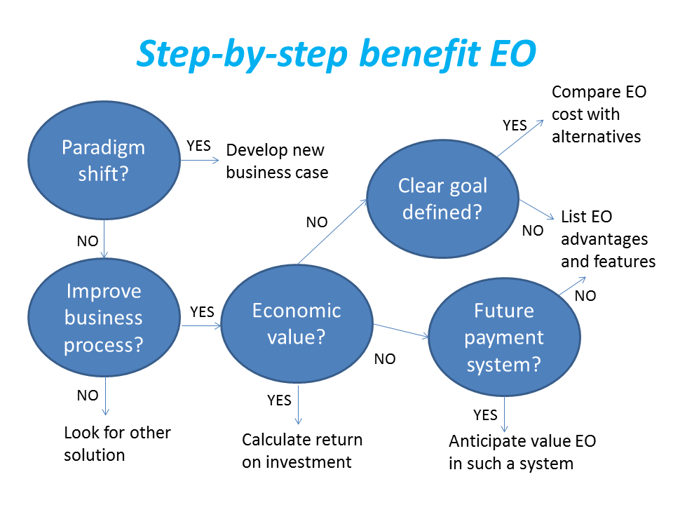
Framework for analysis
Step-by-step analysis of the benefits of earth observation (source: GEONetCab, 2013)

Slide 55
Key questions
Does the new application cause a paradigm shift?
Is the current business or organization process improved?
Does the application provide economic value that can be quantified?
Is a clear measurable goal defined to which the earth observation application contributes?
Is a future payment scheme or other economic mechanism foreseen in which the earth observation application fits?

Slide 56
Assessment of
geospatial solutions
Rating of characteristics of geospatial solutions:
fit-for-purpose
comparative advantage
complexity to user / ease- of-use
elegance
cost-benefit,
sustainability
resilience
reproduction capacity / flexibility
acceptance
level of knowledge transfer required
ethics, transparency, public accountability, objectivity & impartiality
Rating of business environment:
Willingness to pay (by clients)
Embedding (in organizational processes)
Openness (transparency and ease of doing business, access to markets)
Institutions (is the institutional environment conducive to doing business, acceptance of new solutions?)

Slide 57
Fit-for-purpose
An important, but often forgotten requirement:
Does the product or service do what it is supposed to do to solve a certain problem?
In other words: is it really a solution or just an attempt towards a solution?
Quantitative: not applicable
Qualitative (on scale of 1 to 5): based on description of what the EO solution actually does

Slide 58
Comparative advantage
What it does significantly better than other solutions to the same problem.
For earth observation usually the comparative advantages of greater accuracy, better resolution in time and space, comprehensive overview of large areas and near real-time information provision are mentioned as comparative advantages.
Quantitative: calculation of degree in which the EO solution is better than alternatives
Qualitative (on scale of 1 to 5): based on listing of comparative advantages

Slide 59
Complexity (to user) / ease-of-use
At all levels in the value chain the users (professionals and
end-users) are able to work with the product or service.
Quantitative: not applicable
Qualitative (on scale of 1 to 5): based on user testimonials and user surveys

Slide 60
Elegance
Once you get the idea behind this product or service, you want to be part of the community that uses it.
This sense of belonging facilitates the formation of user groups that provide valuable feedback.
Quantitative: none, or it should be the size of the user community
Qualitative (on scale of 1 to 5): based on user testimonials and user surveys

Slide 61
Cost-benefit
The cost-benefit of the product or service is quantified and sufficiently attractive, also in the long-term.
Quantitative: cost-benefit calculation
Qualitative (on scale of 1 to 5): based on quantitative assessment

Slide 62
Sustainability
The product or service can be delivered when it is needed.
There is a long-term perspective that guarantees delivery.
Sustainability concerns the following aspects:
Long-term data availability
Availability of finance/funds to provide the solution continuously for present and future use
Long-term institutional / governmental interest and support
Long-term user interest for a solution that addresses real needs
Quantitative: not applicable
Qualitative (on scale of 1 to 5): based on sensitivity analysis of the EO solution

Slide 63
Resilience
In case of extremes or breakdown in the value chain, the product or service can still be delivered at an acceptable level. Alternatives (plan B) are available (and developed).
Quantitative: cost-benefit calculation of plan B
Qualitative (on scale of 1 to 5): based on risk analysis of the EO solution

Slide 64
Reproduction
capacity / flexibility
The product or service can be easily applied or adapted for use in another region or another situation, while still providing the solution without (too much) extra cost.
Quantitative: calculation of reproduction costs for application in other regions or situations; measurement of spreading of actual use
Qualitative (on scale of 1 to 5): based on quantitative assessment and description of EO solution

Slide 65
Acceptance
The users intuitively get what the product or service is about and are interested. They accept it as a solution to their problem.
Quantitative: none, or survey results about acceptance. After introduction of the solution: number of clients and/or users
Qualitative (on scale of 1 to 5): based on user testimonials and user surveys

Slide 66
Level of knowledge
transfer required
The training requirements for professionals and other users along the value chain are clear and associated costs and efforts are acceptable.
Quantitative: cost and time required to get the users at the desired knowledge and skill level
Qualitative (on scale of 1 to 5): based on knowledge transfer plans and evaluation of training activities

Slide 67
Ethics, transparency,
public accountability,
objectivity & impartiality
Application of Earth observation increases the level of objectivity and impartiality in decision-making processes, including conflict resolution. The application improves transparency and public accountability. It raises no ethical issues or if it does, as in the case of privacy concerns, these are resolved in a satisfactory way for all parties concerned.
Quantitative: not applicable
Qualitative (on scale of 1 to 5): based on user testimonials and user surveys

Slide 68
Several attempts have been made to introduce environmental accounting and to enlarge the sphere of the conventional economy to include and quantify impact on ecosystems.
The following slides give some examples:

Slide 69







Environmental accounting & payment for ecosystem services
SEEA:
System of Environmental-Economic Accounts
(EC, FAO, IMF, OECD, UN, WB )
WAVES:
Wealth Accounting and the Valuation of Ecosystem Services (global partnership, led by World Bank)
TEEB:
The Economics of Ecosystems and Biodiversity
(group led by UNEP)

Slide 70
SEEA Conceptual Framework
Source: SEEA conceptual framework report (EC, FAO, IMF, OECD, UN, WB 2012)

Slide 71
For earth observation the work of the Group on Earth Observations (GEO) is essential to achieve the goal of a Global Earth Observations System of Systems (GEOSS), resulting in the shared GEO common infrastructure (GCI):

Slide 72
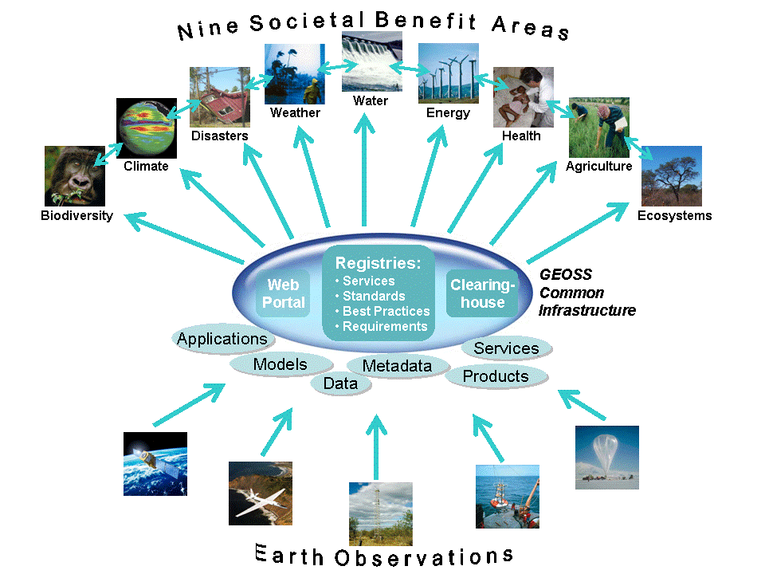

Group on Earth Observations

Slide 73
Marketing elements
Customer value propositions
Crossing the technology chasm
Creating shared value
Promotion tools

Slide 74
Customer value propositions capture the unique value of a product or services as perceived and appreciated by the customer.
Interestingly, they can differ completely from the features that the provider considers most important:

Slide 75
Customer Value Propositions
VALUE PROPOSITION | ALL BENEFITS | FAVOURABLE POINTS OF DIFFERENCE | RESONATING FOCUS
Consists of: | All benefits customers receive from a market offering | All favourable points of difference a market offering has relative to the next best alternative | The one or two points of difference whose improvement will deliver the greatest value to the customer
Answers the customer question: | “Why should our firm purchase your offering?” | “Why should our firm purchase your offering instead of your competitor’s?” | “What is most worthwhile for our firm to keep in mind about your offering?”
Requires: | Knowledge of own market offering | Knowledge of own market offering and next best alternative | Knowledge of how own marketing offering delivers value to customers, compared with next best alternative
Has the potential pitfall: | Benefit assertion | Value presumption | Requires customer value research
Source: Customer value propositions in business markets (HBR 2006)

Slide 76
Buyer behaviour & motivation
Type | Buyer behaviour | Motivation
Transactional sales | Intrinsic value buyers: “keep it cheap and easy to do business” | Understands the product Perceives it as substitutable Cost focus Resents time ‘wasted’ with sales people
Consultative sales | Extrinsic value buyers: “I don’t know the answer: help me analyse and solve the issue | Focus on how the product is used Interested in solutions and applications Values advice and help Needs the sales person
Source: Rethinking the sales force (Rackham, de Vincentis 1999)

Slide 77
Even when customer value propositions are well captured and formulated, introduction of solutions that involve new technology will have to overcome some hurdles.
This is called “crossing the technology chasm”:

Slide 78
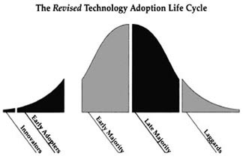
Crossing the technology chasm
Source: Crossing the chasm (Moore 1991)

Slide 79
Crossing the technology chasm
Most clients of EO products and services belong to the early and late majority,
They are pragmatists and are not prepared or willing to take substantial risk: the solution should work and be reliable.
Once convinced, the pragmatists will be long-term clients.
Source: Crossing the chasm (Moore 1991)

Slide 80
More information:
Creating & delivering your value proposition
– managing customer experience for profit
(Barnes, Blake, Pinder; 2009)
Customer value propositions in business markets
(Anderson, Narus, van Rossum [Harvard Business Review]; 2006)
Rethinking the sales force:
refining selling to create and capture customer value
(Rackham, de Vicentis; 1999)
Crossing the chasm
– marketing and selling high-tech products to mainstream customers
(Moore; 1991)

Slide 81
Creating shared value is a key element of successful implementation of earth observation solutions.
To achieve this, in most cases earth observation applications have to be integrated into more general (business or organizational) processes:

Slide 82
Create shared value
Involves cooperation between:
Public sector
Private sector
Social sector
Opportunity for earth observation (integrated) solutions:
Integrate EO in general business / organizational process
Integrate different EO (and GIS and navigation) functionalities

Slide 83
Based on all considerations dealt with in the previous slides, there are some practical approaches that can be applied in combination to promote earth observation applications:

Slide 84

Tools for earth observation marketing:
Success stories (in non-technical language, feasible, replication capacity, sustainable)
Marketing toolkits (international trends, earth observation examples, references)
Pilot projects, innovation funds, quick-wins (demonstration that EO actually works)
Promotion outside EO community (fairs, seminars, lunch-bag meetings, magazines)
Resource facilities for reference and capacity building (distributed, but connected, in different languages)
Source: Marketing earth observation products and services (Noort 2013)

Slide 85
Business elements
Business elements:
Proposal writing
Business procedures

Slide 86
Proposal writing is an art in itself.
During the GEONetCab and EOPOWER projects templates have been developed for writing successful proposals:

Slide 87
Proposal outline
1. Introduction / relevance
2. Objective(s)
3. Activities
4. Output
5. Management & evaluation
6. Risk assessment
7. Time schedule
8. Budget
Annexes
(more detailed version in separate document,
see www.eopower.eu or www.hcpinternational.com)

Slide 88


Other guides that may be useful:
Civicus: writing a funding proposal
Michigan State University: guide for writing a funding proposal
ESRI: writing a competitive GRANT application
REC: project proposal writing

Slide 89
If you run a company, compete for assignments and manage projects, a structured approach towards responsibilities, tasks, implementation and documentation is needed.
The following business procedures may be helpful:

Slide 90
Business procedures
1. On acquisition
2. On offers
3. On negotiation
4. On contracts
5. On project management
6. On travel & deployment
7. On deficiencies & complaints
8. On internal organization
9. On finance
(more detailed version in separate document,
see www.eopower.eu or www.hcpinternational.com)

Slide 91
Again:
SHARED PROBLEM
SHARED LANGUAGE
SHARED SOLUTION

Slide 92
4. Capacity Building

Slide 93
General
Marketing is promotion + capacity building.
Especially for the introduction of new technologies capacity building is important at all levels.
Capacity building is the instrument to increase
self-sufficiency and make solutions work.

Slide 94

General references for capacity building, open data and success stories
GEO Portal: www.earthobservations.org
Capacity building resource facility www.geocab.org
compilation of tutorials, references, open-source software, etc.
Satellites going local: share good practice (Eurisy handbooks) www.eurisy.org
Earth observation for green growth (ESA; 2013)

Slide 95

General references for capacity building, open data (2)
Bringing GEOSS services into practice:
how to use data from the GEO portal and how to provide input
www.envirogrids.net
Science education through earth observation for high schools: basic tutorials on all kind of subjects
www.seos-project.eu
Copernicus briefs:
information on satellite applications for different topics
http://www.copernicus.eu/main/copernicus-briefs

Slide 96
More references open data
Open data for sustainable development (World Bank; 2015)
description of the benefits of open data for a wide range of development goals, including the SDGs http://pubdocs.worldbank.org/pubdocs/publicdoc/2015/8/904051440717425994/Open-Data-for-Sustainable-development-Final-New.pdf
Terms and conditions for the use and distribution of Sentinel data (European Parliament and European Commission; 2014)
standard stipulations related to free and open access to Sentinel data http://www.demarine.de/lr/c/document_library/get_file?uuid=c5067655-b7ad-4d71-b07b-6111808f4abd&groupId=13521
Towards a thriving data-driven economy (European Commission; 2014) policy document on the use of (open) data for a knowledge economy and society
http://ec.europa.eu/information_society/newsroom/cf/dae/document.cfm?doc_id=6210

Slide 97

Capacity building resources for energy & mining (1):
MESoR training seminar on solar radiation services
presentations from the MESoR training seminar + use cases
See also MESoR user handbook & RETScreen engineering textbook
AEGOS Inventory of available curricula of training centers and practices
overview of IT, data management, GIS, RS and web applications courses (Europe, Africa, distance)and thermal infrared
AEGOS Concept note about the needs in capacity building and training
overview of competencies required to work with the AEGOS data infrastructure and the existing gaps in Africa

Slide 98

Capacity building resources for energy & mining (2):
EnerGEO knowledge portal
http://energeo.researchstudio.at/energeo/catalog/main/home.page
communicates and brokers information for a global assessment of the current and future impact on the environment and ecosystems from the energy domains connecting experts and casual users across businesses
Clean energy projects, RETScreen engineering & cases textbook
description of clean energy decision-making software; uses worldwide database of NASA satellite-derived meteorological data (NASA surface meteorology and solar energy dataset (SSE)) from a ten-year period
(1983 – 1993)

Slide 99

Capacity building resources for energy & mining (3):
EO-MINERS
http://www.eo-miners.eu/additional_material/am_introduction.htm
factsheets, indicators, leaflets and reports on earth observation and mining
ENDORSE (energy downstream services) www.endorse-fp7.eu
reports on renewable energy and energy saving
IMPACTMIN http://impactmin.geonardo.com
e-training on new methods and a toolset for impact monitoring of mining operations using earth observation and in-situ data

Slide 100
Further details:
Contact: Mark Noort
m.noort@hcpinternational.com
www.eopower.eu
www.hcpinternational.com

