Slide 1



Earth Observation for
Disaster Management
International trends & developments
Earth observation applications
Business development
Capacity building

Slide 2

0. Introduction
Mark Noort, consultant, project manager
HCP international:
consulting, marketing of earth observation
Project director EOPOWER:
project for promotion & capacity building of
earth observation applications

Slide 3
Sequence:
General assessment of the state-of-the-art of earth observation
Major trends and developments in the application field
Description of earth observation solutions
Assessment of market potential for earth observation solutions and marketing instruments
Capacity building for successful application of earth observation solutions

Slide 4
Earth Observation helps you: save money save lives save the environment

Slide 5
Earth observation
applications
On the verge of reaching new user communities
These new user communities need to be involved
Weakest link / last mile aspects are important
Marketing needed: promotion & capacity building

Slide 6
Life cycle of products & services
Initialization
System analysis & design
Rapid prototyping
System development
Implementation
Post-implementation

Slide 7
Scope
A disaster can be described as:
a serious disruption of the functioning of a community or a society involving widespread human, material, economic or environmental losses and impacts, which exceeds the ability of the affected community or society to cope using its own resources
Disaster management is:
the organization and management of resources and responsibilities for dealing with all humanitarian aspects of emergencies, in particular preparedness, response and recovery in order to lessen the impact of disasters
For harmful algal blooms and oil spills-> see marine environment and resources toolkit
For drought -> see water management toolkit

Slide 8
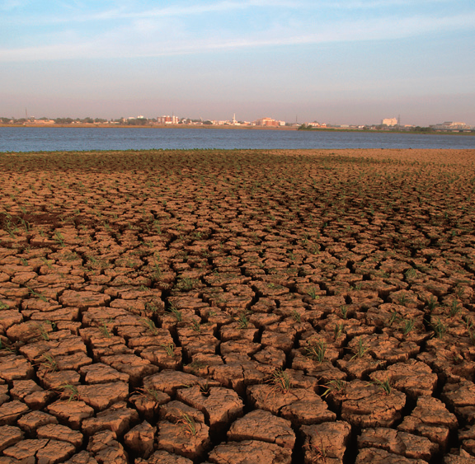
Disaster types
‘Natural’ disasters:
Volcanic eruptions
Earthquakes
Landslides
Floods
Tsunamis
Droughts
Fires, etc.
Man-made disasters:
Industrial calamities
Explosions
Terrorist attacks
Oil spills, etc.

Slide 9
Assessment of business & funding opportunities
Categories of disaster management products & services
Life cycle phase of product or service
Regional context, level of technological & economic development
Optimum marketing mix

Slide 10
1. International trends & developments in disaster management

Slide 11
Issues & trends in
disaster management
Increased (natural) disaster risk is one of the main anticipated consequences of climate change
Attention is shifting from post-disaster intervention to prevention
Emphasis on empowerment of local communities
Increased interest in application of new technologies and open data and software

Slide 12
Drivers
Climate change can lead to an increase in extreme events, such as storms, floods and droughts
Population growth, increase in economic wealth and investment in infrastructure leads to a greater disaster risk (for people and economic assets)
Increasing urbanization, in particular in coastal areas, leads to vulnerability to disasters
Increased pressure on available land and investment in agriculture result in greater disaster risk
Security threats by extremist groups

Slide 13
Climate change
A small change in mean temperature can lead to a considerable increase of extreme events (heavy precipitation, more intense droughts, more fluvial floods, increase in extreme coastal high-water levels, increase in landslides);
Integration of disaster risk management and climate change adaptation is needed to obtain maximum benefit;
Disaster risk management should focus on high-impact, low regret measures, such as early warning systems, risk communication between decision-makers and local citizens, sustainable land management, ecosystem management;
An integrated, multi-hazard risk management approach works best.

Slide 14
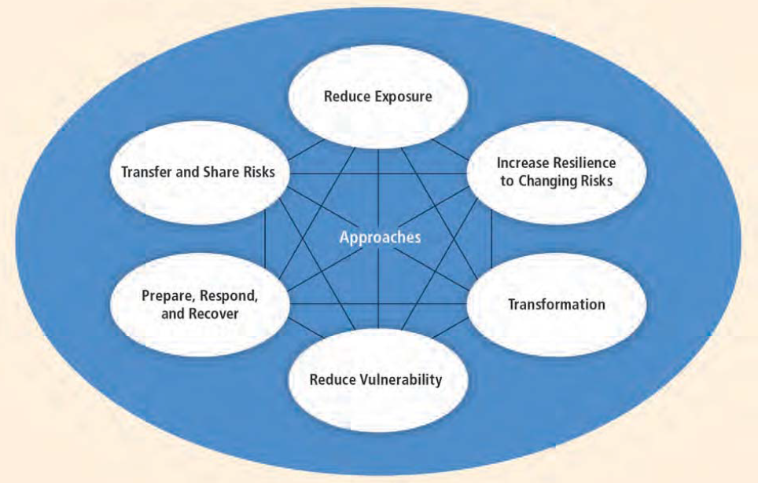
Adaptation and disaster risk management approaches for a changing climate
Source: Managing the risks of extreme events and disasters to advance climate change adaptation (IPCC; 2012)

Slide 15



More information:
Managing the risks of extreme events and disasters to advance climate change adaptation (IPCC; 2012)
extensive description of possible effects of climate change and possible adaptation measures + summary for policy makers
Global risks 2014 – Insight report (WEC; 2014)
analysis of high-impact, high likelihood economic, environmental, geopolitical, societal and technologic risks + management strategies
Natural hazards and climate change in European Regions – territorial dynamics in Europe (ESPON; 2013)
study analysing vulnerability to different hazards + adaptive and response capacity

Slide 16
From post-disaster
intervention to prevention
Investing in disaster prevention saves lives and avoids losses;
Economic return on investment is higher for prevention than for an approach based exclusively on response;
Shift from sector and specialist approach (military, civil defence) to a more integrated approach (general policy and planning, coordination of preparedness and interventions);
Looking at the whole disaster risk portfolio instead of focusing on a single hazard;
The temporal and spatial dynamics of hazard, vulnerability and risk are particularly important for disaster management.

Slide 17



More information:
Natural hazards, UnNatural disasters: The economics of effective prevention (World Bank, UN; 2010)
rationale and plea for increased focus on disaster prevention
Tools for mainstreaming disaster risk reduction - guidance notes for development organizations (Provention; 2007) series of 14 guidance notes describing ways to integrate disaster risk reduction in general policy and all stages of the development project cycle
Natural catastrophes and reinsurance (Swiss Re; 2010)
analysis of potential losses caused by natural hazards and how to minimise risk from a (re)insurer’s point of view

Slide 18
More information (2):
Early warning systems - A state of the art analysis and future directions (UNEP; 2012) overview of the state of the art of early warning systems, including the use of earth observation

Slide 19
Empowerment of
local communities
Community-driven development is crucial for (local) disaster risk management;
Community-driven programmes directed at poverty reduction are particularly important to build the capacity and experience to deal with disaster risk management;
External information flows (scientific, engineering) on disaster risk management should be combined with local knowledge;
High impact, low-regret interventions serve as entry points.

Slide 20

More information:
From social vulnerability to resilience: measuring progress toward disaster risk reduction (UNU-EHS; 2013)
study into and recommendations on community resilience with respect to disasters
Climate and disaster resilience – The role for community-driven development (World Bank; 2014)
rationale for integration of community-driven development into climate and disaster resilience activities and overview of successful practice

Slide 21
New technologies and
open data and software
New technologies and open data and software are becoming increasingly available and often easy to apply;
A collective effort is needed to make optimum use of existing and new data resources for disaster risk management (e.g. Group on Earth Observations);
Open data means legally open (no intellectual property restrictions) and technically open (any software can be used);
The data must be accessible, interoperable and reusable;
New (communication) technologies open up new possibilities for interaction with and involvement of communities.

Slide 22


Open-source software
Look for: GEO, GEOSS, OGC, Terralook, Google Earth, etc. at
www.earthobservations.org (GEO website)
http://geonode.org
An open readiness data toolkit is available at:
http://data.worldbank.org/about/open-government-data-toolkit/readiness-assessment-tool
Open data for resilience website:
http://gfdrr.org/opendri

Slide 23


More information:
Open data for resilience initiative - field guide (World Bank; 2014) description of open data methods and applications + how they fit in integrated disaster risk management
World disasters report – focus on technology and the future of human interaction (IFRC; 2013)
description of new technologies for disaster risk management with a focus on communication for people –centred humanitarian action
Automated integration of geosensors with the sensor web to facilitate flood management (52º North; 2012)
success story on the use of a sensor web to reduce flood risk in Germany

Slide 24
2. Earth observation applications

Slide 25
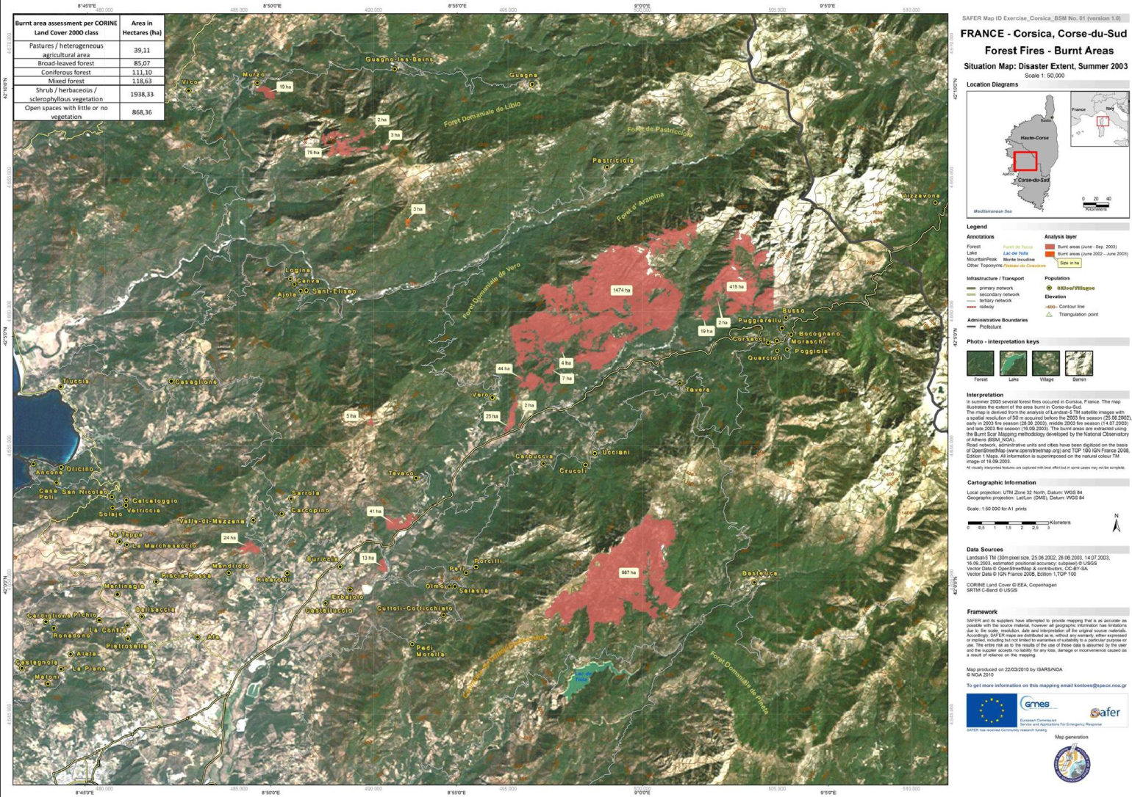
Earth observation for
disaster management
Burnt area mapping in Greece (Source: BEYOND; 2014)

Slide 26
Earth observation
contribution
Risk assessment / simulation models
Forecasting / early warning
Monitoring and damage assessment
Prevention / planning
General

Slide 27
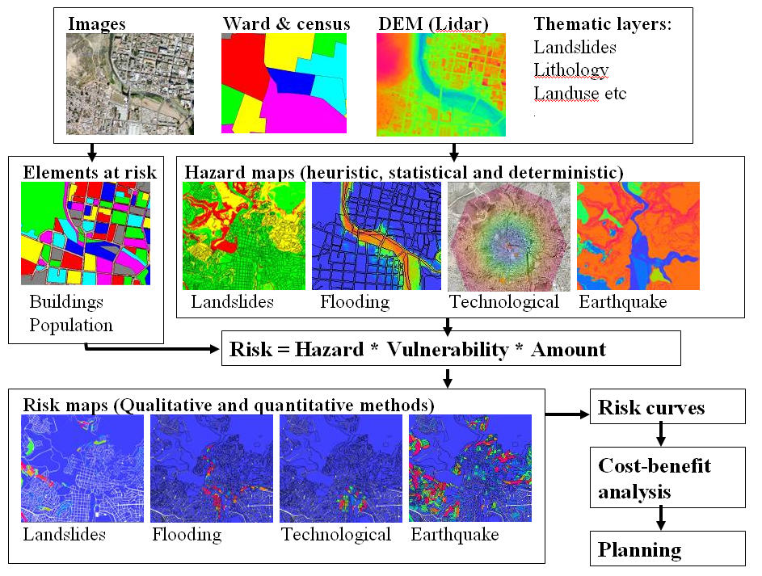
Example risk assessment / simulation models
Risk assessment process used for RiskCity (Source: ITC; 2011)

Slide 28
Risk assessment /
simulation models
Earth observation is used for reference mapping, geological mapping, asset mapping and as base material for modelling and simulations;
Earth observation facilitates regular monitoring and updates for large areas at relatively low cost;
Earth observation can be applied for risk assessment and simulation modelling for virtually all types of disasters;
Cost estimate: reference mapping service 1 – 10 k€ / 100 km², data VHR 1 – 10 k€ / scene, HR and MR free, asset mapping 50 – 100 k€ / country, historical terrain deformation mapping service 20 k€ / site, flood risk mapping 20 – 80 k€ / 50 km²;
Main challenges: cost, complexity, capacity, business model.

Slide 29


Examples:
North African coastal cities address natural disasters and climate change (World Bank, ESA; 2011)
studies on adaptation to climate change with respect to natural disasters for Alexandria, Tunis, Casablanca and the Bouregreg area
Participatory approach for integrated basin planning with focus on disaster risk reduction: the case of the Limpopo river
(UN-HABITAT, ITC; 2011) article on living with floods in Africa, shows community approach, includes a to-do list for participatory GIS (PGIS)
Coping strategies and risk manageability: using participatory geographical information systems to represent local knowledge (ITC; 2010) article on the use of geographical information, including earth observation, to empower communities in the Philippines in coping with floods

Slide 30


More examples:
SERVIR (USAID):
www.servir.net (Central America) www.servirglobal.net (global)
UN-SPIDER: www.un-spider.org
disaster reduction resources and strategies, including earth observation
CAPRA (World Bank, IDB): probabilistic risk assessment in Latin America & the Caribbean www.ecapra.org
DEWETRA: operational risk management methods and resources for many types of disasters, prediction models, weather observations, risk assessment and emergency management, describing the integrated approach of the Italian civil protection department http://dewetra.cimafoundation.org

Slide 31



Even more examples:
The value of geo-information for disaster risk reduction – benefit analysis and stakeholder assessment (ICSU, JB-GIS, UNOOSA; 2013)
assessment of benefits for floods, earthquakes, droughts, fires and landslides, based on questionnaires from stakeholders and expert opinions, covering all stages of disaster management
Atlas of natural hazards and risks in Georgia (CENN; 2012)
atlas integrating risk, vulnerability and hazard information on earthquakes, landslides, mudflows, rockfalls, floods, snow avalanches, wild fires, drought and hail storms

Slide 32
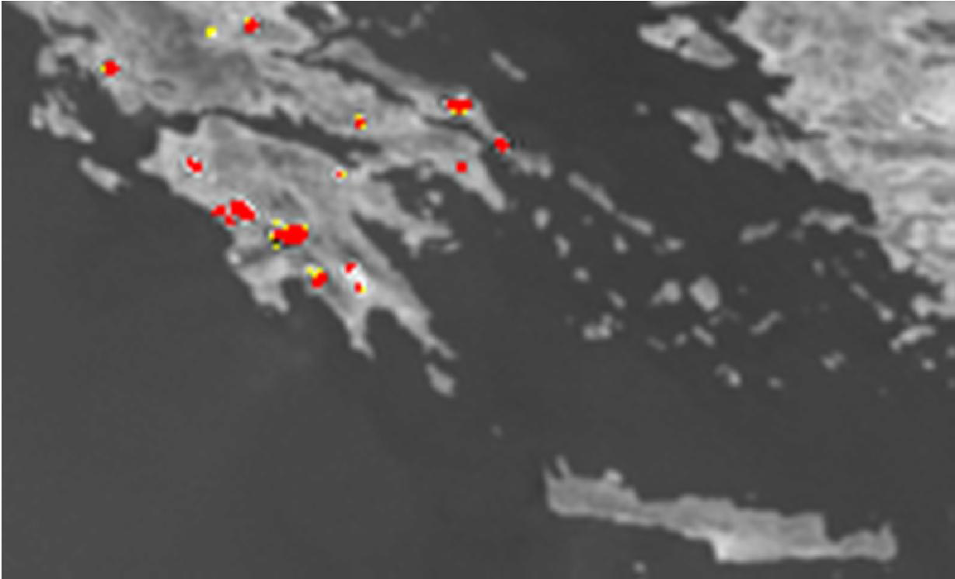
Example forecasting /
early warning
Online system for fire early warning in Greece (source: BEYOND; 2014)

Slide 33
Forecasting /
early warning
Earth observation supports forecasting and early warning for many types of disasters: flooding (hydrological modelling, upstream monitoring), earthquakes (surface deformation), landslides (terrain deformation, early detection), volcanic eruptions (atmospheric composition, terrain deformation), tsunamis (wave height), wild fires (moisture conditions, early detection), desert locusts (breeding conditions, early detection), desertification (monitoring of sand encroachment), dust storms (early detection, monitoring), hurricanes (early detection, monitoring);
Cost estimate: on case-by-case basis;
Main challenges: cost, complexity, capacity, business model.

Slide 34


Examples:
Local flood early warning based on low-tech geoinformatics approaches and community involvement - a solution for rural areas in The Philippines (GIZ; 2010) article on cooperation with local communities on early warning for floods in the Philippines
Nice ‹‹smart city›› serving resilience (Kandel; 2013)
presentation on risk management, forecasting and early warning strategy of Nice
Alert and warning frameworks in the context of early warning systems – a comparative review (UNU-EHS; 2013) description of stages and systems of early warning for hydro-meteorological, geological and biological hazards, comparing between different countries

Slide 35


More examples:
Monitoring restless super-volcanoes (Copernicus; 2015) brochure on earth observation for deformation mapping, detection of thermal anomalies and volcanic gas and ash detection to predict and monitor volcanic eruptions
Landslide warnings from satellites save lives (Copernicus; 2013) brochure on earth observation for forecasting and early warning of landslides (interferometry and geological information)
Flood-PROOFS (DEWETRA)
flood probabilistic forecasting system for small and medium catchments
RISICO (DEWETRA)
a comprehensive system for nationwide and local wildfire risk assessment, forecasting, early warning and response

Slide 36
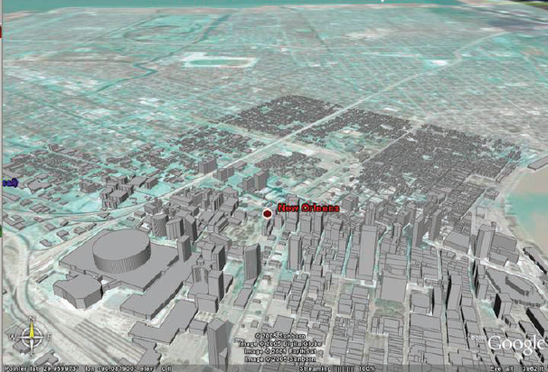
Example monitoring
and damage assessment
Flooded areas near the New Orleans central business district, hurricane Katrina 2005, based on IKONOS images and projected in Google Earth (Source: Successful response starts with a map; 2007)

Slide 37
Monitoring and
damage assessment
Earth observation provides the background information and synoptic overview for monitoring in general;
Earth observation is used to map and monitor flood extent, mudflows, landslides, effects of volcanic eruptions, damaged assets, burned area, refugee movements, etc.;
Earth observation supports (planning and decision-making for) rescue, recovery, rehabilitation and reconstruction operations;
Cost estimate: on case-by-case basis;
Main challenges: cost, capacity.

Slide 38

Examples:
International charter ‘Space and major disasters’ consortium of space agencies and satellite data providers aiming at providing a unified system of rapid space data acquisition and delivery in case of natural or man-made disasters
Geoinformation for disaster and risk management – examples and best practices (UNOOSA; 2010) examples of the use of earth observation for monitoring and damage assessment related to different types of disasters (also covers risk assessment, forecasting and early warning)
Successful response starts with a map: Improving geospatial support for disaster management (National Research Council; 2007) analysis of the use of geo-information, including earth observation, for disaster response in the US with case studies on hurricanes, earthquakes and terrorist attacks

Slide 39

More examples:
Reacting to disasters with space data (Copernicus; 2013)
brochure on earth observation for damage assessment (RapidEye & Sentinels)
How satellites can help manage humanitarian crises (Copernicus; 2013) brochure on earth observation for improving the understanding of a situation and supporting logistical response (Pleiades & Sentinels)
Tracking a burning issue from space (Copernicus; 2013)
brochure on earth observation for responding to wildfires and in the recovery period following an event (DMC & Sentinels)
Tracking flood waters from space (Copernicus; 2013)
brochure on earth observation for flood extent and damage assessment (SPOT-5 & Sentinels)
Fires – A hot topic in the Mediterranean region (Copernicus; 2015)
brochure on earth observation for fire danger mapping and monitoring of fire extent and activity

Slide 40

More examples (2):
How satellites can measure terrain displacements after earthquakes (Copernicus; 2013) brochure on earth observation for mapping of deformation and rapid reference maps
Remote sensing in support of oil spill response – Planning guidance (API; 2013) guide on how to use remote sensing for oil spill detection and response

Slide 41
Growth potential for
earth observation
Risk assessment / simulation models: integrated in disaster management chain.
Main clients: all levels of government, insurance companies.
Forecasting / early warning: for all types of disasters, using near real-time, high resolution imagery.
Main clients: all levels of government.
Monitoring / damage assessment: for all types of disasters, using near real-time, high resolution imagery and integrated in disaster response workflow.
Main clients: all levels of government, insurance companies.

Slide 42
3. Business development

Slide 43
Why is marketing / promotion of earth observation needed?
Public sector information (PSI)
Externalities (environmental accounting & payment for ecosystem services)
Global datasets, open access, data sharing, compatibility (GEO)

Slide 44
If public sector information is made available free-of-charge, demand will increase and, in the end, government revenue also, as companies will derive income from value-added products and services, and consequently pay more taxes (see figures in following slides).

Slide 45
Supply & Demand Public Sector Information
http://vimeo.com/63079712
Source: About GMES and data: geese and golden eggs (Sawyer, de Vries 2012)

Slide 46
Cost-benefit Public Sector Information
Source: About GMES and data: geese and golden eggs (Sawyer, de Vries 2012)

Slide 47
Re-use of Public Sector Information
Source: About GMES and data: geese and golden eggs (Sawyer, de Vries 2012)

Slide 48
Most earth observation applications deal with so-called externalities, such as impact on the environment.
It is difficult to capture these in terms of conventional cost-benefit models.
To tackle this, the following framework for analysis of earth observation applications is developed:

Slide 49
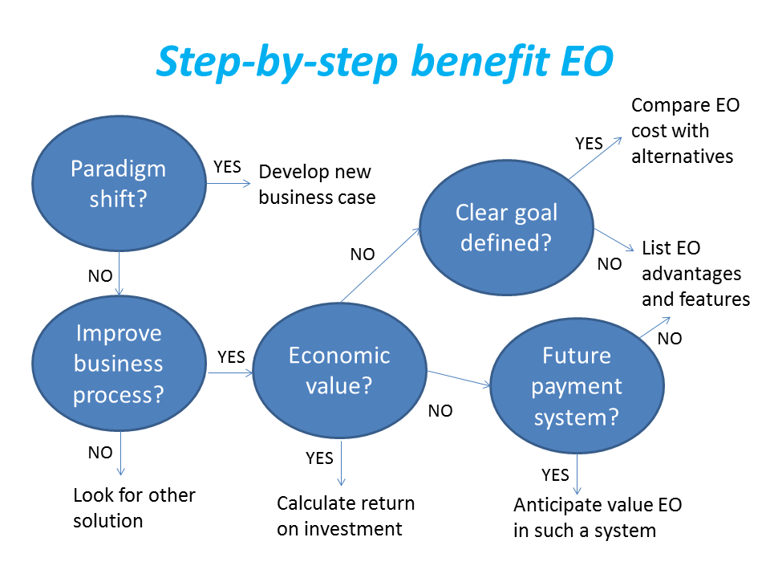
Framework for analysis
Step-by-step analysis of the benefits of earth observation (source: GEONetCab, 2013)

Slide 50
Key questions
Does the new application cause a paradigm shift?
Is the current business or organization process improved?
Does the application provide economic value that can be quantified?
Is a clear measurable goal defined to which the earth observation application contributes?
Is a future payment scheme or other economic mechanism foreseen in which the earth observation application fits?

Slide 51
Assessment of
geospatial solutions
Rating of characteristics of geospatial solutions:
fit-for-purpose
comparative advantage
complexity to user / ease- of-use
elegance
cost-benefit,
sustainability
resilience
reproduction capacity / flexibility
acceptance
level of knowledge transfer required
ethics, transparency, public accountability, objectivity & impartiality
Rating of business environment:
Willingness to pay (by clients)
Embedding (in organizational processes)
Openness (transparency and ease of doing business, access to markets)
Institutions (is the institutional environment conducive to doing business, acceptance of new solutions?)

Slide 52
Fit-for-purpose
An important, but often forgotten requirement:
Does the product or service do what it is supposed to do to solve a certain problem?
In other words: is it really a solution or just an attempt towards a solution?
Quantitative: not applicable
Qualitative (on scale of 1 to 5): based on description of what the EO solution actually does

Slide 53
Comparative advantage
What it does significantly better than other solutions to the same problem.
For earth observation usually the comparative advantages of greater accuracy, better resolution in time and space, comprehensive overview of large areas and near real-time information provision are mentioned as comparative advantages.
Quantitative: calculation of degree in which the EO solution is better than alternatives
Qualitative (on scale of 1 to 5): based on listing of comparative advantages

Slide 54
Complexity (to user) / ease-of-use
At all levels in the value chain the users (professionals and
end-users) are able to work with the product or service.
Quantitative: not applicable
Qualitative (on scale of 1 to 5): based on user testimonials and user surveys

Slide 55
Elegance
Once you get the idea behind this product or service, you want to be part of the community that uses it.
This sense of belonging facilitates the formation of user groups that provide valuable feedback.
Quantitative: none, or it should be the size of the user community
Qualitative (on scale of 1 to 5): based on user testimonials and user surveys

Slide 56
Cost-benefit
The cost-benefit of the product or service is quantified and sufficiently attractive, also in the long-term.
Quantitative: cost-benefit calculation
Qualitative (on scale of 1 to 5): based on quantitative assessment

Slide 57
Sustainability
The product or service can be delivered when it is needed.
There is a long-term perspective that guarantees delivery.
Sustainability concerns the following aspects:
Long-term data availability
Availability of finance/funds to provide the solution continuously for present and future use
Long-term institutional / governmental interest and support
Long-term user interest for a solution that addresses real needs
Quantitative: not applicable
Qualitative (on scale of 1 to 5): based on sensitivity analysis of the EO solution

Slide 58
Resilience
In case of extremes or breakdown in the value chain, the product or service can still be delivered at an acceptable level. Alternatives (plan B) are available (and developed).
Quantitative: cost-benefit calculation of plan B
Qualitative (on scale of 1 to 5): based on risk analysis of the EO solution

Slide 59
Reproduction
capacity / flexibility
The product or service can be easily applied or adapted for use in another region or another situation, while still providing the solution without (too much) extra cost.
Quantitative: calculation of reproduction costs for application in other regions or situations; measurement of spreading of actual use
Qualitative (on scale of 1 to 5): based on quantitative assessment and description of EO solution

Slide 60
Acceptance
The users intuitively get what the product or service is about and are interested. They accept it as a solution to their problem.
Quantitative: none, or survey results about acceptance. After introduction of the solution: number of clients and/or users
Qualitative (on scale of 1 to 5): based on user testimonials and user surveys

Slide 61
Level of knowledge
transfer required
The training requirements for professionals and other users along the value chain are clear and associated costs and efforts are acceptable.
Quantitative: cost and time required to get the users at the desired knowledge and skill level
Qualitative (on scale of 1 to 5): based on knowledge transfer plans and evaluation of training activities

Slide 62
Ethics, transparency,
public accountability,
objectivity & impartiality
Application of Earth observation increases the level of objectivity and impartiality in decision-making processes, including conflict resolution. The application improves transparency and public accountability. It raises no ethical issues or if it does, as in the case of privacy concerns, these are resolved in a satisfactory way for all parties concerned.
Quantitative: not applicable
Qualitative (on scale of 1 to 5): based on user testimonials and user surveys

Slide 63
Several attempts have been made to introduce environmental accounting and to enlarge the sphere of the conventional economy to include and quantify impact on ecosystems.
The following slides give some examples:

Slide 64







Environmental accounting & payment for ecosystem services
SEEA:
System of Environmental-Economic Accounts
(EC, FAO, IMF, OECD, UN, WB )
WAVES:
Wealth Accounting and the Valuation of Ecosystem Services (global partnership, led by World Bank)
TEEB:
The Economics of Ecosystems and Biodiversity
(group led by UNEP)

Slide 65
SEEA Conceptual Framework
Source: SEEA conceptual framework report (EC, FAO, IMF, OECD, UN, WB 2012)

Slide 66
For earth observation the work of the Group on Earth Observations (GEO) is essential to achieve the goal of a Global Earth Observations System of Systems (GEOSS), resulting in the shared GEO common infrastructure (GCI):

Slide 67
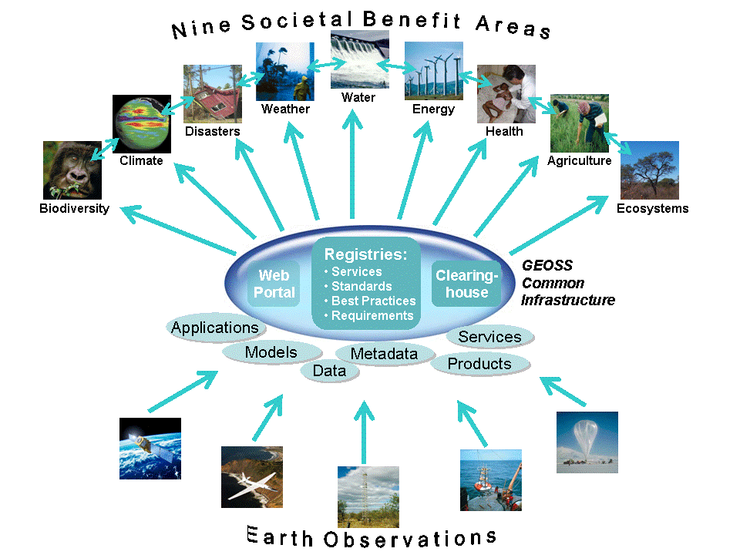

Group on Earth Observations

Slide 68
Marketing elements
Customer value propositions
Crossing the technology chasm
Creating shared value
Promotion tools

Slide 69
Customer value propositions capture the unique value of a product or services as perceived and appreciated by the customer.
Interestingly, they can differ completely from the features that the provider considers most important:

Slide 70
Customer Value Propositions
VALUE PROPOSITION | ALL BENEFITS | FAVOURABLE POINTS OF DIFFERENCE | RESONATING FOCUS
Consists of: | All benefits customers receive from a market offering | All favourable points of difference a market offering has relative to the next best alternative | The one or two points of difference whose improvement will deliver the greatest value to the customer
Answers the customer question: | “Why should our firm purchase your offering?” | “Why should our firm purchase your offering instead of your competitor’s?” | “What is most worthwhile for our firm to keep in mind about your offering?”
Requires: | Knowledge of own market offering | Knowledge of own market offering and next best alternative | Knowledge of how own marketing offering delivers value to customers, compared with next best alternative
Has the potential pitfall: | Benefit assertion | Value presumption | Requires customer value research
Source: Customer value propositions in business markets (HBR 2006)

Slide 71
Buyer behaviour & motivation
Type | Buyer behaviour | Motivation
Transactional sales | Intrinsic value buyers: “keep it cheap and easy to do business” | Understands the product Perceives it as substitutable Cost focus Resents time ‘wasted’ with sales people
Consultative sales | Extrinsic value buyers: “I don’t know the answer: help me analyse and solve the issue | Focus on how the product is used Interested in solutions and applications Values advice and help Needs the sales person
Source: Rethinking the sales force (Rackham, de Vincentis 1999)

Slide 72
Even when customer value propositions are well captured and formulated, introduction of solutions that involve new technology will have to overcome some hurdles.
This is called “crossing the technology chasm”:

Slide 73
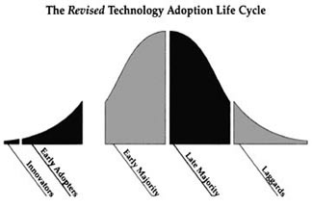
Crossing the technology chasm
Source: Crossing the chasm (Moore 1991)

Slide 74
Crossing the technology chasm
Most clients of EO products and services belong to the early and late majority,
They are pragmatists and are not prepared or willing to take substantial risk: the solution should work and be reliable.
Once convinced, the pragmatists will be long-term clients.
Source: Crossing the chasm (Moore 1991)

Slide 75
More information:
Creating & delivering your value proposition
– managing customer experience for profit
(Barnes, Blake, Pinder; 2009)
Customer value propositions in business markets
(Anderson, Narus, van Rossum [Harvard Business Review]; 2006)
Rethinking the sales force:
refining selling to create and capture customer value
(Rackham, de Vicentis; 1999)
Crossing the chasm
– marketing and selling high-tech products to mainstream customers
(Moore; 1991)

Slide 76
Creating shared value is a key element of successful implementation of earth observation solutions.
To achieve this, in most cases earth observation applications have to be integrated into more general (business or organizational) processes:

Slide 77
Create shared value
Involves cooperation between:
Public sector
Private sector
Social sector
Opportunity for earth observation (integrated) solutions:
Integrate EO in general business / organizational process
Integrate different EO (and GIS and navigation) functionalities

Slide 78
Based on all considerations dealt with in the previous slides, there are some practical approaches that can be applied in combination to promote earth observation applications:

Slide 79

Tools for earth observation marketing:
Success stories (in non-technical language, feasible, replication capacity, sustainable)
Marketing toolkits (international trends, earth observation examples, references)
Pilot projects, innovation funds, quick-wins (demonstration that EO actually works)
Promotion outside EO community (fairs, seminars, lunch-bag meetings, magazines)
Resource facilities for reference and capacity building (distributed, but connected, in different languages)
Source: Marketing earth observation products and services (Noort 2013)

Slide 80
Business elements
Business elements:
Proposal writing
Business procedures

Slide 81
Proposal writing is an art in itself.
During the GEONetCab and EOPOWER projects templates have been developed for writing successful proposals:

Slide 82
Proposal outline
1. Introduction / relevance
2. Objective(s)
3. Activities
4. Output
5. Management & evaluation
6. Risk assessment
7. Time schedule
8. Budget
Annexes
(more detailed version in separate document,
see www.eopower.eu or www.hcpinternational.com)

Slide 83


Other guides that may be useful:
Civicus: writing a funding proposal
Michigan State University: guide for writing a funding proposal
ESRI: writing a competitive GRANT application
REC: project proposal writing

Slide 84
If you run a company, compete for assignments and manage projects, a structured approach towards responsibilities, tasks, implementation and documentation is needed.
The following business procedures may be helpful:

Slide 85
Business procedures
1. On acquisition
2. On offers
3. On negotiation
4. On contracts
5. On project management
6. On travel & deployment
7. On deficiencies & complaints
8. On internal organization
9. On finance
(more detailed version in separate document,
see www.eopower.eu or www.hcpinternational.com)

Slide 86
Again:
SHARED PROBLEM
SHARED LANGUAGE
SHARED SOLUTION

Slide 87
4. Capacity Building

Slide 88
General
Marketing is promotion + capacity building.
Especially for the introduction of new technologies capacity building is important at all levels.
Capacity building is the instrument to increase
self-sufficiency and make solutions work.

Slide 89

General references for capacity building, open data and success stories
GEO Portal: www.earthobservations.org
Capacity building resource facility www.geocab.org
compilation of tutorials, references, open-source software, etc.
Satellites going local: share good practice (Eurisy handbooks) www.eurisy.org
Earth observation for green growth (ESA; 2013)

Slide 90


General references for capacity building, open data (2)
Bringing GEOSS services into practice:
how to use data from the GEO portal and how to provide input
www.envirogrids.net
Science education through earth observation for high schools: basic tutorials on all kind of subjects
www.seos-project.eu
Copernicus briefs:
information on satellite applications for different topics
www.copernicus.eu/pages-secondaires/publications/copernicus-briefs/
MetEd
tutorials and courses on meteorology and related subjects
https://www.meted.ucar.edu/training_detail.php

Slide 91
General references for capacity building, open data (3)
Bringing GEOSS services into practice:
how to use data from the GEO portal and how to provide input
www.envirogrids.net
Science education through earth observation for high schools: basic tutorials on all kind of subjects
www.seos-project.eu
Copernicus briefs:
information on satellite applications for different topics
http://www.copernicus.eu/main/copernicus-briefs
MetEd
tutorials and courses on meteorology and related subjects
https://www.meted.ucar.edu/training_detail.php

Slide 92
More references open data
Open data for sustainable development (World Bank; 2015)
description of the benefits of open data for a wide range of development goals, including the SDGs http://pubdocs.worldbank.org/pubdocs/publicdoc/2015/8/904051440717425994/Open-Data-for-Sustainable-development-Final-New.pdf
Terms and conditions for the use and distribution of Sentinel data (European Parliament and European Commission; 2014)
standard stipulations related to free and open access to Sentinel data http://www.demarine.de/lr/c/document_library/get_file?uuid=c5067655-b7ad-4d71-b07b-6111808f4abd&groupId=13521
Towards a thriving data-driven economy (European Commission; 2014) policy document on the use of (open) data for a knowledge economy and society
http://ec.europa.eu/information_society/newsroom/cf/dae/document.cfm?doc_id=6210

Slide 93


Capacity building resources for disaster management:
CAPRA
probabilistic risk assessment programme for Latin America and the Caribbean www.ecapra.org
DEWETRA
reference material and data on many types of disasters, prediction models, weather observations, risk assessment and emergency management, describing the integrated approach of the Italian civil protection department http://dewetra.cimafoundation.org
Relief Web
tutorials and database with search engine to make your own risk management portfolio or case study http://reliefweb.int/briefingkit
Understanding Risk Forum
platform for discussion and knowledge exchange www.understandingrisk.org

Slide 94

Capacity building resources for disaster management (2):
Multi-hazard risk assessment
distance education course guide book and Risk City exercise book (ITC; 2011) training for the assessment of risks related to multiple hazards, including floods, landslides, earthquakes and technological hazards in an RS and GIS environment, using open source software (ILWIS)
Desastre zero: mapa de risco em sala de aula – manual do professor (INPE; 2013)
manual for educators on risk mapping (English translation expected)
Remote sensing applications
– chapter 11: Cyclone, chapter 12: Flood, chapter 13: Drought ,
chapter 14: Landslide, chapter 15: Earthquake, chapter 16: Forest fire
(NRSC, 2010)

Slide 95


Capacity building resources for disaster management (3):
Handbook of research on developments and trends in wireless sensor networks: from principle to practice (HUST; 2010) description of sensor webs, sensor web architecture and services
Field Guide to Humanitarian Mapping (MapAction)
creating maps for field work, using GPS, Google Earth and open-source GIS software
Toolbox & manual - mapping the vulnerability of communities, example from Buzi, Mozambique (Z-GIS; 2008)
mapping toolkit to provide the community members with appropriate decision support and awareness tools to identify and reduce their own vulnerabilities
MEASURE Evaluation global positioning system toolkit (USAID) toolkit for geographical data collection for development projects

Slide 96

Capacity building resources for disaster management (4):
Quick guide to free geoinformatics for disaster management (University of Portsmouth; 2012)
overview of free geospatial data sources, software and training materials
INFORM user guide
tool for risk assessment and risk management
http://www.inform-index.org/

Slide 97
Capacity building resources for disaster management (5):
Use of active earth observation systems for flood hazard assessment
Examples of flood extent mapping using space-borne RADAR and air-borne LIDAR (ITC; 2015)
3-day EOPOWER (self-study) course for professionals
http://menhir.itc.utwente.nl:5000/fbsharing/KGKOZXKU/
Visual interpretation of landslides using earth observation
Case study: Nehoiu area, Buzau County, Romania (ITC; 2015)
3-day EOPOWER (self-study) course for professionals
http://menhir.itc.utwente.nl:5000/fbsharing/KGKOZXKU/

Slide 98
Further details:
Contact: Mark Noort
m.noort@hcpinternational.com
www.eopower.eu
www.hcpinternational.com

