Slide 1



Earth Observation for
Climate Change
International trends & developments
Earth observation applications
Business development
Capacity building

Slide 2

0. Introduction
Mark Noort, consultant, project manager
HCP international:
consulting, marketing of earth observation
Project director EOPOWER:
project for promotion & capacity building of
earth observation applications

Slide 3
Sequence:
General assessment of the state-of-the-art of earth observation
Major trends and developments in the application field
Description of earth observation solutions
Assessment of market potential for earth observation solutions and marketing instruments
Capacity building for successful application of earth observation solutions

Slide 4
Earth Observation helps you: save money save lives save the environment

Slide 5
Earth observation
applications
On the verge of reaching new user communities
These new user communities need to be involved
Weakest link / last mile aspects are important
Marketing needed: promotion & capacity building

Slide 6
Life cycle of products & services
Initialization
System analysis & design
Rapid prototyping
System development
Implementation
Post-implementation

Slide 7
Scope
Definition of climate: a measure of the average pattern of variation in temperature, humidity, atmospheric pressure, wind, precipitation, atmospheric particle count and other meteorological variables in a given region over long periods of time
Climate change refers to a change in the state of the climate that can be identified (e.g. using statistical tests) by changes in the mean and/or the variability of its properties, and that persists for an extended period, typically decades or longer
IPCC refers to any change in climate over time, whether due to natural variability or as a result of human activity; UNFCCC refers to climate change in terms of (direct or indirect) human activity

Slide 8
Scope (2)
Climate change adaptation: managing the unavoidable
Climate change mitigation: avoiding the unmanageable
Source: Holden, Harvard University

Slide 9
Assessment of business & funding opportunities
Categories of climate change products & services
Life cycle phase of product or service
Regional context, level of technological & economic development
Optimum marketing mix

Slide 10
1. International trends & developments in climate change

Slide 11
Issues & trends in
climate change
Increased resilience of communities with respect to climate variability
Increased adaptive capacity of natural and managed systems under current and predicted climate variability
Role of science in improving modelling, predictions and effects of climate change
Search for establishment of global coping mechanisms, such as carbon accounting

Slide 12
Drivers
Rise of CO2 concentrations and emissions
Rising global mean temperature
Increasing ocean heat storage
Rising sea levels
Increasing loss of ice from Greenland and Antarctica + loss of sea ice
Ocean acidification
Heat waves and extreme temperatures
Increasing drought spells and aridity
Increasing occurrence of heavy rain and flooding

Slide 13
Resilience of
communities
Choose entry points such as food security or risk management;
Identify champions = most appropriate counterpart;
Show vulnerability patterns & socio-economic impact;
Addressing short-term vulnerabilities is the best strategy for preparing for long-term impacts;
Important role for communities and private sector in climate risk management (involve in planning and implementation of adaptation).

Slide 14



More information:
Social vulnerability and adaptation in fragile states
(UNU-EHS; 2012) policy options, developing adaptation strategies in fragile states and building resilience and peace among socially vulnerable groups
Climate knowledge for action, a global framework for action – empowering the most vulnerable (WMO; 2011) advocating a global framework for action, consisting of a user interface platform, climate services information system and three components: observations and planning, research modelling and prediction, capacity building
Acting on climate change: the UN system delivering as one (UN; 2008) overall description of UN strategy

Slide 15





More information (2):
REDD+ and community forestry (WB, FCP, GEF; 2012)
lessons learned from an exchange of Brazilian experiences with Africa
Capacity development on integration of science and local knowledge for climate change impacts and vulnerability assessments (APN; 2010)
SimCLIM and impact models for climate change preparedness at the local level

Slide 16
Adaptive capacity of
natural & managed systems
Analysis of different levels of possible regret (no, low, high) -> aim at no regret, high impact;
Climate change needs to be treated as a major social and economic risk to national economies (not just environmental);
Adaptation should primarily look at policy changes to reduce vulnerability and at “soft” technologies rather than site-specific structural protection measures, unless they cost-effectively address current hazards;
Many adaptation investments involve strengthening or enforcing existing regulations and therefore require full buy-in from regulatory agencies;
Types of response strategies: reactive & anticipatory.

Slide 17

Example agriculture
Adaptation at the farm level
Crop calendar shifts and crop changes
Soil and water management changes
Fertilizer use / land use decisions
Water, labour, capital use (intensive or not, efficiency)
Needed:
Climate information, seasonal climate forecasts, early warning, infrastructure, insurance, technology development (crop varieties, irrigation technology)
Source: Mainstreaming adaptation to climate change in agriculture and natural resources projects (World Bank; 2011)

Slide 18
It can be simple
Trees planted in Niger for soil conservation (left 1975, right 2003)

Slide 19

Example response strategies
Response strategy water resources
Reactive adaptation: protection of groundwater resources, improved management and maintenance of existing water supply systems, protection of water catchment areas, improved water supply, groundwater and rainwater harvesting and desalination.
Anticipatory adaptation: better use of recycled water, conservation of water catchment areas; improved system of water management, water policy reform including pricing and irrigation policies, development of flood controls and drought monitoring
Climate change: impacts, vulnerabilities and adaptation in developing countries (UNFCCC; 2007)

Slide 20
Expected climate effects
developing countries
Africa: temperature ↑, rainfall ↓, droughts ↑, floods ↑
Asia: temperature ↑, rainfall ↓ (except Central Asia), droughts ↑,
cyclones ↑, heat waves ↑
Latin America: temperature ↑, rainfall ?, glaciers ↓, landslides ↑,
floods ↑, hurricanes (Caribbean) ↑, heat waves ↑
Small island developing states: temperature ↑, rainfall ↑ or ↓ (depending on region), cyclones ↑
Climate change: impacts, vulnerabilities and adaptation in developing countries (UNFCCC; 2007)

Slide 21



More information:
The policy climate (Climate Policy Initiative; 2013)
overview of policies and description of initiatives to counter the effects of climate change in Brazil, China, European Union, India and the United States
Developing a climate-smart agriculture strategy at the country level: lessons from recent experience (FAO; 2012)
assessment of existing policies and institutions with recommendations for, and examples of, cost-effective adaptation
Climate-smart agriculture strategy at the country level: lessons from recent experience (World Bank; 2011)
description of adaptation measures, directed at increased productivity and food security, enhanced resilience and reduced carbon emissions for sustainable development; with country examples

Slide 22



More information (2):
Recent trends in EU external action in the fields of climate, environment, development and security (IES; 2011)
description of international and EU climate action on climate change, forests, biodiversity, natural resources, agriculture and food, water, disasters, waste, migration and peace and security
Managing the risks of extreme events and disasters to advance climate change adaptation (IPCC; 2012) description of risks and adaptation options for decision making
Comparative assessment of the vulnerability and resilience of 10 deltas (Delta Alliance; 2010) study comparing climate aspects of the Nile, Incomati, Ganges-Brahmaputra-Meghna, Yangtze, Ciliwung, Mekong, Rhine-Meuse, Danube, California Bay and Mississippi River deltas

Slide 23


More information (3):
Seizing the global opportunity – Partnerships for better growth and a better climate (Global Commission on the Economy and Climate; 2015) the 2015 new climate economy report
Climate change 2014: Impacts, adaptation and vulnerability (IPCC; 2014) summary for policy makers
Being prepared for climate change (EPA; 2014) a workbook for developing risk-based adaptation plans

Slide 24
Role of science
Improved projections, predictions and monitoring of multi-decadal global to regional climate changes
Stronger scientific foundation for adaptation and mitigation
Improved predictions of high-impact weather and climate
Science-based support to responses and planning
Developing national and international climate services
Education and capacity building

Slide 25


More information:
Turn down the heat: why a 4ºC warmer world must be avoided (World Bank; 2012) overview of climate projections and possible impact
Guidelines on analysis of extremes in a changing climate in support of informed decisions for adaptation (WMO; 2009)
guide on datasets, observations, analysis and toolkit(s)
WCRP (GEWEX, CliC, CLIVAR, SPARC) documents reports on clouds, implementation plan and achievements, fact sheets on sea level rise and monsoons
Climate change science compendium (UNEP; 2009) comprehensive popular overview of climate science

Slide 26
Carbon accounting
Importance of MRV: measurement, reporting, verification
Control of emissions leakage (displaced emissions): reduction in one place leads to higher emission in another area
Translation to payment for ecosystem services (PES)
Communication with and involvement of stakeholders
Approved methodologies for verified carbon standard (VCS)
Establishment of land use / land cover baseline, using GIS and remote sensing
Carbon accounting is complemented by (other) multiple benefit assessments

Slide 27




More information:
Climate smart development (World Bank; 2014)
overview and case studies of multiple benefit assessments of climate smart initiatives
Analysing REDD+, challenges and choices (CIFOR; 2012)
detailed overview of approach, methodology, guidelines and performance indicators
Forest carbon accounting, overview and principles
(UNEP, UNDP) general guidelines, stresses importance of remote sensing
REDD+ measurement, reporting and verification (MRV) manual (USAID, FCMC; 2014) review of the data, models, techniques and accounting methods that could be part of an MRV system for reducing emissions from deforestation and forest degradation and the role of conservation, sustainable management of forests and enhancement of forest carbon stocks

Slide 28
2. Earth observation applications

Slide 29
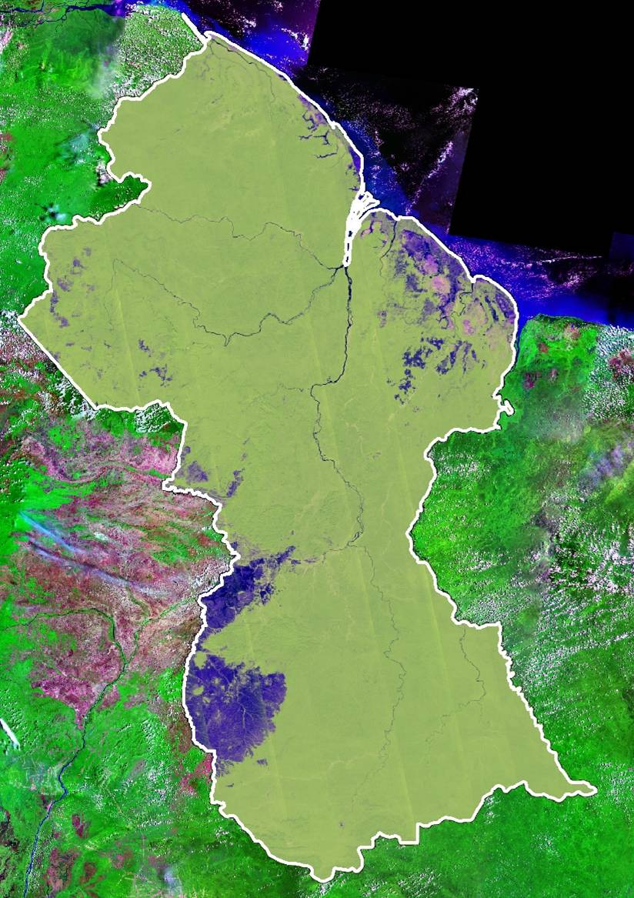
Earth observation for
climate change
ALOS PALSAR mosaic of Guyana with 50 m resolution to enable carbon assessment for REDD+.
(Source: SarVision; 2010)

Slide 30
Earth observation
contribution
Climate monitoring and modelling
Carbon accounting schemes
Prediction and mitigation of the effects of climate change

Slide 31
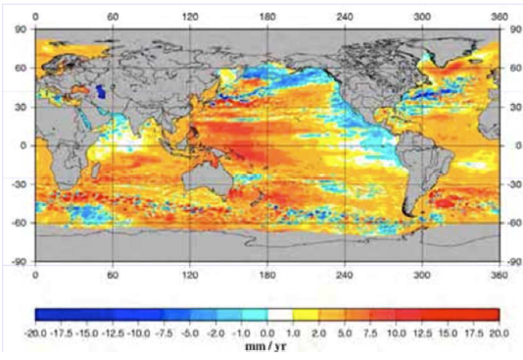
Example monitoring
and modelling
Regional trend in sea level rise (Source: ESA)

Slide 32
Monitoring and
modelling
Earth observation facilitates year-round data collection for climate monitoring and modelling, also when field data collection is not possible (arctic, tropical rainforests);
Reduced costs when compared to traditional field data collection methods in remote environments;
Remote sensing systems can capture a synoptic view of the landscape and oceans, to more adequately characterise dynamics;
Remote sensing provides additional information that can supplement more intensive sampling efforts and help extrapolate findings;
Cost estimate: on case-by-case basis, mainly scientific activity
Main challenges: cost, complexity.

Slide 33




Examples:
Space technologies and climate change (OECD; 2008)
general overview of state-of-the-art with emphasis on implications for water management, marine resources and maritime transport
GEO Carbon showcase: http://www.youtube.com/watch?v=cmS3RergtP4
Copernicus climate change: http://www.youtube.com/watch?v=ujDU6hyn-vg
General climate change: http://preview.grid.unep.org
Essential climate variables reports: www.fao.org/gtos/topcECV.html
Global Climate Observation System (GCOS)

Slide 34


More examples:
State of play of climate change research with earth observation from space (ESA; 2012) presentation showing the relevance of earth observation for climate monitoring and modelling
Global biophysical datasets from NASA missions (Univ. of Montana; 2011) overview of measurements of ECVs, global fire, global net primary production, evapotranspiration, groundwater withdrawal, soil moisture, atmospheric CO₂ and biomass and carbon storage estimates
MeteoSat derived planetary temperature trend 1982 – 2006 (EARS; 2013) analysis of MeteoSat data shows that overall mean temperature has slightly dropped (!) over the last 35 years, mainly due to cloudiness (with some small exceptions)

Slide 35

More examples (2):
Challenges of a sustained climate observing system (Trenberth et al.; 2013) article dealing with datasets, methodologies and scope of satellite observations for climate studies
Climate change research beyond limits (Copernicus; 2015) brochure on the use of EO for sea ice monitoring
El Niño – Tracking a global climate phenomenon (Copernicus; 2015) brochure on the use of EO for detecting and tracking the course of El Niño and to improve the predictability of El Niño events

Slide 36
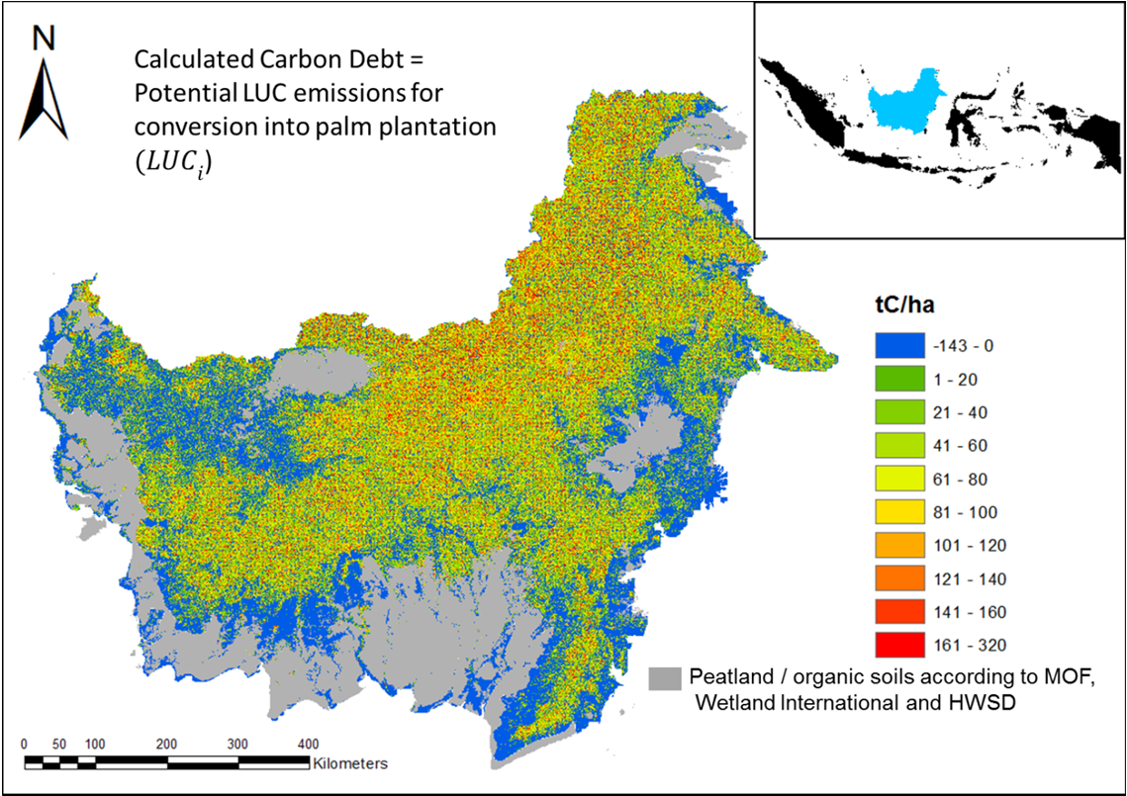
Example carbon
accounting
Potential calculated carbon debt for conversion into palm plantation in Kalimantan, Indonesia (source: IfW; 2013, SarVision; 2008)

Slide 37
Carbon accounting
Earth observation provides information on detecting forest cover and land cover change (optical), also in areas where cloudiness is a problem (radar);
Earth observation helps measuring global biophysical variables related to the status of vegetation, such as leaf area index;
Earth observation supports the measurement, reporting and verification process;
Cost estimate: on case-by-case basis;
Main challenges: cost, complexity, capacity, business model.

Slide 38


Examples:
EU biofuel policies in practice - a carbon map for Kalimantan and Sumatra (IfW; 2013)
calculation of the (potential) carbon effects of conversion of forest and peatland into palm plantation in Indonesia
Integrating remote-sensing and ground-based observations for estimation of emissions and removals of greenhouse gases in forests (GFOI; 2013) methods and guidance for estimating emissions and removals from the broader land use, land-use change and forestry sector with remote sensing and how this can be used for reporting and policy advice
Monitoring of tropical forests and agricultural areas with radar (SarVision; 2011) presentation on REDD+ examples from Guyana and Surinam and oil palm example from Malaysia

Slide 39

More examples:
Integrating remote-sensing and ground-based observations for estimation of emissions and removals of greenhouse gases in forests (GFOI; 2014)
methodological advice on the use of remotely sensed data together with ground-based observations to estimate and report greenhouse gas emissions and removals associated with forests in a manner consistent with the greenhouse gas inventory guidance from the Intergovernmental Panel on Climate Change

Slide 40
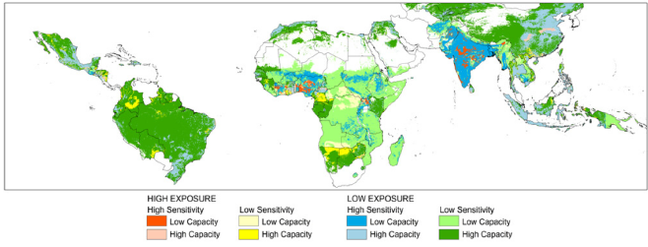
Example prediction
and mitigation
Vulnerability to maximum daily growing season temperature exceeding 30 ºC
(Source: CIESIN; 2013, CGIAR; 2011)

Slide 41
Prediction and
mitigation
Prediction and mitigation products and services use the output of climate monitoring and modelling (and carbon accounting) as input;
Earth observation is used to provide more detailed information that is relevant for local decision-making, such as subsidence measurements for urban coastal areas, hotspot mapping, detailed change detection, extreme weather, renewable energy;
Earth observation provides a good basis for visualization in support of decision-making;
Cost estimate: on case-by-case basis;
Main challenges: cost, cost-benefit, acceptance, business model, knowledge transfer.

Slide 42


Examples:
Climate change hotspots mapping (CIESIN; 2013)
presentation on climate change hotspots mapping for vulnerability assessment and improved targeting of adaptation and mitigation efforts
Critical datasets & potential new tools for detection of climate impact on the water cycle (CSIRO; 2011) presentation with the description of the use of remote sensing and visualization tools to show the potential impact of climate change, with the aim to improve decision making
North African coastal cities address natural disasters and climate change (World Bank, ESA; 2011)
studies on adaptation to climate change with respect to natural disasters for Alexandria, Tunis, Casablanca and the Bouregreg area
Climate change projections and adaptation strategies for multi-objective resource management at Kennedy Space Center, Florida (NASA; 2011) presentation on future projection of climate change and measures for protection of the Kennedy Space Centre and ecosystem preservation

Slide 43
Growth potential for
earth observation
Measurement, reporting and verification for carbon accounting.
Main clients: government, NGOs.
Prediction and mitigation at various levels for decision-making.
Main clients: governments, NGOs.

Slide 44
3. Business development

Slide 45
Why is marketing / promotion of earth observation needed?
Public sector information (PSI)
Externalities (environmental accounting & payment for ecosystem services)
Global datasets, open access, data sharing, compatibility (GEO)

Slide 46
If public sector information is made available free-of-charge, demand will increase and, in the end, government revenue also, as companies will derive income from value-added products and services, and consequently pay more taxes (see figures in following slides).

Slide 47
Supply & Demand Public Sector Information
http://vimeo.com/63079712
Source: About GMES and data: geese and golden eggs (Sawyer, de Vries 2012)

Slide 48
Cost-benefit Public Sector Information
Source: About GMES and data: geese and golden eggs (Sawyer, de Vries 2012)

Slide 49
Re-use of Public Sector Information
Source: About GMES and data: geese and golden eggs (Sawyer, de Vries 2012)

Slide 50
Most earth observation applications deal with so-called externalities, such as impact on the environment.
It is difficult to capture these in terms of conventional cost-benefit models.
To tackle this, the following framework for analysis of earth observation applications is developed:

Slide 51
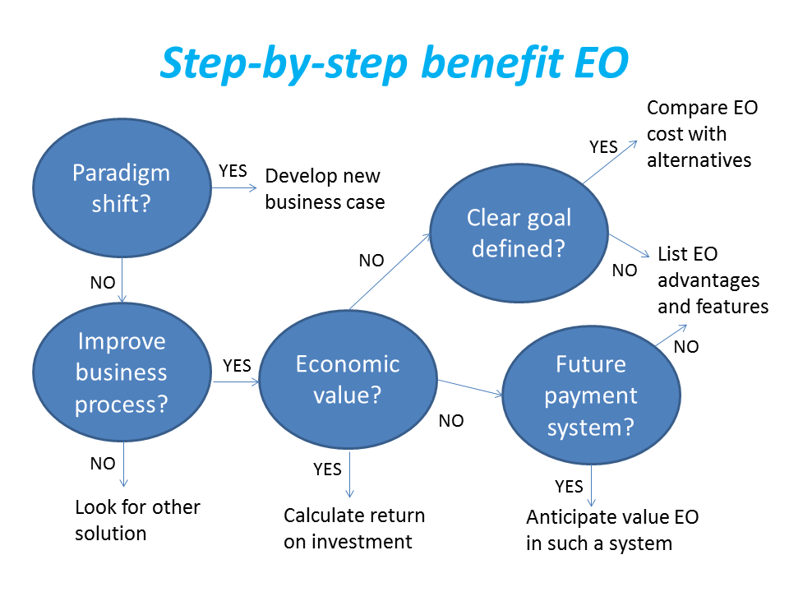
Framework for analysis
Step-by-step analysis of the benefits of earth observation (source: GEONetCab, 2013)

Slide 52
Key questions
Does the new application cause a paradigm shift?
Is the current business or organization process improved?
Does the application provide economic value that can be quantified?
Is a clear measurable goal defined to which the earth observation application contributes?
Is a future payment scheme or other economic mechanism foreseen in which the earth observation application fits?

Slide 53
Assessment of
geospatial solutions
Rating of characteristics of geospatial solutions:
fit-for-purpose
comparative advantage
complexity to user / ease- of-use
elegance
cost-benefit,
sustainability
resilience
reproduction capacity / flexibility
acceptance
level of knowledge transfer required
ethics, transparency, public accountability, objectivity & impartiality
Rating of business environment:
Willingness to pay (by clients)
Embedding (in organizational processes)
Openness (transparency and ease of doing business, access to markets)
Institutions (is the institutional environment conducive to doing business, acceptance of new solutions?)

Slide 54
Fit-for-purpose
An important, but often forgotten requirement:
Does the product or service do what it is supposed to do to solve a certain problem?
In other words: is it really a solution or just an attempt towards a solution?
Quantitative: not applicable
Qualitative (on scale of 1 to 5): based on description of what the EO solution actually does

Slide 55
Comparative advantage
What it does significantly better than other solutions to the same problem.
For earth observation usually the comparative advantages of greater accuracy, better resolution in time and space, comprehensive overview of large areas and near real-time information provision are mentioned as comparative advantages.
Quantitative: calculation of degree in which the EO solution is better than alternatives
Qualitative (on scale of 1 to 5): based on listing of comparative advantages

Slide 56
Complexity (to user) / ease-of-use
At all levels in the value chain the users (professionals and
end-users) are able to work with the product or service.
Quantitative: not applicable
Qualitative (on scale of 1 to 5): based on user testimonials and user surveys

Slide 57
Elegance
Once you get the idea behind this product or service, you want to be part of the community that uses it.
This sense of belonging facilitates the formation of user groups that provide valuable feedback.
Quantitative: none, or it should be the size of the user community
Qualitative (on scale of 1 to 5): based on user testimonials and user surveys

Slide 58
Cost-benefit
The cost-benefit of the product or service is quantified and sufficiently attractive, also in the long-term.
Quantitative: cost-benefit calculation
Qualitative (on scale of 1 to 5): based on quantitative assessment

Slide 59
Sustainability
The product or service can be delivered when it is needed.
There is a long-term perspective that guarantees delivery.
Sustainability concerns the following aspects:
Long-term data availability
Availability of finance/funds to provide the solution continuously for present and future use
Long-term institutional / governmental interest and support
Long-term user interest for a solution that addresses real needs
Quantitative: not applicable
Qualitative (on scale of 1 to 5): based on sensitivity analysis of the EO solution

Slide 60
Resilience
In case of extremes or breakdown in the value chain, the product or service can still be delivered at an acceptable level. Alternatives (plan B) are available (and developed).
Quantitative: cost-benefit calculation of plan B
Qualitative (on scale of 1 to 5): based on risk analysis of the EO solution

Slide 61
Reproduction
capacity / flexibility
The product or service can be easily applied or adapted for use in another region or another situation, while still providing the solution without (too much) extra cost.
Quantitative: calculation of reproduction costs for application in other regions or situations; measurement of spreading of actual use
Qualitative (on scale of 1 to 5): based on quantitative assessment and description of EO solution

Slide 62
Acceptance
The users intuitively get what the product or service is about and are interested. They accept it as a solution to their problem.
Quantitative: none, or survey results about acceptance. After introduction of the solution: number of clients and/or users
Qualitative (on scale of 1 to 5): based on user testimonials and user surveys

Slide 63
Level of knowledge
transfer required
The training requirements for professionals and other users along the value chain are clear and associated costs and efforts are acceptable.
Quantitative: cost and time required to get the users at the desired knowledge and skill level
Qualitative (on scale of 1 to 5): based on knowledge transfer plans and evaluation of training activities

Slide 64
Ethics, transparency,
public accountability,
objectivity & impartiality
Application of Earth observation increases the level of objectivity and impartiality in decision-making processes, including conflict resolution. The application improves transparency and public accountability. It raises no ethical issues or if it does, as in the case of privacy concerns, these are resolved in a satisfactory way for all parties concerned.
Quantitative: not applicable
Qualitative (on scale of 1 to 5): based on user testimonials and user surveys

Slide 65
Several attempts have been made to introduce environmental accounting and to enlarge the sphere of the conventional economy to include and quantify impact on ecosystems.
The following slides give some examples:

Slide 66



Environmental accounting & payment for ecosystem services
SEEA:
System of Environmental-Economic Accounts
(EC, FAO, IMF, OECD, UN, WB )
WAVES:
Wealth Accounting and the Valuation of Ecosystem Services (global partnership, led by World Bank)
TEEB:
The Economics of Ecosystems and Biodiversity
(group led by UNEP)

Slide 67
SEEA Conceptual Framework
Source: SEEA conceptual framework report (EC, FAO, IMF, OECD, UN, WB 2012)

Slide 68
For earth observation the work of the Group on Earth Observations (GEO) is essential to achieve the goal of a Global Earth Observations System of Systems (GEOSS), resulting in the shared GEO common infrastructure (GCI):

Slide 69
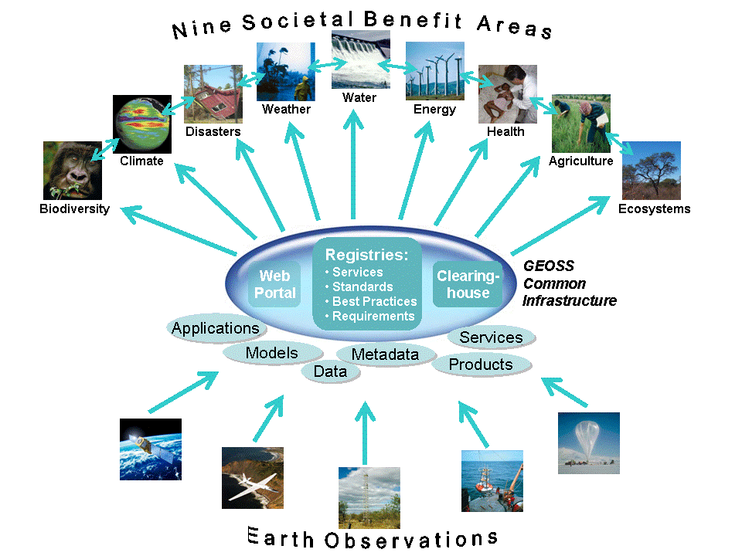

Group on Earth Observations

Slide 70
Marketing elements
Customer value propositions
Crossing the technology chasm
Creating shared value
Promotion tools

Slide 71
Customer value propositions capture the unique value of a product or services as perceived and appreciated by the customer.
Interestingly, they can differ completely from the features that the provider considers most important:

Slide 72
Customer Value Propositions
VALUE PROPOSITION | ALL BENEFITS | FAVOURABLE POINTS OF DIFFERENCE | RESONATING FOCUS
Consists of: | All benefits customers receive from a market offering | All favourable points of difference a market offering has relative to the next best alternative | The one or two points of difference whose improvement will deliver the greatest value to the customer
Answers the customer question: | “Why should our firm purchase your offering?” | “Why should our firm purchase your offering instead of your competitor’s?” | “What is most worthwhile for our firm to keep in mind about your offering?”
Requires: | Knowledge of own market offering | Knowledge of own market offering and next best alternative | Knowledge of how own marketing offering delivers value to customers, compared with next best alternative
Has the potential pitfall: | Benefit assertion | Value presumption | Requires customer value research
Source: Customer value propositions in business markets (HBR 2006)

Slide 73
Buyer behaviour & motivation
Type | Buyer behaviour | Motivation
Transactional sales | Intrinsic value buyers: “keep it cheap and easy to do business” | Understands the product Perceives it as substitutable Cost focus Resents time ‘wasted’ with sales people
Consultative sales | Extrinsic value buyers: “I don’t know the answer: help me analyse and solve the issue | Focus on how the product is used Interested in solutions and applications Values advice and help Needs the sales person
Source: Rethinking the sales force (Rackham, de Vincentis 1999)

Slide 74
Even when customer value propositions are well captured and formulated, introduction of solutions that involve new technology will have to overcome some hurdles.
This is called “crossing the technology chasm”:

Slide 75
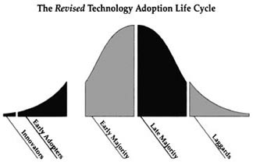
Crossing the technology chasm
Source: Crossing the chasm (Moore 1991)

Slide 76
Crossing the technology chasm
Most clients of EO products and services belong to the early and late majority.
They are pragmatists and are not prepared or willing to take substantial risk: the solution should work and be reliable.
Once convinced, the pragmatists will be long-term clients.
Source: Crossing the chasm (Moore 1991)

Slide 77
More information:
Creating & delivering your value proposition
– managing customer experience for profit
(Barnes, Blake, Pinder; 2009)
Customer value propositions in business markets
(Anderson, Narus, van Rossum [Harvard Business Review]; 2006)
Rethinking the sales force:
refining selling to create and capture customer value
(Rackham, de Vicentis; 1999)
Crossing the chasm
– marketing and selling high-tech products to mainstream customers
(Moore; 1991)

Slide 78
Creating shared value is a key element of successful implementation of earth observation solutions.
To achieve this, in most cases earth observation applications have to be integrated into more general (business or organizational) processes:

Slide 79
Create shared value
Involves cooperation between:
Public sector
Private sector
Social sector
Opportunity for earth observation (integrated) solutions:
Integrate EO in general business / organizational process
Integrate different EO (and GIS and navigation) functionalities

Slide 80
Based on all considerations dealt with in the previous slides, there are some practical approaches that can be applied in combination to promote earth observation applications:

Slide 81

Tools for earth observation marketing:
Success stories (in non-technical language, feasible, replication capacity, sustainable)
Marketing toolkits (international trends, earth observation examples, references)
Pilot projects, innovation funds, quick-wins (demonstration that EO actually works)
Promotion outside EO community (fairs, seminars, lunch-bag meetings, magazines)
Resource facilities for reference and capacity building (distributed, but connected, in different languages)
Source: Marketing earth observation products and services (Noort 2013)

Slide 82
Business elements
Business elements:
Proposal writing
Business procedures

Slide 83
Proposal writing is an art in itself.
During the GEONetCab and EOPOWER projects templates have been developed for writing successful proposals:

Slide 84
Proposal outline
1. Introduction / relevance
2. Objective(s)
3. Activities
4. Output
5. Management & evaluation
6. Risk assessment
7. Time schedule
8. Budget
Annexes
(more detailed version in separate document,
see www.eopower.eu or www.hcpinternational.com)

Slide 85


Other guides that may be useful:
Civicus: writing a funding proposal
Michigan State University: guide for writing a funding proposal
ESRI: writing a competitive GRANT application
REC: project proposal writing

Slide 86
If you run a company, compete for assignments and manage projects, a structured approach towards responsibilities, tasks, implementation and documentation is needed.
The following business procedures may be helpful:

Slide 87
Business procedures
1. On acquisition
2. On offers
3. On negotiation
4. On contracts
5. On project management
6. On travel & deployment
7. On deficiencies & complaints
8. On internal organization
9. On finance
(more detailed version in separate document,
see www.eopower.eu or www.hcpinternational.com)

Slide 88
Again:
SHARED PROBLEM
SHARED LANGUAGE
SHARED SOLUTION

Slide 89
4. Capacity Building

Slide 90
General
Marketing is promotion + capacity building.
Especially for the introduction of new technologies capacity building is important at all levels.
Capacity building is the instrument to increase
self-sufficiency and make solutions work.

Slide 91

General references for capacity building, open data and success stories
GEO Portal: www.earthobservations.org
Capacity building resource facility www.geocab.org
compilation of tutorials, references, open-source software, etc.
Satellites going local: share good practice (Eurisy handbooks) www.eurisy.org
Earth observation for green growth (ESA; 2013)

Slide 92


General references for capacity building, open data (2)
Bringing GEOSS services into practice:
how to use data from the GEO portal and how to provide input
www.envirogrids.net
Science education through earth observation for high schools: basic tutorials on all kind of subjects
www.seos-project.eu
Copernicus briefs:
information on satellite applications for different topics
http://www.copernicus.eu/main/copernicus-briefs
MetEd
tutorials and courses on meteorology and related subjects
https://www.meted.ucar.edu/training_detail.php

Slide 93
More references open data
Open data for sustainable development (World Bank; 2015)
description of the benefits of open data for a wide range of development goals, including the SDGs http://pubdocs.worldbank.org/pubdocs/publicdoc/2015/8/904051440717425994/Open-Data-for-Sustainable-development-Final-New.pdf
Terms and conditions for the use and distribution of Sentinel data (European Parliament and European Commission; 2014)
standard stipulations related to free and open access to Sentinel data http://www.demarine.de/lr/c/document_library/get_file?uuid=c5067655-b7ad-4d71-b07b-6111808f4abd&groupId=13521
Towards a thriving data-driven economy (European Commission; 2014) policy document on the use of (open) data for a knowledge economy and society
http://ec.europa.eu/information_society/newsroom/cf/dae/document.cfm?doc_id=6210

Slide 94

Knowledge data portals for climate change:
Climate change explorer
http://weadapt.org/knowledge-base/using-climate-information/the-climate-change-explorer-tool
Climate wizard
http://www.climatewizard.org/
UNDP adaptation learning net
http://www.adaptationlearning.net/
IPCC data distribution center
http://www.ipcc-data.org/
Earth System Grid http://www.earthsystemgrid.org/home.htm;jsessionid=92341D76DB0CDDB7EE13A2D59C9B80D5

Slide 95


Capacity building resources for climate change:
global change SysTem for Analysis, Research & Training: START
provides guidelines and training opportunities related to climate change issues
Tearfund CEDRA toolkit
step-by-step guide to define community climate adaptation activities in developing countries

Slide 96
START: biodiversity and climate change training
http://start.org/

Slide 97


Capacity building resources for climate change (2):
Kick the habit (UN; 2010)
general introduction on climate change and what you can do as an individual
Climate change science compendium
comprehensive popular overview of climate science
GIS for climate change (ESRI; 2010)
Climate change is a geographic problem (ESRI; 2010)
practical examples and approach

Slide 98


Capacity building resources for climate change (3):
Adapting to climate variability and change (USAID; 2007)
guidance manual for development planning
GOFC-GOLD sourcebook (2009) exhaustive overview of assessing carbon stocks and emissions, detailed description of methodology
Mainstreaming adaptation to climate change in agriculture and natural resources management projects (World Bank; 2010) guidance notes on stakeholder engagement, climate risk assessment, policies and institutions, investing in adaptation, implementation, supervision and evaluation
Mainstreaming climate change adaptation into development planning: a guide for practitioners (UNDP/UNEP; 2011)
guide for policy formulation, including adaptation indicators

Slide 99


Capacity building resources for climate change (4):
Earth observation for forest biomass and carbon mapping
Case study: Afram Headwaters Forest Reserve, Ghana (ITC; 2015)
3-day EOPOWER (self-study) course for professionals
http://menhir.itc.utwente.nl:5000/fbsharing/KGKOZXKU/
Being prepared for climate change
A workbook for developing risk-based adaptation plans (EPA; 2015)
EPA tutorials DPSIR http://www.epa.gov/ged/tutorial/index.htm
Climate change and coastal watersheds (EPA; 2012)
Climate ready estuaries

Slide 100
Further details:
Contact: Mark Noort
m.noort@hcpinternational.com
www.eopower.eu
www.hcpinternational.com

