Slide 1



Earth Observation for
Agriculture
International trends & developments
Earth observation applications
Business development
Capacity building

Slide 2

0. Introduction
Mark Noort, consultant, project manager
HCP international:
consulting, marketing of earth observation
Project director EOPOWER:
project for promotion & capacity building of
earth observation applications

Slide 3
Sequence:
General assessment of the state-of-the-art of earth observation
Major trends and developments in the application field
Description of earth observation solutions
Assessment of market potential for earth observation solutions and marketing instruments
Capacity building for successful application of earth observation solutions

Slide 4
Earth Observation helps you: save money save lives save the environment

Slide 5
Earth observation
applications
On the verge of reaching new user communities
These new user communities need to be involved
Weakest link / last mile aspects are important
Marketing needed: promotion & capacity building

Slide 6
Life cycle of products & services
Initialization
System analysis & design
Rapid prototyping
System development
Implementation
Post-implementation

Slide 7
Scope
In relation to crop farming and livestock farming, the term “agriculture” may be defined as:
the art and science of growing plants and other crops and the raising of animals for food, other human needs, or economic gain
Focus on:
Growing plants and other crops (including pasture),
Transportation of agricultural produce to the market,
Derived products and services related to agriculture with a distinctive geospatial component, such as (re-)insurance, monitoring of compliance with agricultural policies and regulations and other forms of (risk) management.

Slide 8
Assessment of business & funding opportunities
Categories of agricultural products & services
Life cycle phase of product or service
Regional context, level of technological & economic development
Optimum marketing mix

Slide 9
1. International trends & developments in agriculture

Slide 10
Dimensions to characterize
farmers’ operations
Type of agriculture: crops, livestock, fishery/aquaculture, forestry.
Purpose / goal of agricultural activity, such as subsistence farming, market- oriented farming or a mixture of subsistence and market-oriented farming.
Property structure and means for engagement in agricultural activities: human, financial and social/cultural capital employed, such as ownership of and access land and means, tenancy arrangements, credit facilities, government policy and subsidies (e.g. sharecropping, cooperative farming, communal lands, etc.).
Technology level: low, medium, high (e.g. precision agriculture is part of high level technology).

Slide 11
Issues & trends
in Agriculture
Food security and increased production and productivity;
Adaptation to and mitigation of the effects of climate change;
Empowering local communities, bridging the rural digital divide;
Food prices and markets;
Risk management (including insurance).

Slide 12
Drivers
The increasing world population,
Environmental factors (including climate change),
The availability of water resources,
Increasing urbanization and growing middle class population -> increased consumption and changing consumption patterns
Land management (land as a scarce resource).

Slide 13
World food production must rise by 50% in 2030 to meet increasing demand Source: FAO/UN, 2008

Slide 14
Food security & increased
production / productivity
Food security in terms of avoiding hunger and undernourishment;
Food security in terms of increased demand: production and productivity should go up;
Food security in terms of sustainable management of natural resources;
Food security in terms of increased resilience with respect to the effects of climate change and disasters / pests;
Food security in terms of conflicting interests: biofuels may lead to more income for the farmer, but also to higher food prices in general.

Slide 15



More information:
Sustainable agricultural productivity growth and bridging the gap for small family farms (for G20; 2012)
World agriculture towards 2030/2050 – the 2012 revision (FAO; 2012)
Food and water: analysis of potentially new themes in water management - future trends and research needs (FutureWater; 2010)
Solutions sustainable agriculture and food systems – Technical report for the post-2015 development agenda (UNSDSN; 2013)

Slide 16



More information:
The state of food insecurity in the world
economic growth is necessary but not sufficient to accelerate reduction of hunger and malnutrition
(IFAD, WFP, FAO; 2012)
Agricultural outlook 2015 – 2024
highlights (OECD, FAO; 2015)
The state of food and agriculture
investing in agriculture for a better future (FAO; 2010)

Slide 17
Climate change
Climate will likely be substantially warmer in most parts of the world;
Water availability for agriculture will be reduced;
More extreme weather events will occur
(prolonged drought, heavy rainfall, heat waves, frost, etc.);
Danger of pests and diseases will increase.

Slide 18
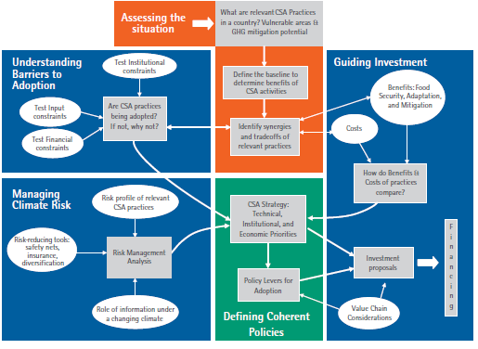
A framework for developing a climate-smart agriculture strategy and investment proposals
(FAO; 2012)

Slide 19
More information:
Climate change and food security:
a framework document (FAO)
The state of the world’s land and water resources for food and agriculture - managing systems at risk (FAO; 2011)
Water-food-energy nexus: towards a widening of the water agenda (FutureWater; 2013)

Slide 20


More information (2):
Climate-smart agriculture - increased productivity and food security, enhanced resilience and reduced carbon emissions for sustainable development (World Bank; 2011)
A growing interest 2 - climate and economic impacts on the plant sector (IGES; 2012)
Uses and limitations of observations, data, forecasts, and other projections in decision support for selected sectors and regions (NASA; 2008)

Slide 21
Empowering
local communities
Local communities as drivers to increase production and productivity in vulnerable areas to achieve food security;
Sustainable management of natural resources at the local level;
Reduce post-harvest transportation and storage losses;
Accessible, timely and affordable information on food prices and markets for farmers;
Support to risk management in the form of (index-based) insurance schemes.

Slide 22


More information:
Sustainable agricultural productivity growth and bridging the gap for small family farms (for G20; 2012)
Smallholder certification in biomass supply chains – guidance manual (CREM; 2013)
Smallholder farmers can feed the world (IFAD)
Foodie – Open data for agriculture
article on information tools for farmers (Foodie project; 2014)

Slide 23


More information (2):
The new harvest
Agricultural innovation in Africa (Juma; 2011)
e-Sourcebook ICT in agriculture
Connecting smallholders to knowledge, networks, and institutions (World Bank; 2011)
Guide for regional integrated assessments:
handbook of methods and procedures (AgMIP; 2013)
The transformational use of information and communication technologies in Africa (World Bank, African Development Bank; 2014)

Slide 24
Food prices & markets
Improve physical market infrastructure and transport to and from markets;
Improve market transparency;
Improve market institutions;
Sustainable management of the whole value chain: include costs of externalities;
Increase resilience of vulnerable farmer and consumer communities.

Slide 25

More information:
Agricultural policy monitoring and evaluation 2013
OECD countries and emerging economies (OECD; 2013)
Agricultural value added services (AgriVAS; 2011):
market entry toolkit
Spatial patterns of food staple production and marketing in South East Africa: implications for trade policy and emergency response (MSU; 2009)

Slide 26
Risk management
Improved prediction capability for detecting possible calamities;
Improved early warning systems and general information provision on agro-meteorological conditions;
Improved physical protection against extreme events;
Sustainable management of natural resources;
Insurance schemes for risk coverage.

Slide 27

More information:
The landscape of micro-insurance in Africa 2012
(Munich Re; 2012)
Weather index-based insurance in agricultural development
a technical guide (IFAD; 2011)
Rainfall variability, food security and human mobility
an approach for generating empirical evidence
(UNU-EHS; 2012)

Slide 28
2. Earth observation applications

Slide 29
Earth observation
for agriculture
Three levels of interaction within a country:
Country level
focusing on policy, research and innovation;
Agro-ecological zone or watershed level
focusing on extension services and management of regional resources;
Farm level
focusing on advice and income optimization.

Slide 30
Earth observation
for agriculture
Remote sensing images showing agriculture patterns (Geospatial World)

Slide 31
Country level: earth observation contribution
Agricultural knowledge and information systems:
parcel identification and measurement, geo-statistics and crop identification, field survey, subsidy and policy monitoring and control,
National crop and yield monitoring,
Transport infrastructure and transport to market
(food chain management),
Land rights,
Market information.

Slide 32
Example agricultural information systems
Agricultural parcel (blue) one single crop group from a single farmer;
farmers’ block/plot (red) one single or several crop groups from a single farmer;
and physical block (yellow) one single or several crop groups from one or several farmers. (GeoCAP, JRC)

Slide 33
Agricultural
information systems
Parcel identification and measurement, geo-statistics and crop identification, field survey, subsidy and policy monitoring and control. Combines data and information on land use, land administration, crop monitoring and agro-ecological zones for better decision making;
Earth observation improves accuracy, enables more frequent and better monitoring, coverage of large (not easily accessible) areas and facilitates integration of information;
Cost estimate:
total cultivated area 100 – 120 k€ / country, mapping of different crops and parcels 1.5 -2.5 € / km²;
Main challenges: cost, capacity, data access;

Slide 34


Examples:
GeoCAP (European Union):
digital land parcel identification, parcel area management, land cover type, compliance monitoring
USDA (USA):
information system(s) for compliance and regulatory use, cropland data, soil modelling, etc. based on common land units
SICA (Colombia):
design, monitoring and tracking of coffee farming activities
SOMABRASIL (Brazil):
system for agricultural observation and monitoring
Technical report on improving the use of GPS, GIS and remote sensing in setting up master sampling frames (2015)

Slide 35
Example crop and
yield monitoring
Field scale wheat yield in the Netherlands
(blue: 9 ton/ha, green: 8 ton/ha;
yellow: 6 ton/ha, red 4 ton/ha)
Source: eLeaf
Maize crop yield forecast 2007
Source: Service operations report Malawi 2007 – 2008 (GMFS, 2008)

Slide 36
Crop and
yield monitoring
Distinguishes between agricultural land and non-agriculture land, different crop types, assesses crop growth in comparison with historical data, predicts yields (including early warning for possible food shortages);
Earth observation improves accuracy, enables more frequent and better monitoring, coverage of large (not easily accessible) areas and facilitates integration of information;
Cost estimate: total cultivated area 100 – 120 k€ / country, mapping of different crops and parcels 1.5 -2.5 € / km², early warning crop health 200 – 300 k€ / continent (with 10-day updates), yield prediction 70 – 100 k€ / 2 – 3 crops / 100,000 km²;
Main challenges: cost, capacity, data access;

Slide 37




Examples:
GEOGLAM: GEO global agricultural monitoring, connected to G20 AMIS
GIEWS: FAO’s global information and early warning system
GMFS: global monitoring of food security, developed through a sequence of ESA and EC-funded projects (latest is SIGMA)
FEWSNET: US system for food security early warning (USGS, USAID, USDA)
FOOD-SEC (MARS): EU system for monitoring of food security and many national systems: China, Argentina, Canada, Ukraine, South Africa, Australia, USA, India, Russia, etc.

Slide 38


Examples (2):
Advances in remote sensing of agriculture: Context description, existing operational monitoring systems and major information needs (Atzberger; 2013)
South Africa national agricultural monitoring (SAGEO; 2014) Presentation on national crop and yield monitoring
More presentations on various crop and yield monitoring systems:
http://swfound.org/events/2013/international-meeting-on-food-security,-earth-observations-and-agricultural-monitoring/

Slide 39
Example
market access
Map of plot locations in relation to markets and extension services (profiling study, Malaysia)

Slide 40
Market access
Analyses the opportunities and constraints for optimum market access of agricultural produce, supports decision making for planning and improvement of infrastructure, storage and market facilities;
Earth observation provides the base layer for spatial information analysis (including crowd-sourcing) and monitoring of agricultural activities (crop growth and land use change);
Cost estimate: see agricultural information systems and crop monitoring
Main challenges: infrastructure, institutions.

Slide 41
Examples:
Many products and services are in development, usually based on satellite navigation, information dissemination with mobile phones and crowd-sourcing.
CHEETAH:
Chains of Horticultural Intelligence; towards Efficiency and Equity in Agro-Food Trade along the Trans-Africa Highway, an ESA-award winning initiative that develops an intelligent app to reduce post-harvest losses and to improve (labour-intensive) road work.

Slide 42
Example
land rights
Digitised parcel boundaries on QuickBird HRSI in Zormandi area
(Source: First experiences using high-resolution imagery-based adjudication approach in Ethiopia (WB))

Slide 43
Land rights
Determines land ownership and land rights to provide a secure basis for farming operations and access to credit;
Earth observation provides the base layer for community participation in determining land ownership and (communal) rights and mapping the results. The information is easier to interpret and more up-to-date than conventional maps.
Cost estimate: see toolkit on urban management, land administration and spatial data infrastructures.
Main challenges: transparency, institutions.

Slide 44
Example
market information
Suitability for delivering content
Source: AgriVAS market entry toolkit
Maize Market Sheds in Eastern and Southern Africa
Source: Unscrambling Africa: Regional Requirements for Achieving Food Security (MSU, 2010)

Slide 45
Market information
Timely and accurate information on commodity prices and markets helps the farmer to improve decision-making with respect to selling and crop selection;
Earth observation provides the base layer for spatial analysis of market information.
Cost estimate: on case-by-case basis.
Main challenges: communication, business model.

Slide 46

Examples:
Harvest Choice
data harmonization (assembling heterogeneous datasets)
+ data distribution (new ways of collecting and distributing spatial data).

Slide 47
Agro-ecological zone / watershed level: earth observation contribution
Site evaluation
(sustainable land use, suitability analysis),
Regional crop and yield monitoring,
Water management,
Weather prediction.

Slide 48
Example site evaluation
Examples of reference parcels super-imposed on aerial orthoimagery
(colours correspond to
different land cover types) (GeoCAP, JRC)

Slide 49
Site evaluation
Analysis and modelling of agro-climatic data, biomass and yield data, soil suitability to achieve optimum and sustainable use of agro-ecological zones;
Earth observation provides the input for modelling and analysis: land cover, land use change, crop identification and monitoring, water resources, soil mapping and climate modelling with more accuracy, wider coverage and higher frequency than conventional methods.
Cost estimate: on case-by-case basis (costs of crop monitoring + modelling).
Main challenges: cost, capacity, data access.

Slide 50



Examples:
Global Agro-Ecological Zones (GAEZ)
initiative of IIASA and FAO for assessing agricultural resources and potential. A model is developed for sustainable utilization of land resources, agricultural development and food security that can be used as baseline for elaboration of local models and plans.
Remote sensing of soils (University of Zurich; 2014)
Description of state of the art of remote sensing of soils: soil mapping, remote sensing products, opportunities and limitations.

Slide 51
Example
water management (1)
Example evapotranspiration Ethiopia
Source: GEONETCast presentation (ITC, 2012)

Slide 52
Example
water management (2)
Mean annual water abstraction estimation for irrigation as amount of water needed to satisfy crop demand, Gabes area, Tunisia, 2006.
Source: Application of satellite remote sensing to support water resources management in Africa (TIGER, 2010)

Slide 53
Water management
Mapping of water resources, analysis and modelling of water quality, water resources and water use to achieve sustainable water management
Earth observation provides higher accuracy, wider coverage and more frequent monitoring of water use for agriculture (evapotranspiration), water quality and availability of water resources. Earth observation serves as base layer for hydrological modelling (digital elevation models and determination of surface roughness).
Cost estimate: on case-by-case basis, mapping of water resources 0.75 € / km².
Main challenges: capacity, account for real cost of water.

Slide 54




Examples:
JCRMO (Spain):
irrigation water needs
ORMVAG (Morocco):
evapotranspiration, irrigation management
Agricultural Catchments Programme (Ireland):
water quality protection, fertilizer advice, soil analysis
eLeaf (the Netherlands):
evapotranspiration, water management

Slide 55

More examples:
Cost and benefits of satellite-based tools for irrigation management (Vuolo et al.; 2013) overview and cost-benefit analysis of EO for irrigated agriculture in Austria
Landsat and water (USGS; 2014) case studies of the uses and benefits of Landsat imagery in water resources
Remote sensing for field scale monitoring of crop productivity and crop water consumption: Possibilities and limitations (UNESCO-IHE; 2015) presentation on the SEBAL tool and FruitLook, including cost-benefit estimates
Coupling VIS/NIR observations for crop characterisation and agro-hydrological model in irrigation management (IRRI-EYE; 2015) presentation on practical application of EO for irrigation management
Managing irrigation from space (TOPS; 2013) presentation on mapping crop water requirements with satellite observations and CIMIS data in California

Slide 56
Example
weather prediction
Precipitation calculated over
Central Africa for 23-02-2008
Source: GEONETCast - DevCoCast application manual (ITC, 2012)
Satellite dish installed at
National University of Rwanda
Source: GEONETCast presentation
(ITC, 2012)

Slide 57
Weather prediction
Weather prediction assists planning of farming operations, such as sowing, irrigation and harvesting. Weather prediction is also crucial in early warning for extreme events and climate modelling for adaptation to and mitigation of the effects of climate change.
Thanks to earth observation and progress in modelling (numerical weather prediction) weather forecasts have improved considerably and can provide quick, accurate and up-to-date information to the farmer.
Cost estimate: most information derived from satellite images is available free-of-charge, processing and delivery is not.
Main challenges: timely and accurate information provision to farmers.

Slide 58

Examples:
GEONETCast:
worldwide information dissemination system by which satellite and in situ data, products and services are transmitted to users through communications satellites. Receiving stations use low-cost, off the shelf technology. Information includes climate, weather, agriculture, air quality, disasters, and more. No internet connection required.
Copernicus:
space-based weather prediction, nowcasting and forecasting of atmospheric parameters at global and regional scales and re-analysis of weather parameters at various temporal resolutions.

Slide 59
Farm level:
earth observation contribution
Farm site evaluation,
Precision agriculture: machine guidance, precise planting and harvesting, fertilization advice, yield monitoring, water management advice,
Pest management,
Weather prediction: temperature, rainfall (amount, geographical distribution, intensity, timing), extremes (rainfall, drought, wind, hail, etc.).

Slide 60
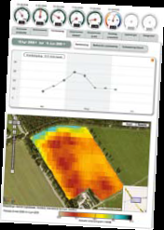
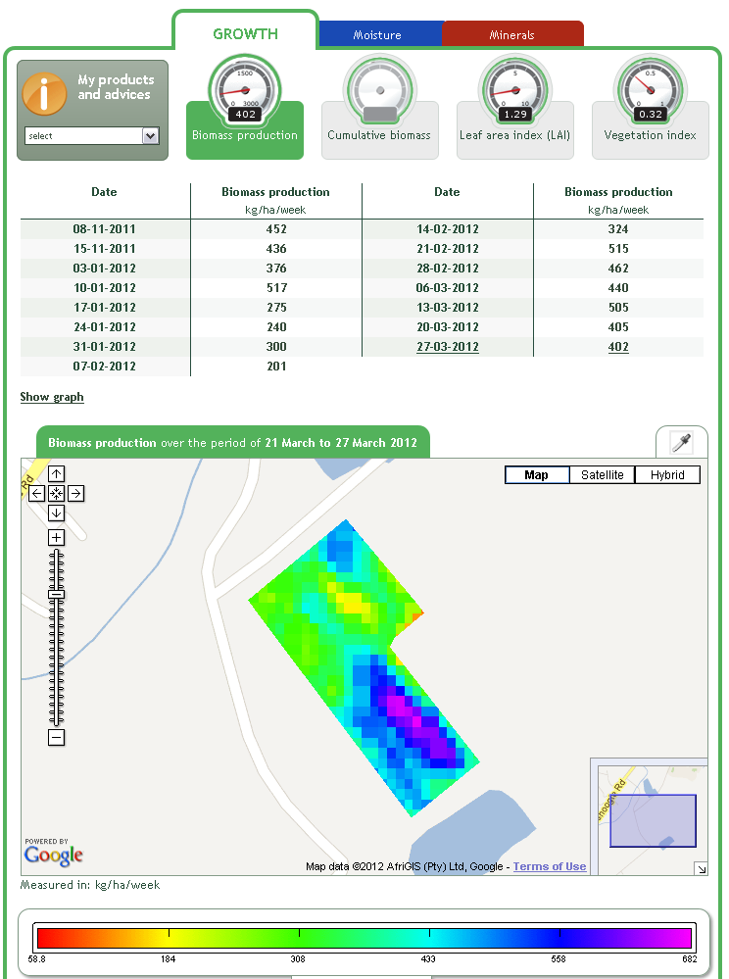
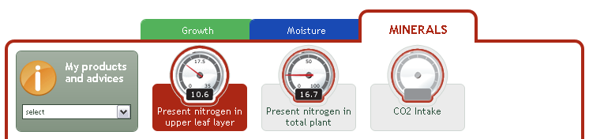
Example
precision agriculture (1)
Source:
MijnAkker, Netherlands
&
FieldLook, Ethiopia
(eLeaf 2012 & 2013)

Slide 61
Example
precision agriculture (2)
Vineyard yield map and comparison 2010 and 2009
Source: Fountas

Slide 62
Precision agriculture
Machine guidance, precise planting and harvesting, fertilization advice, yield monitoring, water management advice.
High-resolution earth observation provides accurate information with high frequency that serves, after processing, to reduce fertilizer input, increase efficiency of water use, etc.
Cost estimate: 10 -15 € / ha.
Main challenges: affordability, cloud cover.

Slide 63
Examples:
Although most geospatial applications for precision agriculture are based on satellite navigations and GIS, there are quite a number of products and services offered (or in development) by commercial EO-providers, such as
Digital Globe (AgroWatch)
Blackbridge
Airbus Defence & Space (FarmStar)
eLeaf (FieldLook)
Cropio
MicroImages (TNTmips)
IRRI-EYE
etc.

Slide 64
Examples (2):
Precision agriculture: An opportunity for EU farmers – Potential support with the CAP 2014 – 2020 (JRC; 2014)
Overview of precision agriculture technology and applications, stakeholders and policy instruments

Slide 65
Example
pest management
“FieldCopter” used to monitor crop health
(AeroVision, sponsor: EC/ Galileo)
Water stress in a vineyard in Spain (AeroVision)

Slide 66
Pest management
Early recognition and treatment of pests, plagues and other diseases / deficiencies.
Earth observation provides clues about crops possibly affected by diseases. Due to the high repetition time and resolution required, UAVs may offer a better alternative (in terms of remote sensing solutions). In special cases, such as locust plagues, earth observation is instrumental for early warning.
Cost estimate: on case-by-case basis.
Main challenges: affordability, timing, accuracy.

Slide 67


Examples:
APHIS (USA):
USDA animal plant health inspection service
EMPRES (FAO):
emergency prevention system for desert locusts, monitoring of desert locusts activity in 30 countries.
FieldCopter (Aerovision and others):
EU-sponsored pilot project that tests a multi-sensing approach (satellites, UAV, etc.) to detect growth deficiencies, diseases and pests and water shortage.

Slide 68
Agricultural insurance:
earth observation contribution
Plot identification,
Crop identification,
Crop monitoring,
Yield estimation,
Loss event monitoring and verification,
Risk assessment,
Insurance product indicators
(precipitation, evapotranspiration, NDVI, etc.).

Slide 69
Example
agricultural insurance
Pre-flood situation in the agricultural area around Breitenhagen,
Germany (source: Munich Re)
Flood on the River Elbe in the agricultural area around Breitenhagen in Germany in June 2013.
The flooded area is shown in light blue, and the reference water level in dark blue
(source: Munich Re)

Slide 70
Insurance
Insurance against extreme events and/or reduced yields is an important safety net for farming.
Earth observation helps reduce costs in assessing risk and monitoring and verification. Index-based insurance, where pay-out is a based on performance of a single or a small number of parameters, earth observation can play a key role.
Cost estimate: 10 – 20 € / ha for smallholder farmers in Africa is an acceptable range for premiums.
Main challenges: acceptance, business model.

Slide 71
Examples:
FESA (EARS):
the food early solutions for Africa offers a framework for index-based insurance for small farmers, based on evapotranspiration.
Many national (mainly conventional) agricultural insurance schemes, where earth observation is used for verification and compliance monitoring.
There are also many index-insurance pilot projects for small farmers, based on earth observation, with different parameters, such as rainfall, NDVI, evapotranspiration, in cooperation with the World Bank, Munich Re, Swiss Re, etc.

Slide 72
Growth potential for
earth observation
Precision agriculture: increase yields and productivity.
Main clients: commercial large-scale agri-businesses.
More detailed agricultural information systems, including monitoring and control.
Main client is government.
Applications that increase the efficiency of resource use, such as water, fertilizer or fuel.
Clients are both individual farmers and (local) government.
Applications that are related to market information: geospatial component of rapid information exchange about prices of agricultural products .
Main clients: farmers and traders.

Slide 73
3. Business development

Slide 74
Why is marketing / promotion of earth observation needed?
Public sector information (PSI)
Externalities (environmental accounting & payment for ecosystem services)
Global datasets, open access, data sharing, compatibility (GEO)

Slide 75
If public sector information is made available free-of-charge, demand will increase and, in the end, government revenue also, as companies will derive income from value-added products and services, and consequently pay more taxes (see figures in following slides).

Slide 76
Supply & Demand Public Sector Information
http://vimeo.com/63079712
Source: About GMES and data: geese and golden eggs (Sawyer, de Vries 2012)

Slide 77
Cost-benefit Public Sector Information
Source: About GMES and data: geese and golden eggs (Sawyer, de Vries 2012)

Slide 78
Re-use of Public Sector Information
Source: About GMES and data: geese and golden eggs (Sawyer, de Vries 2012)

Slide 79
Most earth observation applications deal with so-called externalities, such as impact on the environment.
It is difficult to capture these in terms of conventional cost-benefit models.
To tackle this, the following framework for analysis of earth observation applications is developed:

Slide 80
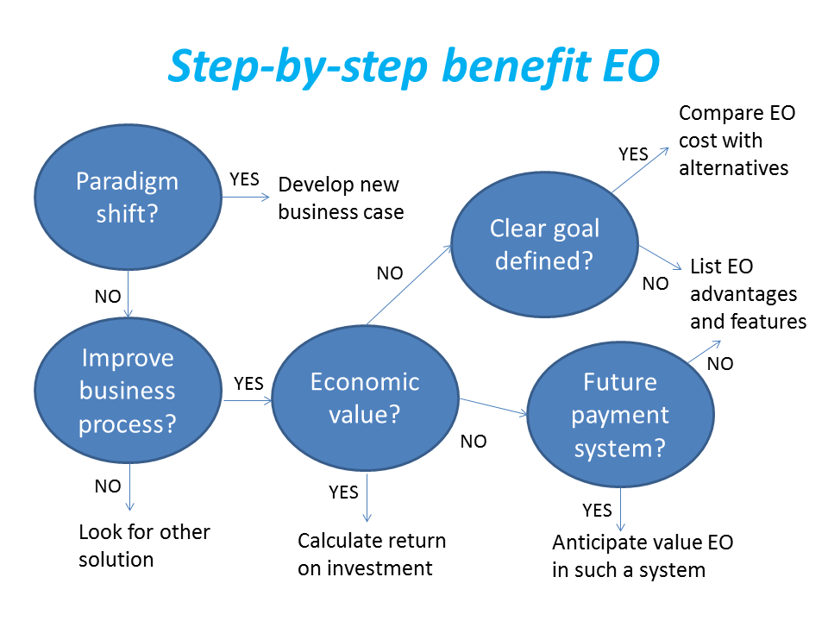
Framework for analysis
Step-by-step analysis of the benefits of earth observation (source: GEONetCab, 2013)

Slide 81
Key questions
Does the new application cause a paradigm shift?
Is the current business or organization process improved?
Does the application provide economic value that can be quantified?
Is a clear measurable goal defined to which the earth observation application contributes?
Is a future payment scheme or other economic mechanism foreseen in which the earth observation application fits?

Slide 82
Assessment of
geospatial solutions
Rating of characteristics of geospatial solutions:
fit-for-purpose
comparative advantage
complexity to user / ease- of-use
elegance
cost-benefit,
sustainability
resilience
reproduction capacity / flexibility
acceptance
level of knowledge transfer required
ethics, transparency, public accountability, objectivity & impartiality
Rating of business environment:
Willingness to pay (by clients)
Embedding (in organizational processes)
Openness (transparency and ease of doing business, access to markets)
Institutions (is the institutional environment conducive to doing business, acceptance of new solutions?)

Slide 83
Fit-for-purpose
An important, but often forgotten requirement:
Does the product or service do what it is supposed to do to solve a certain problem?
In other words: is it really a solution or just an attempt towards a solution?
Quantitative: not applicable
Qualitative (on scale of 1 to 5): based on description of what the EO solution actually does

Slide 84
Comparative advantage
What it does significantly better than other solutions to the same problem.
For earth observation usually the comparative advantages of greater accuracy, better resolution in time and space, comprehensive overview of large areas and near real-time information provision are mentioned as comparative advantages.
Quantitative: calculation of degree in which the EO solution is better than alternatives
Qualitative (on scale of 1 to 5): based on listing of comparative advantages

Slide 85
Complexity (to user) / ease-of-use
At all levels in the value chain the users (professionals and
end-users) are able to work with the product or service.
Quantitative: not applicable
Qualitative (on scale of 1 to 5): based on user testimonials and user surveys

Slide 86
Elegance
Once you get the idea behind this product or service, you want to be part of the community that uses it.
This sense of belonging facilitates the formation of user groups that provide valuable feedback.
Quantitative: none, or it should be the size of the user community
Qualitative (on scale of 1 to 5): based on user testimonials and user surveys

Slide 87
Cost-benefit
The cost-benefit of the product or service is quantified and sufficiently attractive, also in the long-term.
Quantitative: cost-benefit calculation
Qualitative (on scale of 1 to 5): based on quantitative assessment

Slide 88
Sustainability
The product or service can be delivered when it is needed.
There is a long-term perspective that guarantees delivery.
Sustainability concerns the following aspects:
Long-term data availability
Availability of finance/funds to provide the solution continuously for present and future use
Long-term institutional / governmental interest and support
Long-term user interest for a solution that addresses real needs
Quantitative: not applicable
Qualitative (on scale of 1 to 5): based on sensitivity analysis of the EO solution

Slide 89
Resilience
In case of extremes or breakdown in the value chain, the product or service can still be delivered at an acceptable level. Alternatives (plan B) are available (and developed).
Quantitative: cost-benefit calculation of plan B
Qualitative (on scale of 1 to 5): based on risk analysis of the EO solution

Slide 90
Reproduction
capacity / flexibility
The product or service can be easily applied or adapted for use in another region or another situation, while still providing the solution without (too much) extra cost.
Quantitative: calculation of reproduction costs for application in other regions or situations; measurement of spreading of actual use
Qualitative (on scale of 1 to 5): based on quantitative assessment and description of EO solution

Slide 91
Acceptance
The users intuitively get what the product or service is about and are interested. They accept it as a solution to their problem.
Quantitative: none, or survey results about acceptance. After introduction of the solution: number of clients and/or users
Qualitative (on scale of 1 to 5): based on user testimonials and user surveys

Slide 92
Level of knowledge
transfer required
The training requirements for professionals and other users along the value chain are clear and associated costs and efforts are acceptable.
Quantitative: cost and time required to get the users at the desired knowledge and skill level
Qualitative (on scale of 1 to 5): based on knowledge transfer plans and evaluation of training activities

Slide 93
Ethics, transparency,
public accountability,
objectivity & impartiality
Application of Earth observation increases the level of objectivity and impartiality in decision-making processes, including conflict resolution. The application improves transparency and public accountability. It raises no ethical issues or if it does, as in the case of privacy concerns, these are resolved in a satisfactory way for all parties concerned.
Quantitative: not applicable
Qualitative (on scale of 1 to 5): based on user testimonials and user surveys

Slide 94
Several attempts have been made to introduce environmental accounting and to enlarge the sphere of the conventional economy to include and quantify impact on ecosystems.
The following slides give some examples:

Slide 95




Environmental accounting & payment for ecosystem services
SEEA:
System of Environmental-Economic Accounts
(EC, FAO, IMF, OECD, UN, WB )
WAVES:
Wealth Accounting and the Valuation of Ecosystem Services (global partnership, led by World Bank)
TEEB:
The Economics of Ecosystems and Biodiversity
(group led by UNEP)

Slide 96
SEEA Conceptual Framework
Source: SEEA conceptual framework report (EC, FAO, IMF, OECD, UN, WB 2012)

Slide 97
For earth observation the work of the Group on Earth Observations (GEO) is essential to achieve the goal of a Global Earth Observations System of Systems (GEOSS), resulting in the shared GEO common infrastructure (GCI):

Slide 98
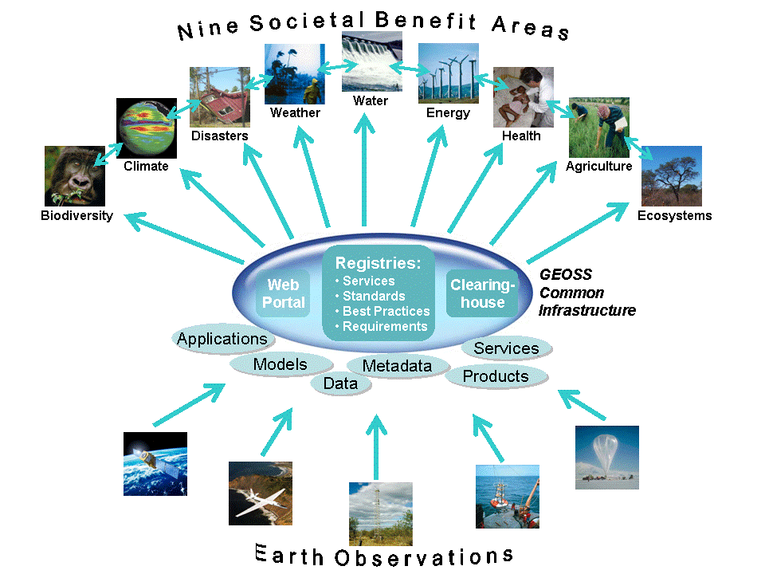

Group on Earth Observations

Slide 99
Marketing elements
Customer value propositions
Crossing the technology chasm
Creating shared value
Promotion tools

Slide 100
Customer value propositions capture the unique value of a product or services as perceived and appreciated by the customer.
Interestingly, they can differ completely from the features that the provider considers most important:

Slide 101
Customer Value Propositions
VALUE PROPOSITION | ALL BENEFITS | FAVOURABLE POINTS OF DIFFERENCE | RESONATING FOCUS
Consists of: | All benefits customers receive from a market offering | All favourable points of difference a market offering has relative to the next best alternative | The one or two points of difference whose improvement will deliver the greatest value to the customer
Answers the customer question: | “Why should our firm purchase your offering?” | “Why should our firm purchase your offering instead of your competitor’s?” | “What is most worthwhile for our firm to keep in mind about your offering?”
Requires: | Knowledge of own market offering | Knowledge of own market offering and next best alternative | Knowledge of how own marketing offering delivers value to customers, compared with next best alternative
Has the potential pitfall: | Benefit assertion | Value presumption | Requires customer value research
Source: Customer value propositions in business markets (HBR 2006)

Slide 102
Buyer behaviour & motivation
Type | Buyer behaviour | Motivation
Transactional sales | Intrinsic value buyers: “keep it cheap and easy to do business” | Understands the product Perceives it as substitutable Cost focus Resents time ‘wasted’ with sales people
Consultative sales | Extrinsic value buyers: “I don’t know the answer: help me analyse and solve the issue | Focus on how the product is used Interested in solutions and applications Values advice and help Needs the sales person
Source: Rethinking the sales force (Rackham, de Vincentis 1999)

Slide 103
Even when customer value propositions are well captured and formulated, introduction of solutions that involve new technology will have to overcome some hurdles.
This is called “crossing the technology chasm”:

Slide 104
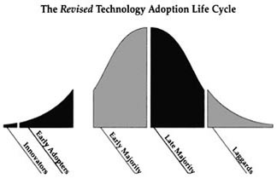
Crossing the technology chasm
Source: Crossing the chasm (Moore 1991)

Slide 105
Crossing the technology chasm
Most clients of EO products and services belong to the early and late majority.
They are pragmatists and are not prepared or willing to take substantial risk: the solution should work and be reliable.
Once convinced, the pragmatists will be long-term clients.
Source: Crossing the chasm (Moore 1991)

Slide 106
More information:
Creating & delivering your value proposition
– managing customer experience for profit
(Barnes, Blake, Pinder; 2009)
Customer value propositions in business markets
(Anderson, Narus, van Rossum [Harvard Business Review]; 2006)
Rethinking the sales force:
refining selling to create and capture customer value
(Rackham, de Vicentis; 1999)
Crossing the chasm
– marketing and selling high-tech products to mainstream customers
(Moore; 1991)

Slide 107
Creating shared value is a key element of successful implementation of earth observation solutions.
To achieve this, in most cases earth observation applications have to be integrated into more general (business or organizational) processes:

Slide 108
Create shared value
Involves cooperation between:
Public sector
Private sector
Social sector
Opportunity for earth observation (integrated) solutions:
Integrate EO in general business / organizational process
Integrate different EO (and GIS and navigation) functionalities

Slide 109
Based on all considerations dealt with in the previous slides, there are some practical approaches that can be applied in combination to promote earth observation applications:

Slide 110

Tools for earth observation marketing:
Success stories (in non-technical language, feasible, replication capacity, sustainable)
Marketing toolkits (international trends, earth observation examples, references)
Pilot projects, innovation funds, quick-wins (demonstration that EO actually works)
Promotion outside EO community (fairs, seminars, lunch-bag meetings, magazines)
Resource facilities for reference and capacity building (distributed, but connected, in different languages)
Source: Marketing earth observation products and services (Noort 2013)

Slide 111
Business elements
Business elements:
Proposal writing
Business procedures

Slide 112
Proposal writing is an art in itself.
During the GEONetCab and EOPOWER projects templates have been developed for writing successful proposals:

Slide 113
Proposal outline
1. Introduction / relevance
2. Objective(s)
3. Activities
4. Output
5. Management & evaluation
6. Risk assessment
7. Time schedule
8. Budget
Annexes
(more detailed version in separate document,
see www.eopower.eu or www.hcpinternational.com)

Slide 114


Other guides that may be useful:
Civicus: writing a funding proposal
Michigan State University: guide for writing a funding proposal
ESRI: writing a competitive GRANT application
REC: project proposal writing

Slide 115
If you run a company, compete for assignments and manage projects, a structured approach towards responsibilities, tasks, implementation and documentation is needed.
The following business procedures may be helpful:

Slide 116
Business procedures
1. On acquisition
2. On offers
3. On negotiation
4. On contracts
5. On project management
6. On travel & deployment
7. On deficiencies & complaints
8. On internal organization
9. On finance
(more detailed version in separate document,
see www.eopower.eu or www.hcpinternational.com)

Slide 117
Again:
SHARED PROBLEM
SHARED LANGUAGE
SHARED SOLUTION

Slide 118
4. Capacity Building

Slide 119
General
Marketing is promotion + capacity building.
Especially for the introduction of new technologies capacity building is important at all levels.
Capacity building is the instrument to increase
self-sufficiency and make solutions work.

Slide 120


General references for capacity building, open data and success stories
GEO Portal: www.earthobservations.org
Capacity building resource facility www.geocab.org
compilation of tutorials, references, open-source software, etc.
Satellites going local: share good practice (Eurisy handbooks) www.eurisy.org
Earth observation for green growth (ESA; 2013)

Slide 121

General references for capacity building, open data + call for proposals
Bringing GEOSS services into practice:
how to use data from the GEO portal and how to provide input
www.envirogrids.net
Science education through earth observation for high schools: basic tutorials on all kind of subjects, including agriculture
www.seos-project.eu
Securing water for food: call for proposals on innovative solutions
securingwaterforfood.org
Copernicus briefs: information on satellite applications for different topics
http://www.copernicus.eu/main/copernicus-briefs

Slide 122
More references open data
Open data for sustainable development (World Bank; 2015)
description of the benefits of open data for a wide range of development goals, including the SDGs http://pubdocs.worldbank.org/pubdocs/publicdoc/2015/8/904051440717425994/Open-Data-for-Sustainable-development-Final-New.pdf
Terms and conditions for the use and distribution of Sentinel data (European Parliament and European Commission; 2014)
standard stipulations related to free and open access to Sentinel data http://www.demarine.de/lr/c/document_library/get_file?uuid=c5067655-b7ad-4d71-b07b-6111808f4abd&groupId=13521
Towards a thriving data-driven economy (European Commission; 2014) policy document on the use of (open) data for a knowledge economy and society
http://ec.europa.eu/information_society/newsroom/cf/dae/document.cfm?doc_id=6210

Slide 123

Capacity building resources for agriculture:
GEOGLAM www.geoglam-crop-monitor.org
AGRICAB (follow-up of DevCoCast and GMFS):
optical remote sensing, radar remote sensing, agro-meteorological modelling, food security information systems, product validation www.agricab.info
DevCoCast: GEONETCast applications for agriculture www.devcocast.eu
e-Sourcebook ICT in agriculture (World Bank, 2011)
Remote sensing applications – chapter 1: Agriculture
(NRSC, 2010)

Slide 124

Capacity building resources for agriculture (2):
Use of active earth observation systems for agricultural monitoring
Monitoring and identification of crop areas using hyper temporal low resolution images (ITC; 2015)
3-day EOPOWER (self-study) course for professionals
http://menhir.itc.utwente.nl:5000/fbsharing/KGKOZXKU/

Slide 125
Further details:
Contact: Mark Noort
m.noort@hcpinternational.com
www.eopower.eu
www.hcpinternational.com

